Slide 1

Spotify Data Analysis
Tamar Noselidze
Notes:
Purpose of the Project: This project explores the Spotify dataset to understand the relationships between various audio features of songs and their popularity.

Slide 2
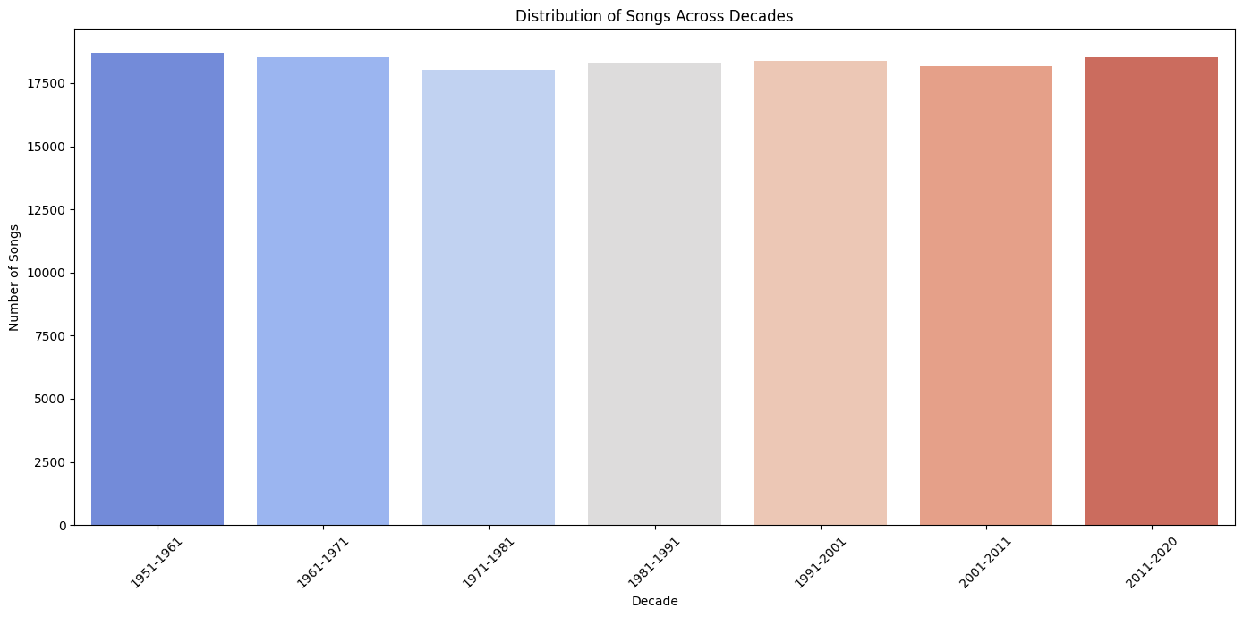
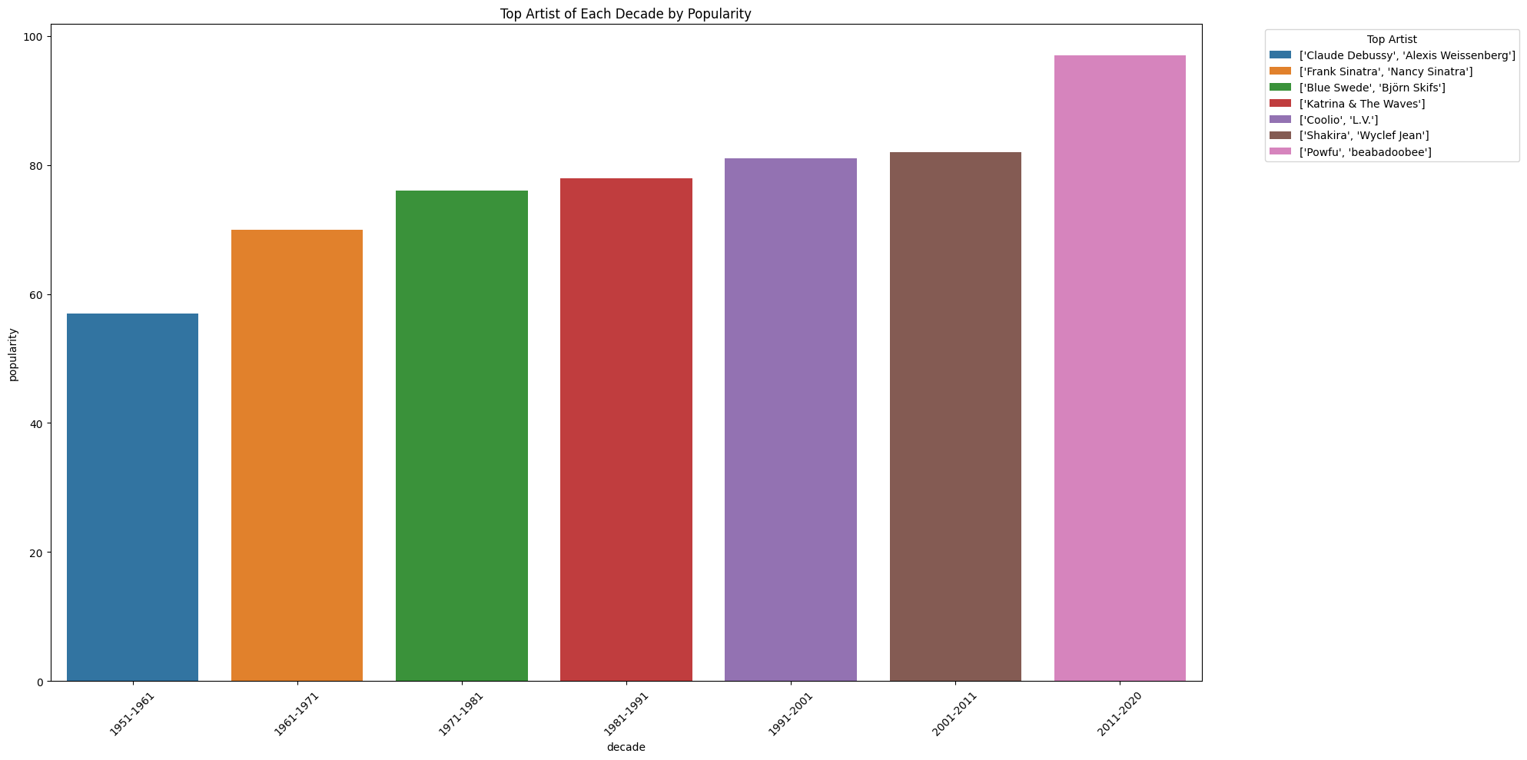
About the dataset:
Tracks are (roughly evenly) distributed over the decades in the dataset
This barplot illustrates the distribution of popularity
of songs in the dataset across different decades,
starting from the 1950s to the 2010s.
Notes:
The dataset consists of approximately 130 000 songs with distinct audio features such as acousticness, danceability, energy, instrumentalness, and liveness. It also includes metadata like artist names, song duration, and release year.
Numerical Features: Danceability, Energy, Loudness, Speechiness, Tempo Categorical Features: Key, Mode Descriptive Features: Artist names, Song ID Time Frame: The data spans various decades, capturing a wide range of music eras and genres, providing a comprehensive foundation for analysis. Preprocessing Steps: Initial data preparation included removing duplicates and handling missing data, ensuring the analysis is based on accurate and complete information.

Slide 3
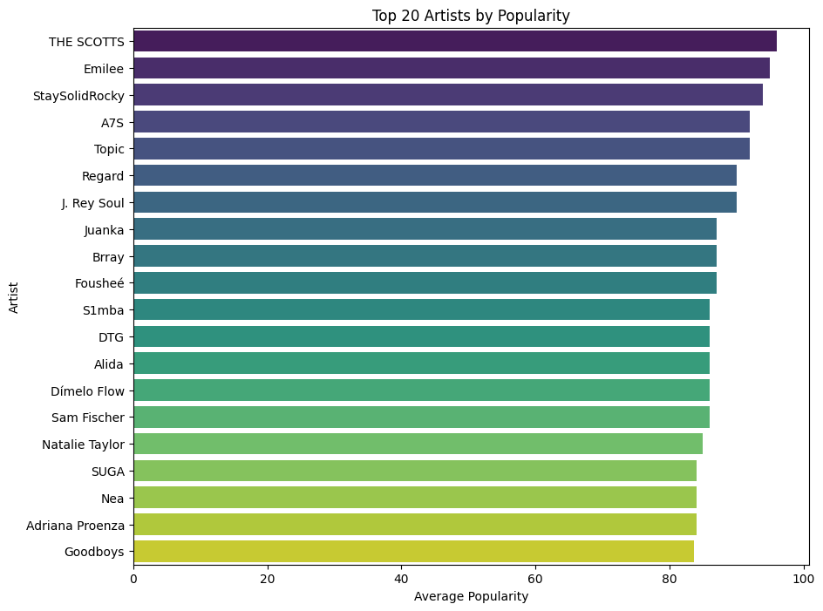
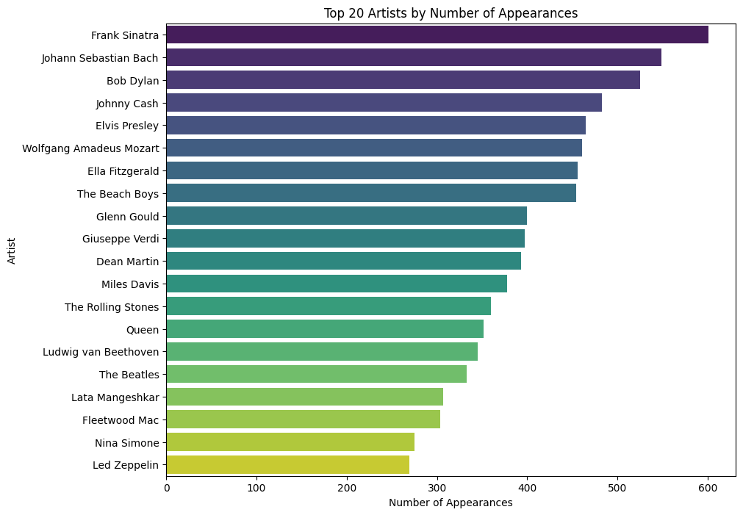
Interesting insights about artist popularity
Notes:
- The first plot illustrates the top 20 artists by average popularity. This metric reflects contemporary listener preferences and trends on Spotify. Artists like The Scotts and Emilee are notable for their high popularity scores, indicating current relevance and frequent streaming.
- The second plot showcases the top 20 artists by the number of appearances in the dataset. This includes a surprising number of classical and legacy artists such as Johann Sebastian Bach, Frank Sinatra, and Bob Dylan.
- While the first plot represents current popular tastes, the second plot's inclusion of historical and classical artists highlights the comprehensive nature of Spotify's catalog. It reflects the dataset's vast archival content, which is not only about current hits but also about providing access to a rich repository of influential musical history.

Slide 4
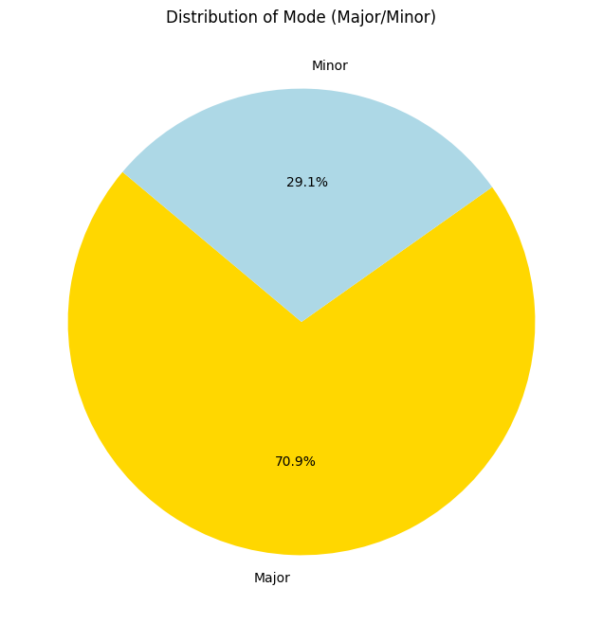
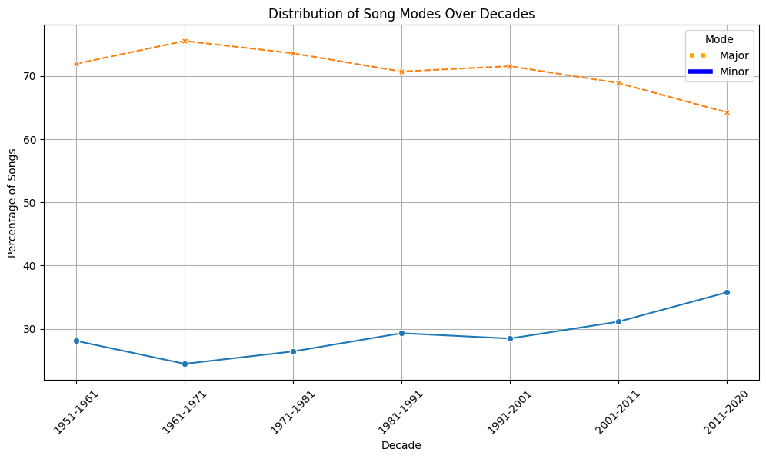
Distribution of song modes in the dataset
Notes:
- First pie chart shows the overall distribution of song modes in the dataset. It reveals a predominant preference for songs in a Major key (70.9%) over Minor (29.1%). This suggests that songs in a Major key are more popular in the dataset, potentially indicating a general listener preference for the typically brighter, happier tonality of Major keys.
- The second plot provides a time-series analysis of the distribution of modes over several decades. It shows a consistent dominance of Major mode songs throughout the periods analyzed. Minor mode songs remain less frequent but show a slight increase in later decades.
- The preference for Major mode might reflect cultural tendencies towards music that conveys positivity, which is often associated with Major key songs. Evolution Over Time: The slight increase in the proportion of Minor mode songs in recent decades could suggest a diversification in musical tastes, possibly influenced by changes in societal moods, music production techniques, or the influence of different music genres that favor Minor keys.

Slide 5
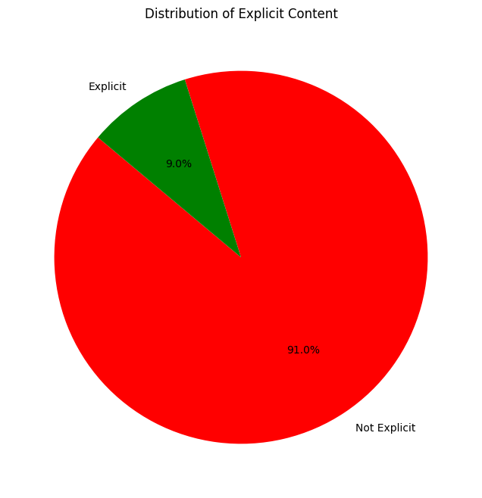
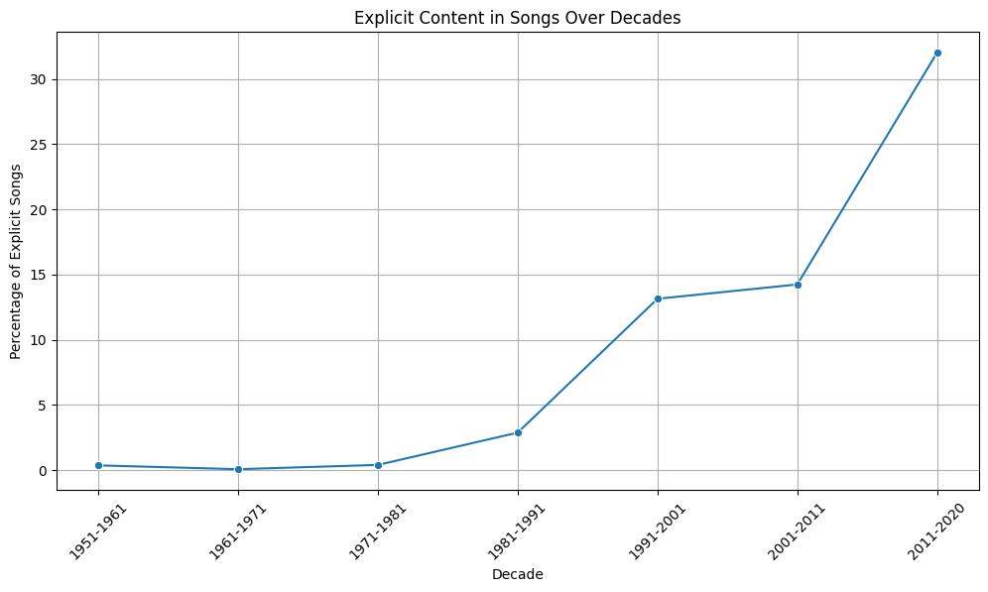
Distribution of explicit content
Notes:
- The first pie chart illustrates the overall distribution of explicit content within the dataset, where 9.0% of the songs are labeled as explicit. This shows a minority but significant portion of the catalog that includes explicit lyrics.
- The second line graph displays the trend in the percentage of songs with explicit content from the 1950s to the 2020s. It reveals a dramatic increase in the proportion of explicit songs over the last few decades.
- The rise in explicit content reflects broader cultural shifts towards more openness in expressing themes of adult nature in music. This could be associated with societal changes, where topics that were once considered taboo are now more openly discussed and portrayed in media.
- Regulatory and Industry Changes; Artistic Freedom

Slide 6
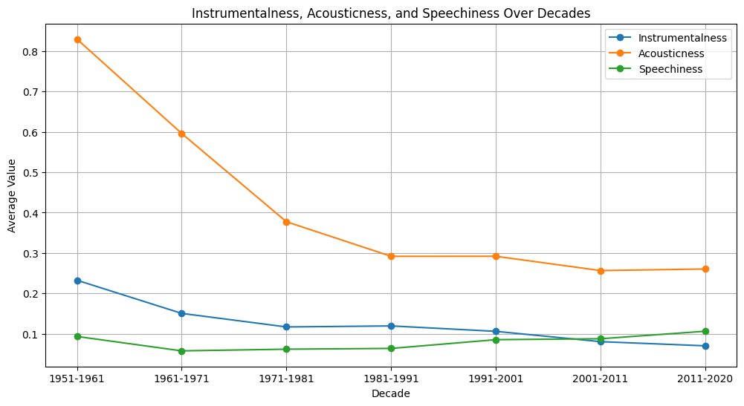
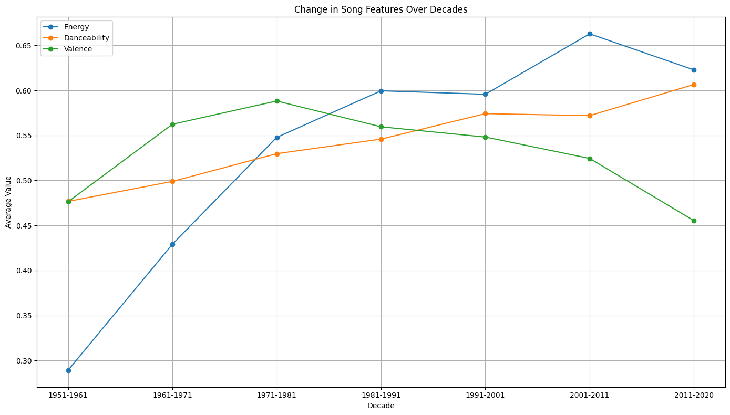
Changes in song features over decades
A clear decline in instrumentalness, i.e. a shift towards more
vocal-centric music over time. Acousticness has also decreased,
reflecting the advent and rise of electronic and synthesized
music production.
A rise in all three attributes, particularly in the recent decades. This suggests a trend towards more vibrant, and danceable music.
Notes:
The first plot shows a clear decline in instrumentalness, suggesting a shift towards more vocal-centric music over time.
Speechiness remains relatively stable but low, indicating that spoken word is not a predominant element in the majority of popular music.
- The second plot indicates a rise in all three attributes, particularly in the recent decades. This suggests a trend towards more vibrant, energetic, and danceable music, which aligns with global shifts towards more engaging and rhythmic music forms in mainstream music.

Slide 7
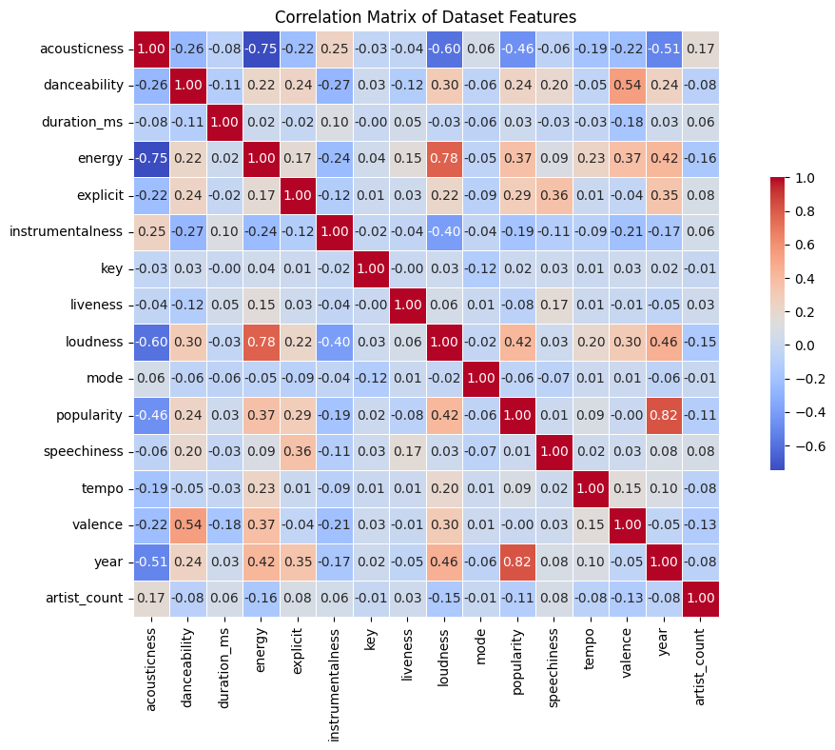
Correlation matrix and its insights
A strong positive correlation (0.78) between energy and loudness
A strong negative correlation (-0.75) indicates that songs with higher acousticness tend to have lower energy
Both energy and loudness have a positive correlation with popularity.
Noticeable negative correlation between acousticness and song popularity.
Danceability shows a positive correlation with popularity, implying that more danceable songs generally achieve higher popularity.
For instrumentalness, there is a slight negative correlation with popularity
Notes:
The correlation matrix provides a detailed view of how different musical features from the Spotify dataset are interrelated. Each cell in the matrix shows the correlation coefficient between two features, ranging from -1 (perfect negative correlation) to +1 (perfect positive correlation), with 0 indicating no correlation.

Slide 8
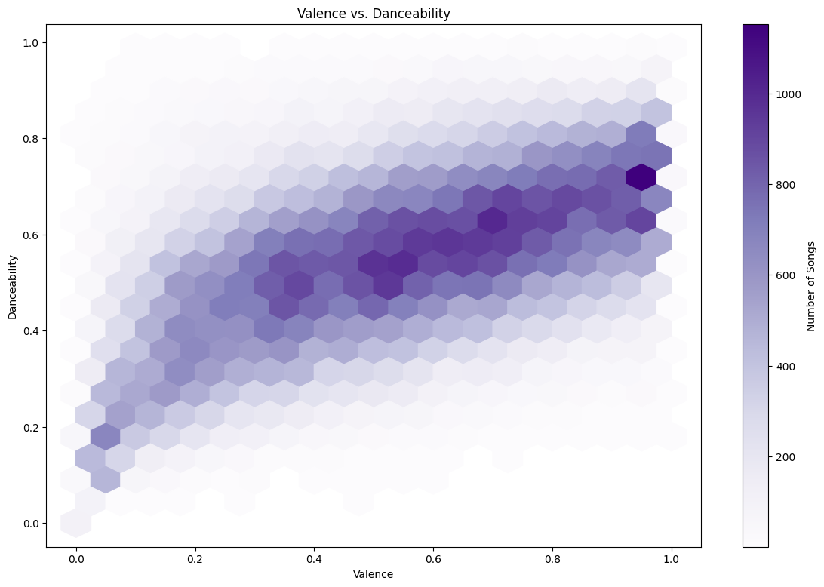
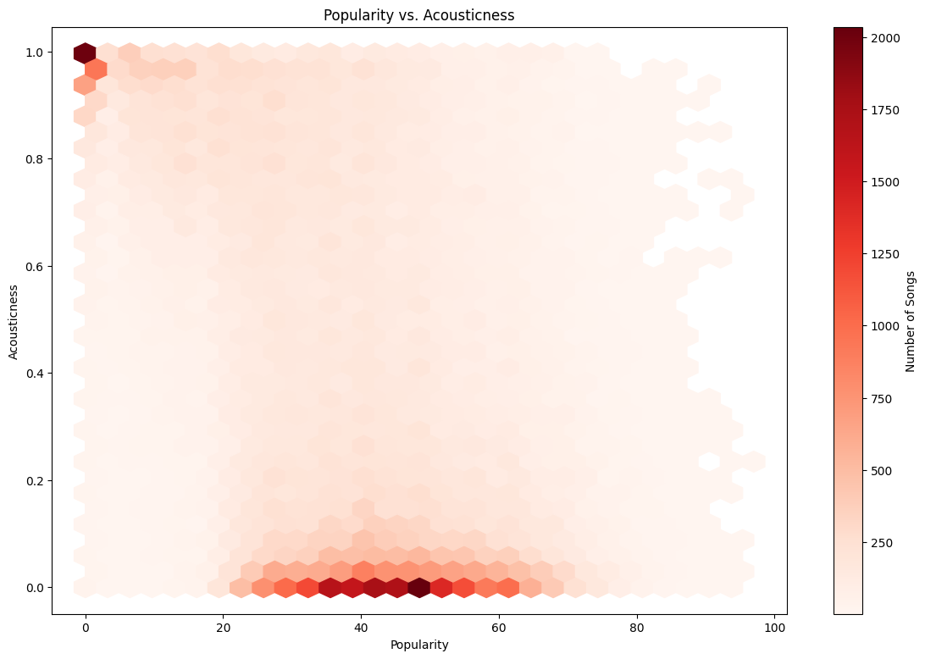
Notes:
The first plot shows a hexbin visualization between valence (the musical positivity) and danceability of songs. The densest area, shown in dark purple, suggests a strong concentration of songs with high danceability and moderate to high valence. This indicates that songs which are more danceable tend to also be more positive, aligning with the idea that upbeat, happy songs are more engaging for dancing.
The second plot explores the relationship between acousticness and song popularity. The concentration of songs is higher at lower levels of acousticness and moderate popularity levels. This suggests that less acoustic (more electronic or produced) songs tend to be more popular, reflecting a trend towards more produced music in popular genres.

Slide 9
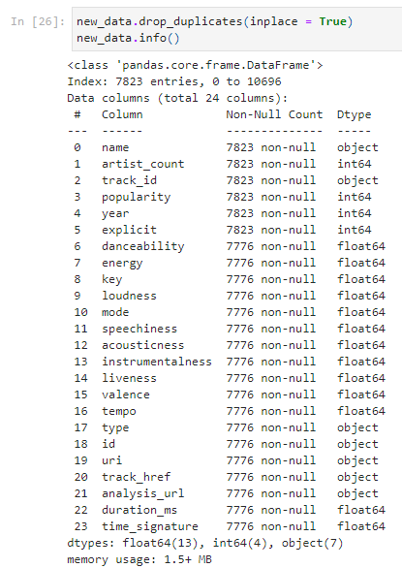
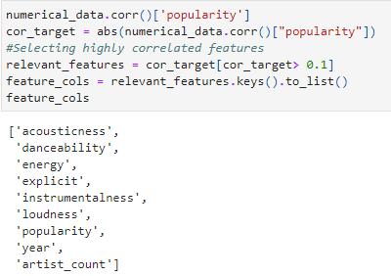

Machine learning
What are the most influential audio features?
How can we choose and train a model on this dataset?
Can we predict the popularity in unseen data?
How accurate would this predictions be?
Notes:
A correlation analysis was performed to identify features strongly associated with 'popularity'. Features like 'acousticness', 'danceability', 'energy', 'loudness', and 'year' were selected based on their correlation coefficients.
This step is critical to ensure that the model uses the most relevant data to predict popularity, enhancing the accuracy and efficiency of the model.
The dataset was split into training (80%) and validation (20%) sets to evaluate the model’s performance on unseen data.
Features like 'loudness' and 'year' were scaled using MinMaxScaler to normalize their values, ensuring that no single feature disproportionately influences the model's predictions.
A RandomForestRegressor was chosen for its ability to handle non-linear relationships and its robustness against overfitting.
The model was evaluated using cross-validation with negative mean squared error as the scoring method. The RMSE (Root Mean Square Error) was calculated to measure the average error in popularity prediction.

Slide 10
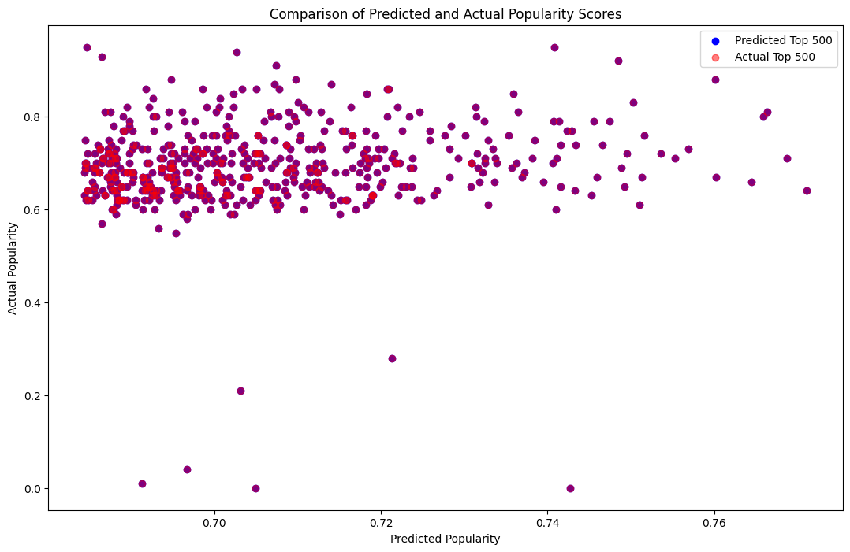
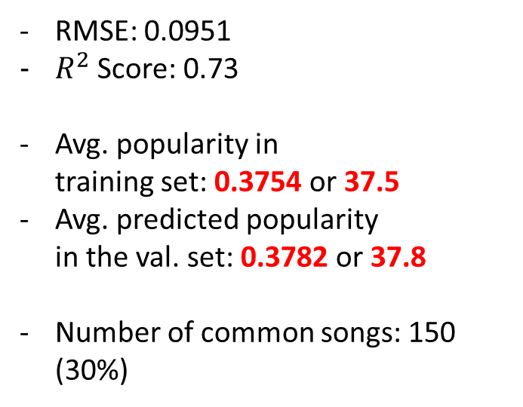
Performance on validation set
RMSE: 0.0951
$R^{2}$Score: 0.73
Avg. popularity in training set: 0.3754 or 37.5
Avg. predicted popularity in the val. set: 0.3782 or 37.8
Number of common songs: 150 (30%)
Notes:
This slide presents the performance of a model predicting song popularity on a validation set. Key metrics include a Root Mean Square Error (RMSE) of 0.0951 and an 𝑅^2 score of 0.73, indicating decent model accuracy. The average popularity score in the training set is 0.3754 (37.5%), while the average predicted popularity in the validation set is slightly higher at 0.3782 (37.8%). The scatter plot compares predicted and actual popularity scores, showing some clustering around high actual popularity values. Additionally, the model correctly identifies 150 common songs (30%) between the top 500 predicted and actual popularity rankings. This highlights the model’s effectiveness in ranking.

Slide 11
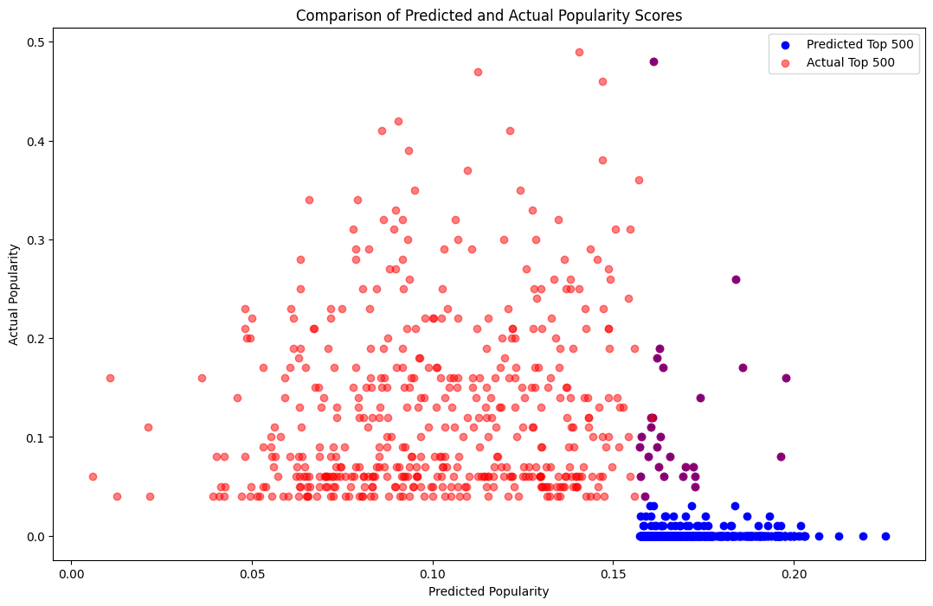
Performance on test set
RMSE: 0.1115
Avg. popularity in training set: 0.3754 or 37.5
Avg. predicted popularity in test set: 0.1054 or 10.5
Avg. (actual) popularity in test set: 0.147 or 14.7
Number of common songs: 27 (~5.4%)
Notes:
Key metrics show a higher RMSE of 0.1115 compared to the validation set, indicating slightly less accurate predictions.
The average predicted popularity on the test set is significantly lower (0.1054 or 10.5%) than the average actual popularity (0.147 or 14.7%), suggesting the model underestimates popularity on this dataset.
- The test set was retrieved differently, which might have introduced a distribution shift not seen in the training/validation sets.
- This discrepancy may indicate that the audio features the model was trained on are not strongly indicative of a song's popularity.
Overall, the results suggest that while audio features contribute to understanding song popularity, they are not solely sufficient, pointing to the need for incorporating a broader range of features and potentially more sophisticated modeling techniques.
If audio features alone were strong predictors of popularity, then all successful songs could theoretically follow the same trend, which is not observed in practice. This suggests that other factors, such as marketing, artist popularity, social media influence, and cultural trends, play significant roles in a song's popularity.

