Slide 1
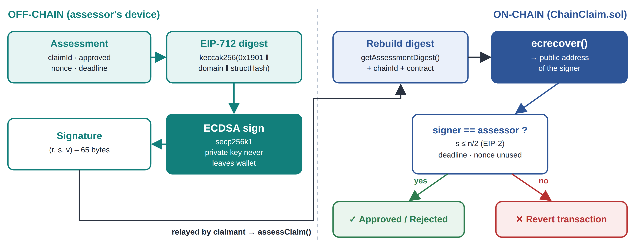
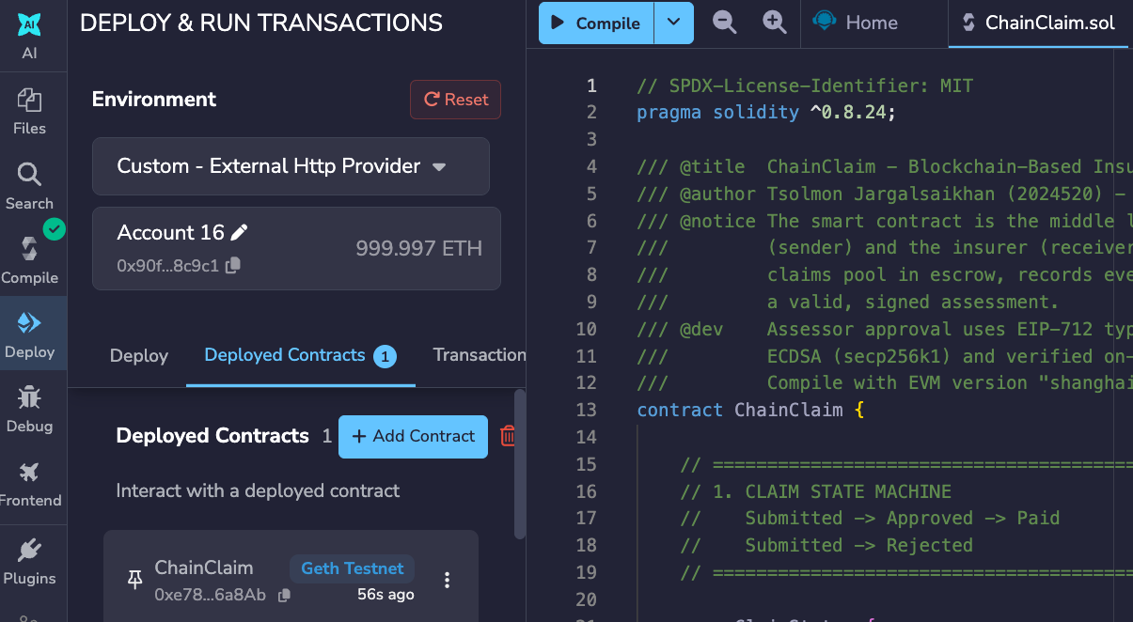
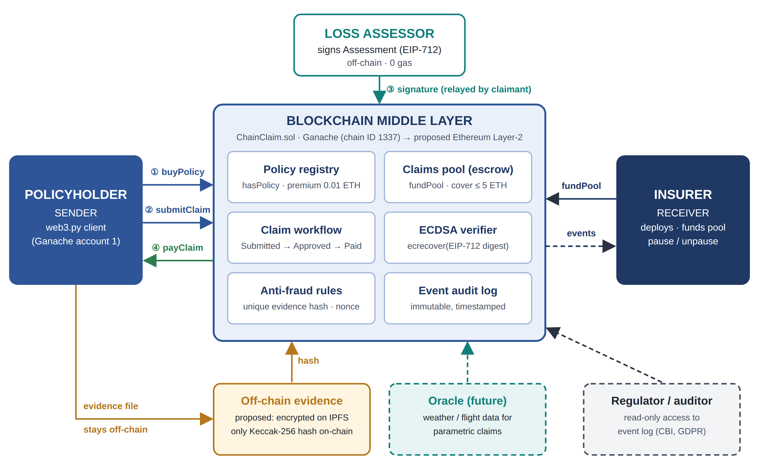
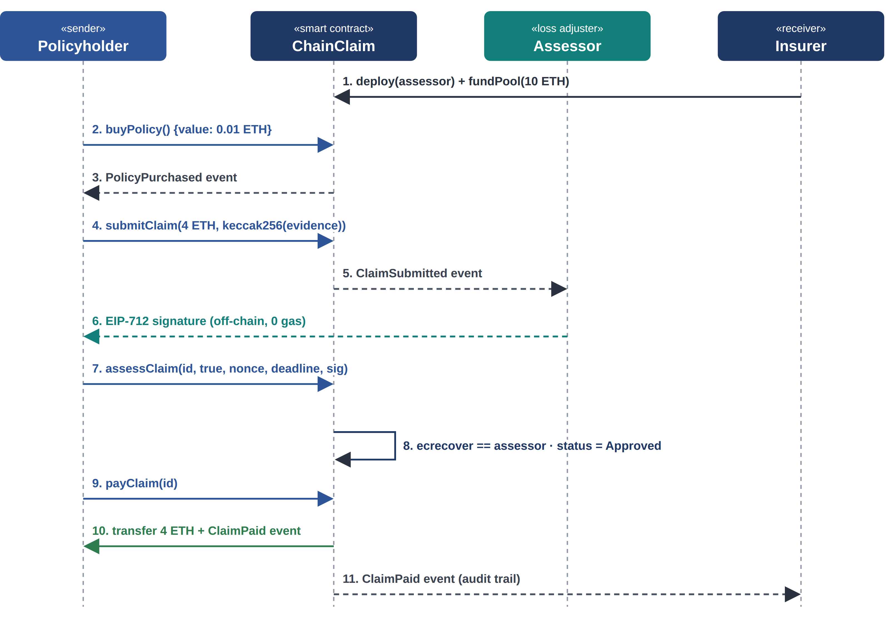
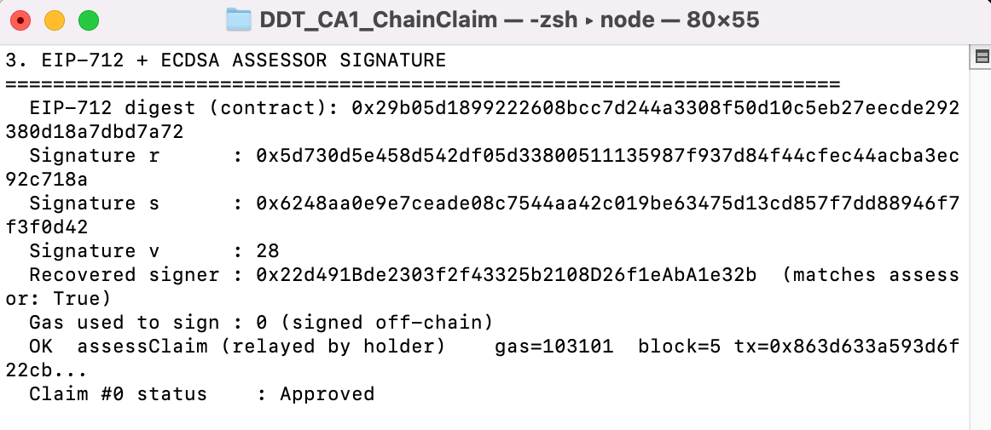
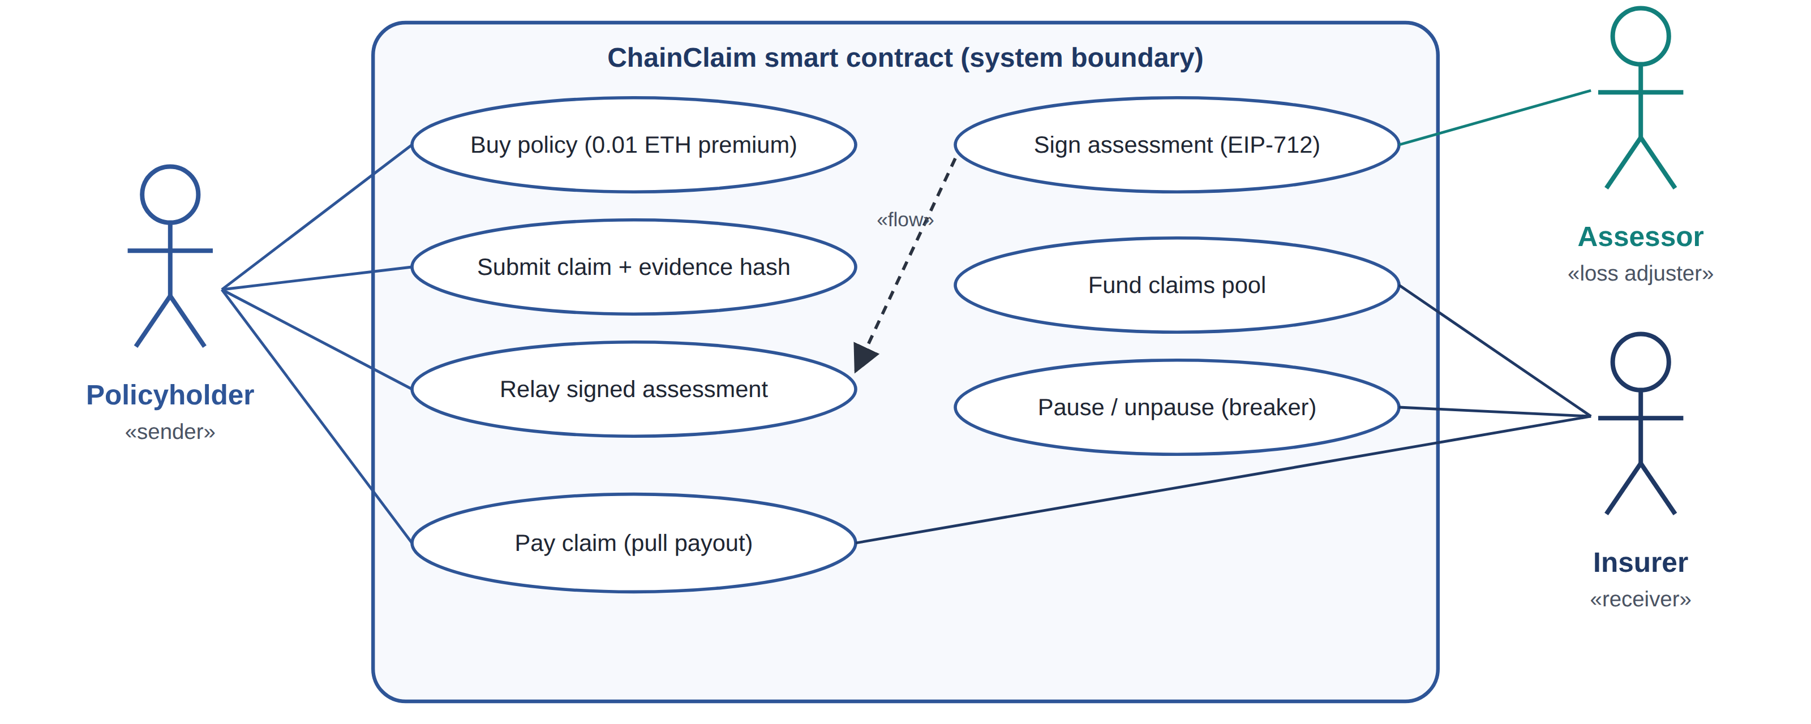
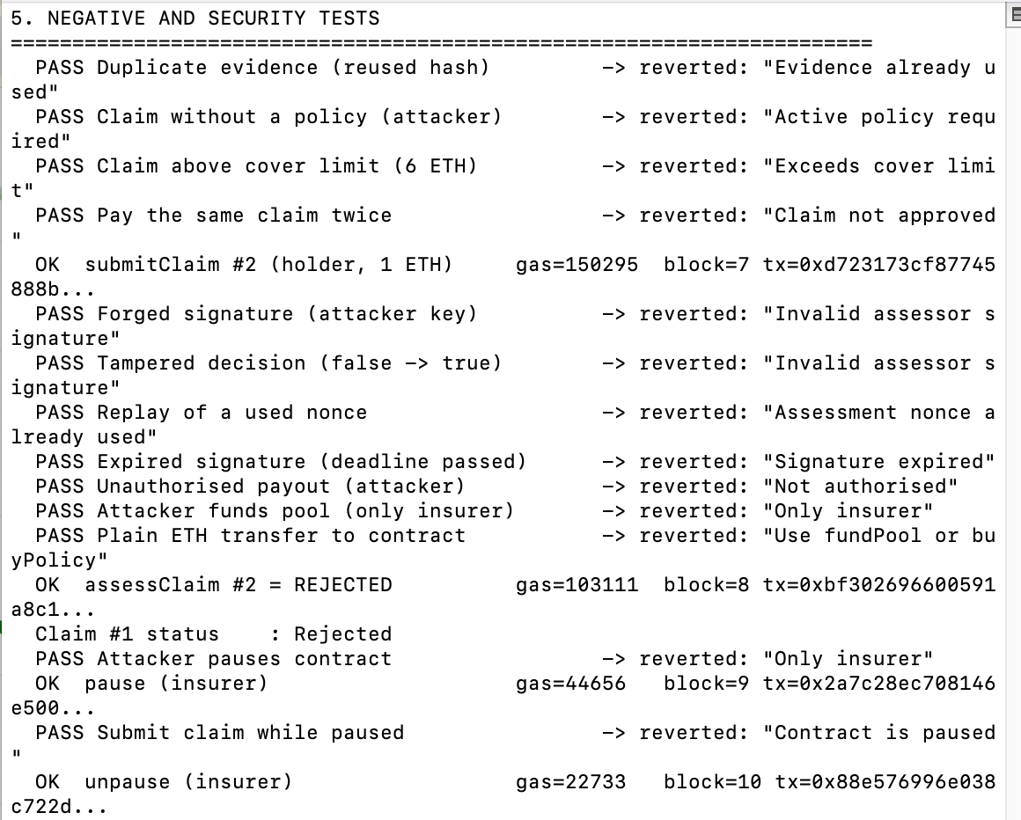
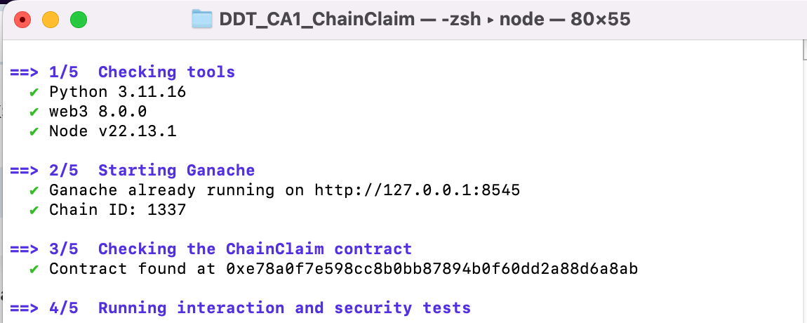
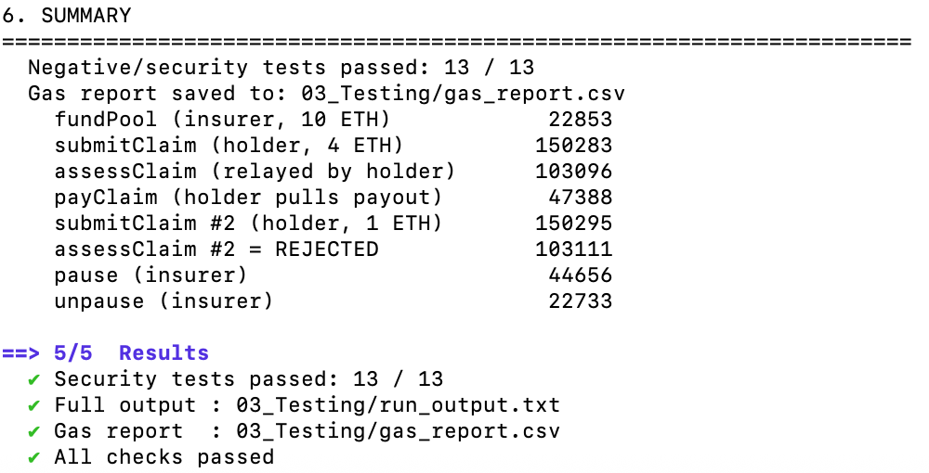
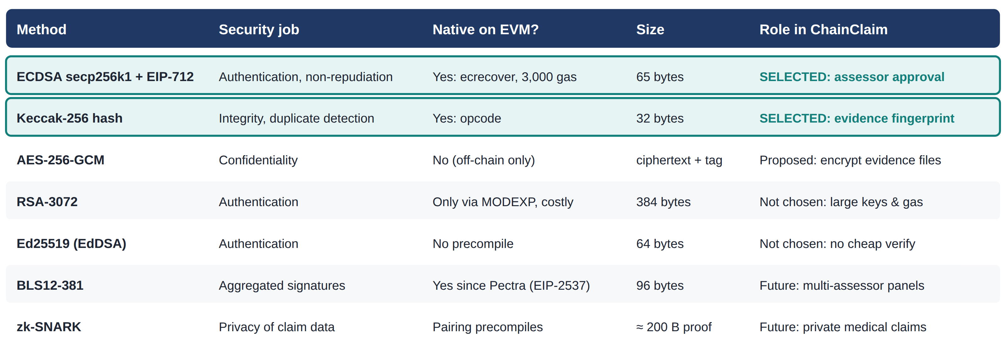
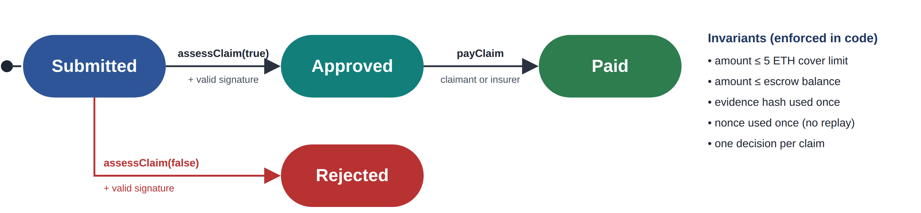
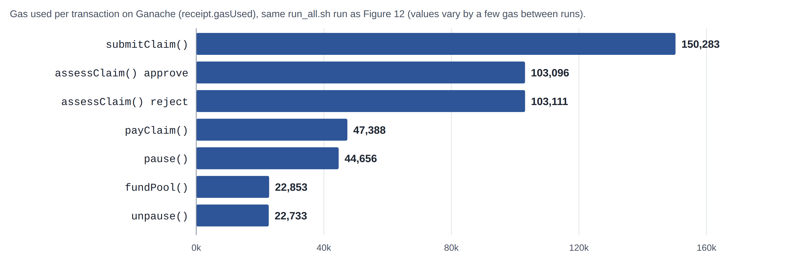
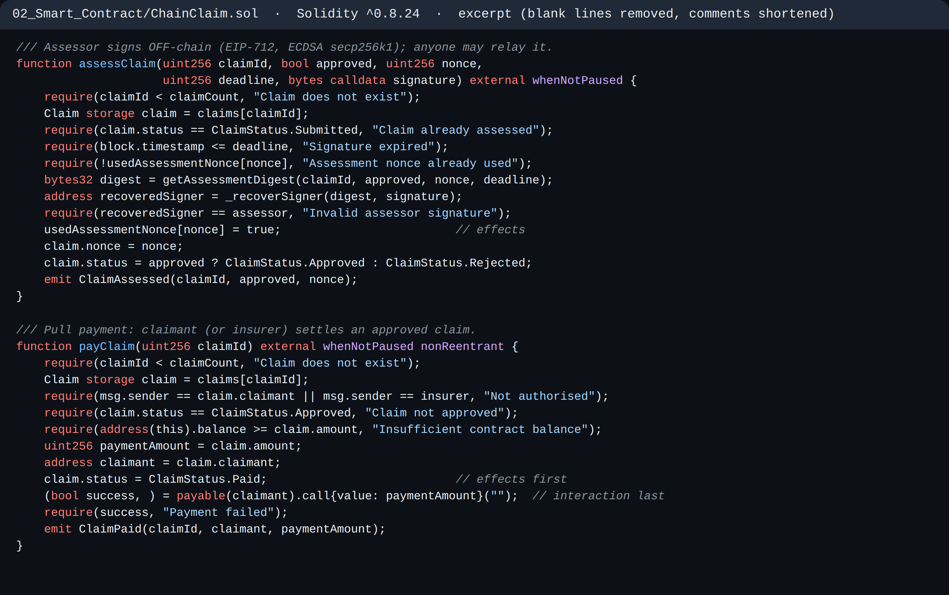
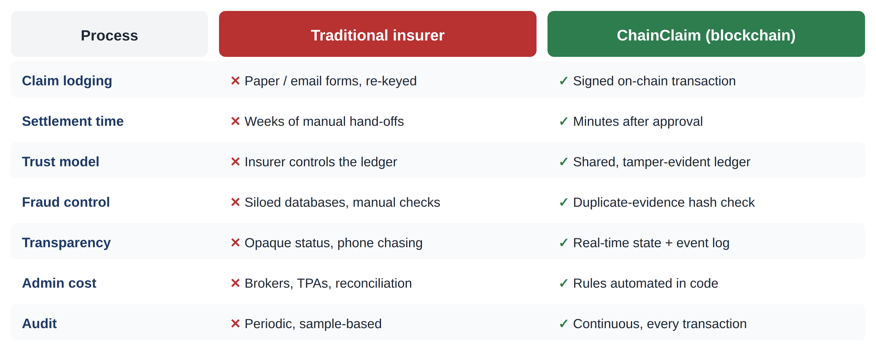
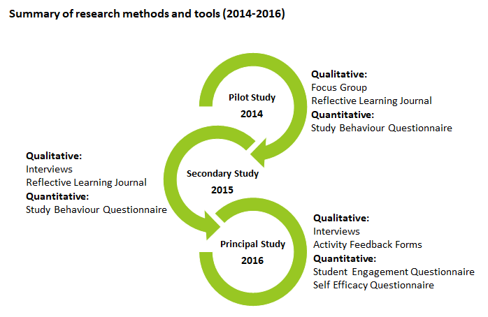
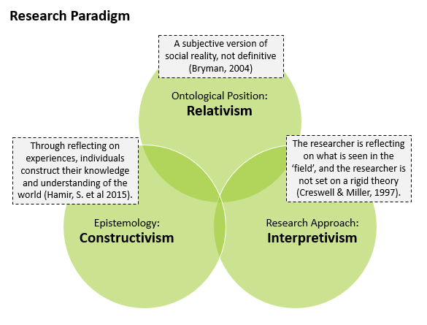

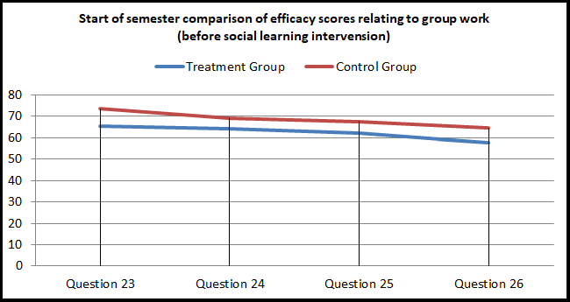
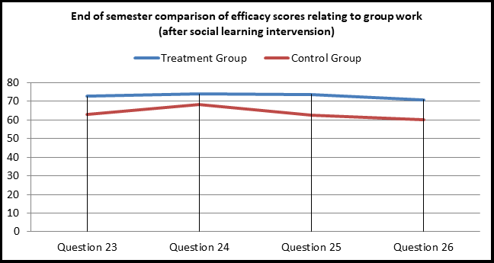
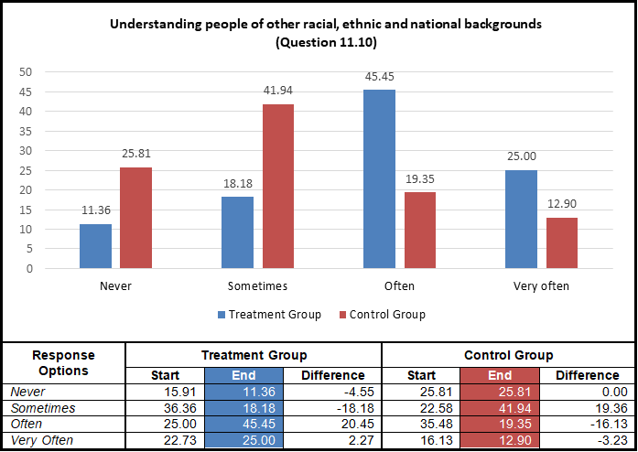
ChainClaim: A Blockchain-Based Insurance Claims Settlement DApp
Solidity Smart Contract with ECDSA (EIP-712) Signatures on Ethereum
Tsolmon Jargalsaikhan | Student No. 2024520 | CCT College Dublin – BSc (Hons) Computing in IT | DDT CA1 | github.com/Tamara520/chainclaim-insurance-dapp
CRITERION 1 · BLOCKCHAIN SOLUTION PROPOSAL
CRITERION 1 · BENEFITS, CHALLENGES & CRYPTOGRAPHY
CRITERION 2 · SMART CONTRACT DESIGN
CRITERION 2 · DEPLOYMENT, EXECUTION & TESTING
INTRODUCTION
RECENT ADVANCEMENTS USED
HOW ECDSA SECURES A CLAIM
IMPLEMENTATION & TESTING
Insurance claims are still slow, paper-based and dependent on trusting one party. Customers wait weeks and fraud is costly: Irish insurers detected €76m of fraudulent claims, with about €200m more undetected (Insurance Europe, 2019). ChainClaim moves the claim lifecycle onto a smart contract between the policyholder (sender) and the insurer (receiver), so neither side can alter the record or delay an approved payout.
Layer-2 rollups + EIP-4844 (Dencun, 2024): blob data made small claims cheap to settle (Ethereum Foundation, 2024).
Stack: Solidity 0.8.24 in Remix IDE, Ganache v7 (chain ID 1337), Python web3.py scripts (deploy.py, interact.py) and a Bash runner (run_all.sh).
Account abstraction (ERC-4337, EIP-7702): smart wallets and insurer-paid gas (Buterin et al., 2021; 2024).
13 / 13
security tests passed
1
shell command: deploy + test
47,388
gas to pay a claim
0 gas
assessor signs off-chain
EIP-712 typed signatures: off-chain approval, on-chain verification (Bloemen, Logvinov and Evans, 2017).
SOLUTION & BUSINESS MODEL
BLS precompile (EIP-2537, Pectra): aggregated multi-assessor signatures (Vlasov et al., 2020).
Oracles & ZK proofs: Chainlink feeds for parametric cover (Chainlink Labs, 2024); ZK proofs for private claims.
Figure 5 – Off-chain signing, on-chain verification
BENEFITS
Authentication | only the assessor's key can approve
Integrity | Keccak-256 hash; any edit changes it
Non-repudiation | signed decision is permanent proof
Confidentiality | only hashes on-chain; files stay off-chain
Replay safety | deadline + one-time use + low-s (EIP-2)
Speed & cost: payout in one transaction, no reconciliation.
Fraud reduction: reused evidence and forged approvals are rejected by code (13 tests).
Trust & audit: every state change is an immutable, auditable event.
SMART CONTRACT DESIGN
CHALLENGES (CRITICAL VIEW)
ChainClaim.sol holds premiums and the claims pool in escrow, enforces policy rules (0.01 ETH premium, 5 ETH cover limit) and pays only after a valid signed assessment. It uses checks-effects-interactions, a re-entrancy guard, pull payment and a circuit breaker.
Figure 9 – Remix: compiled (0.8.24) and deployed to Ganache
GDPR vs immutability: erasure rights clash with permanent storage; only hashes go on-chain.
Figure 1 – ChainClaim architecture: blockchain as the middle layer
Oracle problem: a dishonest assessor can still sign; mitigated by rotation and multi-signature panels.
Consortium model: Irish insurers, assessors and the regulator run nodes on an Ethereum Layer-2.
Irreversible bugs: costly (Siegel, 2016); mitigated by tests and a circuit breaker.
Regulation: Central Bank of Ireland oversight and MiCA rules for euro stablecoins (European Union, 2023).
Revenue: insurers pay a per-policy fee; assessors earn per signed assessment.
Verdict: blockchain fits best when distrusting parties share claims; a single insurer could use a database.
Customer value: live claim status, fast payout and insurer-paid gas.
CRYPTOGRAPHIC SECURITY
Figure 10 – EIP-712 digest, signature and recovered assessor
Shared fraud registry: insurers compare evidence hashes, never personal data.
Selected: ECDSA (secp256k1) signatures with EIP-712 typed data, plus Keccak-256 hashing.
Native & cheap: ecrecover verifies a signature for 3,000 gas (Wood, 2014).
Efficient: 256-bit ECC equals 3072-bit RSA with smaller keys (Barker, 2020).
Context binding: chainId and contract address are signed, blocking cross-contract replay.
Figure 6 – UML sequence diagram
Figure 2 – UML use-case diagram
Figure 12 – run_all.sh: one command runs everything; all checks passed
DISRUPTIVE IMPACT
Figure 11 – All 13 attacks revert with a clear reason
Blockchain removes reconciliation between insurers, brokers and administrators and replaces discretionary delays with code.
Figure 7 – Claim state machine and invariants
Figure 4 – Cryptographic methods compared
REFERENCES
Barker, E. (2020) Recommendation for Key Management: Part 1 – General (NIST SP 800-57 Part 1 Rev. 5). Gaithersburg: NIST.
Figure 13 – Gas from transaction receipts
Bloemen, R., Logvinov, L. and Evans, J. (2017) EIP-712: Typed structured data hashing and signing. Available at: https://eips.ethereum.org/EIPS/eip-712 (Accessed: 27 September 2026).
Buterin, V. et al. (2021) ERC-4337: Account abstraction using alt mempool. Available at: https://eips.ethereum.org/EIPS/eip-4337 (Accessed: 27 September 2026).
Buterin, V. et al. (2024) EIP-7702: Set code for EOAs. Available at: https://eips.ethereum.org/EIPS/eip-7702 (Accessed: 27 September 2026).
CONCLUSION
Chainlink Labs (2024) Chainlink Data Feeds. Available at: https://docs.chain.link/data-feeds (Accessed: 27 September 2026).
Ethereum Foundation (2024) Cancun-Deneb (Dencun) FAQ. Available at: https://ethereum.org/en/roadmap/dencun/ (Accessed: 27 September 2026).
ChainClaim shows a smart contract can be a neutral middle layer for insurance claims: premiums, approvals and payouts are enforced by code, ECDSA and Keccak-256 provide authentication and integrity, and all 13 attack tests were rejected. Next steps: multi-assessor BLS signatures, ZK proofs for medical claims and a Layer-2 pilot.
European Union (2023) Regulation (EU) 2023/1114 on markets in crypto-assets (MiCA). Official Journal of the European Union, L150.
Figure 3 – Traditional claims process vs ChainClaim
Insurance Europe (2019) Insurance fraud: not a victimless crime. Brussels: Insurance Europe.
Siegel, D. (2016) 'Understanding the DAO attack', CoinDesk, 25 June.
Vlasov, A. et al. (2020) EIP-2537: Precompile for BLS12-381 curve operations. Available at: https://eips.ethereum.org/EIPS/eip-2537 (Accessed: 27 September 2026).
Wood, G. (2014) Ethereum: a secure decentralised generalised transaction ledger (Yellow Paper). Available at: https://ethereum.github.io/yellowpaper/paper.pdf (Accessed: 27 September 2026).
Figure 8 – Key functions: signed assessment and pull payment
Notes:
ChainClaim poster – DDT CA1. Evidence screenshots: see 09_Evidence/EVIDENCE_LOG.md in the GitHub repository.

