Slide 1
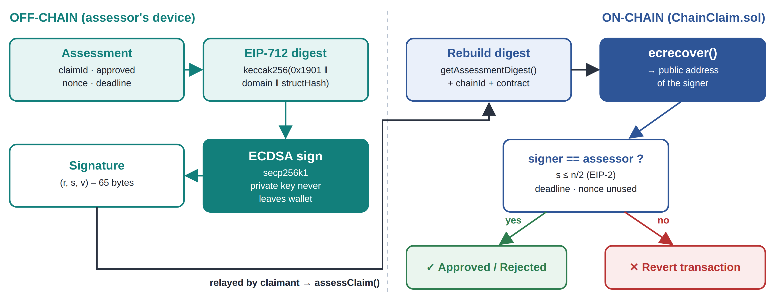
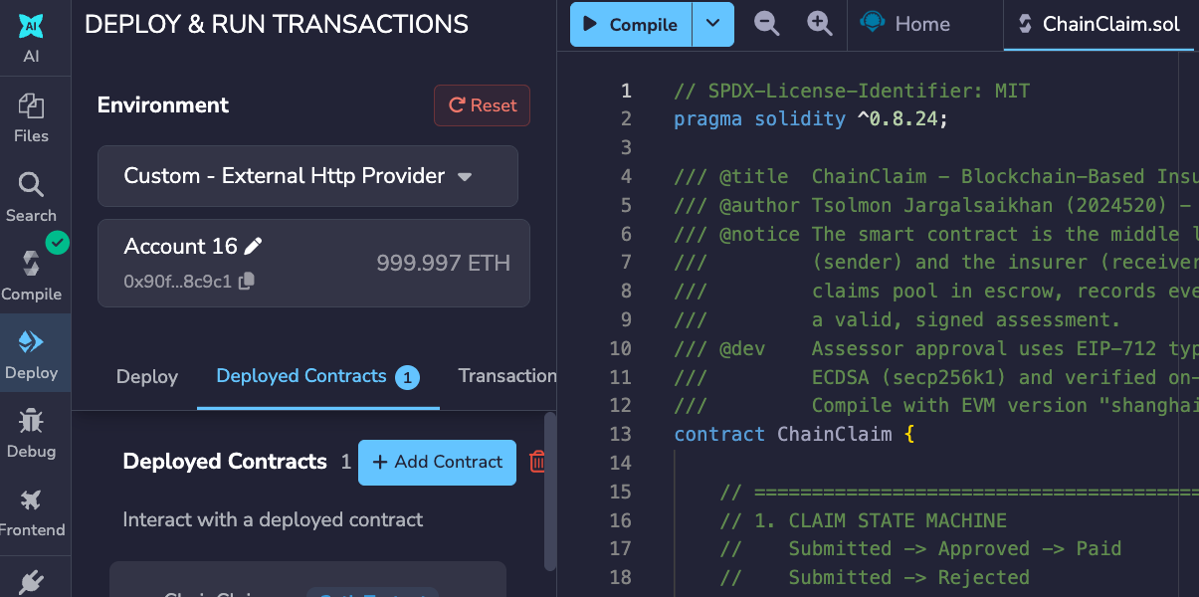
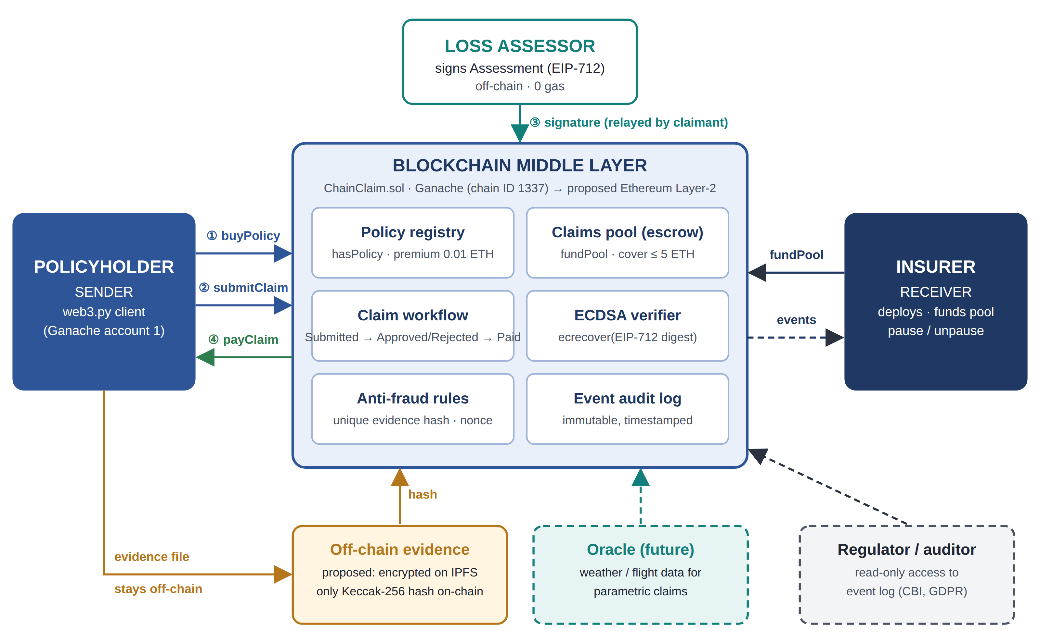
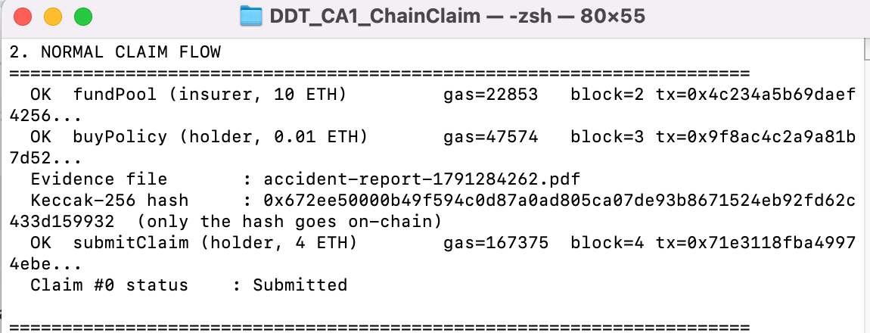
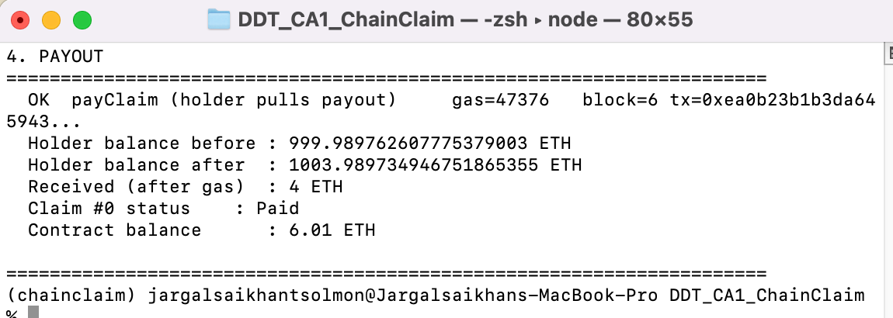
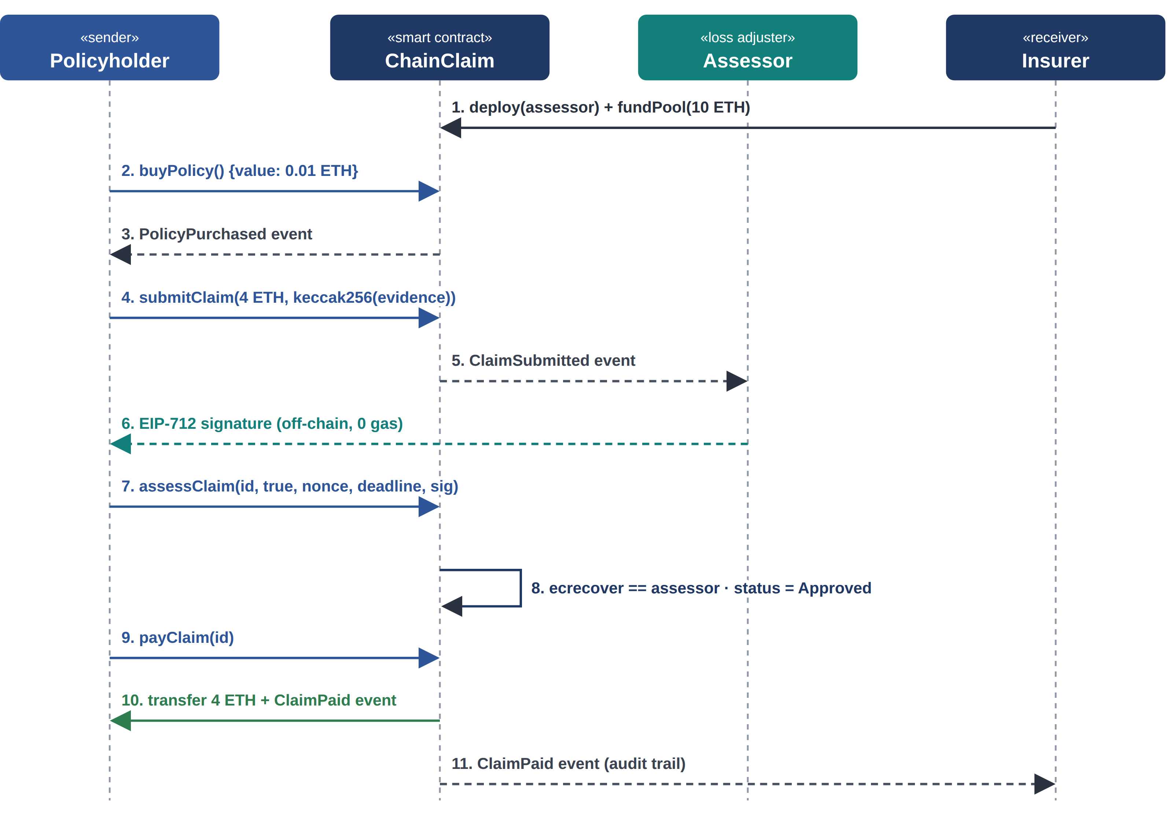
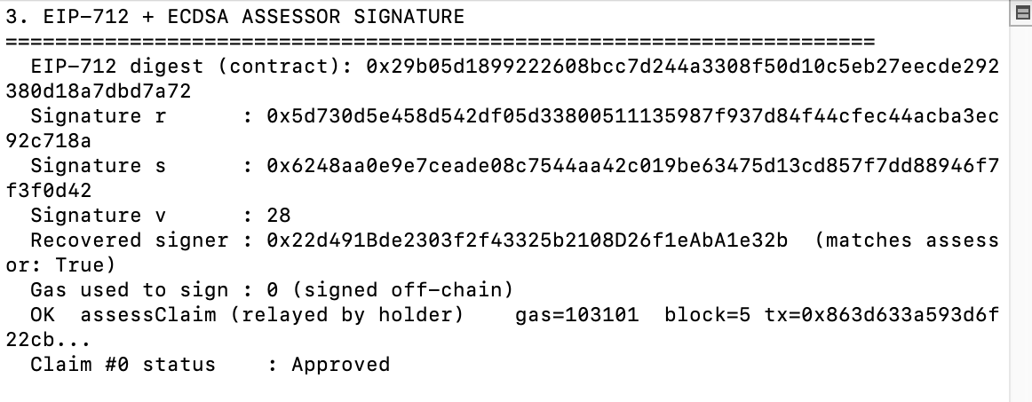
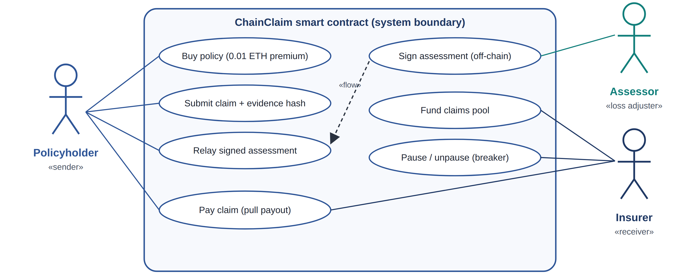
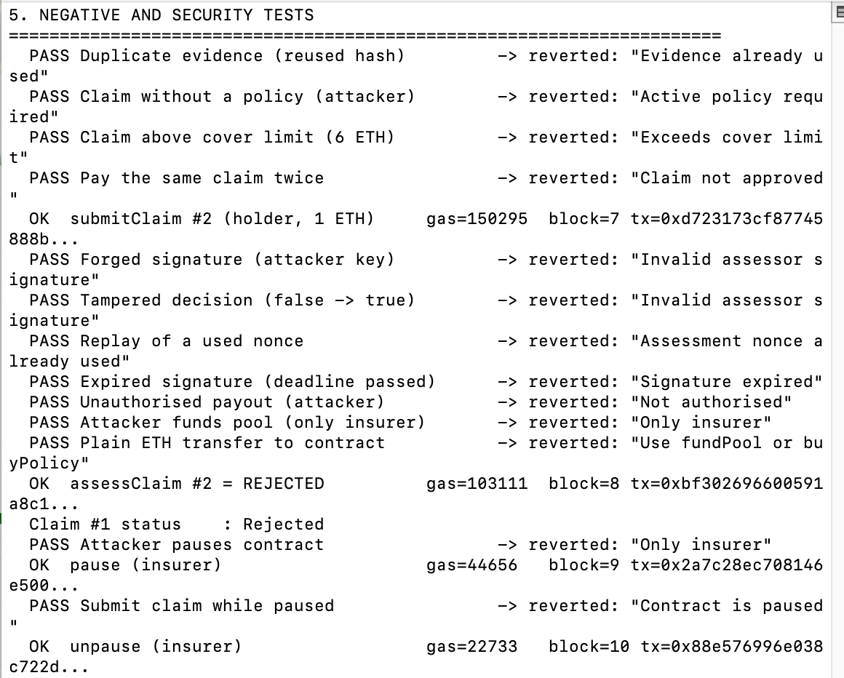
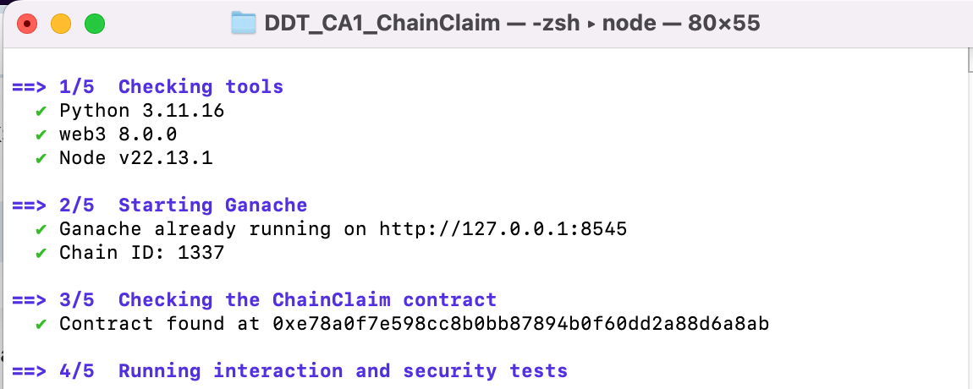
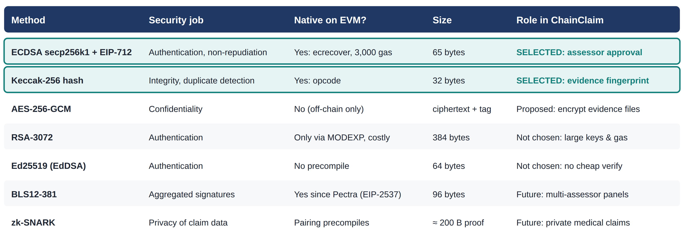
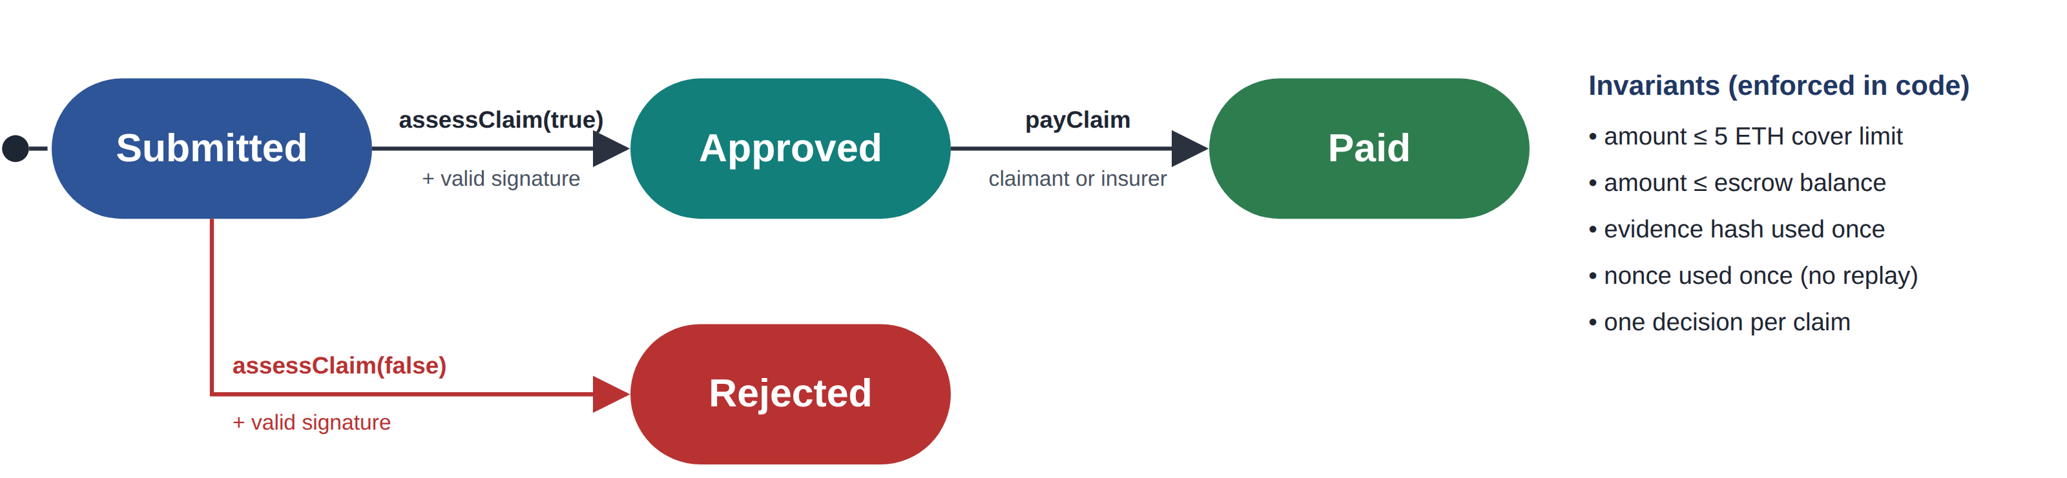
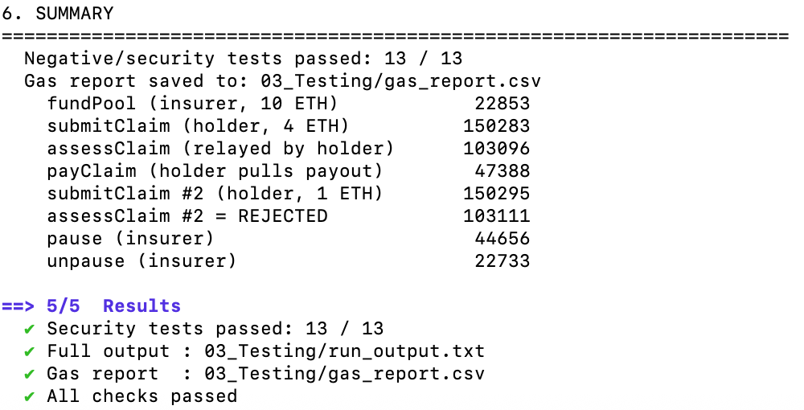
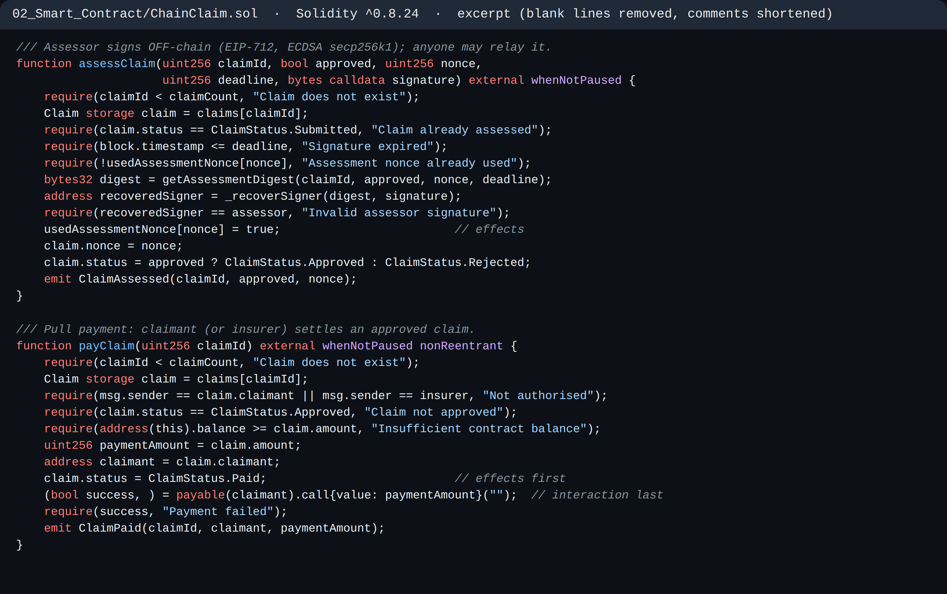
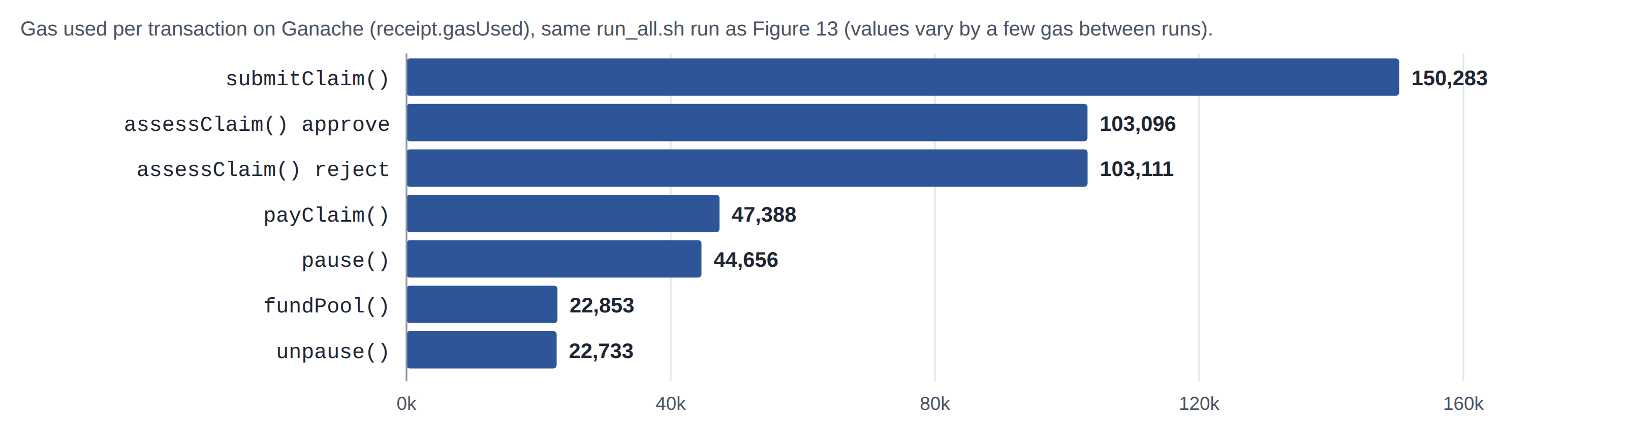
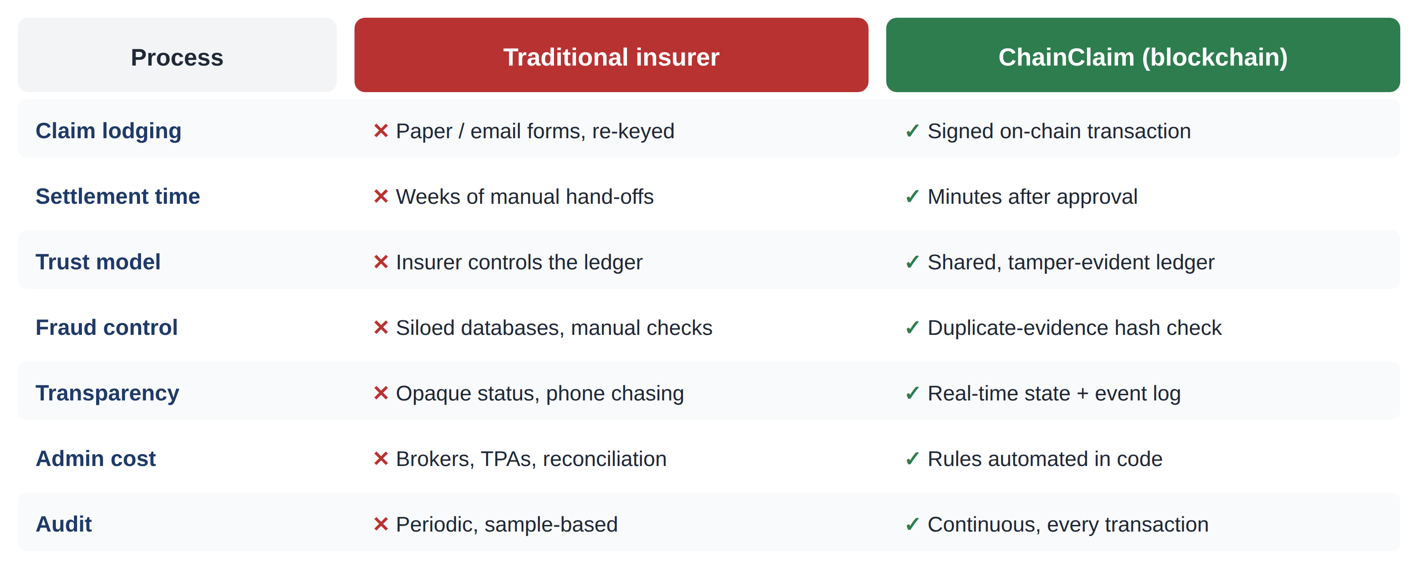
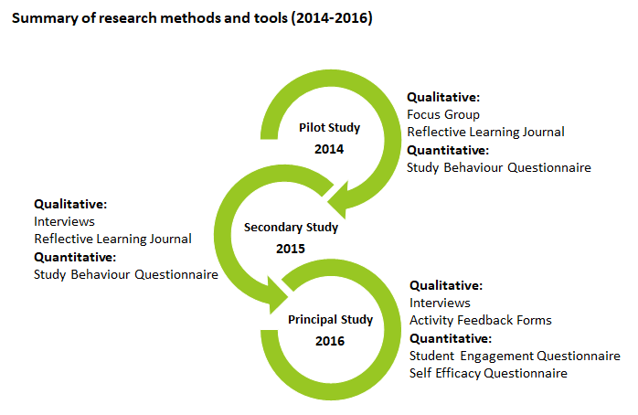
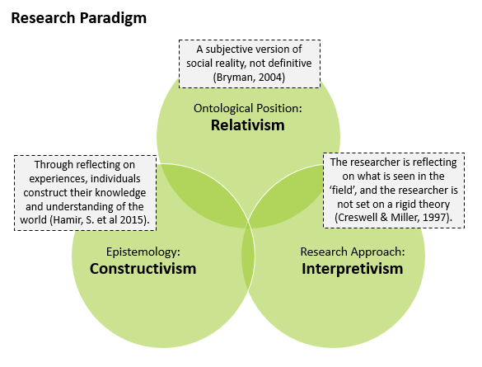

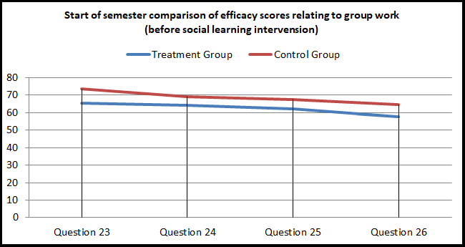
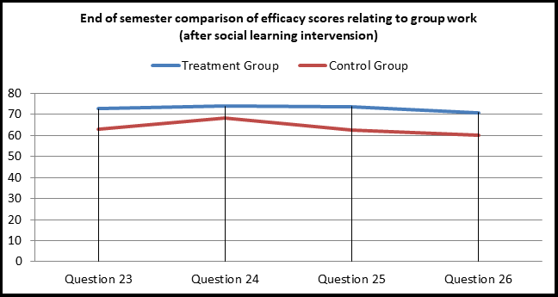

ChainClaim: A Blockchain-Based Insurance Claims Settlement DApp
Solidity Smart Contract with ECDSA (EIP-712) Signatures on Ethereum
Tsolmon Jargalsaikhan | Student No. 2024520 | CCT College Dublin – BSc (Hons) Computing in IT | DDT CA1 | github.com/Tamara520/chainclaim-insurance-dapp
CRITERION 1 · BLOCKCHAIN SOLUTION PROPOSAL
CRITERION 1 · BENEFITS, CHALLENGES & CRYPTOGRAPHY
CRITERION 2 · SMART CONTRACT DESIGN
CRITERION 2 · DEPLOYMENT, EXECUTION & TESTING
INTRODUCTION
RECENT ADVANCEMENTS USED
HOW ECDSA SECURES A CLAIM
IMPLEMENTATION & TESTING
Insurance claims are still slow, paper-based and dependent on trusting one party. Customers wait weeks and fraud is costly: Irish insurers detected €76m of fraudulent claims, with about €200m more undetected (Insurance Europe, 2019, p. 8). ChainClaim moves the claim lifecycle onto a smart contract between the policyholder (sender) and the insurer (receiver), so neither side can alter the record and only a publicly logged pause can hold up an approved payout.
Layer-2 rollups + EIP-4844 (Dencun, 2024): blob data made small claims cheap to settle (Ethereum Foundation, 2024).
Stack: Solidity 0.8.24 in Remix IDE, Ganache v7 (chain ID 1337), Python web3.py scripts (deploy.py, interact.py) and a Bash runner (run_all.sh).
Account abstraction (ERC-4337, EIP-7702): smart wallets and insurer-paid gas (Buterin et al., 2021; 2024).
13 / 13
security tests passed
1
shell command: deploy + test
47,388
gas to pay a claim
0 gas
assessor signs off-chain
EIP-712 + EIP-2 (used): off-chain approval, on-chain check with low-s rule (Bloemen, Logvinov and Evans, 2017).
SOLUTION & BUSINESS MODEL
BLS precompile (EIP-2537, Pectra): aggregated multi-assessor signatures (Vlasov et al., 2020).
Oracles & ZK proofs: Chainlink feeds for parametric cover (Chainlink Labs, 2024); ZK proofs for private claims.
Figure 5 – Off-chain signing, on-chain verification
BENEFITS
Authentication | only the assessor's key can approve
Integrity | Keccak-256 hash; any edit changes it
Non-repudiation | signed decision is permanent proof
Confidentiality | evidence hashed on-chain; amounts public (AES proposed)
Replay safety | deadline + one-time use + low-s (EIP-2)
Speed & cost: approval and payout in two transactions, no reconciliation.
Fraud reduction: reused evidence and forged approvals are rejected by code (13 tests).
Trust & audit: every state change is an immutable, auditable event.
SMART CONTRACT DESIGN
CHALLENGES (CRITICAL VIEW)
ChainClaim.sol holds premiums and the claims pool in escrow, enforces policy rules (0.01 ETH premium, 5 ETH cover limit) and pays only after a valid signed assessment. It uses checks-effects-interactions, a re-entrancy guard, a claimant-callable payout and a circuit breaker.
Figure 9 – Remix deploy to Ganache, chain 1337 (Remix label: “Geth Testnet”)
GDPR vs immutability: erasure rights clash with permanent storage; only hashes go on-chain.
Figure 1 – ChainClaim architecture: blockchain as the middle layer
Trusted assessor: a dishonest assessor can still sign; mitigated by rotation and multi-signature panels.
Proposed consortium: Irish insurers, assessors and the regulator operate a permissioned Ethereum Layer-2.
Irreversible bugs: costly (Siegel, 2016); mitigated by tests and a circuit breaker.
Figure 10 – Transactions on Ganache: fundPool, buyPolicy, submitClaim (left) and 4 ETH payout (right)
Regulation: Central Bank of Ireland oversight and MiCA rules for euro stablecoins (European Union, 2023).
Revenue: insurers pay a per-policy fee; assessors earn per signed assessment.
Verdict: blockchain fits best when distrusting parties share claims; a single insurer could use a database.
Customer value: live claim status and fast payout.
CRYPTOGRAPHIC SECURITY
Shared fraud registry: insurers compare evidence hashes, never personal data.
Selected: ECDSA (secp256k1) signatures with EIP-712 typed data, plus Keccak-256 hashing.
Native & cheap: ecrecover verifies a signature for 3,000 gas (Wood, 2014).
Figure 11 – EIP-712 digest, signature and recovered assessor (earlier run)
Efficient: 256-bit ECC equals 3072-bit RSA with smaller keys (Barker, 2020).
Context binding: chainId and contract address are signed, blocking cross-contract replay.
Figure 6 – UML sequence diagram
Figure 2 – UML use-case diagram
DISRUPTIVE IMPACT
Figure 7 – Claim state machine and invariants
Figure 13 – run_all.sh: one command runs everything; all checks passed
Blockchain removes reconciliation between insurers, brokers and administrators and replaces discretionary delays with code. Approved claims settle in minutes instead of weeks, fraud checks move from siloed databases to a shared hash registry, and administrators shift from processing paperwork to auditing signed decisions.
Figure 12 – All 13 attacks revert with a clear reason
Figure 4 – Cryptographic methods compared
REFERENCES
Barker, E. (2020) Recommendation for Key Management: Part 1 – General (NIST SP 800-57 Part 1 Rev. 5). Gaithersburg: NIST.
Bloemen, R., Logvinov, L. and Evans, J. (2017) EIP-712: Typed structured data hashing and signing. Available at: https://eips.ethereum.org/EIPS/eip-712 (Accessed: 27 September 2026).
Buterin, V. et al. (2021) ERC-4337: Account abstraction using alt mempool. Available at: https://eips.ethereum.org/EIPS/eip-4337 (Accessed: 27 September 2026).
Figure 14 – Gas from transaction receipts
Buterin, V. et al. (2024) EIP-7702: Set code for EOAs. Available at: https://eips.ethereum.org/EIPS/eip-7702 (Accessed: 27 September 2026).
CONCLUSION
Chainlink Labs (2024) Chainlink Data Feeds. Available at: https://docs.chain.link/data-feeds (Accessed: 27 September 2026).
Ethereum Foundation (2024) Cancun-Deneb (Dencun) FAQ. Available at: https://ethereum.org/en/roadmap/dencun/ (Accessed: 27 September 2026).
ChainClaim shows a smart contract can be a neutral middle layer for insurance claims: premiums, approvals and payouts are enforced by code, ECDSA and Keccak-256 provide authentication and integrity, and all 13 attack tests were rejected. Next steps: multi-assessor BLS signatures, ZK proofs for medical claims and a Layer-2 pilot.
European Union (2023) Regulation (EU) 2023/1114 on markets in crypto-assets (MiCA). Official Journal of the European Union, L150.
Insurance Europe (2019) Insurance fraud: not a victimless crime. Brussels: Insurance Europe.
Siegel, D. (2016) 'Understanding the DAO attack', CoinDesk, 25 June.
Vlasov, A. et al. (2020) EIP-2537: Precompile for BLS12-381 curve operations. Available at: https://eips.ethereum.org/EIPS/eip-2537 (Accessed: 27 September 2026).
Figure 3 – Traditional claims process vs ChainClaim
Wood, G. (2014) Ethereum: a secure decentralised generalised transaction ledger (Yellow Paper). Available at: https://ethereum.github.io/yellowpaper/paper.pdf (Accessed: 27 September 2026).
Figure 8 – Key functions: signed assessment and pull payment
Notes:
ChainClaim poster – DDT CA1. Evidence screenshots: see 09_Evidence/EVIDENCE_LOG.md in the GitHub repository.

