Slide 1

Lesson 4
Sortings. Basic data structures: stack, queue

Slide 2
Algorithm
Self-contained step-by-step set of operations to be performed
Finiteness – terminates after finite number of operations
Definiteness – each step is unambiguous
Input – 0 and more
Output 1 and more

Slide 3
Bubble sort algorithm
Array of int
Go through array. If element i > i + 1 – swap them
Repeat while at least one swap exists.

Slide 4
Insertion sort
Array of int
Start from element 1.
Compare to element 0.
If 1st less the 0th – swap them
Take element 2.
Compare with 1st. If 2nd less – swap them. Not 2nd element on 1st place.
Compare 1st with 0th. Swap.
Element i not less than i – 1 – swap with previous. If not less – choose next and do the same

Slide 5
LIFO & FIFO
Last In First Out: Stack.
First In First Out: Queue.

Slide 6

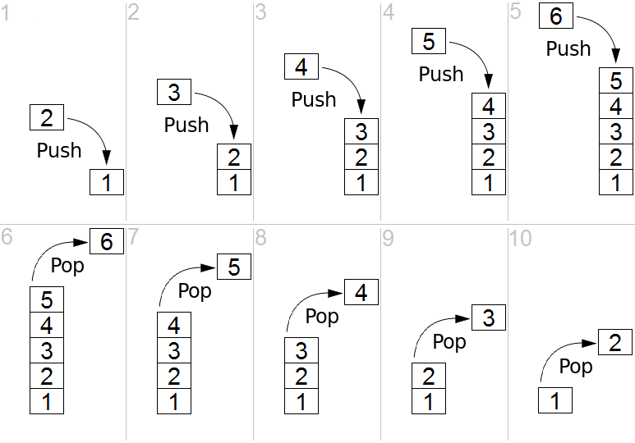
Stack

Slide 7
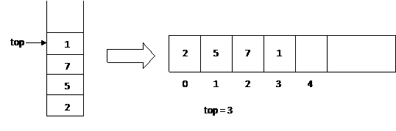
Array-based implementation

Slide 8
Stack API
Push – push data on stack
Pop – pop data from stack
IsEmpty – is there any data in stack?
IsFull – is there stack full?
Peek – get data from stack without pop

Slide 9
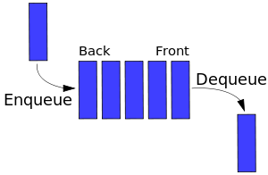
Queue

Slide 10
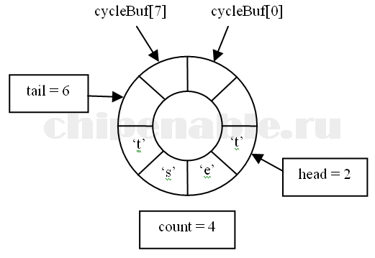
Circular (ring) buffer

Slide 11
Queue API
Enqueue – put element in queue
Dequeue – get element from queue(through out parameter, true if element got from queue, false otherwise)
IsFull – return true buffer is full
IsEmpty – return true if buffer is empty

Slide 12
Homework
Implement Swap method which takes array of int and two indexes to swap.
Implement Bubble sort (using Swap).
Implement Insertion sort (using Swap).
Implement Stack
Implement Circular Buffer Queue

