Slide 1
House Price Analysis
for Local Armenian Market
Business Analytics
Team Members:
Anna Martirosyan
Tamara Sedrakyan
Meri Torosyan
Professor: Hrant Davtyan

Slide 2
Introduction
This project will help to understand the relationships between house feature variables and its prices for the local Armenian market, based on the data available in different online platforms.

Slide 3
Problem
This research aims to fill the gap of the academic analysis in the real estate industry for Armenian market.
It explores the direct relationships between house price and features such as sqm size, number of rooms, agency, district, building type, etc.

Slide 4
Dataset and Features
Price
Currency
Price_USD
Price_per_sqm
Sqm
Type
Floor
nFloor
Rooms
City
District
Agency
Broker
Source
ID
HTML ID

Slide 5
Cleaning the dataset
Floor
Type
Broker/Agency
District

Slide 6
The model built will try to analyze the relationship between the dependent variable “Price_USD” and the rest of the independent variables

Slide 7
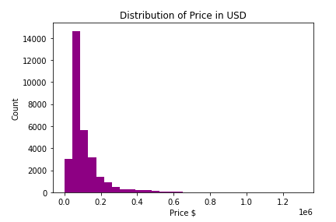
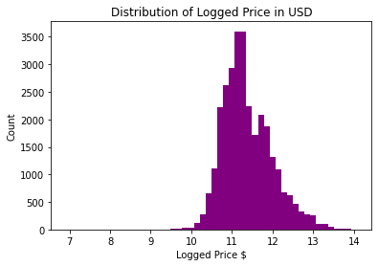
As a dependent variable “Price_USD” was used, however, because of its right-skewed distribution its log was calculated, making the distribution a bit more normal.

Slide 8
Methodological approach
Linear Regression
Decision Tree
Random Forest
Backward elimination was used to eliminate insignificant ones.
Feature engineering was conducted, such as adding interaction points.

Slide 9
R Square Adjusted has the exact same value as the R squared itself, which means that the model has a good performance and is not changing its results based on the number of independent variables added.

Slide 10
OLS Regression Model: External Validation
0.793
test
The model needs to be checked for the outside population as well, this is why train and test split was used.
0.754
train
Fitting the linear OLS model again, the R-squared were:

Slide 11
Polynomial second degree Linear Regression model
The R-squared were:
0.817
test
Polynomial second degree regression was done because some quadratic relationships between variables and Price_USD were detected in the pairplots.
0.813
train

Slide 12
Mean Squared Error
0.0784
train
0.0786
test
0.0756
train
0.0739
test
The cross validation score mean
Linear Regression 0.0792
Decision Tree 0.0865
Random Forest 0.0882.
Decision tree regression model
0.0802
train
0.0777
test
OLS model
Random Forest
model

Slide 13
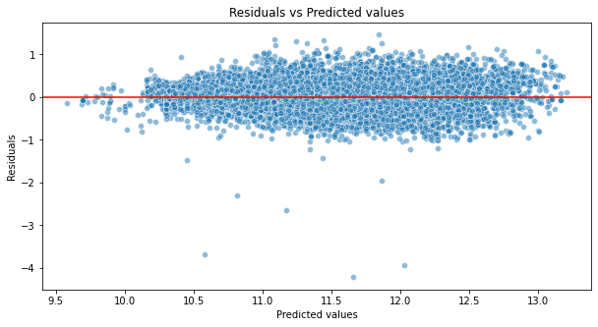
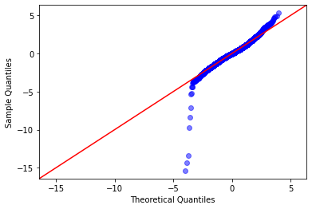
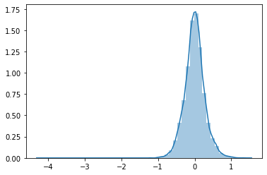
Check the LINE assumptions
Independence
Partially satisfied
Linearity
Satisfied
Normality
Partially satisfied
Equal Variance
Satisfied

Slide 14
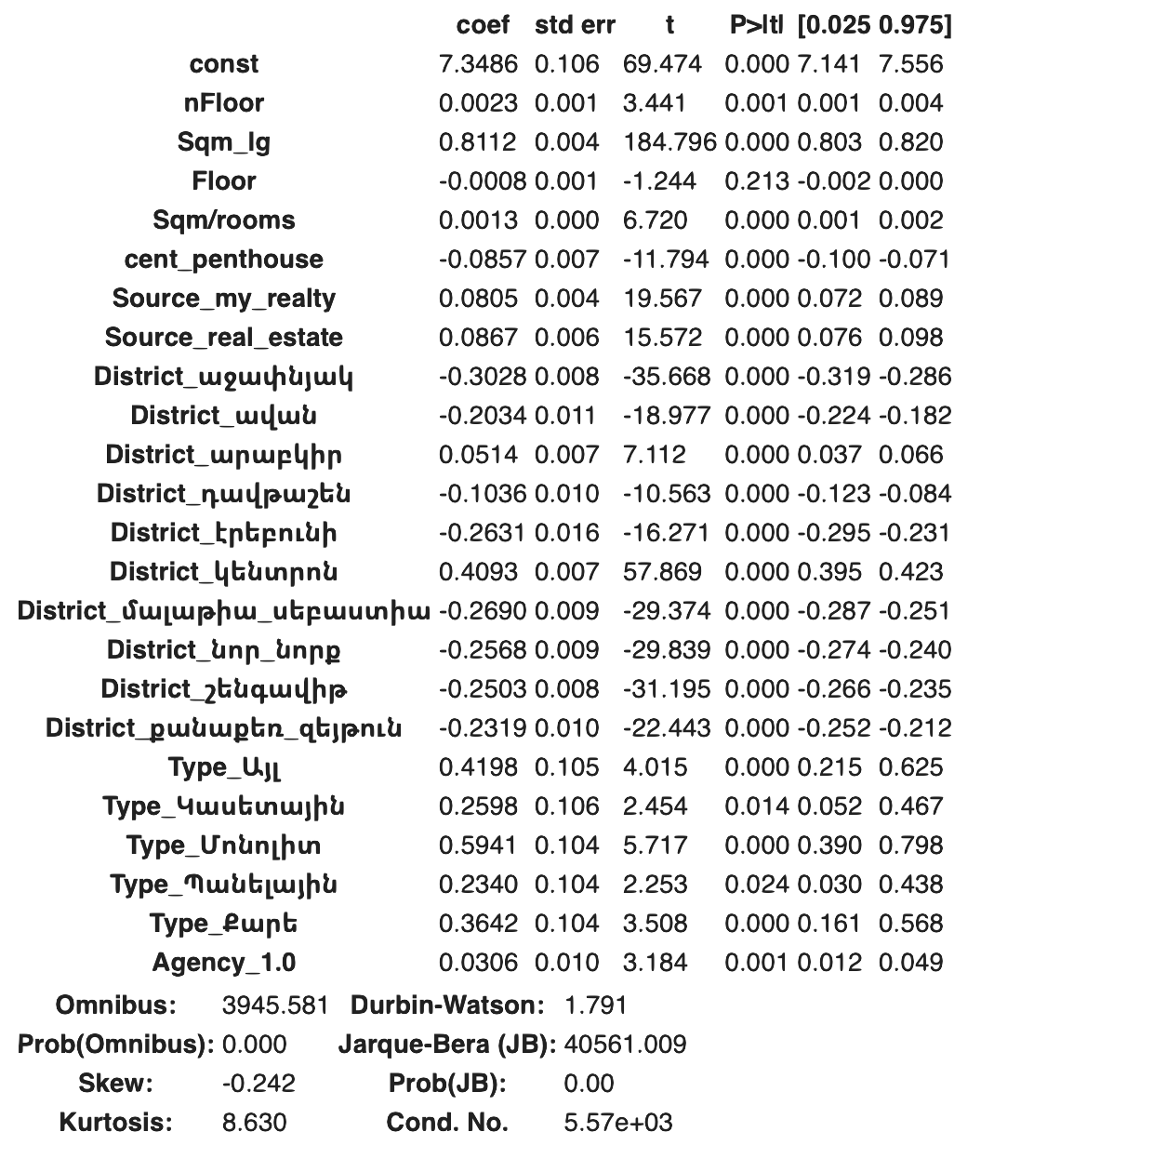
Results
An increase in the building’s number of total floors by one unit, will lead to 0.23% change in its price.
On average 59.41% percent increase in mean price is expected if we observe “Աղյուսե” type of flat compared to the “Մոնոլիտ” type.
When the district of the house is changed from “0” (not indicated) to “Դավթաշեն”, its mean price will decrease with on average 10.36%.
When the district of the house is changed from “0” (not indicated) to “Կենտրոն”, its mean price will increase with on average 40.93%.
When there is a one percent change in square meter of the house, it leads to on average 0.8112% increase in the mean price.

Slide 15
THANKS
Does anyone have any questions?
stay safe and stay HOME

