Slide 1
GROUP IMAGE SHARER
INSTALLATION GUIDE AND USER MANUAL
Project Report
By: Tamara Bain & Maciej Ogrocki
Cmput 391 Fall 2014

Slide 2
Contents
Setup and References Page 2
Site map and Layout Page 3
------------------------- Page 4
User Management Module Page 5
Security Module Page 6
Uploading Module Page 7
Display Module Page 8
Search Module Page 9
Data Analysis Module Page 10
Page 1

Slide 3
Setup and References
Technologies Used:
Nginx 1.6.2 (reverse proxy): a IMAP/POP3 proxy server. We use this as a proxy server to send users to the App section to of our server. While sending files directly to the index. This speeds up file uploads greats. http://nginx.org/
Gunicorn 19.1.1 (WSGI server): a Python WSGI HTTP Server for UNIX. We use this for our App Server. http://gunicorn.org/
MySQL 5.6.20: a SQL Database. Used for the backend of our database. http://www.mysql.com/
Python 3.4.2: Python is a widely used general-purpose, high-level programming language. This is the main language we scripted our project. https://www.python.org/
Boostrap3 (Custom Modification of Bootswatch Darkly): HTML, CSS, and JS framework. We used this to format our HTML, CSS and JS. We used the Darkly theme with custome modifications. HTML, CSS, and JS framework
Jquery2: JavaScript library. Used in page scripts and a Bootstap dependency. http://jquery.com/
MagicSuggest2 (Pretty JS Multiselect widgets): JavaScript Library used for multiple widgets. Used for the suggestion bar for easier searching. http://nicolasbize.com/magicsuggest/
Pictonic : Icon databank. Icons used for the site. https://pictonic.co/
Following Python External Librarires:
Flask 0.10.1 : web mirco-framework
Flask-sqlalchemy 2.0 : Adds SQLAlchemy support to your Flask application.
Flask-whoosh : is a Flask extension that integrates the functionality of Whoosh (personal custom fork https://github.com/Tamarabyte/Flask-WhooshAlchemy)
Flash-login 0.2.11 : used for handling user sessions
Flash-WTF 0.10.2 : a form objects
Jinja2 2.7.3 : a html templates
Pillow 2.6 : a python image library
Passlib 1.6.2 : a password hash algorithms
References:
Flask file upload documentation:
http://flask.pocoo.org/docs/0.10/patterns/fileuploads/
Thumbnail resize algorithm provided by:
http://united-coders.com/christian-harms/image-resizing-tips-every-coder-should-know/
Page 2

Slide 4
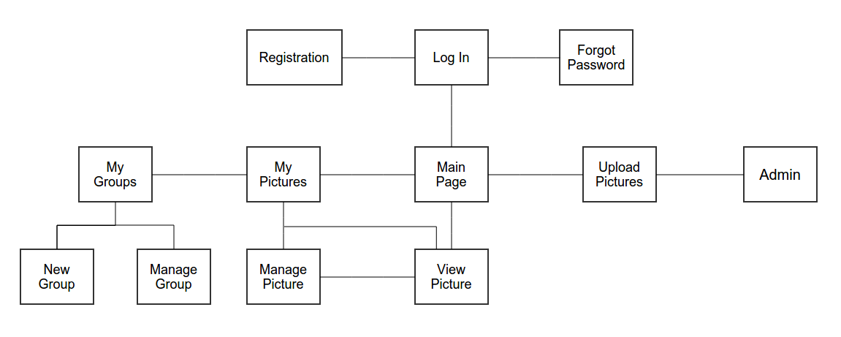
Sitemap and Layout
Website Layout: Reason for using this format over others.
Sitemap: Explanation of the site map
Page 3

Slide 5
SQL Python Page (NP)
Page 4

Slide 6
User Management
The Code for the User Management page can be found in :
database391/app/views/user_management_views.py
database391/app/forms/user_management_forms.py
user_management_forms.py contains the forms for: Logging in users, registering users, reporting a forgotten password and changing a password.
user_management_views.py are seen by a user before logging in. It Include: login view, registration view, lost password view, password change view and contains helpers for sending registration emails and password reset email
Registration :
- User_name: Primary Key, Maximum length of 24 characters, Must be unique
- Password : Maximum length of 24 characters, Saved as a base 64 hash
- First_name : Maximum length of 24 characters
- Last_name : Maximum length of 24 characters
- Address : Maximum length of 128 characters
- Email : Maximum length of 128 characters, Must be unique
- Phone : Exactly 10 numbers. Must be formated as XXX-XXX-XXXX
(No field may be null.)
Page 5

Slide 7
Security
Page 6

Slide 8
Uploading
Page 7

Slide 9
Display
Page 8

Slide 10
Search
Page 9

Slide 11
Data Analysis
Page 10

