Slide 1
GROUP IMAGE SHARER
INSTALLATION GUIDE AND USER MANUAL
By: Tamara Bain & Maciej Ogrocki
Cmput 391 Fall 2014

Slide 2
Contents
Installation Guide Page 2
User Management Module Page 3
Security Module Page 4
Uploading Module Page 5
Display Module Page 6
Search Module Page 7
Data Analysis Module Page 8
Other Information Page 9
Page 1

Slide 3
Installation Guide
Recommended Browser: Chrome/Safari/Chromium
Page 2

Slide 4
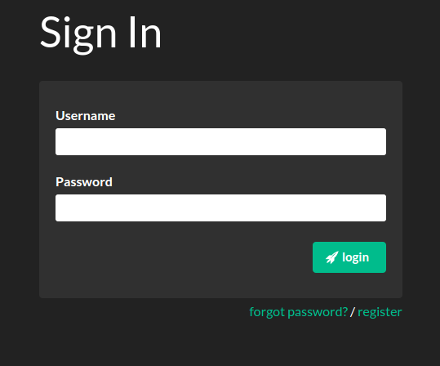
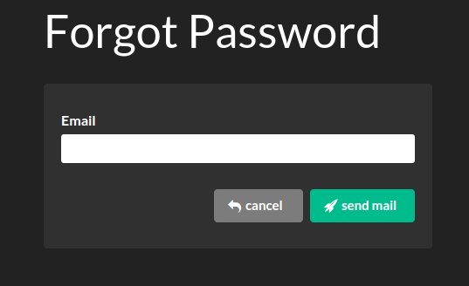
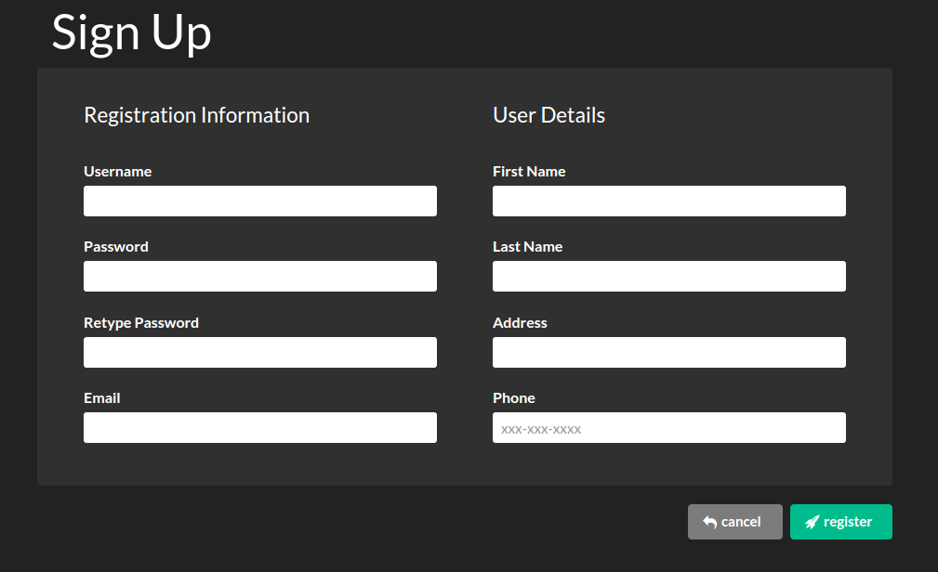
User Management Module
To Access “Group Image Sharer” first type:
www.wildgamerappears.com The first page
you will see will be the Sign In page.
If you already have a account enter your
username and password then click login.
If you do not have a account click the
“register” link.
If you have forgotten your password click
the “forgot password? link.
When you click the “forgot password”
link you will be brought to this page.
Here you may enter your email and
click Send mail.
A new temporary password will be
sent to your email shortly.
When you click the
“register” link you will be
brought to this page. Here
you will be asked to input all
your registartion information.
Once you click the register
button you will be sent a
confirmation email.
If any field is invalid the
fourm will not submit. You
will be notified if any of the
field are invalid
Page 3

Slide 5
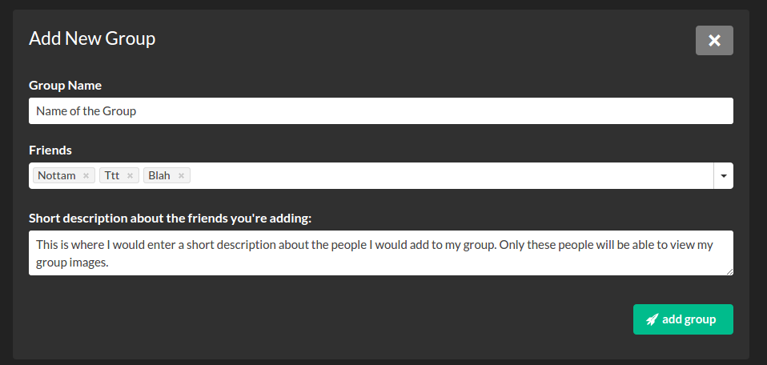


Security Module
To access group settings simply press on the “My Groups” button in the menu bar
You may create a group and invite people to the group. Images can be set so that
only people in the group may view these images. When adding a new group simply
click the plus button, enter a group name, include which friends you would like
to include and finally a short discription of why you are adding these people.
Inside each image in “My Pictures” you are
able to change who can view that image
Anyone in your group may view these images
Each image will have
a privacy setting of :
Group, Public or Private
Anyone may view these images
Only You may view these Images
Page 4

Slide 6
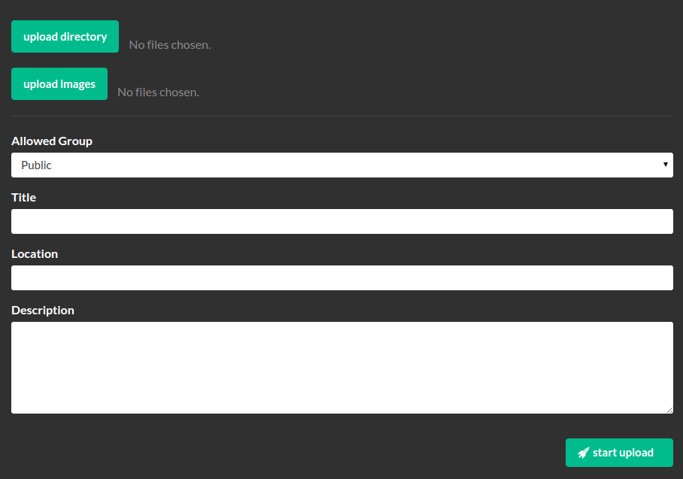
Uploading Module
To Upload a image go to the “Upload Picture” Tab
In the “Upload Picture” tab you are able to upload all selected images by clicking
on the “upload images” button or a directory of images using the “upload directory” button
Each group can be set to a specific viewing group such as “Public”, “Private”
or “a custome user group”. To expand all options simply open the “Allowed Group” drop
down menu.
Each image is to also be given a Title, Location of where the image was taken and
a short desctiption about the image. Subject has been changed to title to be simplicity
Page 5

Slide 7
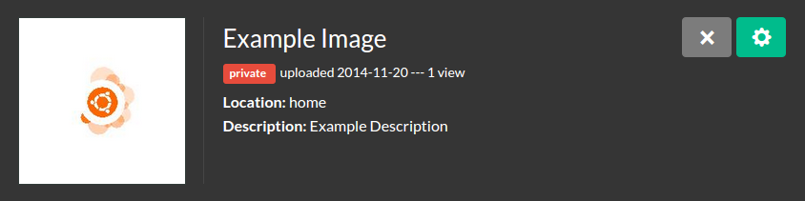
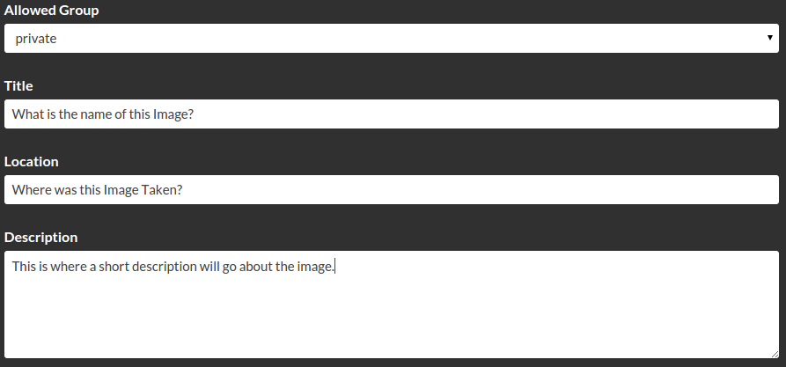
Display Module
To view and edit your images go to the “My Pictures” tab
Here you can view all of your images as well as information about each image.
By clicking on the “X” Icon you may delete your image from the database.
By clicking the “Teal Gear Icon” you may access the images setting
When you click on the “Teal Gear Icon” you will be brought to a full version of your
image. Under your image you will see a few options. Here you may modify details
about your images.
Allowed groups : Will let you chang which group's can view this image
Title : Is the title of the Image
Location : Is the location of where the image was taken
Desciption : Is a short body of text about your image
Page 6

Slide 8
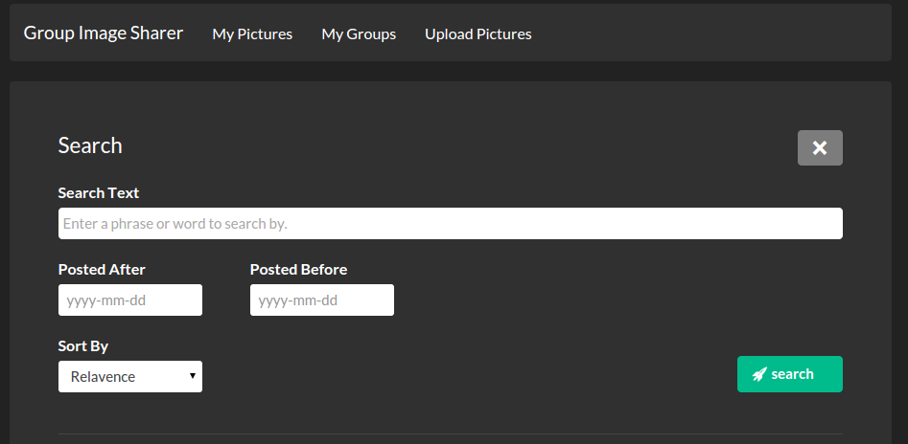

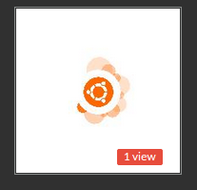
Search Module
On the main page you can view all images that are viewable to you. If you click
“Teal +” button you will expand a “Search” view. Here you may sort and search
all viewable image in a few ways.
Search text : This allows you to enter key words. Images with that key word in the
Title, Location and Description will be displayed. Image with more keywords will
be appear first. To input multiple words enter your first key word. Press enter and
Input the next key word.
Posted After/Before : This allows you to view images that have been posted before
or after a specific date. You are also able to view image in a date range.
Sort By: You may also sort your seach results in four ways.
Relavence : Image with the most use of a keyword will be listed first. Keywords in
titles are weighted more then those in location. Keywords in Location are weighted
More then those in desciption.
Most Views : Images that more unique users have viewed will be listed first.
Newest First : Most recently uploaded images will be listed first.
Newest Last : Most recently uploaded images will be listed last.
On each thumbnail of an image you can view the amout of unique views
The Privacy setting determinds the color of the view box
Red : Private
Yellow : A Group View
Green : Public
Page 7

Slide 9
Data Analysis Module
Page 8

Slide 10
Other Information
Page 9

