Slide 1

Burger Backend interview assignment
Tamás Balogh - 2022

Slide 2


General directions
Using Azure ecosystem
Using non relational DB
Use RESTful API principles
It should be stateless

Slide 3
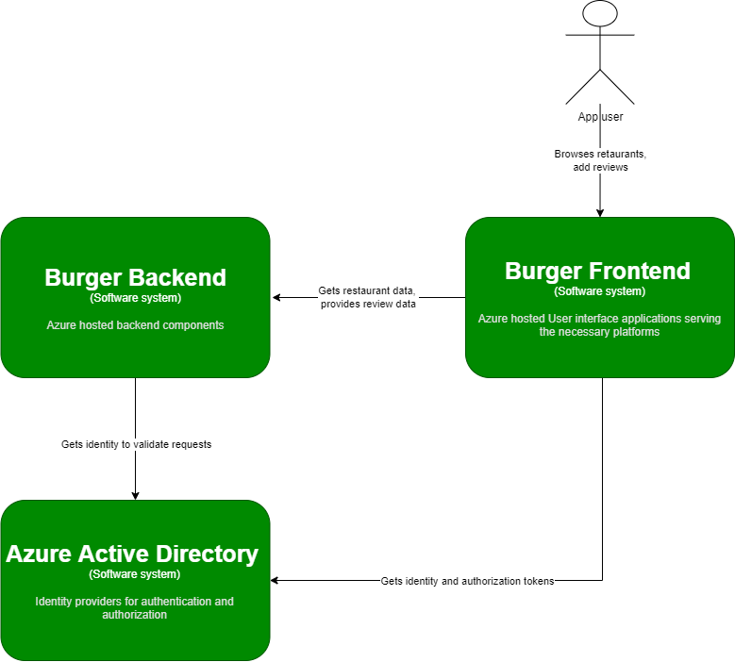
Architecture – High level overview

Slide 4
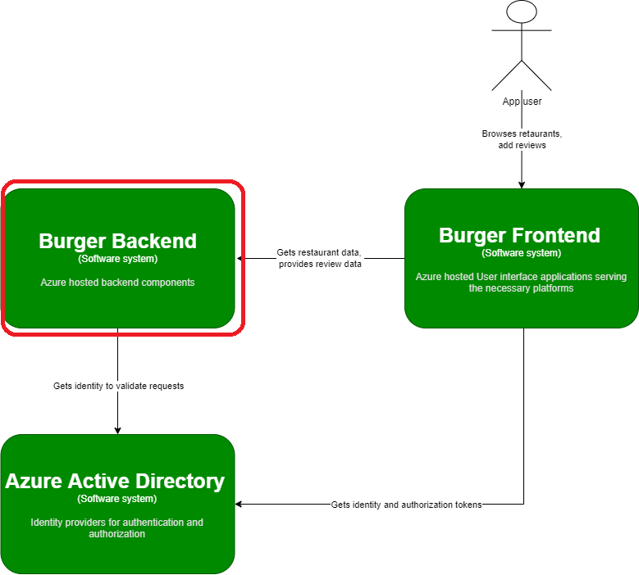
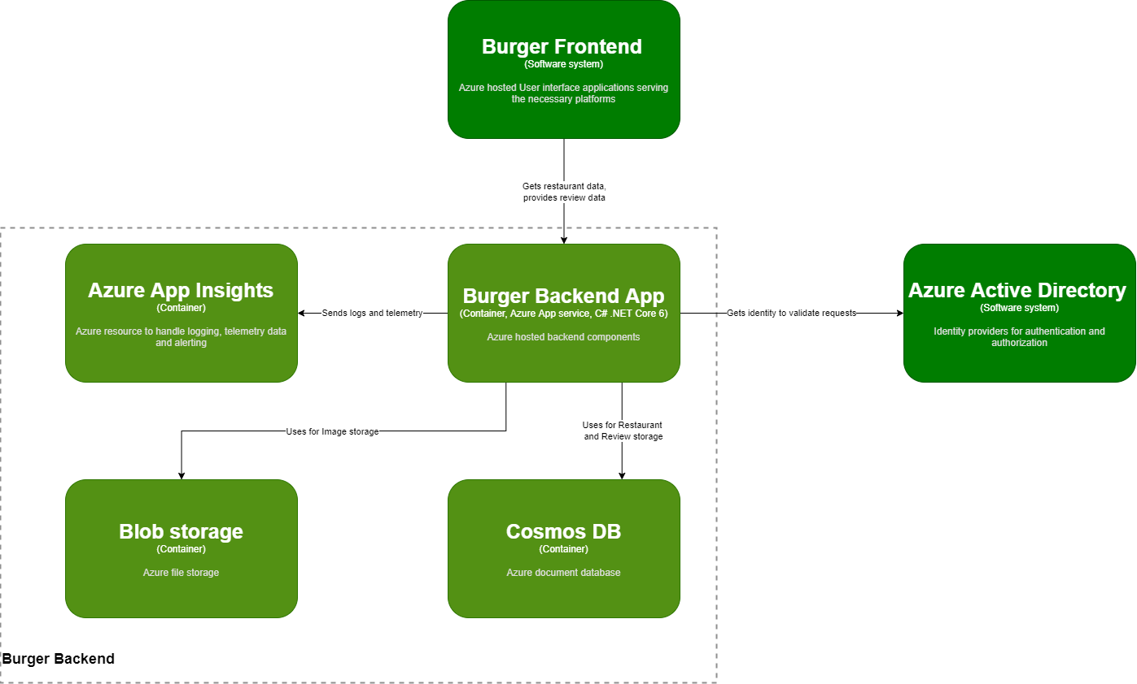
Architecture – Burger Backend solution components

Slide 5
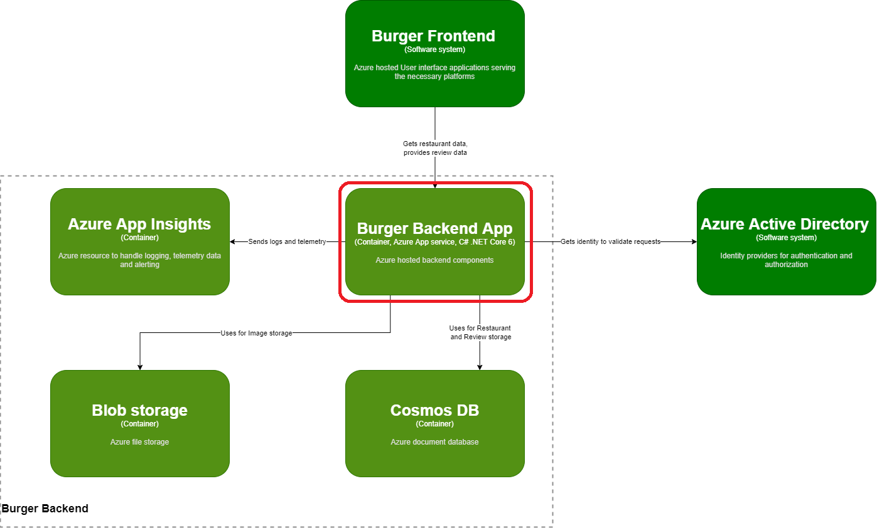
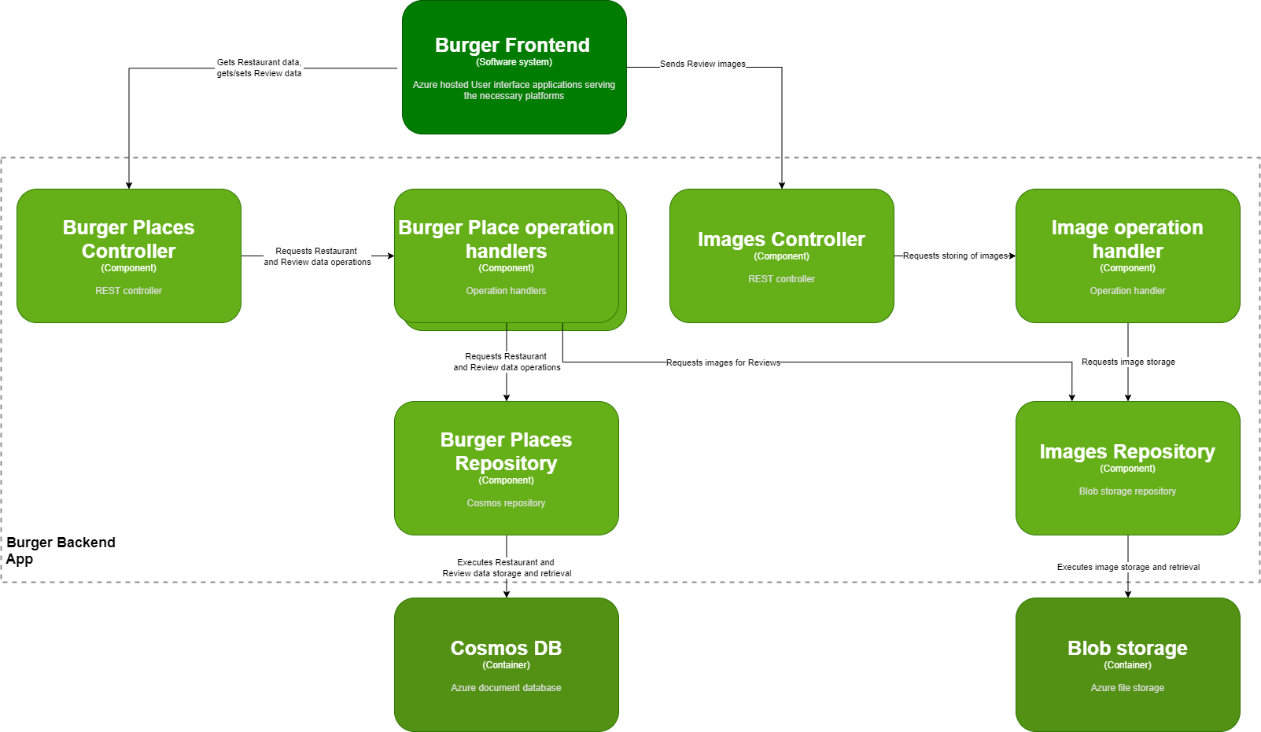
Architecture – Application details

Slide 6
Considerations
Security and user privacy:
Using Azure Active Directory for Authentication, Authorization and role management
User data is not stored in custom solution code or database (only the GUID value representing the user in Azure AD) only in Azure AD which has the necessary compliances.
Scaling:
As the application is stateless the App service plan’s Scale out feature can be used to scale the application
resources dinamically based on usage (based on CPU% used or connectivity metrics)
No need foreseen based on the assignment description to use different Regions when scaling
Consider caching in front of the CosmosDB if there would be latency in database operations

Slide 7
Possible improvements for full-scale application
Complete Authentication methods using AAD via the App service running the API application
Support additional Identity providers than Microsoft (e.g. Google, Facebook)
Consider using AAD role based authorization levels (e.g. admin users to handle Restaurant data)
Send User role via Authentication token from what the backend application decides if the action is allowed
Create separated Dev/UAT/Production environments
Create CI/CD pipelines (Azure Pipelines and yaml descriptions)
Add Intergration tests (with CosmosDB emulator)
Consider adding performance tests
Add automatic resizing of uploaded pictures
Add more filtering / sorting options to GET endpoints
Add more logging about usage
Partition keys based on Restaurant
Some extra feature possibilities
Recommendations based on score and similar taste

