Slide 1
Burger Case Assignment
Tamás Péter

Slide 2
My Goals
Include process and problem solving
Focus on parts relevant to position
System architecture
Component based development
Data fetching concepts

Slide 3
Agenda
Interpreting the problem
Designing UI
System diagram / architecture
Technology choices
Frontend planning (layout, components etc.)
Code, implementation details
Testing
Improvements, project future

Slide 4
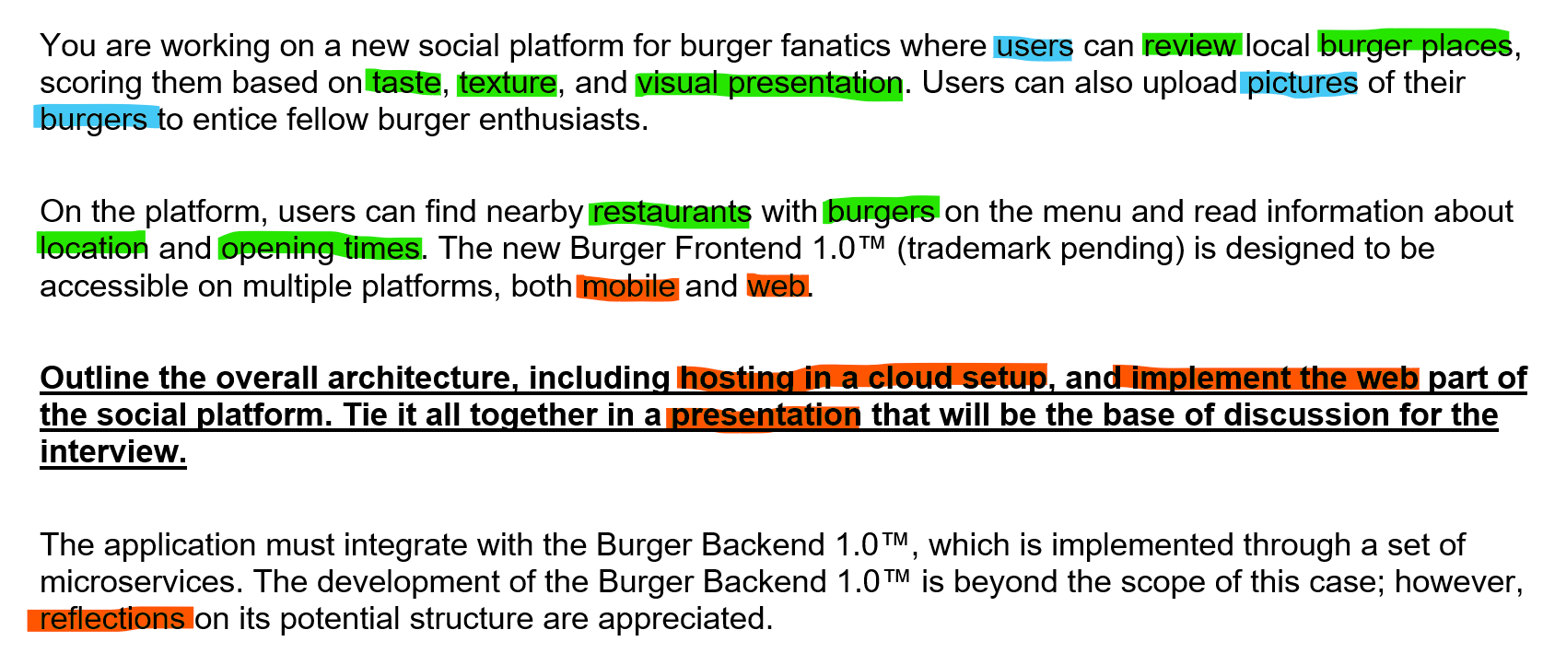
First Things First

Slide 5
Prioritizing requirements
As a user I want to choose a restaurant from the map* so I can navigate to their page
As a user I want to see information about the restaurant so I can read about the menu, rating and reviews
As a user I want to review the restaurant, so others can see my opinion
As a user I want to upload pictures of my burgers to the restaurants page, to entice fellow burger enthusiasts

Slide 6
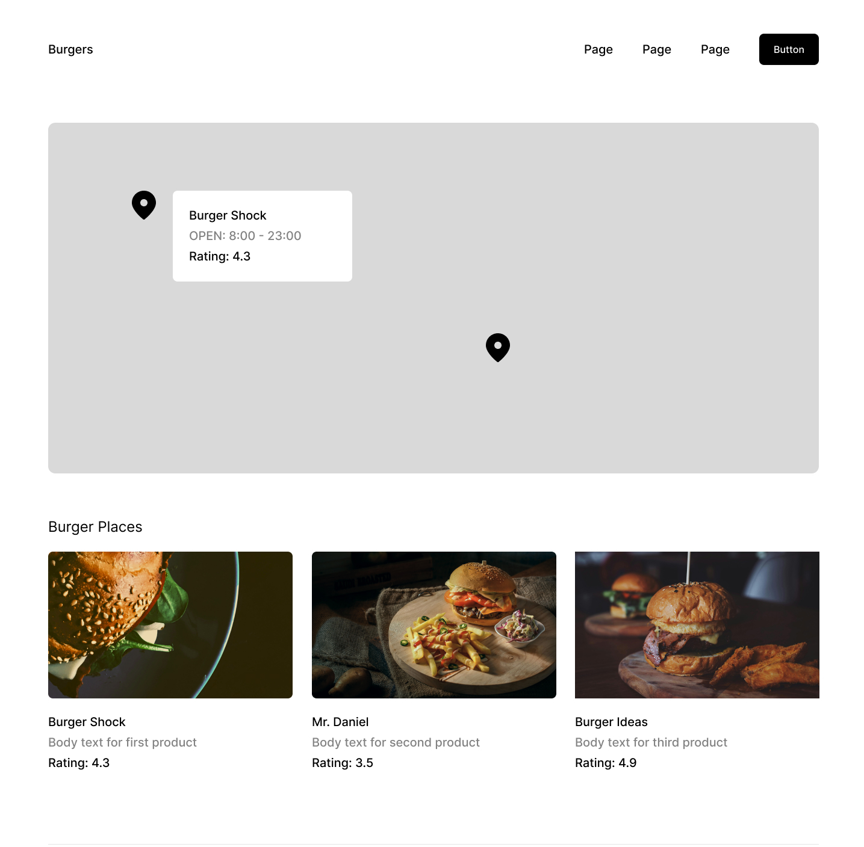
Visualizing Data
Restaurants:
[
"burger-shock",
"mr-daniels",
"burger-ideas"
]
Data Fetching, Interaction Design

Slide 7
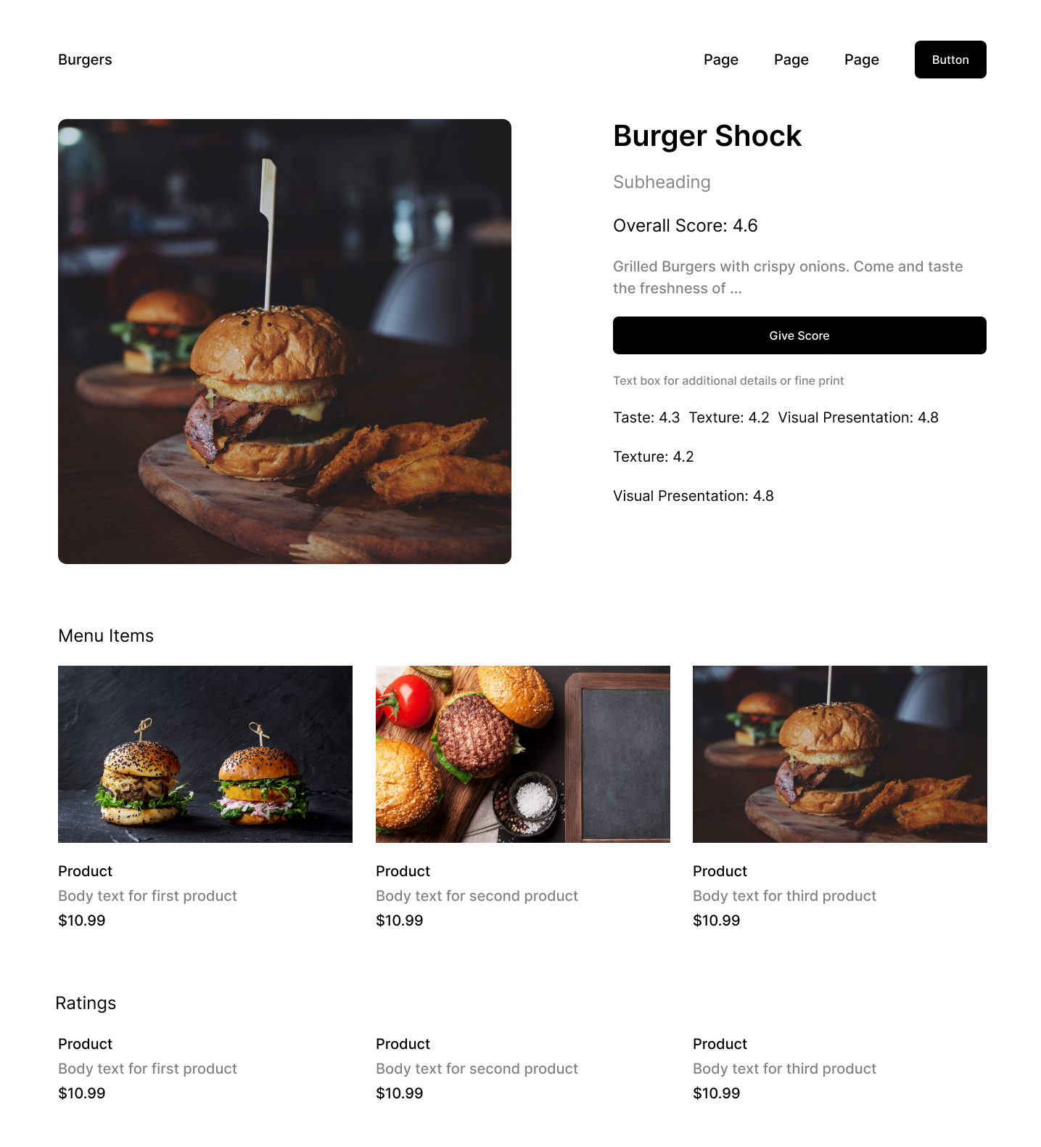
Visualizing Data
"id": "burger-shock",
"name": "Burger Shock",
"image": "/images/burger-shock.jpg",
"rating": 4.4,
"menuItems": [
{
"id": "cheese-burger",
"name": "Cheeseburger",
"price": 5.99,
"description": "A classic cheeseburger with lettuce, tomato, and pickles."
},
...
],
"reviews": [
{
"id": "review-1",
"name": "John Doe",
"rating": 5,
"comment": "Great burgers!"
},
...
]
}
Data subset fetching or secondary index

Slide 8
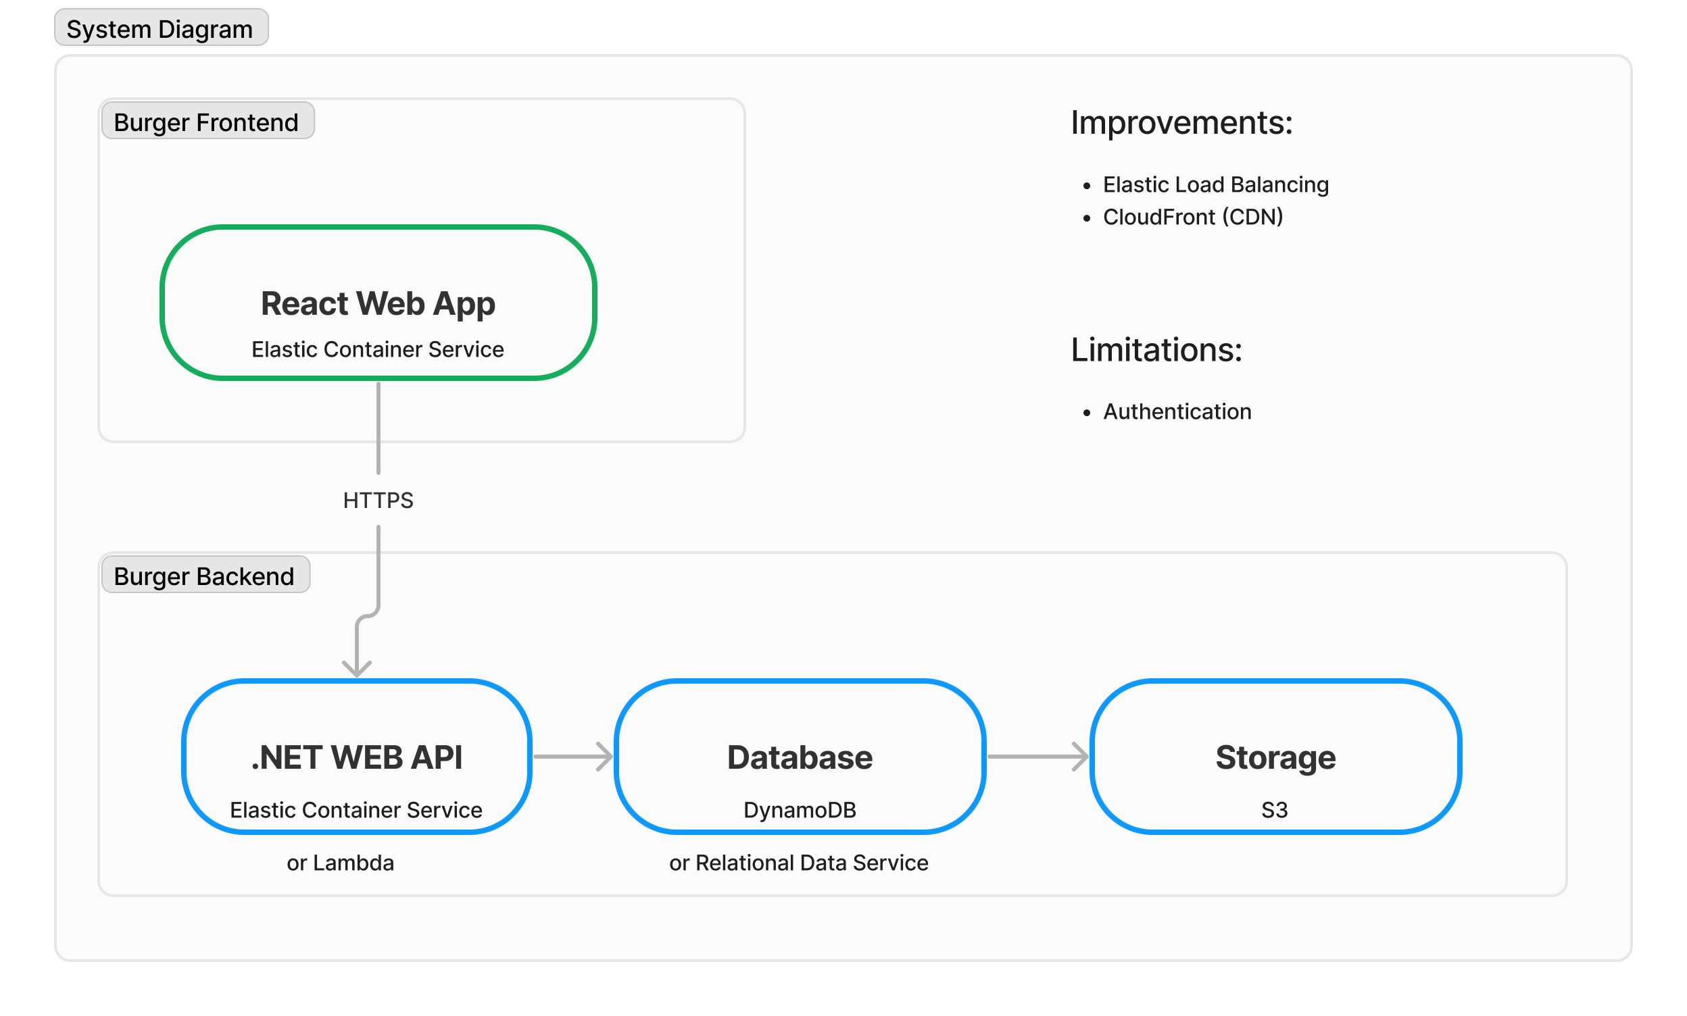
Images, Read-heavy vs Write-heavy

Slide 9
Technology Choice
React with TypeScript
Next.js
Project (SEO, data fetching)
Position
Personal
Cypress.io

Slide 10
Components

Slide 11
Components
(reusability, children components, flexibility

Slide 12
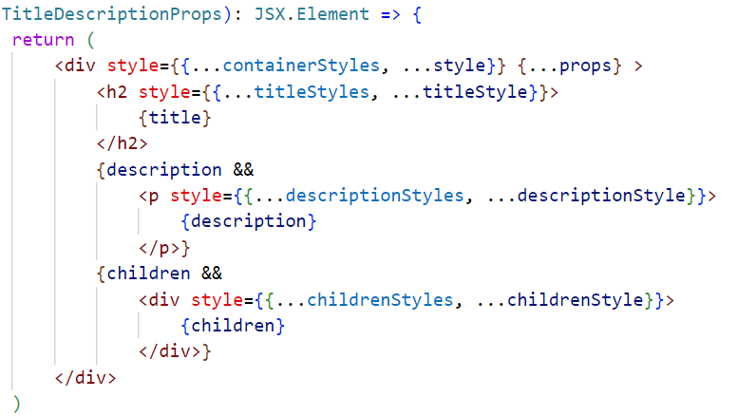
Components

Slide 13
Components
(Naming, reusability vs separation of concerns, globally available components)

Slide 14
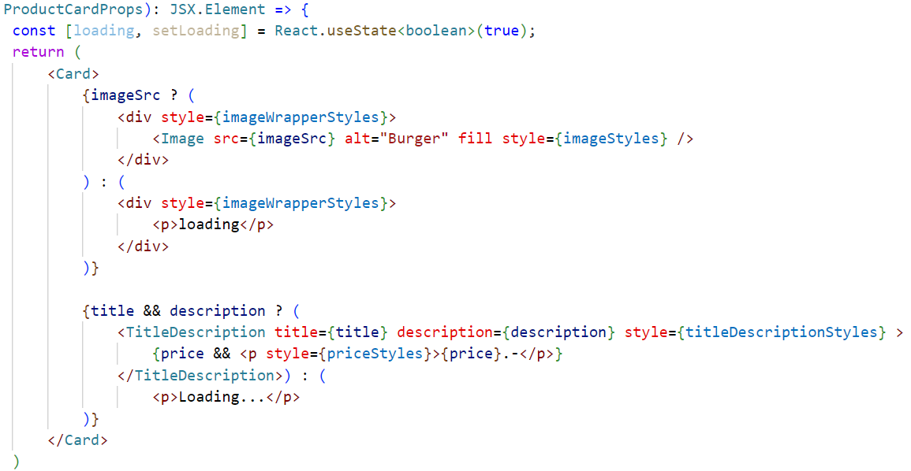
Components
Improvement: Export inner part as a Layout component

Slide 16
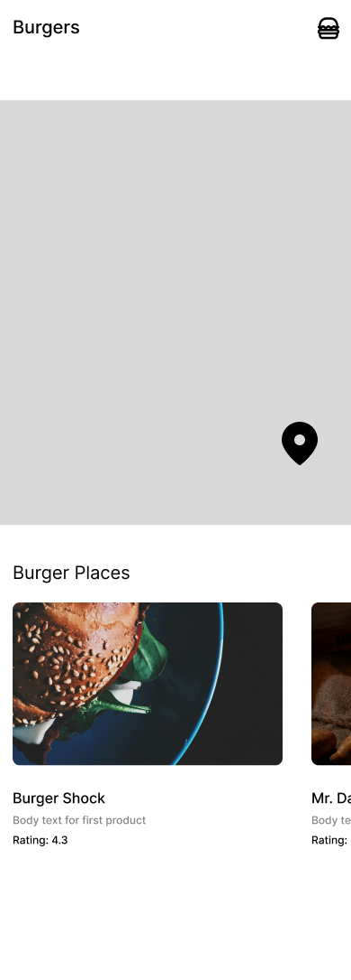
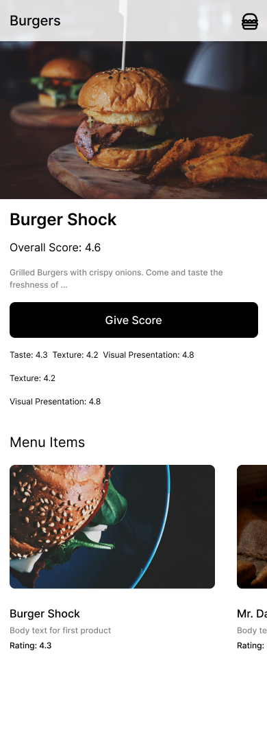
Responsiveness
Mobile First Design
Next Image Component
Loading skeletons
Layout responsiveness, Dynamic image resolution

Slide 17
Project Structure
Folder structure
Component file structure
Providers

Slide 18
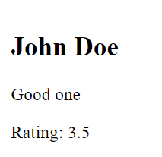
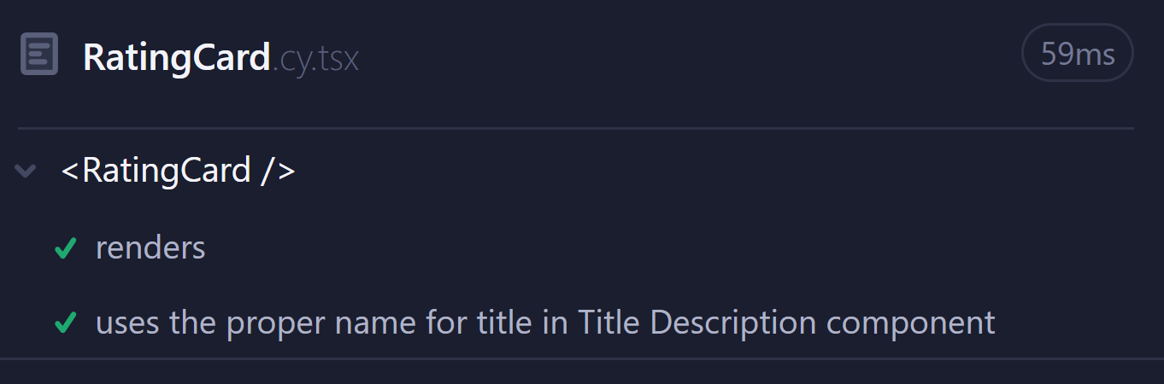
Component Tests
Nested Components
TDD, Black Box vs White Box Tests, Unit vs Integration Tests

Slide 19
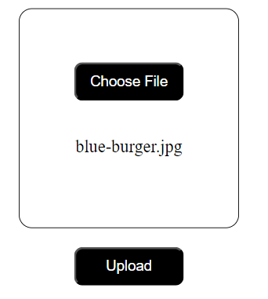
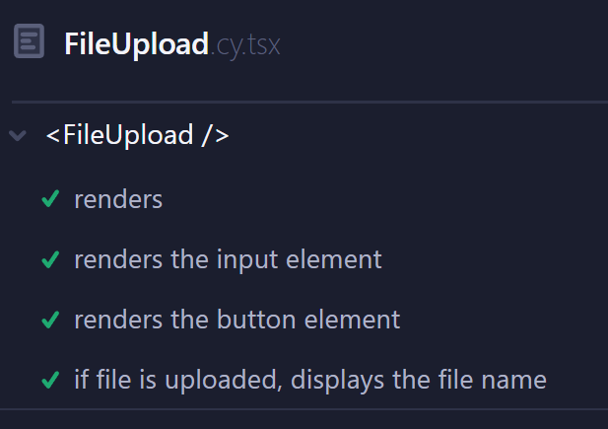
Component Tests
Async tests
Future tests, challenges of testing (conditional tests)

Slide 20
Improvements & Project Future
User authentication
Security concerns
Data fetching optimalization
Implementation of Cloud and CI/CD
Finalize the UI design and stick with it
More testing

Slide 21
Discussion
Questions
Potential topics:
Security
Version Control
CI / CD
TypeScript
Microservice Architecture
Animations

