Slide 1
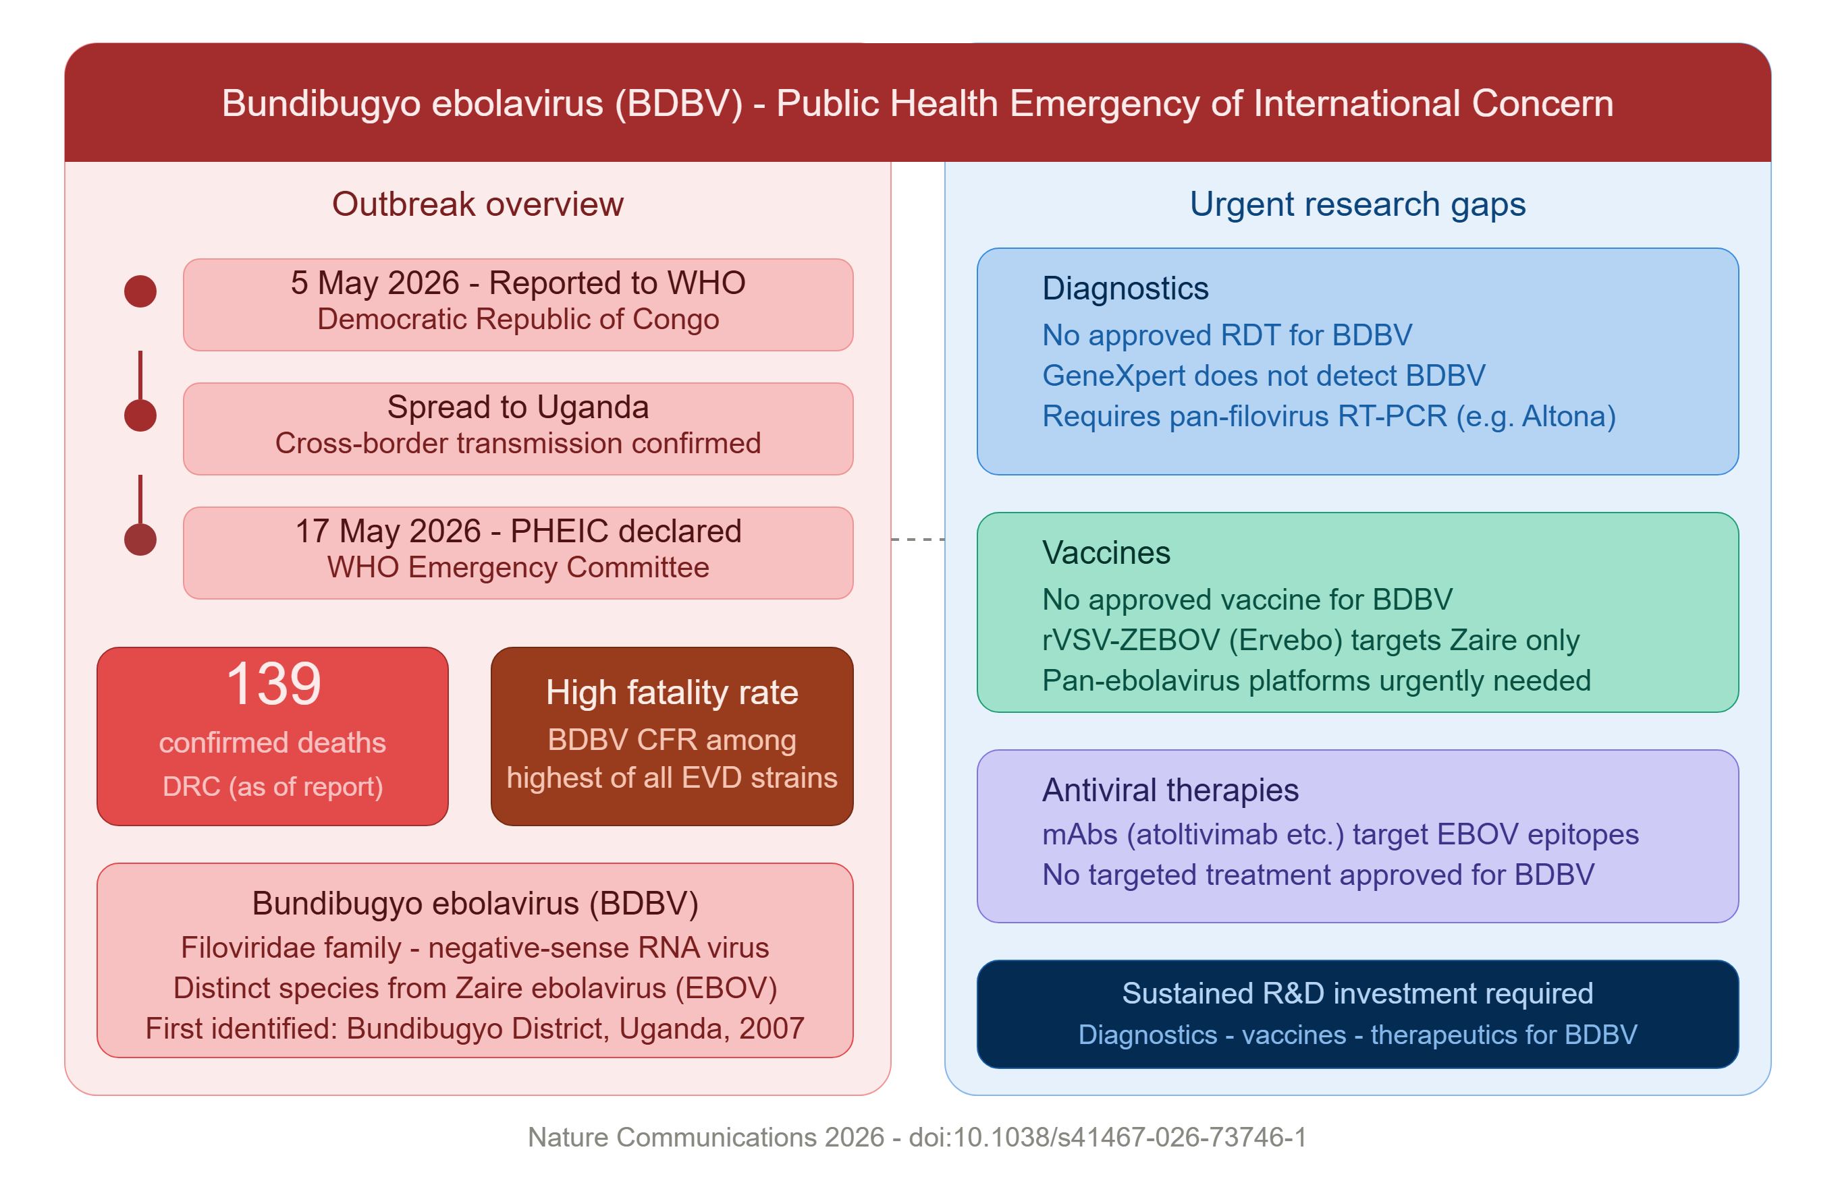
PNG version of original

Slide 2
Bundibugyo ebolavirus (BDBV) - Public Health Emergency of International Concern (PHEIC)
Outbreak overview
Urgent research gaps
5 May 2026 - Reported to WHO
Diagnostics
Edited version of ungrouped SVG
Democratic Republic of Congo
No approved RDT for BDBV
GeneXpert does not detect BDBV
Spread to Uganda
Requires pan-filovirus RT-PCR (e.g. Altona)
Cross-border transmission confirmed
17 May 2026 - PHEIC declared
Vaccines
WHO Emergency Committee
No approved vaccine for BDBV
rVSV-ZEBOV (Ervebo) targets Zaire only
139
High fatality rate
Pan-ebolavirus platforms urgently needed
confirmed deaths
BDBV CFR among
DRC (as of report)
highest of all EVD strains
Antiviral therapies
mAbs (atoltivimab etc.) target EBOV epitopes
No targeted treatment approved for BDBV
Bundibugyo ebolavirus (BDBV)
Filoviridae family - negative-sense RNA virus
Distinct species from Zaire ebolavirus (EBOV)
Sustained R&D investment required
First identified: Bundibugyo District, Uganda, 2007
Diagnostics - vaccines - therapeutics for BDBV
Nature Communications 2026 - doi:10.1038/s41467-026-73746-1

