Slide 1









Catalog
Browser
Message Broker
Inventory
host.docker.internal:5008
Frontend
Identity
Trading

Slide 2
Catalog
Browser
Inventory
host.docker.internal:5008
Frontend
Identity
Trading
Monolith

Slide 3




@Icons.Material.Filled.Inventory
@Icons.Material.Filled.Person
@Icons.Material.Filled.MenuBook
@Icons.Material.Filled.AddBusiness
Catalog
Trading
Inventory
Identity

Slide 4
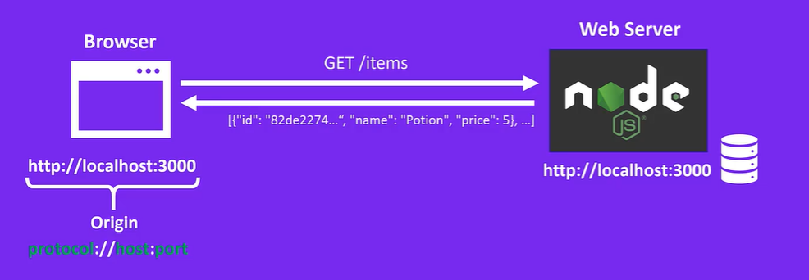

http://localhost:5008
http://localhost:5008

Slide 5


off
PressSwitch()
PressSwitch()
PressSwitch()
on
GotError()
error

Slide 6
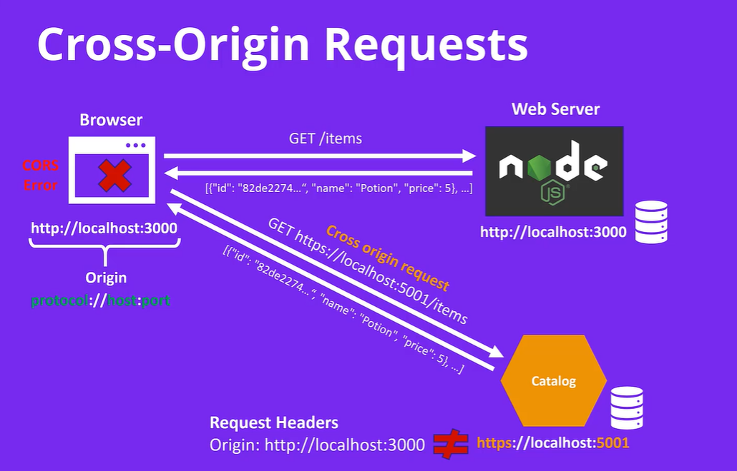
http://localhost:5008
http://localhost:5008
http://localhost:5008

Slide 7
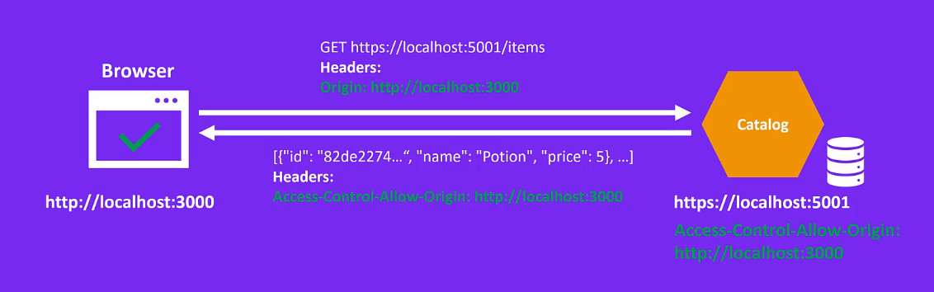
Origin: http://localhost:5008
http://localhost:5008
Access-Control-Allow-Origin: http://localhost:5008
http://localhost:5001
Access-Control-Allow-Origin:
http://localhost:5008

Slide 8
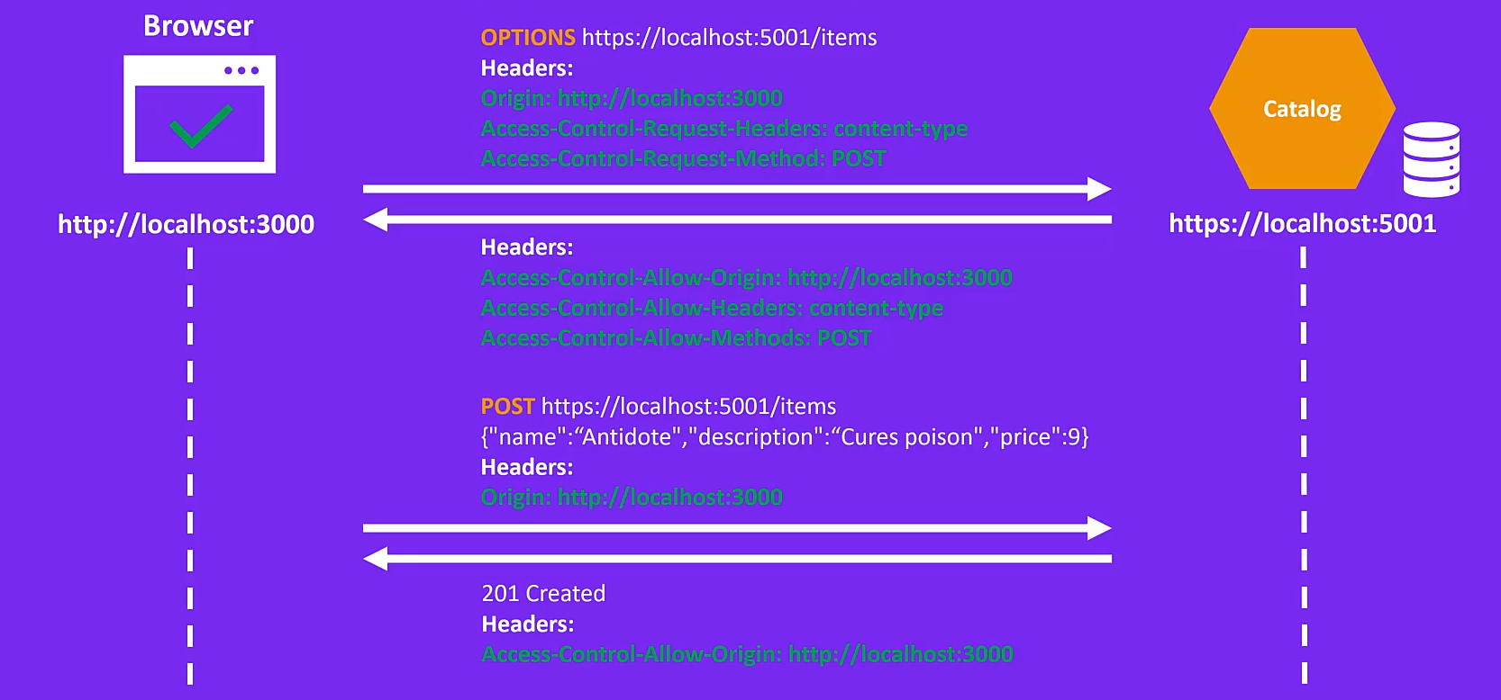
Origin: http://localhost:5008
Access-Control-Request-Headers: content-type
Access-Control-Request-Method: POST
http://localhost:5008
Access-Control-Allow-Origin: http://localhost:5008
Access-Control-Allow-Headers: content-type
Access-Control-Allow-Methods: POST
Origin: http://localhost:5008
Access-Control-Allow-Origin: http://localhost:5008

Slide 9
