Slide 1
Customer Profiling in Banking Data
Salma Moustafa
Sarmad Shaikh
Tameem Alshomari

Slide 2
Intro
The objective of our project was to implement a baseline and/or novel algorithm for customer profiling(i.e. Clustering) based on customer behavior in financial systems.
Customers are small and medium enterprises with behavior descriptors (i.e. logins in certain banking systems, transfers to partners, invoices issued).

Slide 3
Data
Invoice_history.csv | Transfer_history.csv | Customer_login_history.csv | Static_data.csv
PARTY-ID INVOICE-ID TAXINCLUSIVEAMOUNT CURRENCY TAXEXCLUSIVEAMOUNT PAYABLEAMOUNT ISSUEDATE TAXPOINTDATE DUEDATE | PARTY_ID TRANSFER-ID AMOUNT CURRENCY VALUE-DATE | LAST_LOGIN | PARTY-ID CREATED-ON LAST-LOGIN LOB-CODE SIZE PACKAGE REGION COUNTY

Slide 4
Pyspark
Create a separate data transformation pipeline for every dataset.
Aggregated features from original tables are created to describe customer behavior in each dataset.
The new aggregated tables are used for training the clustering model (K-Means) in the upcoming steps.

Slide 5
Transformed Data
Invoices | Transfers | Customer_Login | Static_Data
PARTY-ID min(INV-PERIOD) max(INV-PERIOD) avg(INV-PERIOD) sum(TAXINCLUSIVEAMOUNT) max(TAXINCLUSIVEAMOUNT) min(TAXINCLUSIVEAMOUNT) avg(TAXINCLUSIVEAMOUNT) sum(TAXEXCLUSIVEAMOUNT) max(TAXEXCLUSIVEAMOUNT) min(TAXEXCLUSIVEAMOUNT) avg(TAXEXCLUSIVEAMOUNT) invoice-count currency-vector | PARTY-ID unique-transfers-count transfers-count currency-vector sum(AMOUNT) max(AMOUNT) min(AMOUNT) avg(AMOUNT) | • PARTY-ID • LAST-LOGIN | • PARTY-ID • CREATED-ON • LAST-LOGIN • LOB-CODE • SIZE • PACKAGE • REGION • COUNTY

Slide 6
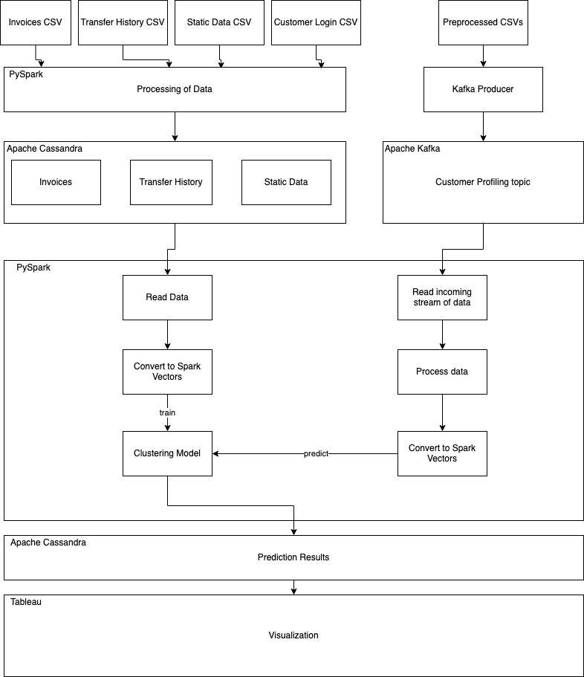
System architecture

Slide 7
Apache Cassandra
The storage solution used for this project is Apache Cassandra as it is a popular choice with Spark and because of its scalability on distributed systems
We store data after they are processed into the Cassandra tables
It’s then read by the pipeline that is used for training the model
The output of that pipeline, which are the predictions of the clustering, is also stored in Cassandra
We connect these tables to Tableau for visualization

Slide 8
Apache Kafka
Kafka is our event streaming system that streams the customer data for prediction
It can be seen as a source of our test data
Using this, we can try to simulate a real-time analysis of customer profiling

Slide 9
Cassandra
We use Cassandra in this project to store the processed data from their respective PySpark processing pipelines. From Cassandra, we ingest them into our model training pipeline, combine all the datasets into a single dataset, convert it into features and feed it into our model for training. We also store the output predictions from the model into our database. These tables are used for visualization purpose later.

Slide 10
Tableau
connect Cassandra to Tableau
Connect to Cassandra as an ODBC Data Source

Slide 11
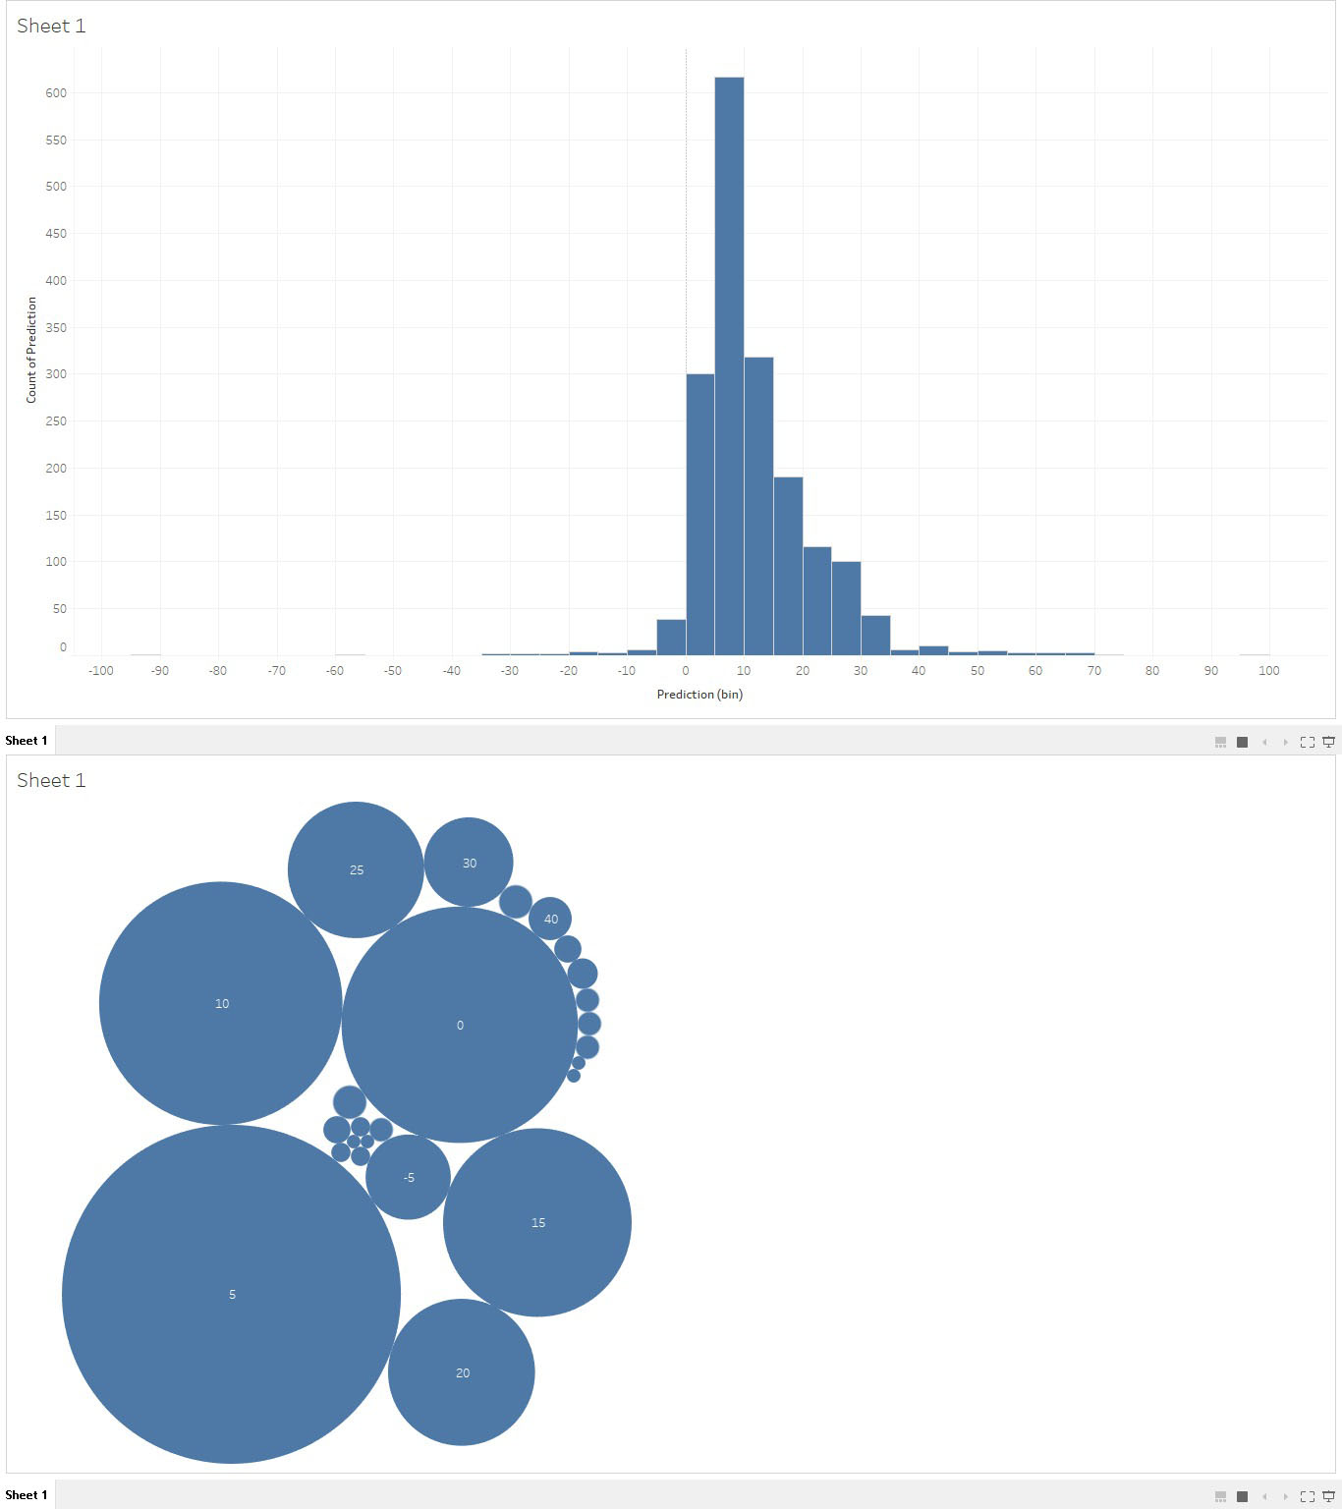
Tableau Visualization

Slide 12
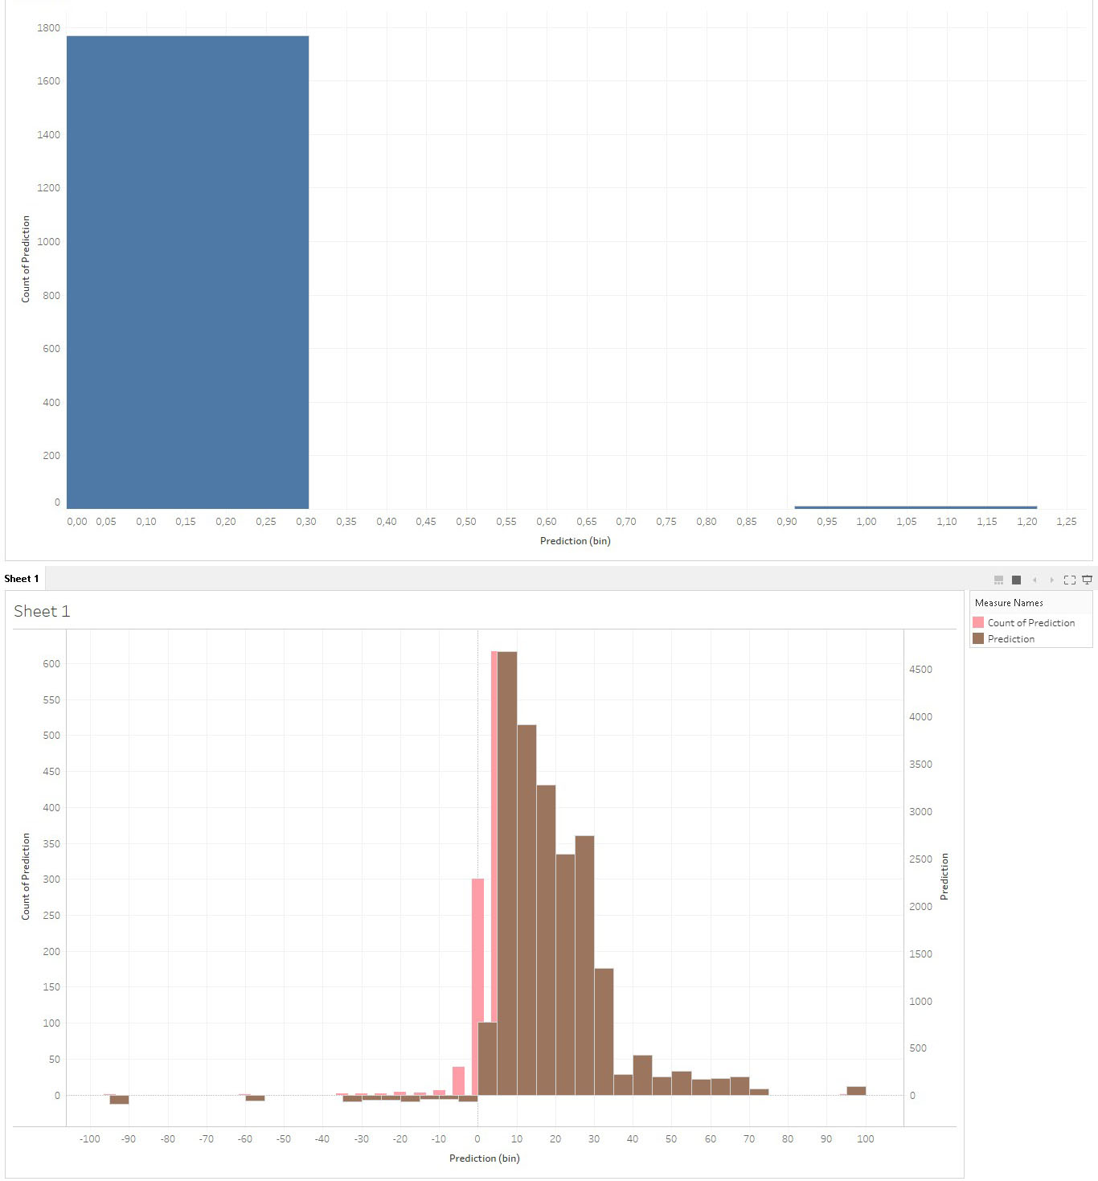
Tableau Visualization

Slide 13
Contributions
Sarmad Shaikh: - I1I8G4
Contributed to the design of the architecture of the system
Contributed to the streaming pipeline and the model training pipeline of the project
Contributed to the Kafka producer and the consumer part in the streaming part
Connected PySpark pipelines to Cassandra tables for storage
Generated CQL script for replication of Cassandra database
Contribution to the setup of Tableau with Cassandra
Contribution to creation of the report and presentation with the other members of the team.
Participated in all team meetings

Slide 14
Contributions
Salma Moustafa - G09BEI
Contributed to setting up Apache Kafka and working on Kafka producer.
Setting up Pyspark on Docker.
Worked on invoices and transfers in Pyspark pipeline for preprocessing and training.
Contributed to designing System Architecture.
Worked on setting up Cassandra and connecting Cassandra to Pyspark as part of the pipeline.
Contribution to conguration and setting up Tableau.
Collaborated on writing report and making presentation with the rest of the team members.
Participated in all team meetings.

Slide 15
Contributions
Tameem Alshomari – H9WHAV
Data preprocessing on Jupyter Notebook: For static data and customer login history
Setting up Pyspark on Docker.
Worked on Static Data and customer login history in Pyspark pipeline for preprocessing and training.
Contributed to designing System Architecture.
Contributed to setting up Apache Kafka and Contributed to the Kafka producer and the consumer part in the streaming part
Worked on setting up Cassandra and connecting Cassandra to Pyspark as part of the pipeline.
Contribution to conguration and setting up Tableau.
Contribution to the visulization part on Tableau for the visualizing of tables data and model results
Collaborated on writing report and making presentation with the rest of the team members.
Participated in all team meetings.
Code repository management on Github: creating repository, reviewing pull requests and access management And Participated in preparing presentation material

Slide 16
Github Repository
https://github.com/TameemElshoumari/explainable-customer-profiling-in-financial-systems

Slide 17
Thank you

