Slide 1

OptiVision: Advanced Screening for Early Detection of Vision Impairments
By the students:
Tameer Amer 322836388.
Redan Ganim 209003474.
By the mentor:
Dr.Natali Levi.

Slide 2
Introduction
OptiVision is a desktop application designed for early detection of vision impairments.
Millions of people worldwide suffer from undiagnosed vision problems.
The project provides an easy-to-use solution for home-based vision screening.
OptiVision includes multiple vision tests that can help users detect vision issues early, before they worsen.

Slide 3
Problem Statement
Vision impairments often go undiagnosed until they reach severe levels.
Lack of accessible tools for people to detect potential vision issues from home.
Delayed diagnosis can lead to more serious health consequences, impacting quality of life.
OptiVision aims to solve this problem by offering a home-based screening tool.

Slide 4
Existing Solutions & Limitations
Comprehensive Eye Examination:
-Conducted by optometrists or ophthalmologists.
-Involves a series of tests to assess visual acuity, detect refractive errors, and evaluate overall eye health.
Limitations: Requires in-person visits, time-consuming, and costly.
School-Based Vision Screenings:
-Basic tests by teachers or school nurses.
-Basic eye tests to identify students who may have vision problems.
Limitations: Limited tests, not comprehensive.
Digital Tools and Apps:
-Preliminary at-home vision screening tools.
Limitations: Limited accuracy, lack of professional calibration, and reliable data storage.

Slide 5
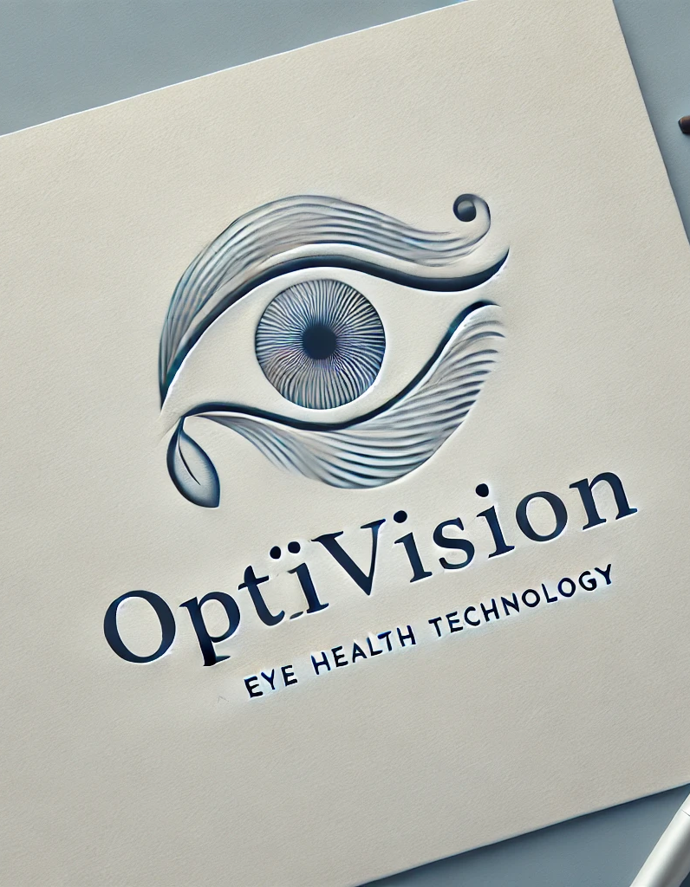
Why OptiVision is Better?
Comprehensive Testing: Multiple validated tests for accurate and complete vision screening.
Accessibility: Users can perform tests anytime at home.
Cost-Effective: Reduces the need for frequent clinical visits.
Data Storage & Tracking: Secure storage and tracking of results over time, providing actionable insights for users.

Slide 6
Project Objectives
Accessibility: Provide easy access to vision impairment detection tools.
Scientific Validity: Offer scientifically validated vision tests.
Early Detection: Encourage early intervention to prevent further vision deterioration.
Data Tracking: Store user results and allow users to track their vision health over time.

Slide 7
Solution Overview
OptiVision offers a range of vision tests:
Visual Acuity
Color Vision
Contrast Sensitivity
Blur Detection
Field of Vision
The application helps users perform these tests at home.
Test results are securely stored for future tracking, and the system provides recommendations based on the user’s results.
The goal is to detect potential vision impairments early and guide users toward seeking professional care if needed.

Slide 8
Vision Tests
Visual Acuity Test: Measures sharpness of vision by determining the smallest letters a user can see at a specific distance.
Color Vision Test: Identifies color blindness by testing the user's ability to distinguish between different colors.
Contrast Sensitivity Test: Measures the ability to differentiate between varying levels of contrast, critical for night vision or low-light conditions.
Blur Detection Test: Detects problems with visual clarity and sharpness, potentially identifying refractive errors like myopia.
Field of Vision Test: Assesses the user's peripheral vision to detect conditions like glaucoma.

Slide 9
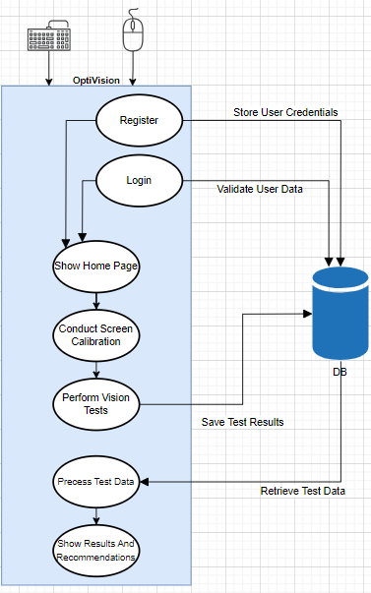
System Architecture

Slide 10
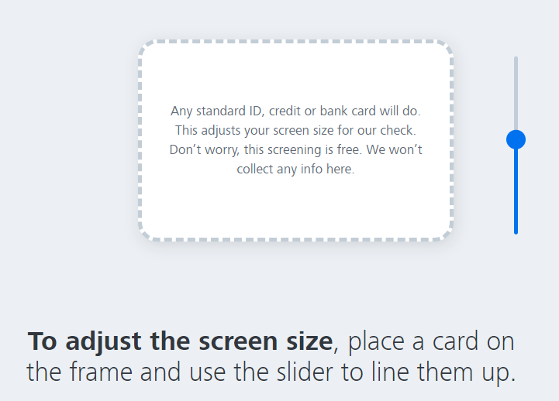
Screen Calibration
Why Calibration Matters: Ensures that all tests are scaled correctly for the user's specific monitor size.
Users calibrate their screen using a real-world object (e.g., credit card or ID) to adjust screen dimensions.
Calibration ensures accurate results across different monitors and screen settings.

Slide 11
Functional Flow
User Login/Registration: User signs in or creates an account to access the app.
Screen Calibration: User performs initial screen calibration for accurate test measurements.
Perform Vision Tests: User selects and completes a vision test.
Process Results: System analyzes the test data.
Results Display: User views the test results and system recommendations.
Save Results: Test results are stored in the database for future reference.
Review Past Results: Users can access their test history to track their vision health over time.

Slide 12



Technology Stack
Programming Language:
Desktop App:
Database:

Slide 13
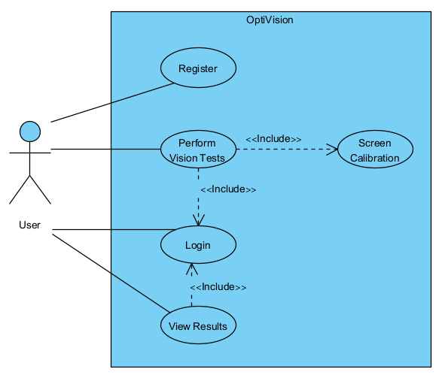
Use Case Diagram

Slide 14
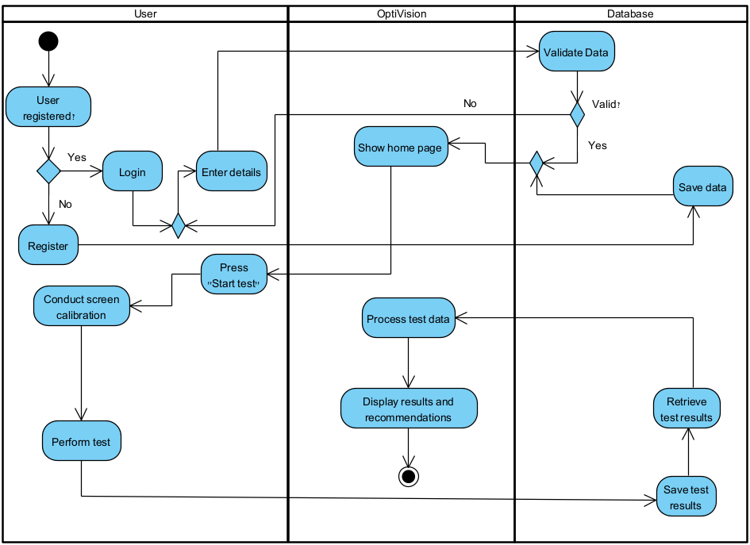
Activity Diagram

Slide 15
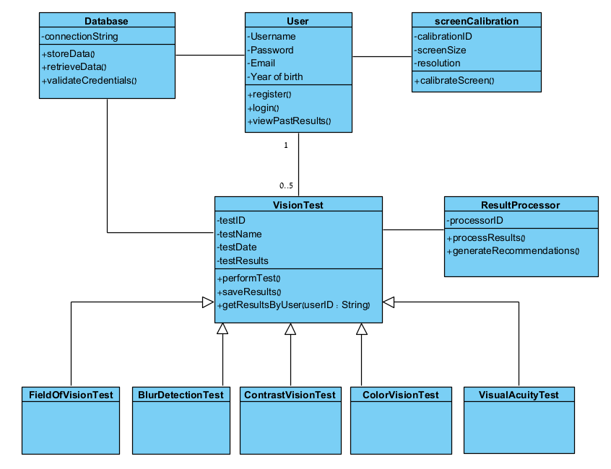
Class Diagram

Slide 16
Testing Plan
Input Hardware: Test that the app accesses monitor, keyboard, and mouse correctly.
Desktop App: Ensure all features work, including login, screen calibration, test execution, and result display.
Database Interaction: Test data storage, retrieval, and validation for user accounts and test results.
Vision Test Accuracy: Validate that all tests (visual acuity, color vision, etc.) are accurate when compared to industry benchmarks.
Notes:
Input Hardware: We ensure the app functions correctly across various devices by testing compatibility with different monitors, keyboards, and mice.
Desktop App: We will make sure that all app features work, from login to result display, for seamless operation.
Database Interaction: Our tests confirm that data storage, retrieval, and validation are secure and efficient.
Vision Test Accuracy: We validate the accuracy of our vision tests against clinical standards to ensure reliable health insights.

Slide 17
Evaluation
System Functionality:
Tested for login, calibration, vision tests, and result storage.
Ensured results are saved and retrievable.
User Experience:
Tested for easy navigation and test flow.
Users can follow instructions and perform tests smoothly.
Accuracy:
Verified test results using benchmark data from optometry practices.
Accurate detection of vision issues like color blindness and myopia.
Notes:
System Functionality: We've thoroughly tested crucial features including login, calibration, and vision tests, ensuring all results are stored accurately and retrievable.
User Experience: Our evaluation focused on the ease of navigation and smooth test flow, allowing users to complete tests effortlessly.
Accuracy: We've verified the precision of our tests against industry benchmarks to ensure reliable detection of conditions like color blindness and myopia.

Slide 18
Challenges
Screen Calibration: Ensuring accurate calibration across various monitor sizes.
Test Accuracy: Developing tests that consistently produce valid results comparable to clinical tests.
Secure Data Storage: Implementing secure methods for storing and protecting sensitive user data.
Input Handling: Ensuring compatibility with different hardware inputs (monitors, keyboards, etc.).
Notes:
Screen Calibration:
"We ensure that our tests are accurate on any device by carefully calibrating the screen across different monitor sizes."
Test Accuracy:
"Our tests are developed to consistently match clinical standards, ensuring reliable and valid results."
Secure Data Storage:
"We prioritize user privacy by implementing robust security measures to protect sensitive data."
Input Handling:
"Our software is designed to be fully compatible with various hardware inputs like monitors and keyboards, ensuring a smooth user experience."

Slide 19
Conclusion
OptiVision provides a comprehensive tool for early detection of vision impairments.
The system makes vision health more accessible, allowing users to track their vision over time.
Early detection can help prevent severe vision problems, improving quality of life.
OptiVision offers a practical, home-based solution for regular vision screening.

Slide 20
Questions
Thanks for your attention.
Questions?

