Slide 1
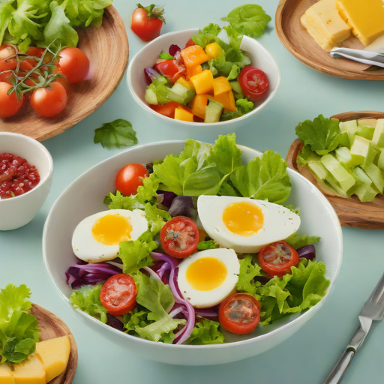
Recipe Site Traffic
Tamer Ahmed
Data Scientist Professional Practical Exam

Slide 2
1. Project Overview
Background:
The project is for Tasty Bytes, a company providing meal plans and recipe discovery services. The product manager wants to improve the selection of recipes displayed on the homepage, as selecting a popular recipe can increase traffic to the website by up to 40%, boosting subscriptions.
Goal:
To clean and validate data, perform exploratory analysis, develop predictive models, and evaluate their performance while ensuring alignment with business metrics.

Slide 3
2. Methodology - Data Collection
Source of the dataset:
Relevant and well-curated.
Key features:
- Recipe
- Calories
- Carbohydrate
- Sugar
- Protein
- Category
- Servings

Slide 4
2. Methodology - Data Cleaning and Validation
Handling Missing Values:
- Replaced missing values with mean values.
Reformatting:
- Ensured features aligned with the data dictionary.
Transformations:
- Renamed and remapped fields for consistency.

Slide 5
2. Methodology - Exploratory Analysis and Model Development
Exploratory Analysis:
Single-variable and multi-variable analysis conducted.
Model Development:
- Logistic Regression as the primary model.
- Performance metrics: F1 Score and Accuracy.

Slide 6
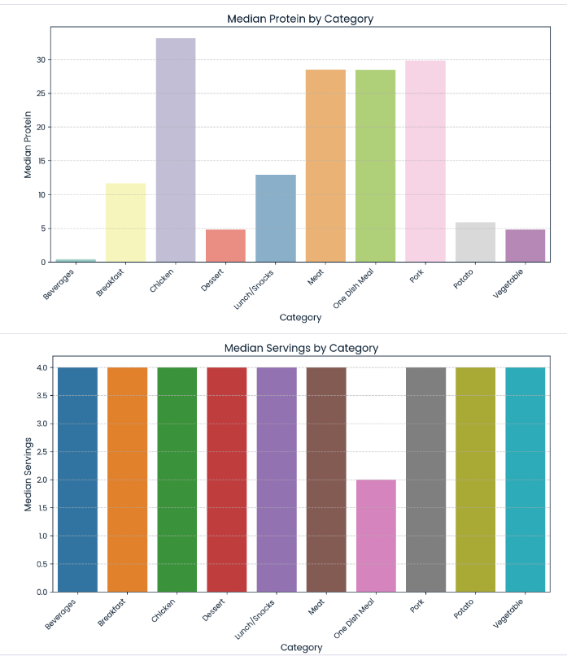
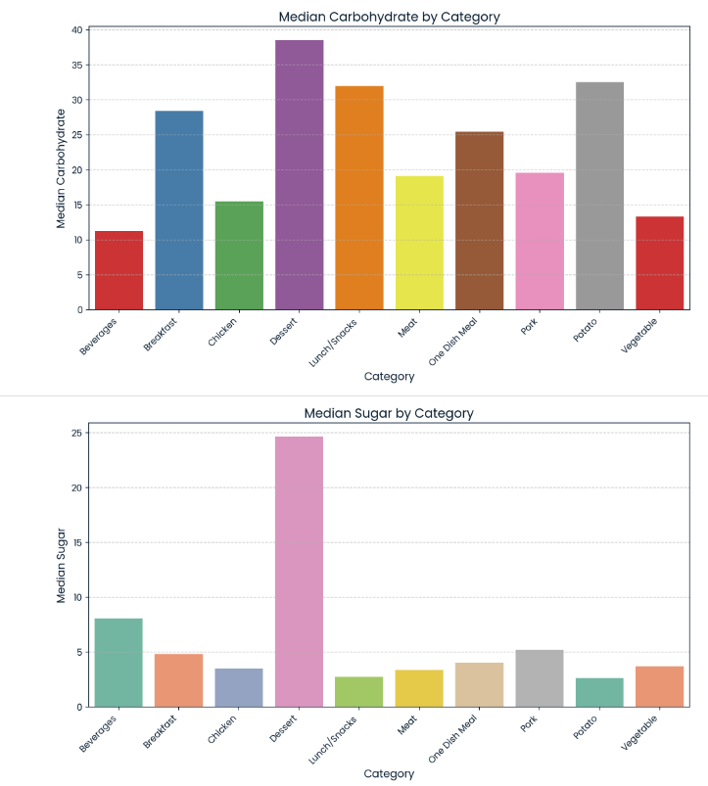

Slide 7
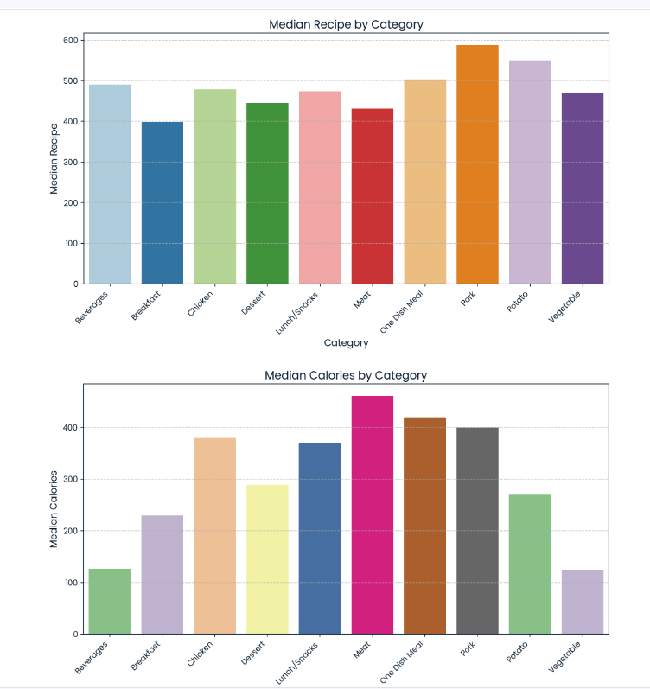
The bar charts reveal distinct variations in median nutritional content (calories, carbohydrates, sugar, and protein) across recipe categories. "One Dish Meal," "Meat," and "Pork" exhibit higher median calories and protein.
"Breakfast" and "Lunch/Snacks" show higher median carbohydrates. As expected, "Dessert" has the highest median sugar. Conversely, "Beverages" and "Vegetable" categories generally have lower medians for most nutrients.

Slide 8
These findings are relevant for dietary planning (e.g., choosing lower-calorie recipes from "Vegetable" or higher-protein from "Meat"), recipe development (e.g., creating high-protein breakfasts or low-sugar desserts), and health research (investigating nutritional impacts of dietary patterns).

Slide 9
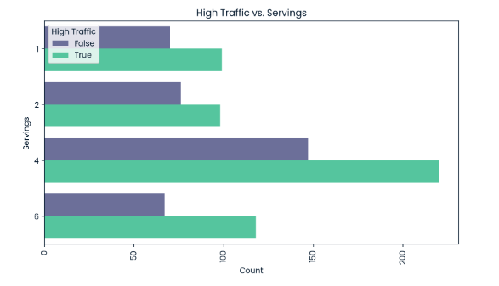
This count plot explores the relationship between the number of servings in a recipe and whether it receives high traffic. By analyzing the bars, we can see:
Distribution of Servings: The overall distribution of servings can be observed, with some serving sizes appearing more frequently than others.
High-Traffic Recipes: The coloring by "high_traffic" indicates whether high-traffic recipes tend to have a specific serving size range. Are there more or fewer high-traffic recipes in certain serving size categories?

Slide 10
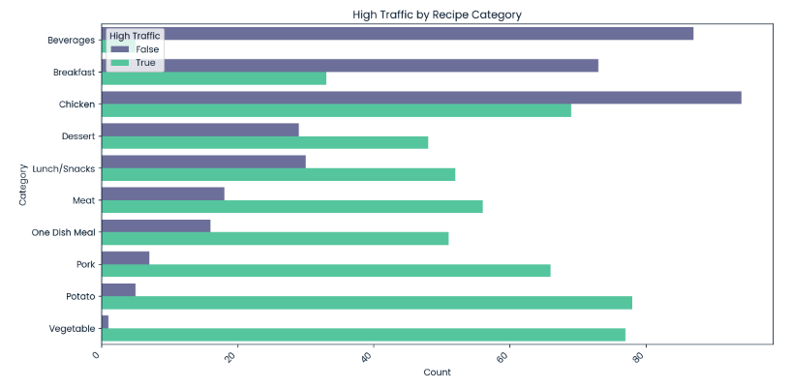
This count plot explores how the distribution of high-traffic recipes varies across different recipe categories. By analyzing the bars, we can understand:
Popular Categories: Which recipe categories have the highest number of high-traffic recipes? Are there any categories with surprisingly low or high traffic?
Traffic Distribution: Does high traffic seem evenly distributed across all categories, or are there some categories attracting more high-traffic recipes?

Slide 11
Step 4: Model Evaluation& Comparison
Logistic Regression: Shows consistent performance between training and test sets (accuracy around 75-76%, F1-score around 80%). This indicates good generalization and no significant overfitting.
Decision Tree: Exhibits severe overfitting (100% accuracy on training, ~64% on test). This means the model has memorized the training data and performs poorly on unseen data.
Random Forest: Also shows overfitting, though slightly less severe than the Decision Tree (100% training accuracy, ~73% test accuracy).
SVM: The SVM model consistently predicts all instances as the positive class (all True for high traffic). This results in perfect recall (1.0) but low precision and moderate F1-score. This behavior suggests a potential issue with the model's configuration or the data not being suitable for a linear SVM.

Slide 12
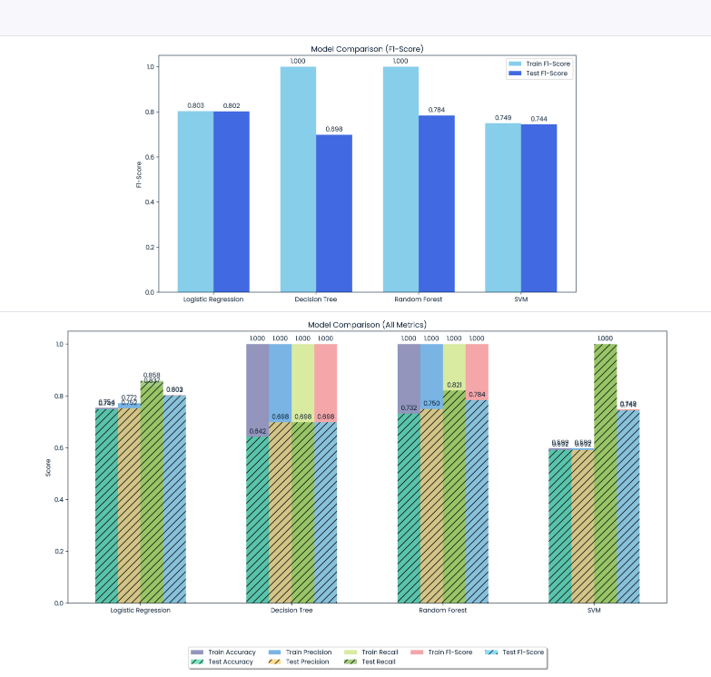

Slide 13
3. Key Findings
Traffic linked to specific food categories and higher calorie content.
Logistic Regression outperformed other models.
Subscribers favored recipes balancing nutritional value and calorie content.

Slide 14
4. Recommendations
Highlight recipes with higher carbohydrate and protein content.
Display cost per serving for user guidance.
Collect additional features (e.g., preparation time, cost per serving).
Continuously refine models with updated data.

Slide 15
5. Conclusion
This project successfully:
- Demonstrated effective data cleaning and validation.
- Provided insights into factors driving website traffic.
- Deployed a robust predictive model with actionable findings.
Thank you!

