Slide 1


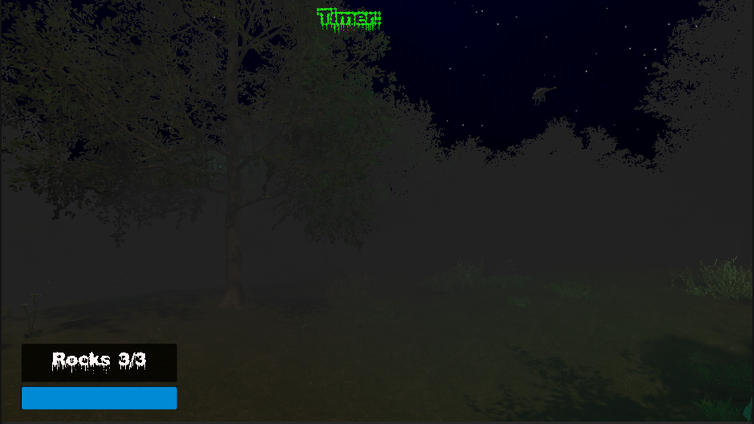
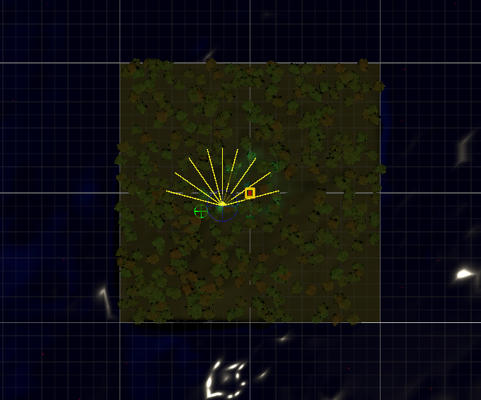

REINFORCEMENT LEARNING TO IMPROVE AI BEHAVIOUR AND ADAPTABILITY IN A GAME ENVIRONMENT
Tamer Hussen | S23130437 | Supervisor: Jan Krasniewicz | Computer Games Technology
Introduction & Background
Traditional NPCs rely on static scripts (FSM, Behaviour Trees).
Scripted AI struggles to adapt to unpredictable player strategies.
This project explores Reinforcement Learning (RL) via Unity ML-Agents to create dynamic, believable, and adaptable AI.
Discussion
Early RL training produced coherent tracking, but extended training caused instability (reward plateaus).
The RL scent trail succeeded out-of-sight, but the NavMesh baseline (Enemy B) remained more robust overall.
Key Takeaway: RL offers dynamic emergence but currently requires vastly more iteration than traditional scripting to achieve reliable baseline difficulty.
Problem Statement
Scripting multi-sensory AI (vision, sound, scent) causes massive developer overhead.
Scripted agents cannot dynamically adjust their tactics when players break line-of-sight or use unconventional evasion methods.
Methods & Implementation
Environment: 3D Forest Arena (Unity).
Sensory Inputs: Raycast vision, auditory triggers, multipoint scent trail.
Training: PPO (up to 20 million steps).
Reward Strategy: Rewarded for capture; penalized for losing target.
References
Datatonic, T., 2022. Reinforcement Learning: How to Train an RL Agent from Scratch.
Juliani, A., Berges, V., Vckay, E. & al., e., 2018. Unity ML-Agents: A toolkit for reinforcement learning and imitation learning in games.
First-person View
Aims & Objectives
Implement an RL agent using Proximal Policy Optimization (PPO).
Develop a multi-sensory observation system (vision cone, audio, multipoint scent trail).
Compare the RL agent's adaptability and believability against a custom C# Behaviour Tree baseline using A* NavMesh pathfinding.
Top-Down View
Results & Evaluation
10 participants tested Enemy A (RL) vs Enemy B (Baseline).
Enemy B was significantly more effective at out-of-sight tracking.
Players rated Enemy B as more "dynamic" and less mechanical.
Conclusion & Future Work
Reinforcement Learning provides a highly dynamic, adaptable alternative to scripted game AI.
While setup and training require significant iteration, the resulting emergent behaviour feels more human-like to players.
Future Work: Expanding the sensory array to include environmental interactions (e.g., disturbing foliage) and porting the model to more complex, multi-level map topologies.
I am grateful to Allah and my family for their support, and to my supervisor, Jan Krasniewicz, for his invaluable guidance throughout this project.| https://github.com/TamerHussen/Final-Year-Project

