Slide 1

Pet Shelter Lebanon

Slide 2

Motivation:
As an owner of 4 different pets since childhood, and as someone raised by parents who love animals, I couldn’t help but create a website to contribute to saving lives of other pets.

Slide 3
Objective:
My main goal is to help save the lives of unsheltered, ill, vulnerable pets around Lebanon. As well as raising awareness towards adopting pets instead of purchasing them as they are neither disposable merchandise nor sources of profit. Moreover, this shelter allows people to donate in order to contribute towards saving these precious souls.

Slide 4
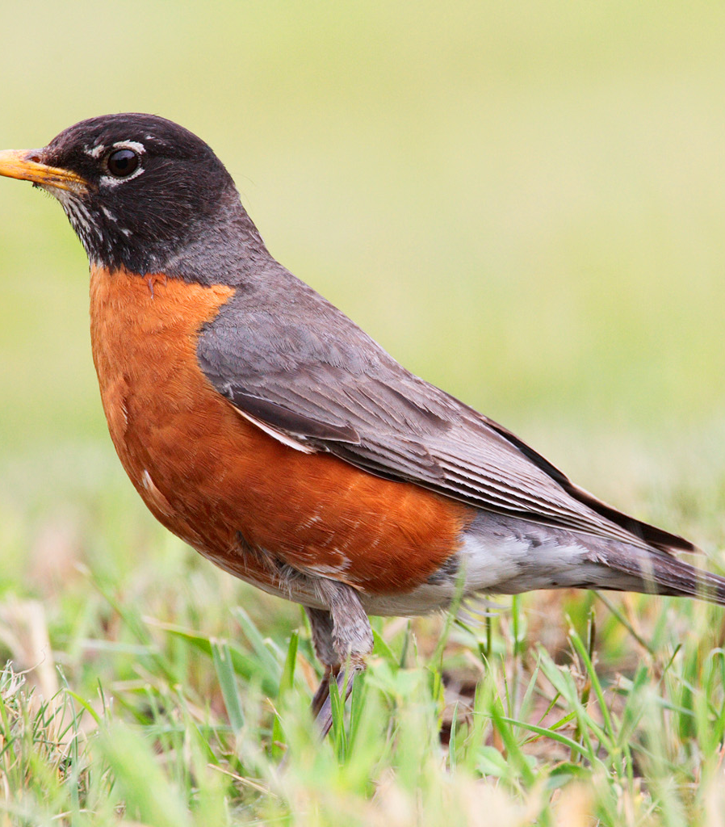
Bird.
This Photo by Unknown Author is licensed under CC BY-SA

Slide 5

Money
$$$$$$$$$$ (cash)(M0NEY)

Slide 6

This Photo by Unknown Author is licensed under CC BY

