Slide 1

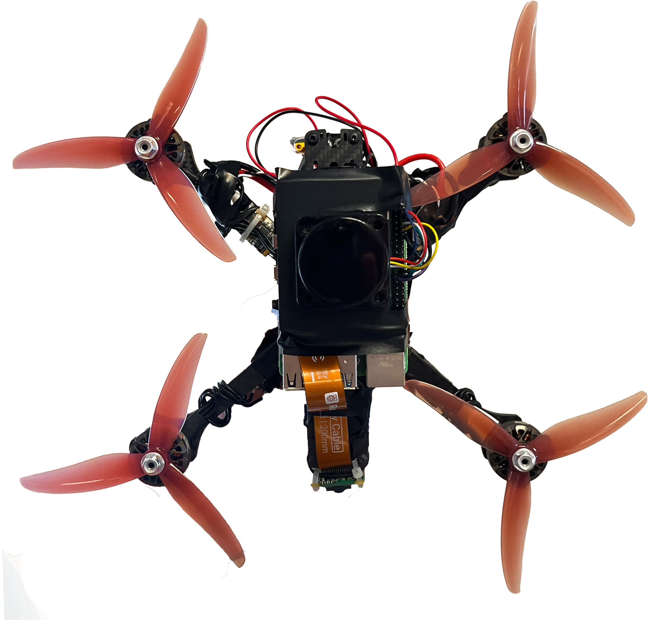
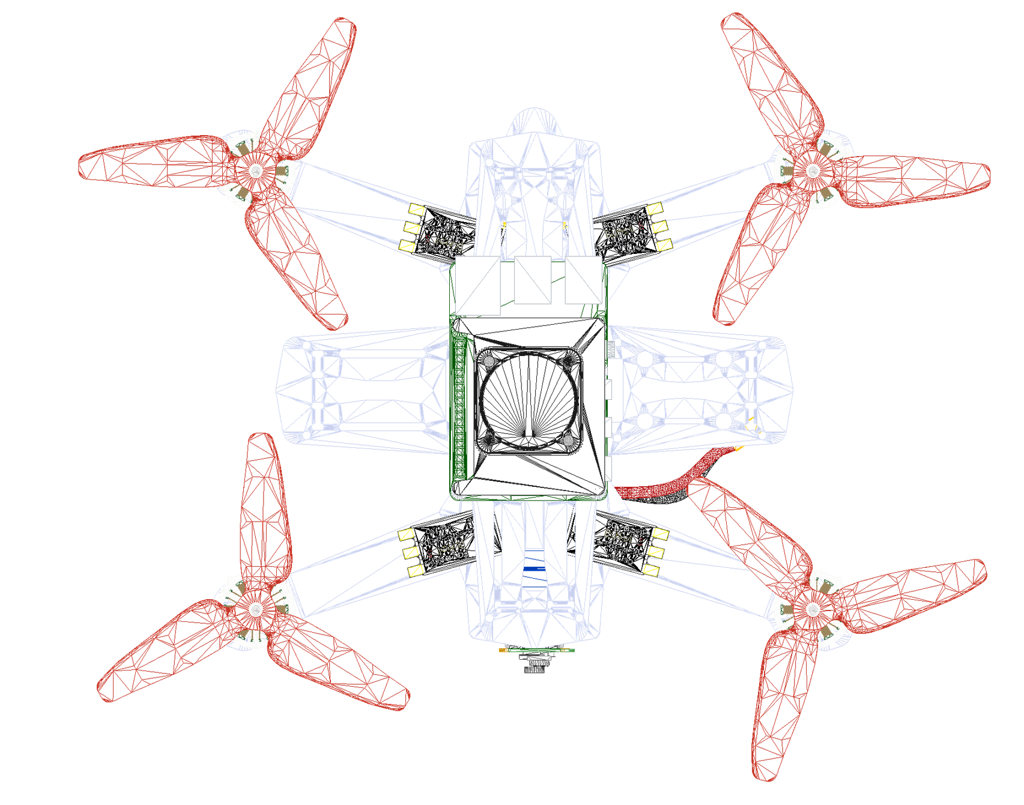
FOURTH YEAR PROJECT
29/04/2026
AERODROP
Tamer Zraiq
INDOOR
DRONE
AUTONOMOUS
https://canva.link/fapaegxadt0hio3
AN AUTONOMOUS INDOOR DRONE FOR SEARCH AND RESCUE
PROJECT ENGINEERING
ATU

