Slide 1
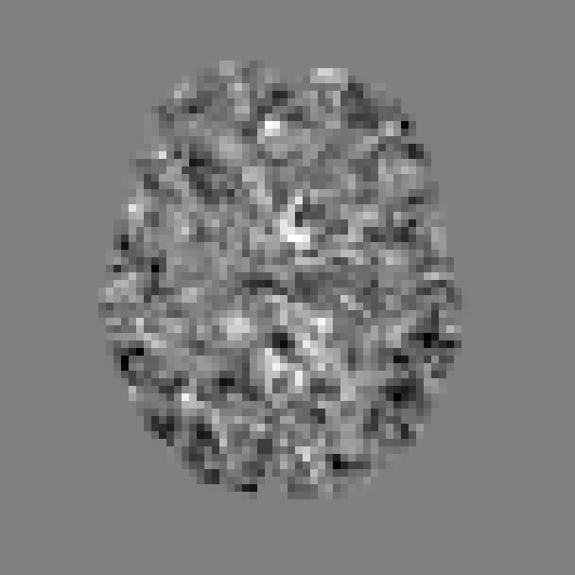
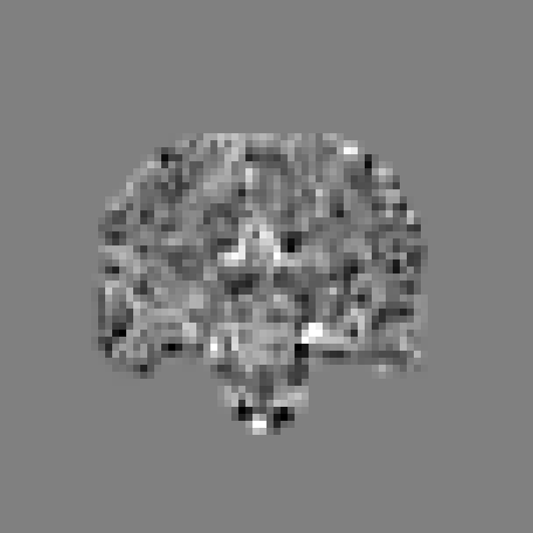
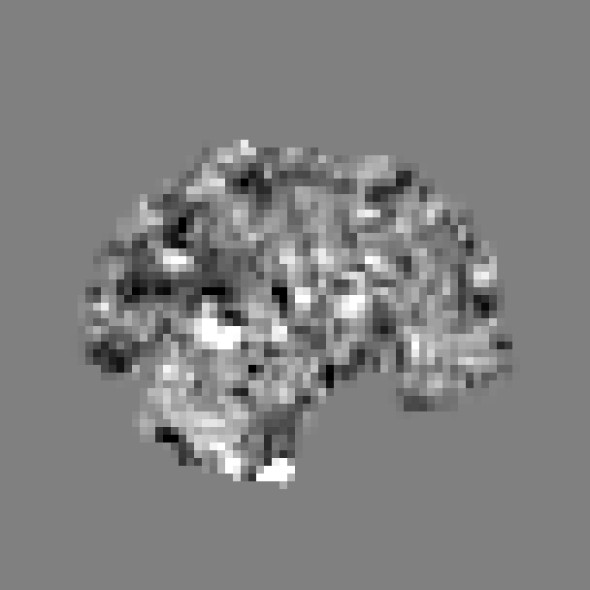
Can a computer tell autism
from a resting brain scan?
Replicating a brain-connectivity classifier and testing a picture-and-text model on ABIDE, 871 people scanned at 20 sites
Tamilore Bolodeoku | Yale University | github.com/Tamibolo01/abide-replication
The question
Result 1: the fingerprint works at new hospitals
Result 2: the picture-and-text model works as machinery
Resting-state fMRI records how the blood-oxygen signal rises and falls across the brain while a person lies still for a few minutes. ABIDE is a public collection of such scans, about half from people with an autism diagnosis.
Can a computer learn, from the scans alone, who has the diagnosis? And does what it learns still work at a hospital it has never seen?
Trained on 19 sites, tested on the 20th, repeated for every site. Share of people classified correctly, pooled over all 871:
Before days of cluster time, a sanity check: give the model 10 people from one site (5 autism, 5 control) and ask it to learn them by heart. A model that cannot even memorise ten people it has seen has a broken pipeline, not a hard problem.
10/10
89%
0.00
people learned
of their single pictures
change after saving and reloading
871
20
46%
Loss at every training step. Falling = learning; grey = random guessing.
people scanned
sites (hospitals, universities)
with an autism diagnosis
Two ways to ask the computer
About two in three people correct at a hospital the model never saw, against 54% from always guessing "control". This matches the published paper, down to tangent embedding being the best measure.
Within the same sites (10-fold cross-validation) the best setting reaches 68%.
A. Connectivity fingerprint
Scan: about 100 brain regions
Do pairs of regions rise and fall together?
5,050 numbers per person
Simple classifier
Final score per person after training. Positive = "autism" fits better.
Replicates Abraham et al. (2017). A weighted sum of the 5,050 numbers decides. Three ways of measuring "together" are compared; the best, tangent embedding, first lines every scan up against the group average.
What checking our own code taught us
B. Pictures and words
A first version found no advantage for tangent embedding, unlike the paper. Before blaming the paper we audited our pipeline, one change at a time on the same people, and found three mistakes of our own:
■ autism diagnosis ■ control
One slice at one instant
A short report from the record
Model learns to match picture to report
Which report fits best?
Adapts MaMA (Du et al., 2024), a mammography model. No time series at all: the model only ever sees single pictures. A picture is a map of where the signal is above or below its usual level at that instant, not anatomy. Personal details in the reports are hidden 80% of the time so the model cannot cheat by memorising them.
1
Signals not standardised: the library only did it for one of the three measures
At real scale: not yet
2
One setting fixed by hand: instead of tuned on the training people
On 50 people from one site with a few minutes of training, the model is no better than guessing (52% chance). That is expected at this scale and is not a verdict. The slowest part of training is matching pictures to reports, because once personal details are hidden most reports read the same.
3
Wrong "chance" level: random guessing (51%) instead of always guessing the larger group (54%)
What the model actually sees: one instant of one scan, cut three ways (76 x 76 pixels each; mid-grey = signal at its usual level).
Fixing them changed the conclusion. Check your own pipeline before you argue with a paper.
Next steps
1
Run the model at scale
2
Compare the two fairly
3
Richer text reports
4
Back to the biology
5
Write it up
all 50 PITT people with proper cross-validation, then all 20 sites, on the Yale cluster with longer training.
same people, same splits, including the leave-one-site-out test that matters clinically.
hide fewer details or add clinical fields, so pictures can be matched to reports.
which region pairs carry the most weight, and do they match autism networks in the literature?
once step 1 has run.
How we make sure the numbers can be trusted
No peeking. Every number comes from people the model never saw during training, and anything learned from data (even an average) is learned from the training group only. Automated tests check this every time the code changes.
Quality gates. Tests and style checks must pass before a change is kept, and every reported number is tied to the exact command and code version that produced it.
Honest chance. "Chance" is what you get by always guessing the larger group (54%), not 50%.
Cross-validation: train on most people, test on the rest, repeated so everyone is tested once. Leave-one-site-out: train on 19 sites, test on the 20th. Leakage: any way test information can influence training; it inflates results. Loss: the model's running error score; falling means learning.
Abraham A. et al. (2017) Deriving reproducible biomarkers from multi-site resting-state data: the ABIDE autism dataset, NeuroImage. Du Y., Onofrey J., Dvornek N.C. (2024) MaMA: multi-view and multi-scale alignment for contrastive language-image pre-training in mammography, IPMI 2025. Data: ABIDE Preprocessed Connectomes Project (C-PAC pipeline, quality-checked sample).

