Slide 1
Employee Data Analysis using Excel
STUDENT NAME: Tamil Selvi p
REGISTER NO:312211275
DEPARTMENT: B. COM GENERAL (COMMERCE)
COLLEGE: DR.M.G.R.JANAKI OF ARTS AND SCIENCE FOR WOMEN.

Slide 2
PROJECT TITLE
Employee Performance Analysis using Excel

Slide 3


AGENDA
Problem Statement
Project Overview
End Users
Our Solution and Proposition
Dataset Description
Modelling Approach
Results and Discussion
Conclusion
3/21/2024 Annual Review

Slide 4

PROBLEM STATEMENT
struggle to effectively assess employee performance due to the complexity and volume of data available.
The primary challenges include:
Difficulty in consolidating performance metrics from various sources.
Lack of insight into individual and team performance trends.
Inability to visualize data effectively for management decisions.
Inefficient manual processes for tracking and reporting employee performance.
This project aims to address these challenges by utilizing Excel's robust data analysis and visualization tools to create a comprehensive performance analysis model.

Slide 5

PROJECT OVERVIEW
The objective of this project is to develop an Excel-based performance analysis system that will:
Collect and analyze employee performance data.
Utilize various Excel techniques such as data manipulation, conditional formatting, pivot tables, and charts to derive insights.
Enable management and HR departments to identify high-performing employees, understand departmental performance, and address any performance gaps effectively.
Create dashboards and reports that are user-friendly and can be easily interpreted by end users.
.

Slide 6


WHO ARE THE END USERS?
Management: To assess overall employee performance for decision-making regarding promotions, rewards, and resource allocation.
Human Resources: To track attendance, productivity, and performance reviews, facilitating more informed personnel decisions.
Employees: To gain insights into their own performance, encouraging self-improvement and development

Slide 7
OUR SOLUTION AND ITS VALUE PROPOSITION
We propose the development of an Excel mod for effective performance analysis: hat integrates several tools and techniques
Data Manipulation: Use of Power Query to cleanmerge, and transform data for analysis Conditional Formatting: To visually highlight performance metrics that meet or fall below specific thresholds.
Pivot Tables: To summarize and analyze large datasets, enabling users to easily view performance by department, employee, or metric.
Charts and Graphs. To visualize trends and performance distributions, making it easier to communicate findings to stakeholders.
This solution will provide a clear overview of employee performance, facilitate data-driven decision-making, and streamine performance review processes.

Slide 8
Dataset Description
The dataset consists of 30 records capturing various aspects of employee performance, including:
Employee ID: Unique identifier for each employee.
Employee Name: Names of employees.
Department: The department in which each employee works (eg, Sales, IT, HR).
Attendance Rate (%): The percentage of days attended.
Tasks Completed: The number of tasks completed over a specific period.
Project Scores. Scores awarded based on project contributions (out of 100).
Customer Feedback: Average feedback from customers (out of 5).
Overtime Hours: Total overtime hours worked during the period.
Performance Rating: Overall rating based on various metrics (out of 5)

Slide 9

THE "WOW" IN OUR SOLUTION
=IF(AND(B2>90, C2 >100), 'Excellent", "Needs Attention")
‹#›

Slide 10
MODELLING
Modelling Approach
The analysis will be conducted using the following approach:
. Data Preparation: Clean and format the dataset using Power Query to ensure accuracy and consistency.
2. Analysis:
Apply conditional formatting to highlight top performers and those needing improvement.
Use pivot tables to aggregate data and explore trends across different dimensions (eg., department, tasks completed)
Create visualizations (charts/graphs) to display performance data and trends clearly.
3. Insights Extraction: Analyze the summarized data to identify patterns, correlations, and key insights related to employee performance.
‹#›

Slide 11
In this section, present the findings from the analysis
Key Insights: Summarize the performance trends identified, such as which departments have the highest/lowest attendance rates, task completion rates, and overall performance ratings.
Visualizations: Include charts and pivot tables that illustrate the findings effectively.
Discussion. Interpret the results and discuss their implications for the organization. Address any limitations of the analysis and suggest areas for further exploration or data collection

Slide 12
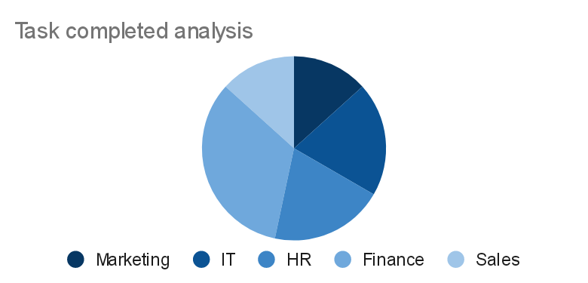
RESULTS
‹#›

Slide 13
conclusion
Summarize the project outcomes:
The project successfully analyzed employee performance data using Excel tools and techniques.
Key trends and insights were identified that can inform management decisions.
Recommendations for future performance management strategies based on the analysis results.
Emphasize the importance of continuous data analysis for improving employee performance and overall organizational effectiveness

