Slide 1
Sentiment Classification Using LSTM
TAMIL SELVI K
ASSISTANT PROFESSOR / CSE
KONGU ENGINEERING COLLEGE

Slide 2
Step #1 : Data Preprocessing
Load dataset(.csv file)
  data = pd.read_csv(‘sentiment.csv)
From the dataset, select the necessary columns(features)
  data = data[[‘text’,’sentiment’]]
  In the feature (sentiment), we have taken only (positive, negative), excluded netural for binary classification (for this workout)
  data = data[data.sentiment != ’Neutral’]

Slide 3
Step #1 : Data Preprocessing
Convert all the characters into lowercase to avoid ambiguity in word embedding
data[‘text’] = data[‘text’].apply(lambda x: x.lower())
Remove the special characters like ,::;-etc… and replace by none(no space)
data[‘text’] = data[‘text’].apply((lambda x: re.sub(‘[^a-zA-z0-9\s]’,’’,x)))
Remove (rt) and replace by space(‘ ‘)
for idx,row in data.iterrows():
row[0] = row[0].replace('rt',' ')

Slide 4
Step #1 : Data Preprocessing
Similarly convert the classification labels( sentiments ( +ve / -ve)) to numerical values
Y = pd.get_dummies(data[‘sentiment’]).values
One-hot encoding
positive ---- [0 1]
negative ---- [1 0]

Slide 5
Step #2 : Tokenization and Sequencing
Tokenizer(Max.num.words, split=‘ ‘)
Split the text into words separated by space with maximum number of words (index from 1 to Max.num.words)
fit_on_texts( texts_data)
assign unique integer for each words in the given text from Tokenizer
texts_to_sequences(texts_data)
For each tweet, convert the words of the tweet into integers given by tokenizer

Slide 6
Step #3 : Building a Model
Create a Sequential model
model =Sequential()
First model for processing text is Embedding Layer, add it
Embedding(Max_features, embed_dim, input_length = X.shape[1],….)
Max_features = Max num of unique words in the given dataset
input_length = Max num of words in a tweet (among all tweets)
embed_dim = hyperparameter

Slide 7
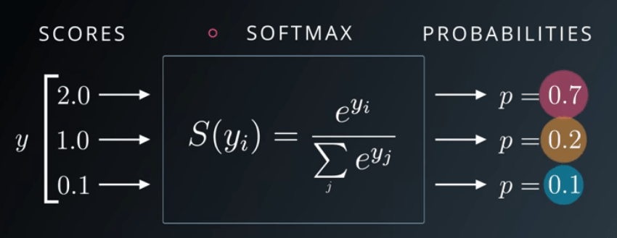
Step #3 : Building a Model
Second layer to add is LSTM
LSTM(Num of hidden neurons, dropout,…)
Num of hidden neuron = hyperparameter
Then add output layer(Dense)
Dense(num_classes, activation)
num_classes = 2(+ve / -ve)
activation = ‘softmax’

Slide 8
Step #4 : Compile the model
compile(loss, optimizer, metrics)
loss = categorical_crossentropy
optimizer = adam
metrics = accuracy

Slide 9
Step #5 : Split the data into train set and test set
train_test_split(X,Y, test_size = int, …)
test_size = split ratio (80:20) = 0.2
returns
X_train, X_test
Y_train, Y_test

Slide 10
Step #6 : Train the model using train set
model.fit(X_train, Y_train, epochs, batch_size, verbose)

Slide 11
Step #7 : Evaluate the model using test set
model.evaluate(X_test,Y_test,batch_size, verbose,….)
evaluate() computes the loss based on the input you pass it, along with any other metrics that you requested in the metrics param when you compiled your model

Slide 12
Step #8 : Predict the new data
model.predict(new_data,….)
returns
predict() generates output predictions based on the input you pass it
Generate the probabilities (based on the output of the last layer)

Slide 13


