Slide 1
WEB TECHNOLOGY CAPSTONE PROJECT
Campus Event Registration and
Management System
A Modern Full-Stack MERN Platform with Concurrency-Safe Atomic Reservations
Candidate Name: Tamilzhniyan K.
Register / Roll Number: URK24CS1140
Department & Branch: B.Tech in Computer Science and Engineering
Institution: Karunya University | Academic Year 2026
GitHub Repository: https://github.com/Tamil-k-iniyan/Campus-Event-Registration-
Notes:
Respected examiners, good morning. I am Tamilzhniyan K., register number URK24CS1140 from the Department of Computer Science and Engineering at Karunya University. Today, I present my Web Technology capstone project: the Campus Event Registration and Management System, built with the MERN stack.

Slide 2
CONTEXT & SIGNIFICANCE
Project Overview: Unified Campus Event Ecosystem
What is CampusEvents?
• Centralized Digital Portal: Replaces disorganized WhatsApp posters, physical flyers, and disconnected Google Forms with one official hub.
• Two Segregated Roles: Role-Based Access Control dividing Student Attendees from Faculty Event Administrators.
• Real-Time Capacity Gauges: Students immediately see live remaining seats before attempting registration.
• Instant Self-Service: One-click registration, instant cancellation before start time, and downloadable CSV rosters for faculty.
System Interaction Flow
1. Student User
Discovers hackathons, workshops, and sports meets. Submits booking with optional special notes.
2. React Client (Vite)
Dispatches asynchronous requests with JWT Bearer tokens to REST endpoints.
3. Express.js Server
Validates inputs, sanitizes data, and executes atomic conditional seat increments.
4. MongoDB Database
Stores persistent User profiles, Event catalogs, and Unique Registration records.
5. Faculty Admin
Monitors capacity utilization, reviews attendee rosters, and exports CSV reports.
Campus Event Registration and Management System | Karunya University | Tamilzhniyan K. (URK24CS1140)
Notes:
This slide outlines what the Campus Event Registration and Management System achieves. It replaces paper notices and spreadsheets with a clean digital portal connecting students and faculty. The diagram demonstrates the 5-step lifecycle from student discovery to atomic database writes and administrative CSV exports.

Slide 3
PROBLEM ANALYSIS
Problem Statement: Challenges in Legacy Event Management
Paper & Google Forms Vulnerabilities
Traditional forms lack atomic capacity validation. When 50 students apply for 30 seats simultaneously, overbooking occurs, causing chaos at the venue.
Duplicate Registration Submissions
Without database-level unique compound keys, students register multiple times under different names, corrupting attendance records.
Zero Visibility & Missed Deadlines
Notices are scattered on bulletin boards and social media groups. Students miss deadlines and remaining seat counts are invisible.
Severe Administrative Overhead
Faculty and student coordinators spend hours manually compiling attendance rosters and validating student roll numbers.
Campus Event Registration and Management System | Karunya University | Tamilzhniyan K. (URK24CS1140)
Notes:
Here we highlight the core bottlenecks of current campus processes: lack of capacity enforcement causing overbooking, duplicate student submissions, scattered discovery, and manual attendance reconciliation. Our project directly solves each of these vulnerabilities through software engineering.

Slide 4
SCOPE & GOALS
Project Objectives: Engineering Goals & Deliverables
1. Centralized Event Hub
Establish a single searchable catalog for academic seminars, hackathons, workshops, cultural galas, and athletic championships.
2. Concurrency-Safe Booking
Implement atomic database reservation operators to eliminate overselling under simultaneous peak student registrations.
3. Duplicate Prevention
Enforce compound unique database indexing ({ student: 1, event: 1 }) ensuring zero duplicate active registrations.
4. Role-Based Access Control
Segregate student attendees from faculty administrators using cryptographically signed JSON Web Tokens (JWT).
5. Live Faculty Administration
Provide real-time analytics dashboards, capacity progress tracking, and 1-click CSV roster generation.
6. High-Performance Responsive UI
Develop an intuitive user experience using React 18, Vite, and Bootstrap 5 adaptable to mobile, tablet, and desktop viewports.
Campus Event Registration and Management System | Karunya University | Tamilzhniyan K. (URK24CS1140)
Notes:
The project accomplished six key engineering objectives: centralizing event listings, guaranteeing atomic seat capacity reservation, preventing duplicate registrations via unique indexes, implementing stateless JWT authentication, providing faculty administration with CSV export, and delivering a responsive React user interface.

Slide 5
SYSTEM FEATURES
Proposed System: Student & Administrator Capabilities
Student Portal Features
✔ Account Registration & Auth: Secure login with JWT token session handling and profile management.
✔ Search & Multi-Filter Catalog: Filter by Technical, Hackathon, Cultural, Sports, and Seminar categories.
✔ Seat Capacity Indicators: Color-coded progress bars showing exact seats remaining in real time.
✔ 1-Click Atomic Registration: Instant seat reservation with optional special dietary or team notes.
✔ Self-Service Cancellation: Relinquish seats before event start date, restoring seat availability.
✔ Student Dashboard: Personal audit log of confirmed, upcoming, and past event bookings.
Faculty Admin Console
✔ Executive KPI Dashboard: Instant overview of Total Events, Upcoming, Registered Students, and Bookings.
✔ Full Event CRUD Management: Create, edit, publish, and delete events with capacity bound enforcement.
✔ Attendee Roster Inspection: Search registered students by full name, college email, or roll number.
✔ Automated CSV Export: Single-click download of attendance spreadsheets formatted for Excel.
✔ Publication Status Toggles: Switch events between Published, Draft, Closed, and Cancelled modes.
✔ Safety Bounds Checking: Prevents reducing event capacity below the number of enrolled attendees.
Campus Event Registration and Management System | Karunya University | Tamilzhniyan K. (URK24CS1140)
Notes:
Slide 5 details the functional breakdown. The student portal focuses on frictionless discovery, atomic reservation, and booking history. The faculty administration panel gives organizers complete control: editing event dates, monitoring capacity bars, inspecting student rosters, and downloading CSV reports.

Slide 6
CORE TECHNOLOGIES
Technology Stack: Full-Stack MERN Architecture
React 18 & Vite
Node.js & Express.js
MongoDB & Mongoose 8
Security & Tooling
FRONTEND PRESENTATION
Component-based architecture, virtual DOM for instant UI updates, client-side routing with React Router DOM, bundled via Vite 6 Rollup for sub-2s build times.
BACKEND APPLICATION TIER
Asynchronous, non-blocking REST API server. Implements middleware for Helmet, CORS, body parsing, express-rate-limit, and centralized error catching.
DATABASE PERSISTENCE
NoSQL document store with Mongoose ODM schemas. Enforces compound unique indexes, timestamps, virtual computed properties, and atomic update operators.
AUTHENTICATION & CI/CD
Bcrypt.js password hashing (10 salt rounds), stateless JSON Web Tokens (7-day expiry), Git version control, and GitHub Actions continuous deployment.
Campus Event Registration and Management System | Karunya University | Tamilzhniyan K. (URK24CS1140)
Notes:
Here is our technical foundation: React 18 with Vite for frontend, Node.js and Express.js for the REST API backend, MongoDB with Mongoose 8 for data modeling, and bcrypt with JWT for security. Each technology was selected for performance, reliability, and academic rigor.

Slide 7
ARCHITECTURAL MODEL
System Architecture: 3-Tier Multi-Layer Design
Tier 1: Client Presentation Tier — React 18 Single Page Application (Port 5173 / GitHub Pages)
• React Components (Navbar, EventCard, FilterPanel, Modals) • React Router DOM with client-side protected route guards • AuthContext global session management (User state, Token) • Axios HTTP client with Bearer token request interceptor
Tier 2: Application Logic Tier — Express.js RESTful API Server (Port 5000 / Render)
• Security Pipeline: Helmet headers, CORS policies, Rate limiting • Authentication & Authorization: JWT verification & RBAC check • Input Validation: express-validator sanitization & bounds rules • Resource Controllers: Auth, Events, Registrations, Admin
Tier 3: Data Persistence Tier — MongoDB Database Server (campus_events / Atlas)
• Users Collection: Hashed passwords, Student/Admin roles • Events Collection: Capacity, remainingSeats, indexes • Registrations Collection: Unique compound index { student, event } • Atomic Operators: findOneAndUpdate with $expr and $inc
Campus Event Registration and Management System | Karunya University | Tamilzhniyan K. (URK24CS1140)
Notes:
Slide 7 shows our 3-Tier Architecture. The client tier executes in the browser using React and Axios. Requests travel over HTTP to the Express backend tier, where security, authentication, and validation middleware process requests. Finally, controllers communicate with MongoDB using Mongoose schemas and atomic operators.

Slide 8
DATA MODELS
Database Design: Mongoose Schemas & Indexing Strategy
users Collection
Student & Faculty Admin Accounts
events Collection
Campus Symposiums, Hackathons, Fests
registrations Collection
Attendee Seat Reservations & Audit
• name: String (2-60 chars, Required)
• email: String (Unique index, normalized lowercase)
• password: String (Bcrypt hashed, 10 salt rounds)
• role: Enum: ['student', 'admin'] (Default: student)
• department: String (College branch / department)
• studentId: String (Campus Roll Number)
• timestamps: Date (createdAt, updatedAt auto-generated)
• title & desc: String (Text search indexed, required)
• category: Enum: Technical, Workshop, Cultural, Sports...
• eventDate: Date (Compound index with status: 1)
• venue & time: String (Auditorium/Lab, start & end time)
• capacity: Number (Max seats limit, positive integer >= 1)
• registeredCount: Number (Live enrolled attendee count)
• remainingSeats: Virtual: Math.max(0, capacity - registered)
• student: ObjectId (ref: User, compound unique index)
• event: ObjectId (ref: Event, compound unique index)
• status: Enum: ['confirmed', 'cancelled']
• registeredAt: Date (Seat booking timestamp)
• cancelledAt: Date (Cancellation audit timestamp)
• notes: String (Optional dietary or team requirements)
• UNIQUE KEY: { student: 1, event: 1 } (Prevents duplicates)
Campus Event Registration and Management System | Karunya University | Tamilzhniyan K. (URK24CS1140)
Notes:
Our MongoDB database is named campus_events and has three collections: users, events, and registrations. We use Mongoose virtuals for remainingSeats calculation, and compound unique indexes to guarantee that no student can hold multiple active registrations for the same event.

Slide 9
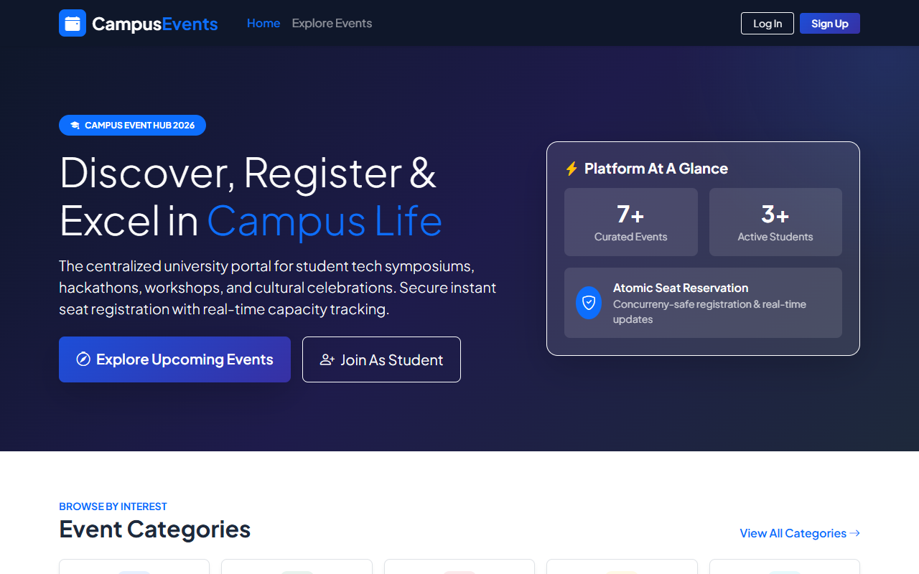
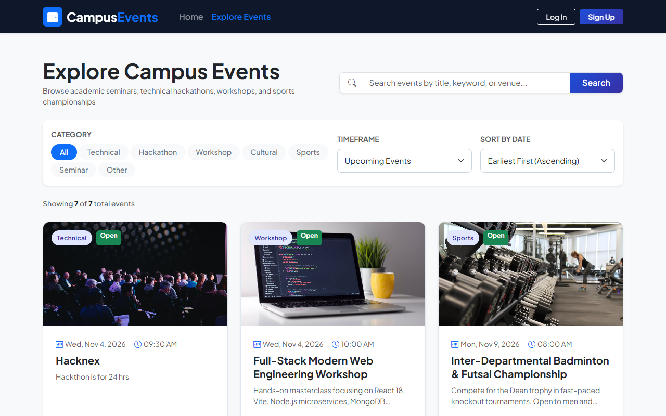
VISUAL INTERFACE
Frontend User Interface: Modern University Design System
Campus Landing Page (Hero, Live Stats, Category Cards)
Events Explorer (Keyword Search, Category Pills, Capacity Progress)
UI Design System Principles: Navy blue & indigo university theme, Bootstrap 5 responsive grid, real-time search filtering, color-coded capacity indicators, and clean accessible form inputs.
Campus Event Registration and Management System | Karunya University | Tamilzhniyan K. (URK24CS1140)
Notes:
These are genuine screenshots captured directly from our running React application. On the left is the university landing page with hero banner and platform statistics. On the right is the events explorer showing category filter pills, keyword search, and dynamic seat capacity progress bars.

Slide 10
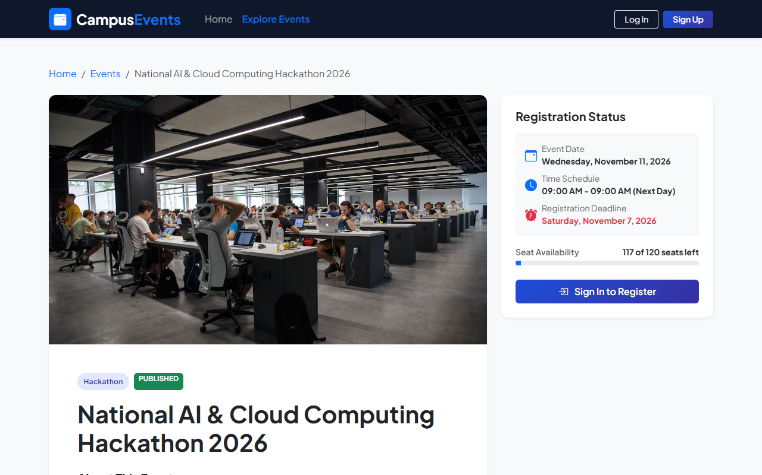
TRANSACTION LOGIC
Student Registration Workflow: Atomic Seat Booking Flow
Booking Lifecycle & Concurrency Guard
1. Student Authentication
Student signs in with credentials; JWT Bearer token is stored in client session.
2. Event Selection & Review
Student selects an event, reviews date, venue, syllabus, and available seats.
3. Deadline & Status Verification
Server verifies event is 'published' and registration deadline has not elapsed.
4. Duplicate Booking Check
Queries existing registration records. If active, rejects duplicate submission.
5. Atomic Seat Increment ($inc)
MongoDB executes findOneAndUpdate with condition registeredCount < capacity. Prevents overselling completely.
6. Registration Record Created
Document created in registrations collection. Student receives confirmed status badge.
Live Event Details Page with Remaining Seats Gauge & Booking Action
Campus Event Registration and Management System | Karunya University | Tamilzhniyan K. (URK24CS1140)
Notes:
Slide 10 details our atomic registration workflow. When a student clicks Register, our backend executes a conditional update checking that current count is strictly less than capacity. This guarantees no two students can take the same remaining seat. On the left is the live event details page.

Slide 11
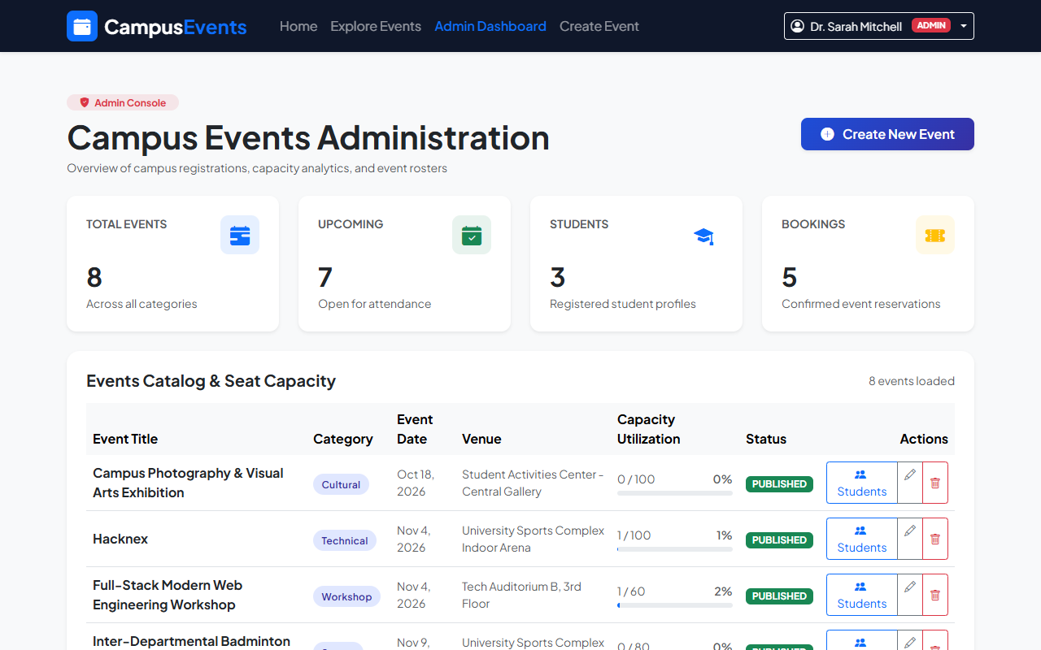
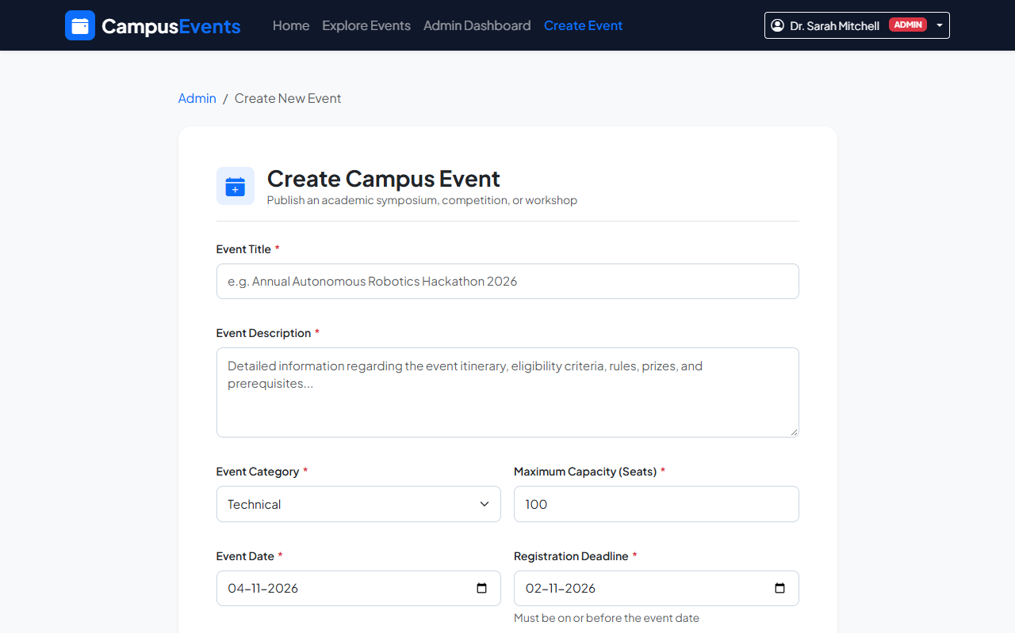
ADMINISTRATIVE PANEL
Administrator Console: Live Management & Analytics
Admin Dashboard (KPI Metrics, Capacity Progress Bars, Actions)
Event Publication Form (Date Chronology, Capacity & Status Rules)
Faculty Administrative Powers: Live analytics cards (Total Events, Students, Confirmed Bookings), event CRUD with capacity safety bounds, attendee search by roll ID, and automated CSV spreadsheet export.
Campus Event Registration and Management System | Karunya University | Tamilzhniyan K. (URK24CS1140)
Notes:
Slide 11 shows actual screenshots of our Administrator Console. The left image demonstrates the KPI dashboard displaying total events, student accounts, and confirmed bookings. The right image shows the event creation form with validation rules enforcing that registration deadlines precede event dates.

Slide 12
SERVER ARCHITECTURE
Backend & API Integration: RESTful Endpoints Architecture
POST /api/auth/register [Public]
Student registration with bcrypt password hashing and JWT issuance.
POST /api/auth/login [Public]
User authentication; returns token and role payload.
GET /api/events [Public]
Query events with search, category filters, and pagination parameters.
GET /api/events/:id [Public / Auth]
Event details with current user's registration status badge.
POST /api/events [Admin Only]
Create campus event with capacity and chronological date rules.
POST /api/registrations/:id [Student]
Atomic seat reservation with conditional concurrency check.
DELETE /api/registrations/:id [Student]
Cancel upcoming registration; restores seat capacity count.
GET /api/admin/dashboard [Admin Only]
Platform metrics, category distribution, and capacity table.
GET /api/admin/registrations/export/:id [Admin Only]
Generates downloadable CSV file stream of event attendees.
Campus Event Registration and Management System | Karunya University | Tamilzhniyan K. (URK24CS1140)
Notes:
Here is our RESTful API endpoint architecture. Routes are organized into four resources: authentication, events, registrations, and administrative reporting. All private routes are guarded by JWT verification and role authorization middleware.

Slide 13
SYSTEM SECURITY
Input Validation & Security Safeguards
Client-Side Validation (React)
✔ Email regex pattern validation
✔ Minimum password length (6+ characters)
✔ Confirm password matching parity
✔ Required field indicators and instant feedback
Server-Side Validation (Express)
✔ express-validator schema sanitization
✔ Chronological checks: deadline <= event date
✔ Capacity bounds: positive integer >= 1
✔ ObjectId format verification (isMongoId)
Authentication & Authorization
✔ Bcrypt password hashing (10 salt rounds)
✔ Stateless 7-day HMAC-SHA256 JWT tokens
✔ Role-Based Access Control (Student vs Admin)
✔ ProtectedRoute and AdminRoute guards
Infrastructure Hardening
✔ Helmet HTTP security response headers
✔ CORS restricted to authorized origins
✔ express-rate-limit brute force protection
✔ Environment variables (.env) for credentials
Campus Event Registration and Management System | Karunya University | Tamilzhniyan K. (URK24CS1140)
Notes:
Slide 13 outlines our security architecture. We never rely solely on frontend validation. Every request is re-validated on the server with express-validator. Passwords use bcrypt with 10 salt rounds, sessions use stateless JWTs, and Helmet secures HTTP headers.

Slide 14
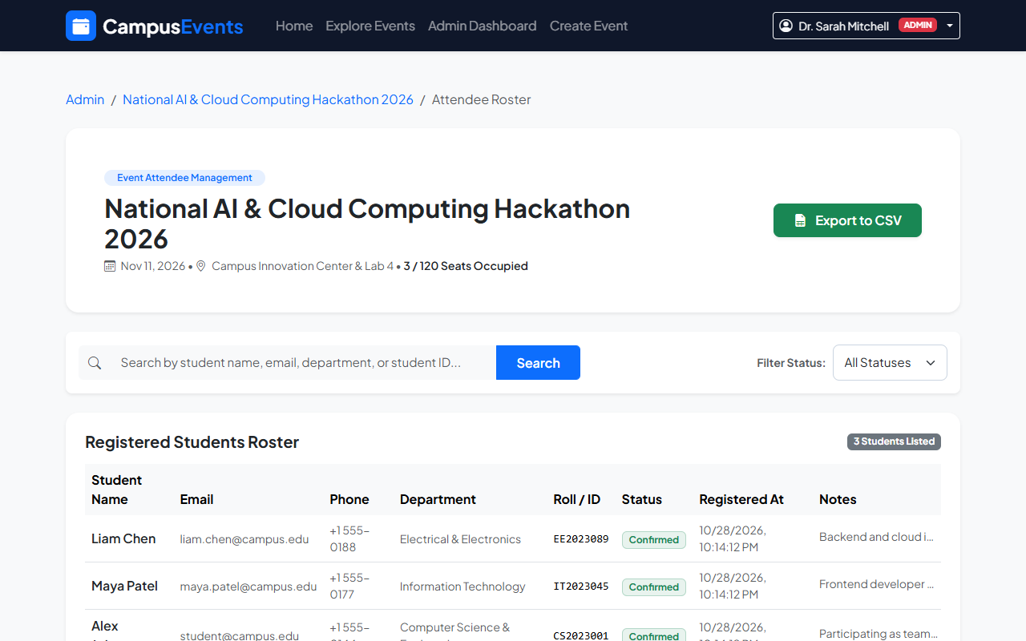
DATABASE VERIFICATION
MongoDB Data Integrity: Event & Registration Persistence
Physical Document Separation
Event Document (events collection):
Stores title, category, date, venue, capacity (e.g. 120), and registeredCount (e.g. 3).
Registration Document (registrations):
Stores individual attendee records referencing student: ObjectId and event: ObjectId, with status: 'confirmed'.
Referential Integrity via Mongoose:
populate('student') and populate('event') dynamically join records without monolithic tables.
Compound Unique Index Integrity:
index({ student: 1, event: 1 }, { unique: true }) ensures that even if concurrent network calls race, only ONE registration document is ever created.
Attendee Roster View Generated from MongoDB Registrations Collection
Campus Event Registration and Management System | Karunya University | Tamilzhniyan K. (URK24CS1140)
Notes:
In Slide 14, we demonstrate data persistence in MongoDB. Event records and registration records are stored separately for referential integrity. On the left is the live attendee roster. The compound unique index guarantees that registeredCount and actual registration documents remain 100% synchronized.

Slide 15
QUALITY ASSURANCE
Testing Methodology & Verification Results
21 / 21
Automated API Tests Passed
25 / 25
Documented Test Scenarios Passed
100%
Test Pass Rate
1.16s
Vite Production Build Time
Key Verified Test Scenarios (Sample Matrix):
[TC-01] Student Registration: 201 Created; JWT token & profile returned — [PASS]
[TC-02] Duplicate Email Rejection: 400 Bad Request: Account already exists — [PASS]
[TC-08] Role Authorization Guard: 403 Forbidden: User role 'student' unauthorized — [PASS]
[TC-12] Atomic Seat Reservation: 201 Created; registeredCount atomically +1 — [PASS]
[TC-13] Duplicate Event Booking: 400 Bad Request: Already registered for event — [PASS]
[TC-17] Cancellation & Seat Return: 200 OK; registeredCount atomically -1 — [PASS]
[TC-21] CSV Roster Streaming: 200 OK; text/csv file stream generated — [PASS]
Campus Event Registration and Management System | Karunya University | Tamilzhniyan K. (URK24CS1140)
Notes:
Slide 15 shows our rigorous testing methodology. We executed 21 automated integration tests via backend/test/api.test.js with a 100% pass rate. We verified duplicate rejection, role authorization blocking, atomic increment, cancellation decrement, and CSV downloads.

Slide 16
DEVOPS & HOSTING
GitHub Repository & Deployment Architecture
GitHub Version Control
• Repository URL:
https://github.com/Tamil-k-iniyan/Campus-Event-Registration-
• Branch & Commits:
main branch with descriptive commits, structured .gitignore excluding secrets, and MIT License.
• CI/CD Automation:
GitHub Actions workflow (.github/workflows/deploy.yml) automatically builds Vite frontend and publishes to GitHub Pages.
• Academic Documentation:
Repository includes PROJECT_REPORT.docx, DATABASE_SCHEMA.md, API_DOCUMENTATION.md, and TEST_CASES.md.
Deployment & Hosting Options
• Live Frontend (GitHub Pages):
https://tamil-k-iniyan.github.io/Campus-Event-Registration-/
• Cloud API Hosting (Render):
Ready-to-deploy render.yaml blueprint configured for free Node.js service hosting.
• Cloud Database (MongoDB Atlas):
Free MongoDB M0 Cluster connection string configured via MONGO_URI.
• Local Execution Commands:
Backend: cd backend && npm run dev (Port 5000)
Frontend: cd frontend && npm run dev (Port 5173)
Campus Event Registration and Management System | Karunya University | Tamilzhniyan K. (URK24CS1140)
Notes:
Slide 16 details version control and deployment. Our GitHub repository is Tamil-k-iniyan/Campus-Event-Registration-. The frontend deploys via GitHub Actions, and the repository includes a render.yaml blueprint for deploying the Express API to Render with MongoDB Atlas.

Slide 17
FUTURE WORK
Future Enhancements: Roadmap for Production Scaling
1. Contactless QR-Code Ticketing
Generate signed QR code entry passes for confirmed students; provide a volunteer mobile scanner app for rapid venue admission.
2. Automated Waitlist Queue
When capacity hits maximum, allow students to join an automated queue that promotes attendees when cancellations occur.
3. Automated Certificate Generation
Dynamically generate verifiable PDF participation and winner certificates stamped with unique verification hashes.
4. Push & Email Notifications
Integrate Nodemailer and web push notifications to alert students of registration confirmations and 24-hour event reminders.
5. Academic Calendar Integration
Provide 1-click 'Add to Google Calendar' and Apple iCal (.ics) exports with automated schedule synchronization.
6. Advanced Participation Analytics
Provide departmental Dean reports tracking student engagement trends across academic semesters.
Campus Event Registration and Management System | Karunya University | Tamilzhniyan K. (URK24CS1140)
Notes:
Looking forward, we have identified high-value enhancements for campus deployment: contactless QR-code ticket scanning at venue doors, automated waitlist queues, automatic PDF participation certificates, and calendar synchronization.

Slide 18
Project Conclusion
✔ Successfully delivered a complete, professional, full-stack campus event management web application.
✔ Eliminated event overbooking through atomic concurrency-safe seat reservation algorithms in MongoDB.
✔ Prevented duplicate registrations using database-level unique compound indexing ({ student: 1, event: 1 }).
✔ Empowered faculty with live analytics dashboards, capacity utilization progress bars, and instant CSV exports.
✔ Validated 100% of API endpoints through automated integration testing and rigorous input sanitization.
THANK YOU!
Questions & Answers | Tamilzhniyan K. | URK24CS1140
Notes:
In conclusion, the Campus Event Registration and Management System successfully demonstrates how full-stack web engineering solves real campus logistical problems. Thank you for your time and guidance. I welcome your questions.

