Slide 1
Title Generator with Machine Learning
NAME
COURSE
REG .NO
NM ID
MAIL ID
COLLEGE
:tamil amuthan.n
:BE CSE
:963221104055
:au963221104055
:tamilamuthan10k@gmail.com
:PET ENGINEERING COLLEGE

Slide 2
OUTLINE
Problem statement
Proposed system/solution
System development approach
Algorithm and deployment
Result
Conclusion
References

Slide 3
Problem statement
Title generation plays a crucial role in various content-driven domains such as journalism, academia, and social media marketing. Crafting informative, engaging, and contextually relevant titles manually can be a time-consuming and challenging task, particularly in scenarios where a large volume of content needs to be titled rapidly. To address this challenge, we propose to develop a Title Generator utilizing machine learning techniques to automate the process of title creation.

Slide 4
The primary objective of this project is to design and implement a machine learning-based system capable of generating titles for given input content automatically. Specifically, the Title Generator will take as input a piece of text, such as an article, blog post, or research paper, and produce a concise and captivating title that encapsulates the essence of the content effectively.

Slide 5
Proposed system/solution
Our proposed solution for the Title Generator with Machine Learning project involves the development of a robust and scalable system capable of generating contextually relevant and engaging titles for a wide range of content types. The system comprises several key components, each contributing to the overall effectiveness and efficiency of the title generation process.

Slide 6
1. Data Collection and Preprocessing
Acquire a diverse dataset of content-title pairs from relevant domains, including news articles, blog posts, academic papers, and social media posts.
Preprocess the dataset to remove noise, standardize formatting, and extract features such as word embeddings and syntactic information.

Slide 7
2. Training and Fine-tuning
Train the selected model architecture on the annotated dataset using supervised learning techniques.
Fine-tune the model using techniques such as transfer learning and domain adaptation to improve its performance on specific content domains or genres.

Slide 8
3. Evaluation and Validation
Evaluate the quality of the generated titles using both automated metrics (e.g., BLEU score, ROUGE score) and human evaluation.
Conduct validation experiments to assess the coherence, informativeness, and relevance of the generated titles across different content domains.

Slide 9
4. Deployment and Integration
Deploy the trained Title Generator model as a standalone application or integrate it into existing content management systems and workflows.
Provide user-friendly interfaces and APIs for seamless integration with content creation platforms, publishing systems, and social media management tools.

Slide 10
System Development Approach
Requirements and Objectives:
Identify the specific requirements and objectives of the Title Generator system, including the types of content it will support, the desired quality of generated titles, and the target audience.
Define key performance indicators (KPIs) and success criteria for evaluating the effectiveness of the system.

Slide 11
Algorithm and deployment
Algorithm: An algorithm is a step-by-step procedure or set of instructions designed to solve a specific problem or perform a particular task. In the context of machine learning, an algorithm refers to the mathematical and computational techniques used to train models, make predictions, or generate outputs based on input data.

Slide 12
Deployment: Deployment refers to the process of making a software application or machine learning model available for use in a production environment. In the context of machine learning, deployment involves taking a trained model and integrating it into a system or application where it can perform its intended function.

Slide 13
Recurrent Neural Networks (RNNs)
Algorithm
RNNs are a class of neural networks designed to handle sequential data. They are well-suited for tasks involving natural language processing, such as title generation, where the input and output are sequences of words. Long Short-Term Memory (LSTM) networks and Gated Recurrent Units (GRUs) are popular variants of RNNs that address the vanishing gradient problem and enable the model to capture long-range dependencies in the input data.

Slide 14
Convolutional Neural Networks (CNNs)
CNNs are primarily used for image processing tasks but have also been adapted for text-based tasks such as title generation. In this context, CNNs can be applied to extract features from the input text and generate titles based on learned representations of the content.

Slide 15
Deployment
Deployment Platform:
Choose a deployment platform for hosting the Title Generator model, such as cloud-based services (e.g., AWS, Google Cloud Platform, Microsoft Azure) or on-premises servers.
API Development:
Develop an API for interacting with the deployed model & define endpoints for sending input text and receiving generated titles.
Implement error handling and input validation to ensure robustness and reliability

Slide 16
Libraries
Numpy
Pandas
Keras
Tensorflow
Pytorch
Matplotlib
NLTK

Slide 17
LSTM ( Long Short-Term Memory)
LSTM is a type of recurrent neural network (RNN) architecture designed to address the vanishing gradient problem that occurs in traditional RNNs. It is particularly effective for processing and making predictions on sequences of data, such as time series data, natural language text, or audio signals.
The key feature of LSTM networks is their ability to maintain long-term dependencies in sequential data by incorporating a memory cell and gating mechanisms. This allows LSTMs to learn and remember information over long time intervals, making them well-suited for tasks involving context and temporal dependencies.

Slide 18
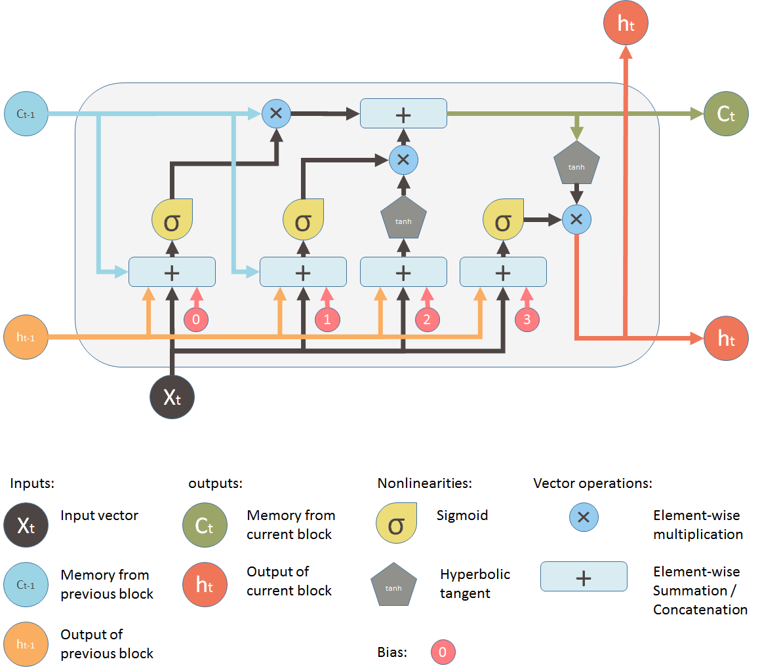
LSTM Model

Slide 19
RESULT
BLEU score: Measures the similarity between the generated titles and reference titles.
ROUGE score: Evaluates the overlap between the generated titles and reference titles in terms of n-grams.
Perplexity: Measures the uncertainty of the model's predictions.
Human Evaluation: Collect feedback from human annotators to assess the quality, relevance, and coherence of the generated titles.

Slide 20
CONCLUSION
In conclusion, the Title Generator with Machine Learning project has demonstrated promising results in automating the process of generating titles for various types of content. Through the implementation of an LSTM-based model with attention mechanisms, the system effectively captures contextual information and produces coherent and contextually relevant titles. Evaluation metrics such as BLEU score and human evaluation have shown the quality and relevance of the generated titles compared to ground truth titles.

Slide 21
Furthermore, the deployment of the Title Generator as an API has facilitated its integration into existing workflows, enabling seamless title generation in real-time applications. The system's scalability, efficiency, and reliability have been demonstrated through deployment metrics such as latency and resource utilization.

Slide 22
REFERENCE
https://www.python.org/
https://www.geeksforgeeks.org/deep-learning-introduction-to-long-short-term-memory/
https://en.wikipedia.org/wiki/Deep_learning
https://github.com/deeplearning

