Slide 1
AUTOMATED SYSTEM FOR
REAL-TIME STREET LIGHT FAULT DETECTION USING IOT
TEAM MEMBERS:
SUDHARSAN S - 210701266
SUBHIKSHAA S - 210701264
TAMIL PRIYA V - 210701282

Slide 2

PROBLEM STATEMENT
Develop an automated system for real-time street light fault detection, precise location tracking, and efficient maintenance in cities to enhance urban lightning infrastructure

Slide 3
ABSTRACT
The "Automated System for Real-Time Street Light Fault Detection using IoT" introduces an innovative approach to optimize urban lighting infrastructure by integrating advanced technologies. Leveraging IoT sensors, the system swiftly detects street light faults in real-time and transmits relevant information to the control system instantaneously using the Blynk application. This proactive approach facilitates efficient maintenance strategies, ensuring timely resolution of issues. With its scalable architecture and seamless integration with existing city infrastructure, this solution emerges as a comprehensive tool for addressing the dynamic challenges of urban lighting management.
5

Slide 4
EXISTING SYSTEM
The existing system uses GPS for locating the place of street light faults which might sometimes be inaccurate. It employs GSM modules and 89C51 microcontrollers to enhance efficiency, automatically adjusting illumination based on preset time delays and sending updates via phone. Smart lighting, also known as adaptive street lighting, optimizes energy use without compromising safety by dimming when not needed. This addresses the inefficiencies of manual systems, reducing electricity wastage and costs associated with constant operation but does not provide dynamic assistance with fault detection.

Slide 5
PROPOSED SYSTEM
Our proposed system uses Node MCU to get inputs from the LDR and detect faults using the sensed outputs. Our solution aims at achieving a reliable and faster way of detecting fault in street lights. This system provides a way of alerting using pop-up notifications when a defect is found in the respective street lights. This approach ensures that maintenance can be conducted promptly, reducing downtime and enhancing public safety. Additionally, this system provides unique ID for each street light resulting in easier identification and management. We have used the Blynk application to provide a convenient and a easy-to-use interface to display the condition of the street lights.

Slide 6
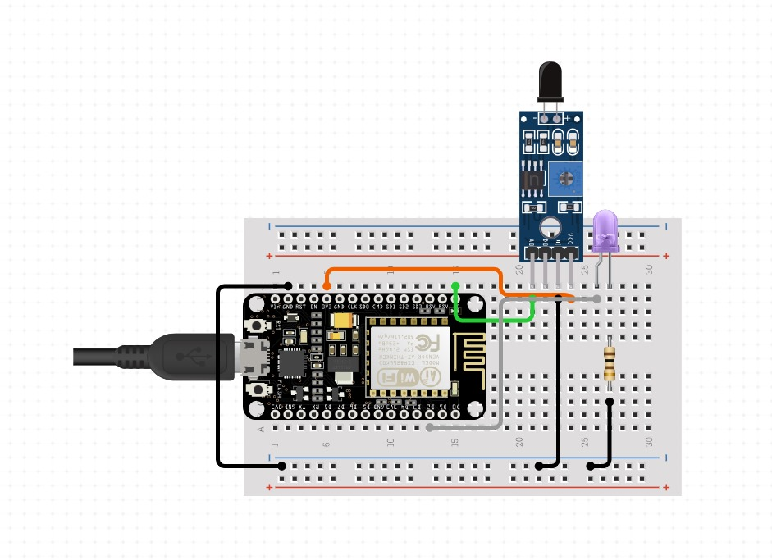
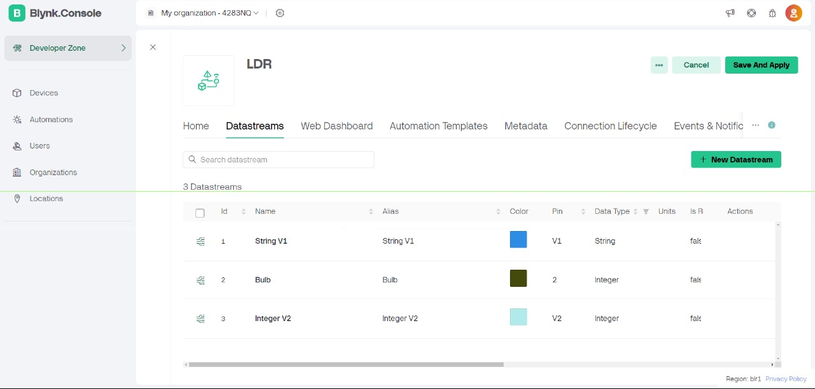
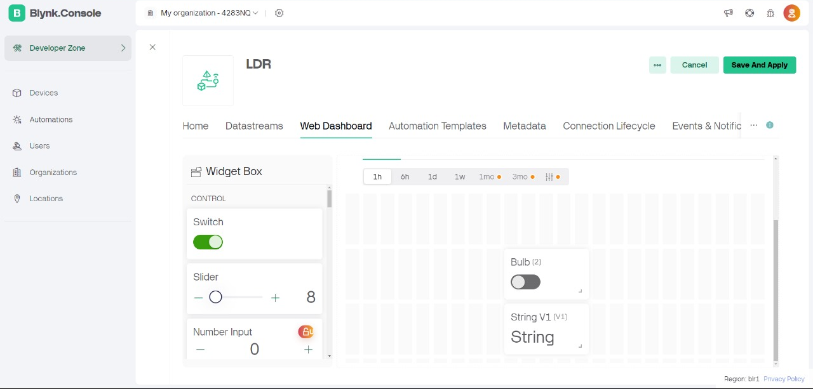
ARCHITECTURE

Slide 7
MODULES
Controlling street lights remotely
Monitoring street lights through LDR sensor frequently
Displaying fault condition with street light number in Blynk application
Sending notifications through Blynk application

Slide 8
MODULE DESCRIPTION
Controlling street lights remotely
The street lights can be turned ON/OFF through the Blynk application remotely. As the street lights have to be powered only after the day time, the service people can turn them ON from their location conveniently.
Monitoring street lights through LDR sensor frequently
The LDR senses the street lights condition and sends it output to the Blynk application. The LDR can also be turned ON for operation from the control station after the street lights has been powered ON. LDR performs continuous sensing and provides the current lighting condition every second.

Slide 9
MODULE DESCRIPTION
Displaying fault condition with street light number in Blynk application
Using the inputs received from the light’s condition (ON/OFF state) and LDR sensor, The Blynk application shows a message if the street light is faulty. It displays the street light’s allocated ID along with the message which helps in locating the faulty street light easily.
Sending notifications through Blynk application
The system also sends a pop-up notification through the Blynk application if a fault occurs in any of the connected lights. This alerts the service people get notified instantly of changes even if they are not currently using the application.

Slide 10
RESULT AND DISCUSSION
We have developed a prototype system for the automated street light fault detection through wireless communication using IoT modules. We used Blynk application to provide an interface to display alerts and also the status of the street lights with rapid response based on its unique ID.
The level of accuracy is promising for a prototype and suggests that with further refinement, the system could achieve even greater reliability. The occurrence of false positives, although minimal, indicates the need for tuning the sensor thresholds and fault detection algorithms.

Slide 11
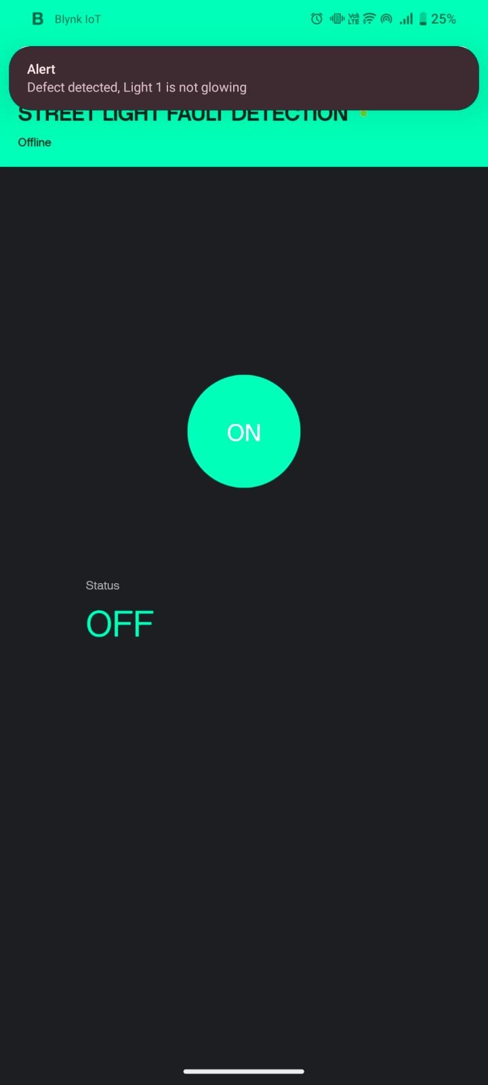
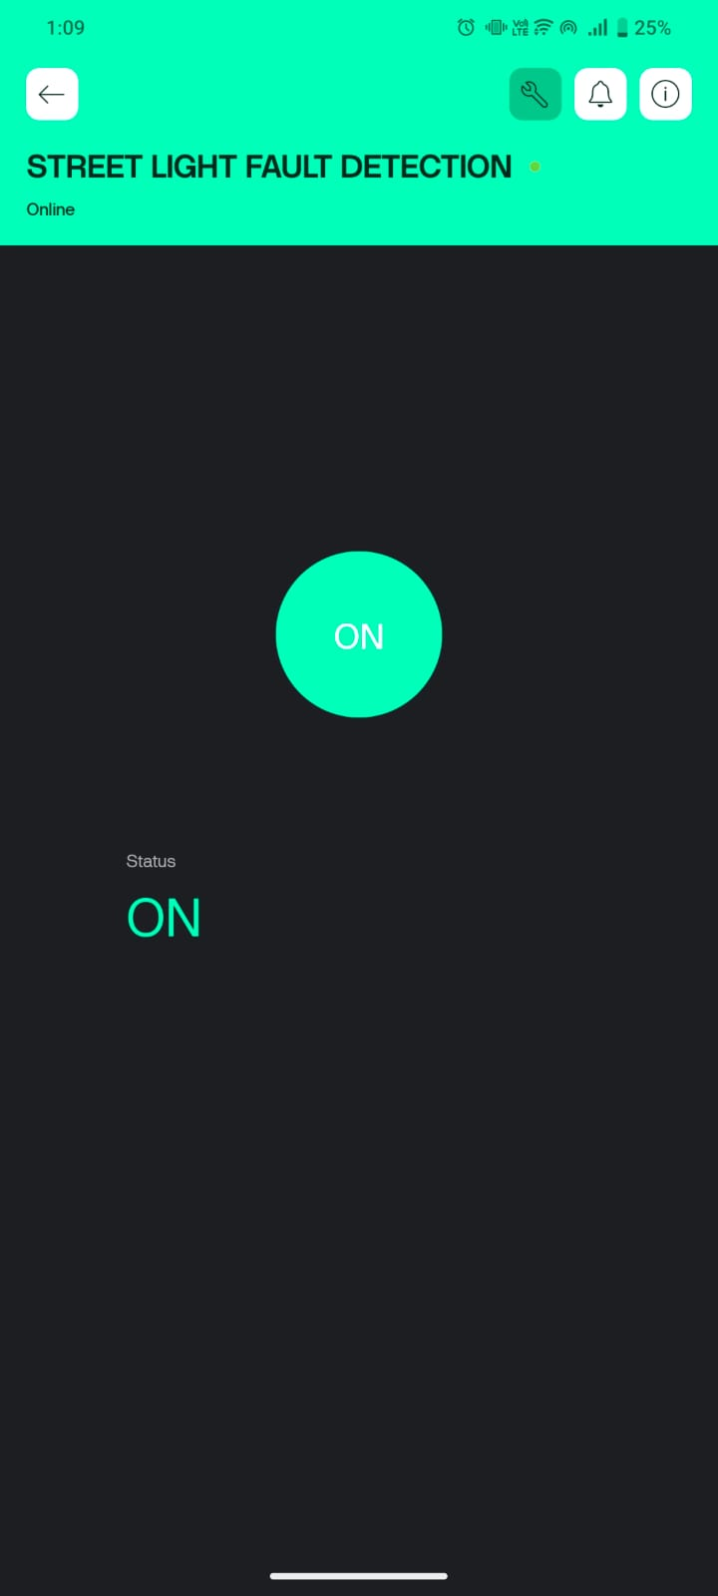

Slide 12
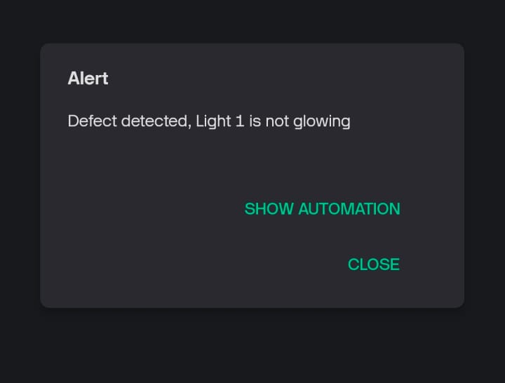

Slide 13
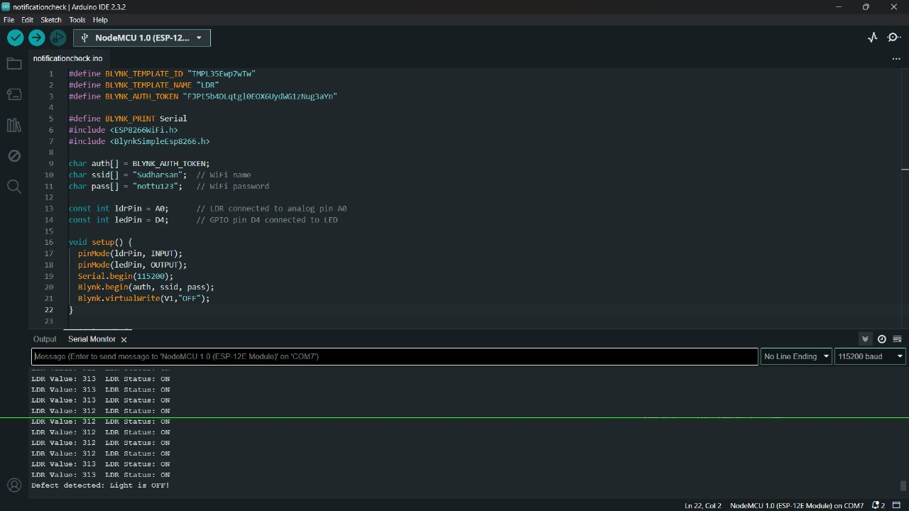

Slide 14
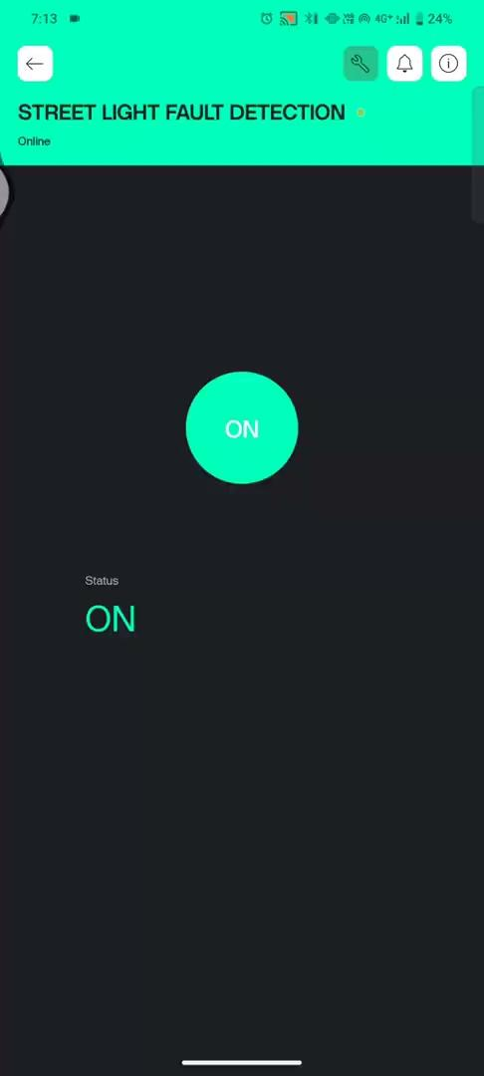


Slide 15
CONCLUSION AND FUTURE ENHANCEMENTS
Thus our automated real-time street light fault detection system aims in improving and enhancing urban lighting infrastructure thereby ensuring safety and security even in smaller and interior streets. Our notification facility helps the person at authority to get notified by the changes of the street lights conditions seamlessly. It also mentions the specific street light's number which helps the servicemen or the authority locate the faulty street light accurately.
This system when equipped with a solar power source or any other renewable forms of energy for maintenance can promote a sustainable future.

