Slide 1
Fastag Fraud Predection

Slide 2
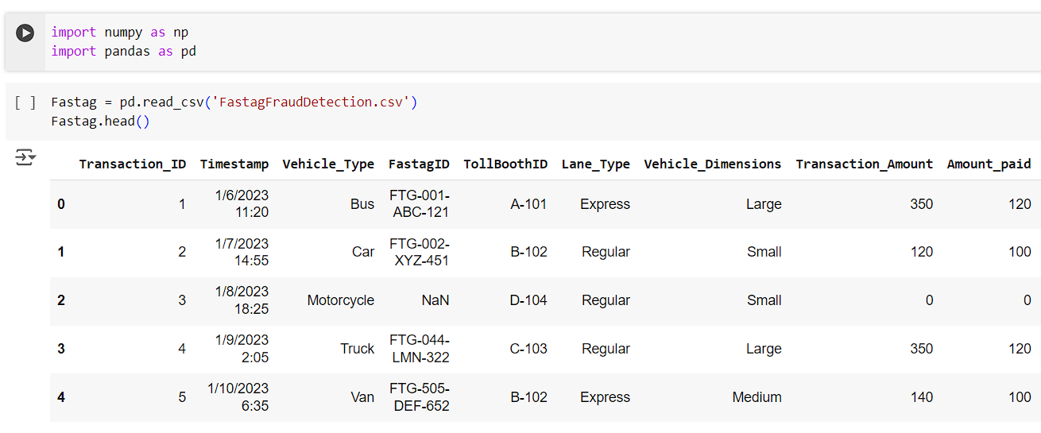
Import required libraries for Preprocess,Train and Test the model
Upload the CSV file for read and the Dataset

Slide 3
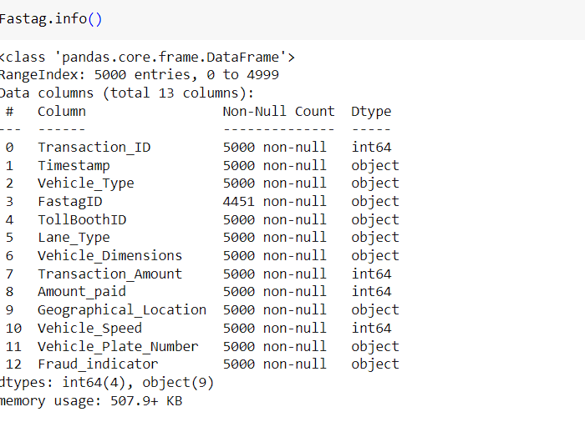
Fastag.info()
The info() function in pandas is used to get a concise summary of a DataFrame.
:

Slide 4
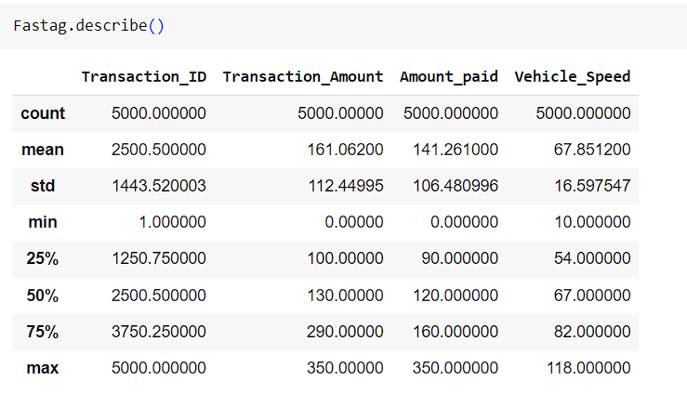
Fastag.describe()
The describe() function in pandas generates descriptive statistics of the
DataFrame's numeric columns by default

Slide 5
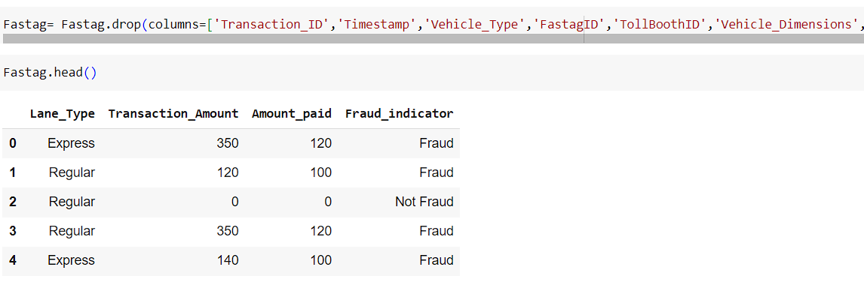
Fastag.drop()
The drop() function is used to remove the unnecessary column in the dataset

Slide 6
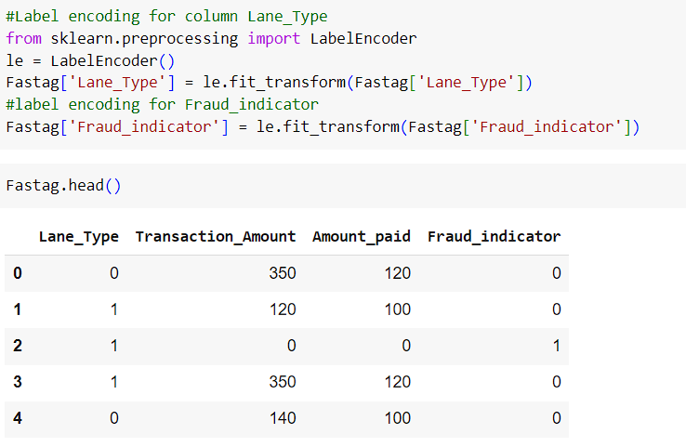
Label Encoding
Label encoding is a method of converting categorical data into numerical
data so that machine learning algorithms can process it.
This technique assigns a unique integer to each category value

Slide 7
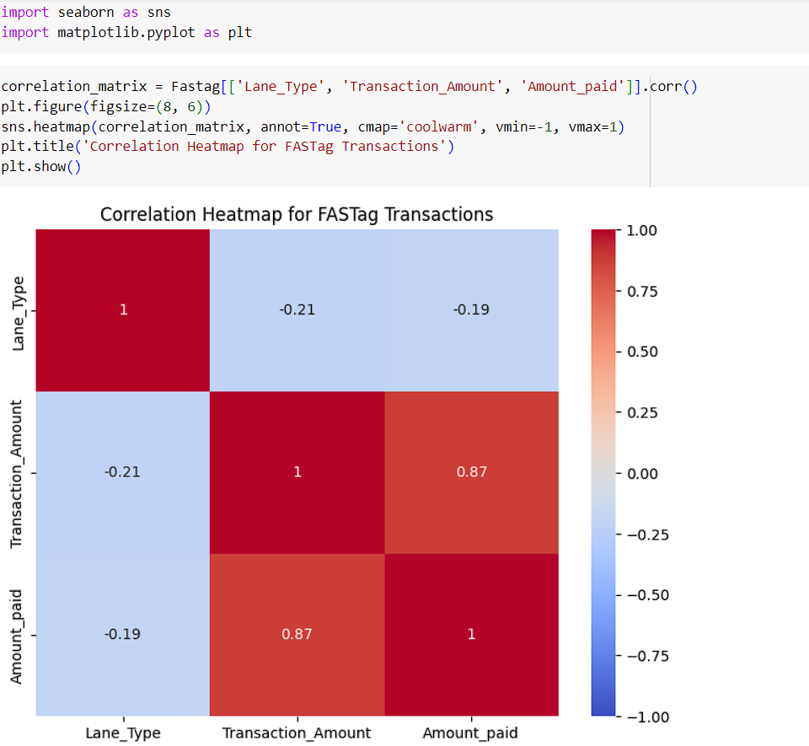
Plot the data point by Data visualization

Slide 8
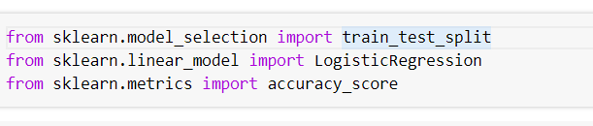
train_test_split
The train_test_split function in scikit-learn is used to split
a dataset into training and testing sets.

Slide 9
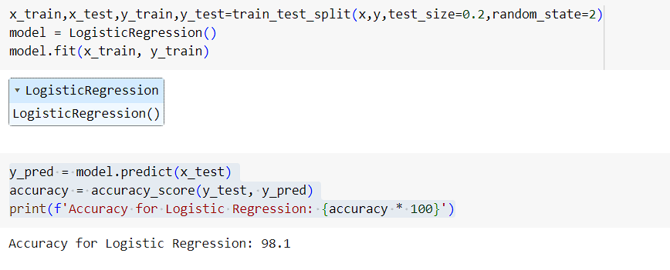
Logistic Regression
Logistic regression is a statistical method for predicting binary outcomes. It estimates the probability that a given input point belongs to a certain class. The output is a probability value between 0 and 1, which can be mapped to two possible classes using a threshold (typically 0.5).

Slide 10
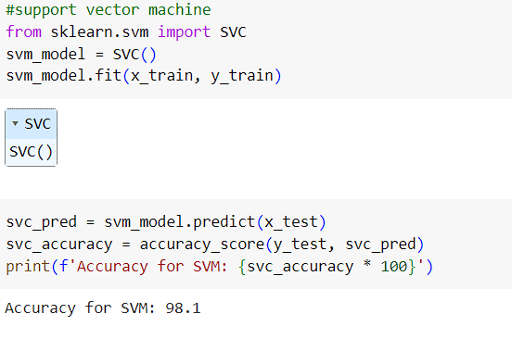
Support Vector Machine
Support Vector Machines (SVM) are a powerful set of supervised learning methods used for classification, regression, and outliers detection. SVMs are particularly well suited for classification of complex but small- or medium-sized datasets.

Slide 11
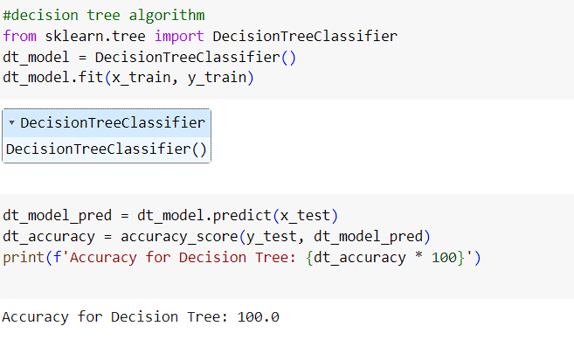
Decision Tree Algorithm
A Decision Tree is a popular and intuitive supervised learning algorithm used for both classification and regression tasks. It works by splitting the data into subsets based on the value of input features, recursively partitioning the data to create a tree-like model of decisions

Slide 12
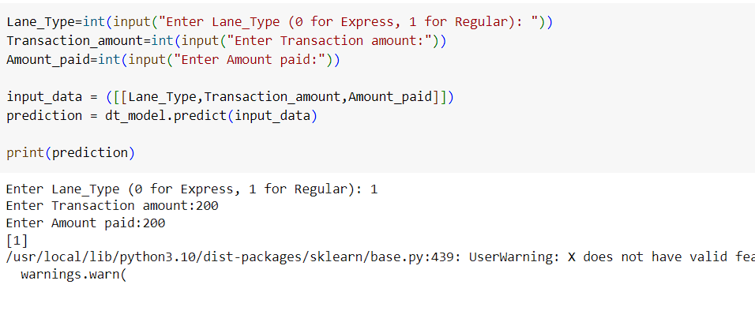
Predicit the model from the user’s input

Slide 13
THANK YOU

