Slide 1

SRM INSTITUTE OF SCIENCE AND TECHNOLOGY
Chennai – 600 089
SCHOOL OF COMPUTER SCIENCE ENGINEERING
DEPARTMENT OF COMPUTER SCIENCE AND ENGINEERING W/S IN ARTIFICIAL INTELLIGENCE AND MACHINE LEARNING
PLACEMENT TRAINING PROJECT
AIRLINE RESERVATION SYSTEM
CLASS/YEAR/SEC : AIML/III/B BATCH NUMBER : 4
Team Members | Supervisor
J. Arun (RA2311026020077) Tamil Selvan. K (RA2311026020090) | NAME: Mr. Dinesh G.T

Slide 2
AGENDA
Abstract
Scope and Motivation
Introduction
Objective
Problem Statement
Proposed Work
  Architecture Diagram
  ER Diagram
  Novel idea
  Modules
Module Output
Results and Discussion
Conclusion
Future Work

Slide 3
ABSTRACT
Airline Reservation System is a Java-based console application integrated with MS SQL Server that manages flight ticket booking and cancellation. It uses OOP principles such as abstraction, inheritance, encapsulation and polymorphism to handle passengers, seat allocation and fare calculation. The system supports real-time seat availability, passenger search, and revenue tracking using JDBC and SQL CRUD operations.

Slide 4
SCOPE AND MOTIVATION
SCOPE
MOTIVATION
Focus: Ticket management and seat inventory control for a specific flight entity.
Functions: Booking processing, cancellation handling, passenger record retrieval, and revenue calculation.
Emphasis: Integration of Object-Oriented Java logic with SQL Server database operations.
Addresses: The problem of losing data when a program closes (since it uses a database now).
Enables: Calculating ticket prices automatically based on the seat class (Economy vs. Business).
Improves: Organization by replacing manual paper records with digital storage.

Slide 5
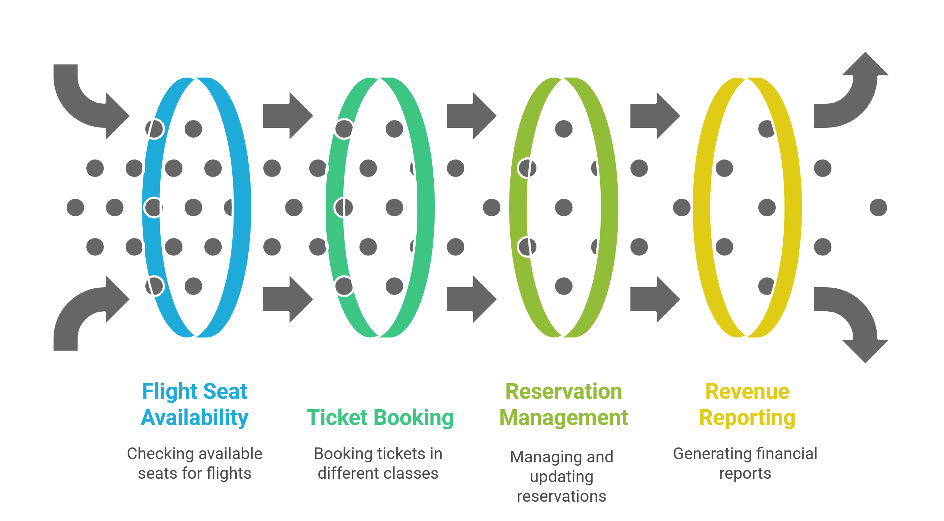
INTRODUCTION
This project focuses on designing and implementing an automated Airline Reservation System to streamline the ticket booking process. The system will store and manage passenger data, flight seat availability and reservation records. It will provide tools to book tickets across various classes (Economy, Business, etc.), cancel reservations and generate revenue reports.

Slide 6
OBJECTIVES
To automate the airline ticket booking process, reducing the need for manual paperwork and human error.
To implement a relational database system for the secure and persistent storage of passenger and flight records.
To ensure accurate inventory management by validating seat availability in
real-time before confirming a reservation.
To facilitate financial tracking by automatically calculating fares based on seat class and generating total revenue reports.
To design a modular code structure by separating database connection logic from core business logic for better maintainability.

Slide 7
PROBLEM STATEMENT
Manual System Inefficiencies: Traditional or manual methods of airline reservation involve significant paperwork, leading to slow processing times and inefficient data handling.
Data Inconsistency and Loss: Storing passenger records in physical files or non-relational formats often results in data redundancy, loss of information, and lack of data persistence.
Calculation Errors: Manual calculation of fares based on different seat classes (Economy, Business, etc.) is prone to human error, affecting revenue accuracy.
Inventory Management Issues: Without a centralized database, it is difficult to track real-time seat availability, leading to potential overbooking or underutilization of flight capacity.

Slide 8
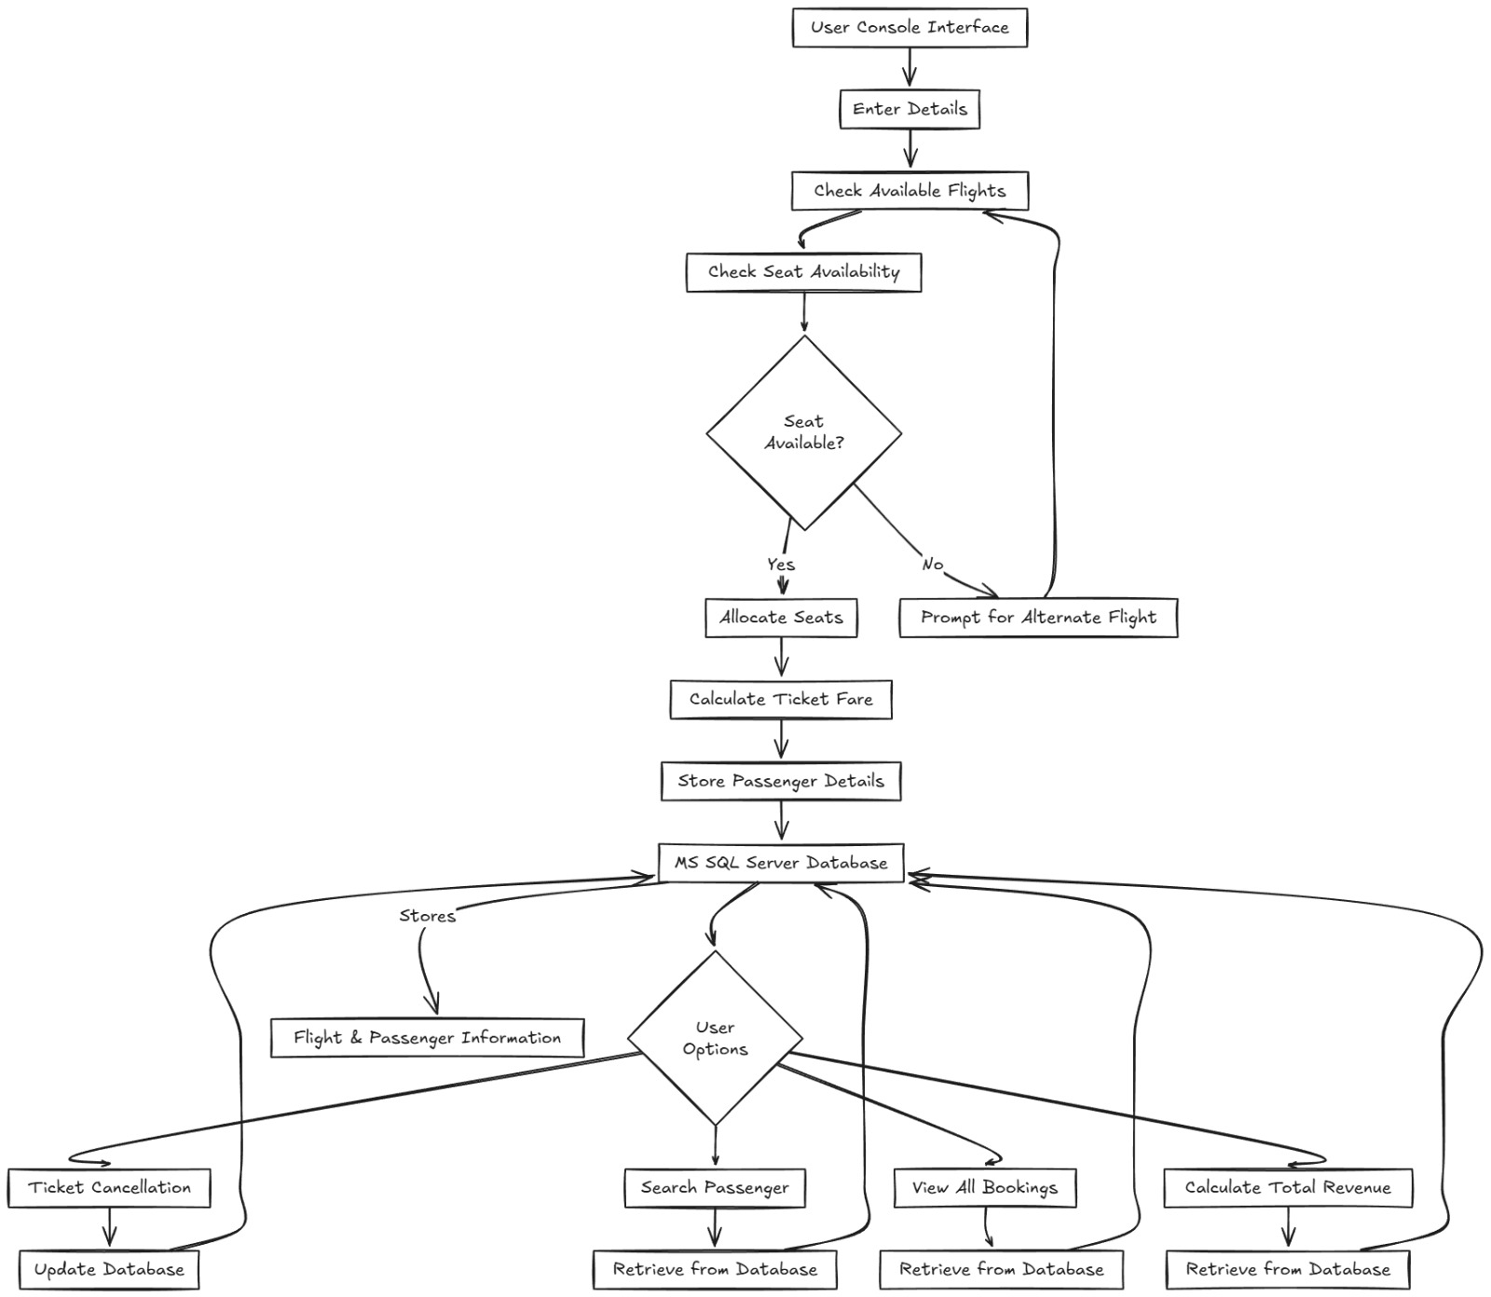
PROPOSED WORK-ARCHITECTURE DIAGRAM

Slide 9
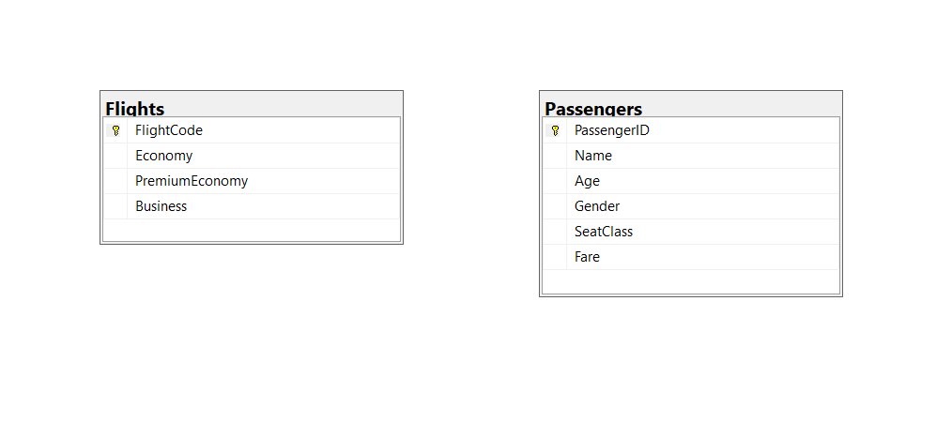
PROPOSED WORK-ER DIAGRAM

Slide 10
PROPOSED-NOVEL IDEA
Object-Oriented Design: The system is built using Java’s Object-Oriented principles (classes for Passengers, flights, tickets) making the code modular, scalable, and easy to maintain or expand in the future.
Automated Validation Logic: Unlike manual systems, the proposed model implements automated logic to check seat availability in real-time before confirming any booking, effectively preventing overbooking errors.
Dynamic Fare Computation: The model includes a predefined fare structure linked to seat classes (Economy, Business, etc.), allowing the system to automatically calculate and assign the correct ticket price without human intervention.
Secure Data Connectivity: The system employs JDBC (Java Database Connectivity) to establish a secure and reliable communication channel between the user interface and the backend database for all operations.

Slide 11
PROPOSED-MODULES
Ticket Reservation Module
Cancellation Management Module
Passenger Enquiry Module
Seat Inventory Management Module
Revenue Reporting Module
Database Connection Module

Slide 12
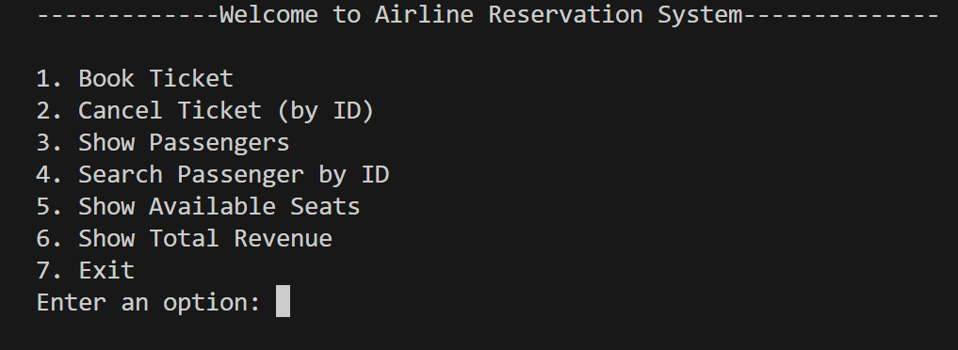
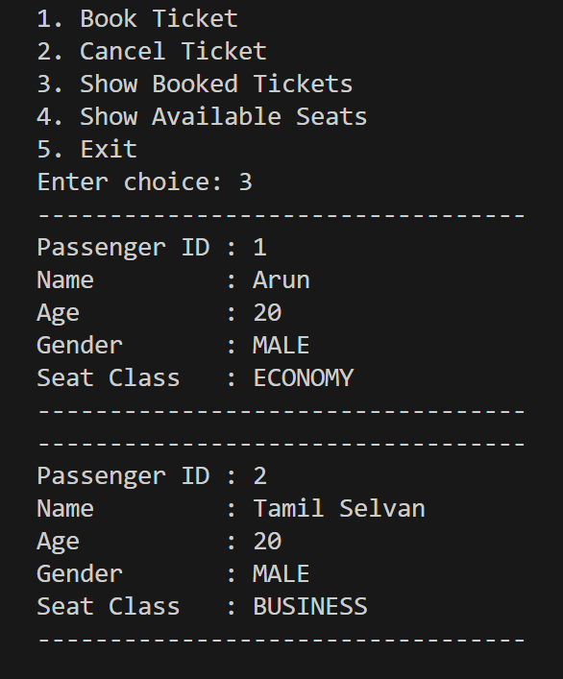
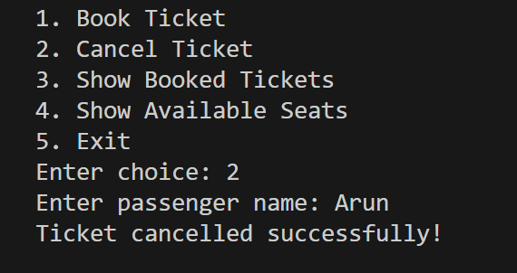
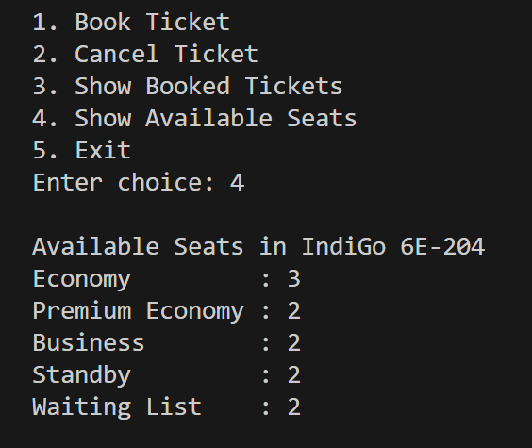
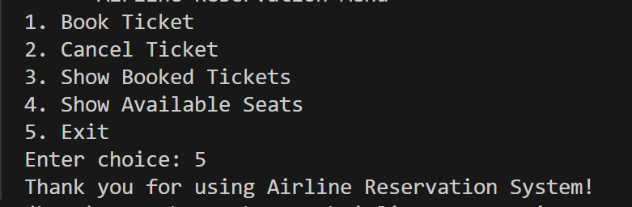
MODULE OUTPUT

Slide 13
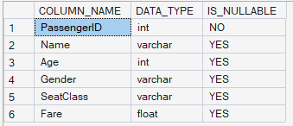
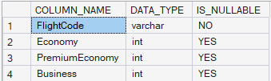
MODULE OUTPUT

Slide 14
RESULTS AND DISCUSSIONS
The Airline Reservation System was successfully implemented using Java and SQL Server, establishing secure database connectivity for persistent data storage. It automates critical tasks such as ticket booking, cancellation, and real-time inventory tracking to effectively prevent overbooking and manual errors. The final application meets all project objectives, providing a streamlined interface for efficient passenger management and accurate revenue reporting.
Metric
Manual System
Proposed System

Slide 15
CONCLUSION
The Airline Reservation System successfully automates the ticketing process by integrating Java with a MS SQL Server database, ensuring data accuracy and persistent storage. It effectively resolves the inefficiencies of manual systems by providing real-time validation for seat availability and automated fare calculations. Overall, the project demonstrates a functional application of Object-Oriented Programming and database management concepts to solve real-world problems

Slide 16
FUTURE SCOPE
GUI Implementation: Transitioning from a console-based interface to a Graphical User Interface (GUI) or web platform to improve user experience.
Payment Gateway Integration: Adding secure online payment processing to handle real-time transactions and instant ticket generation.
Multi-Flight Support: Expanding the database logic to manage schedules, routes, and inventories for multiple flights simultaneously.
Role-Based Access: Implementing distinct login modules for Administrators and Passengers to ensure data security and proper access control.
Notification System: Integrating email or SMS services to send automated booking confirmations and flight status updates to passengers.

Slide 17
THANK YOU

