Slide 1
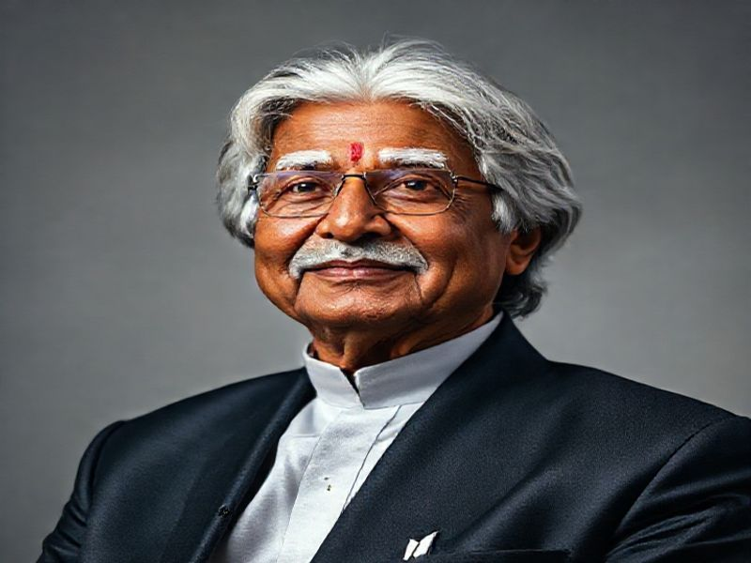
Dr. APJ Abdul Kalam: The People's President
This presentation explores the life, achievements, and legacy of Dr. APJ Abdul Kalam, one of India's most beloved presidents and a renowned scientist. We will delve into his early life, professional accomplishments, and his enduring impact on society.
by AI Research Team

Slide 2
Dr. APJ Abdul Kalam: A Visionary Leader
• 11th President of India (2002-2007)
• Renowned aerospace scientist
• Known as the 'People's President'
• Inspirational teacher and orator
• Recipient of the Bharat Ratna, India's highest civilian honor

Slide 3
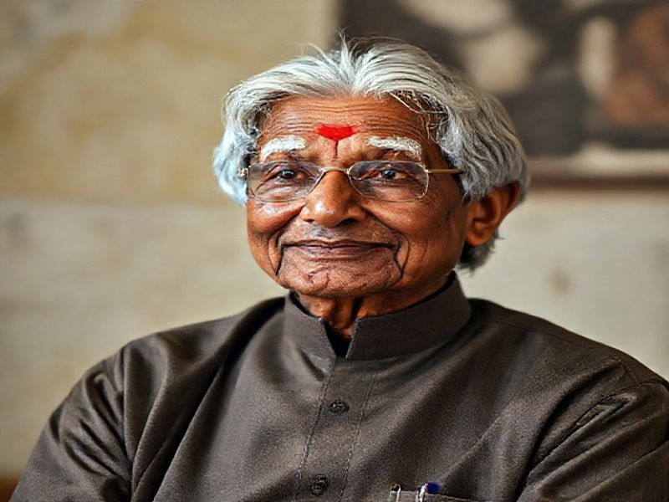
Early Life and Education
Born on October 15, 1931, in Rameswaram, Tamil Nadu, India
Studied aeronautical engineering at the Madras Institute of Technology
Worked as a scientist at the Defence Research and Development Organisation (DRDO)

Slide 4
Professional Achievements
Known as the 'Missile Man of India' for his work on the Agni and Prithvi missiles
Project Director of India's first Indigenous Satellite Launch Vehicle (SLV-III)
S
W
Chief Executive of India's Integrated Guided Missile Development Programme (IGMDP)
Chief Scientific Adviser to the Prime Minister of India (1992-1999)
T
O

Slide 5
Presidency and Legacy
Elected as the 11th President of India in 2002, serving until 2007
Popularly known as the 'People's President' for his humility and accessibility

Slide 6
Conclusion
Dr. APJ Abdul Kalam's life and work continue to inspire millions
His contributions to science, education, and leadership are unparalleled
His vision for a developed India remains a guiding light

