Slide 1
Future of AI
A look into the future of Artificial Intelligence.

Slide 2
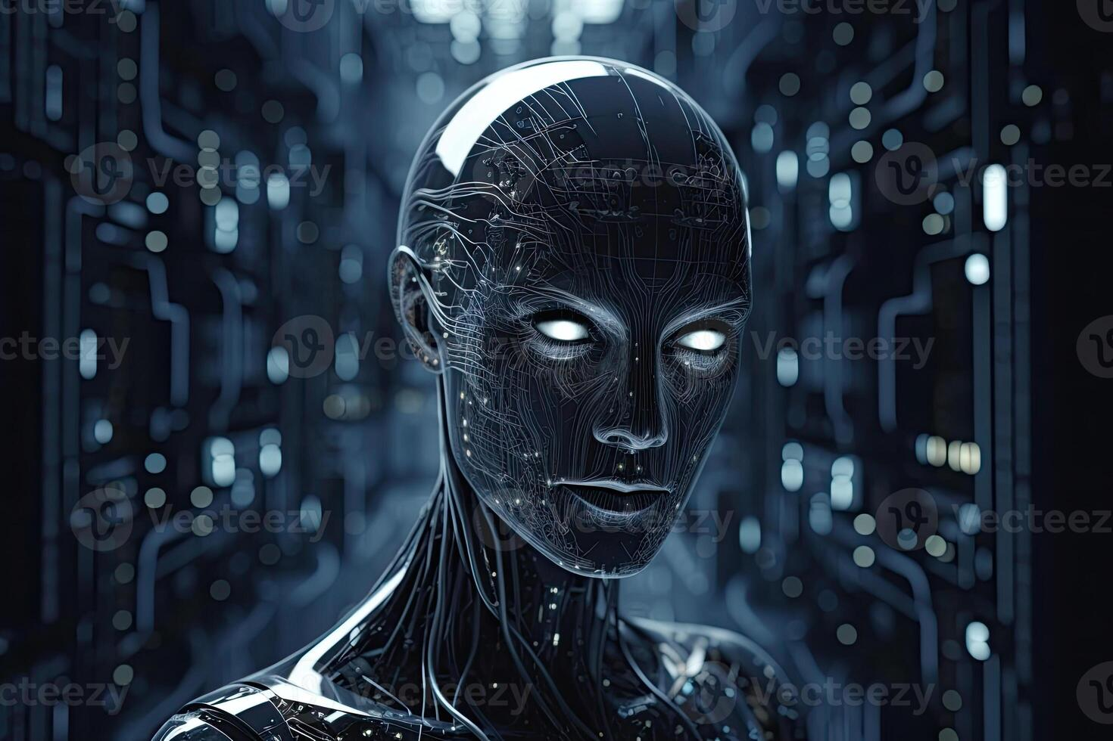
1. Introduction
AI is growing fast
Impact on society
Future trends

Slide 3
2. Machine Learning
Deep Learning
Neural Networks
Data Processing

