Slide 1
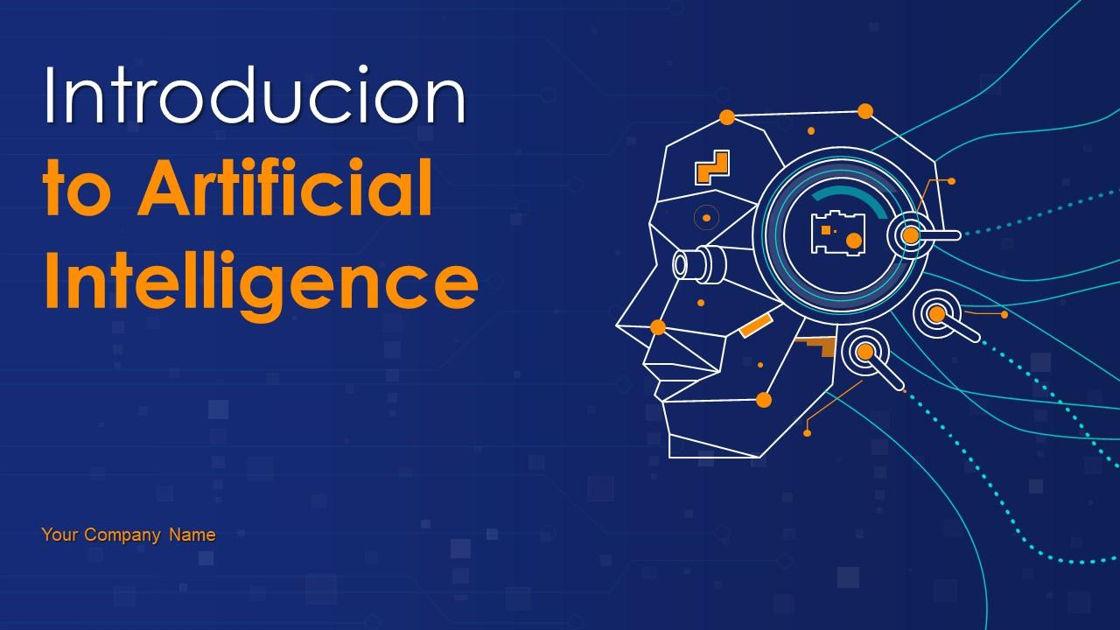
Introduction to AI
This presentation provides a comprehensive overview of Artificial Intelligence, covering its definition, history, types, applications, and future trends. It is designed to be informative and engaging for a professional audience.

Slide 2

Introduction to Artificial Intelligence
• Welcome to our presentation on AI
• Understanding the basics and impact of AI
• Designed for professionals and enthusiasts

Slide 3

What is Artificial Intelligence?
• Simulation of human intelligence in machines
• Capabilities: learning, reasoning, problem-solving, perception
• Goal: create systems that can perform tasks normally requiring human intelligence

Slide 4

A Brief History of AI
• 1950s: Birth of AI as a field (Turing, McCarthy)
• 1980s: Expert systems and commercial AI applications
• 2010s: Deep learning and AI's resurgence (e.g., AlphaGo, Siri)

Slide 5
Types and Applications of AI
• Types: Narrow AI, General AI, Superintelligent AI
• Applications: Healthcare, Finance, Autonomous Vehicles, Virtual Assistants
• Impact: Transforming industries and daily life

Slide 6

Conclusion and Future of AI
• AI is a rapidly evolving field with immense potential
• Future trends: Explainable AI, AI ethics, and human-AI collaboration
• Thank you for your attention. Questions?

