Slide 1
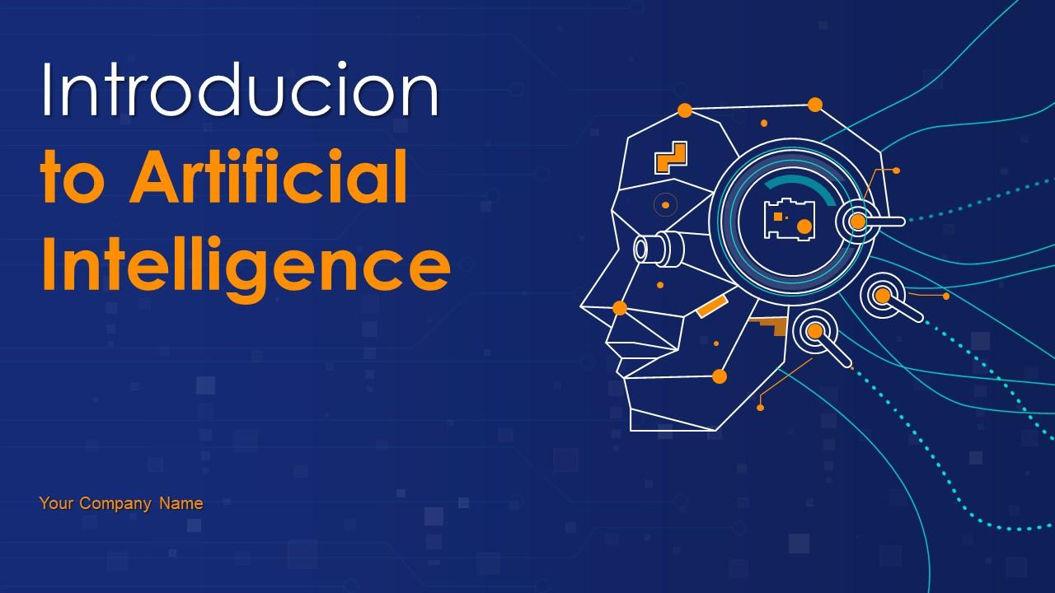
Introduction to AI
This presentation provides a comprehensive introduction to Artificial Intelligence (AI), covering its definition, history, types, applications, and future trends. It is designed to be informative and engaging for a professional audience.

Slide 2

Introduction to Artificial Intelligence
• Welcome to our presentation on AI
• Understanding the basics and implications of AI
• Exploring the future of AI technology

Slide 3

What is Artificial Intelligence?
• AI refers to the simulation of human intelligence in machines
• It enables machines to learn, reason, and perform tasks
• AI can be categorized into narrow AI and general AI

Slide 4

A Brief History of AI
• 1950s: Birth of AI as a field of study
• 1980s: Rise of expert systems and machine learning
• 2010s: Deep learning and AI's resurgence

Slide 5
Applications of AI
• Healthcare: Disease diagnosis and drug discovery
• Finance: Fraud detection and algorithmic trading
• Automotive: Autonomous vehicles and driver assistance

Slide 6
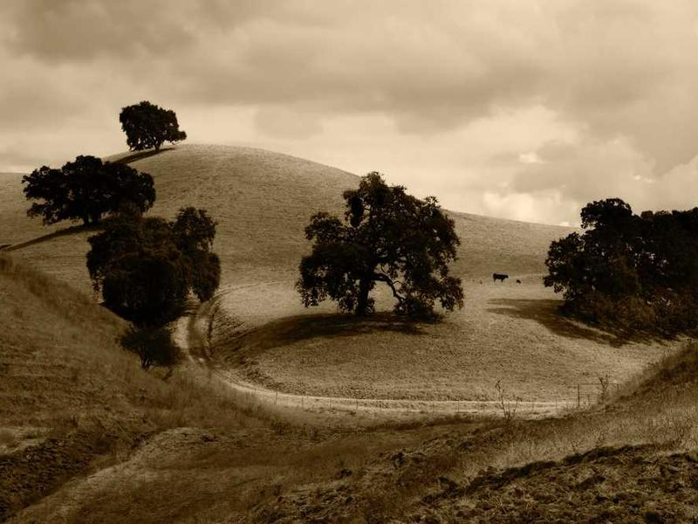
Conclusion and Future Trends
• AI is transforming industries and our daily lives
• Future trends include explainable AI, AI ethics, and AI in edge computing
• Thank you for your attention. Let's embrace the future of AI together!

