Slide 1
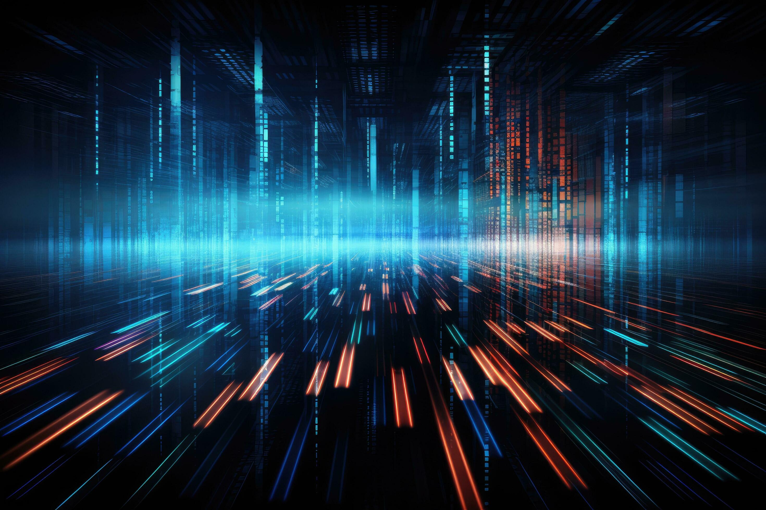
Introduction to AI
This presentation provides a comprehensive overview of Artificial Intelligence, covering its definition, history, applications, challenges, and future trends. It is designed to be informative and engaging for a professional audience.

Slide 2
Introduction to Artificial Intelligence
• Welcome to our presentation on AI
• Understanding the basics and implications of AI
• Designed for professionals and enthusiasts alike

Slide 3

What is Artificial Intelligence?
• Simulation of human intelligence in machines
• Capabilities: learning, reasoning, problem-solving
• Subfields: Machine Learning, Natural Language Processing, Robotics

Slide 4

A Brief History of AI
• 1950s: Birth of AI as a field
• 1980s: Expert Systems and Commercial AI
• 2010s: Deep Learning and Big Data

Slide 5

Applications and Challenges of AI
• Applications: Healthcare, Finance, Autonomous Vehicles
• Challenges: Ethical concerns, Data privacy, Job displacement
• Opportunities: Innovation, Efficiency, New industries

Slide 6

Conclusion and Future Trends
• AI is transforming industries and societies
• Future trends: General AI, AI ethics, Regulation
• Continuous learning and adaptation are key
• Thank you for your attention

