Slide 1
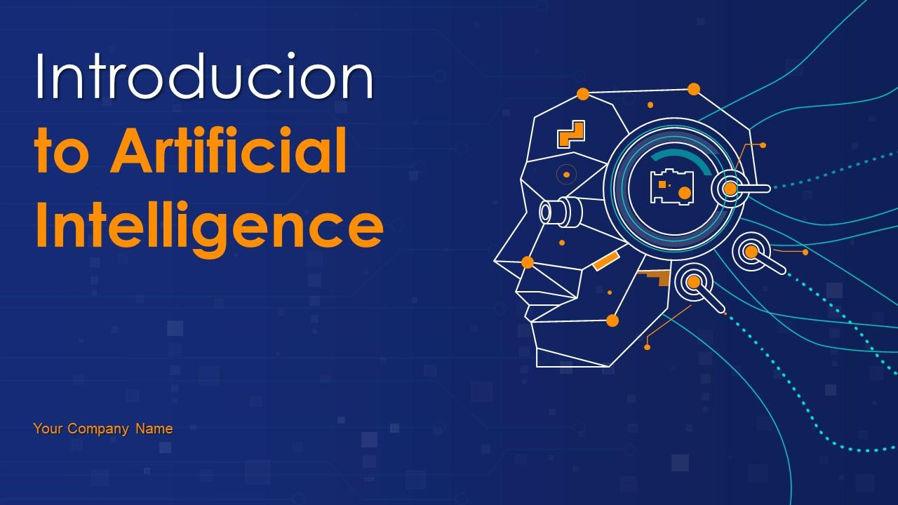
Introduction to AI
This presentation provides a comprehensive overview of Artificial Intelligence, its history, applications, and future trends. It is designed to be informative and engaging for a professional audience.
by AI Research Team

Slide 2
Introduction to Artificial Intelligence
• Welcome to our presentation on AI
• Understanding the basics and impact of AI
• Exploring the future of AI technology

Slide 3

What is Artificial Intelligence?
Definition of AI: Simulating human intelligence in machines
Key components: Learning, reasoning, problem-solving, perception
Types of AI: Narrow AI, General AI, Superintelligent AI

Slide 4
History and Evolution of AI
Early beginnings: Alan Turing and the Turing Test
Milestones: Expert systems, Machine Learning, Deep Learning
S
W
Recent advancements: Neural networks, Natural Language Processing
T

Slide 5

Applications of AI
Healthcare: Disease diagnosis, drug discovery, personalized medicine
Finance: Fraud detection, algorithmic trading, customer service

Slide 6
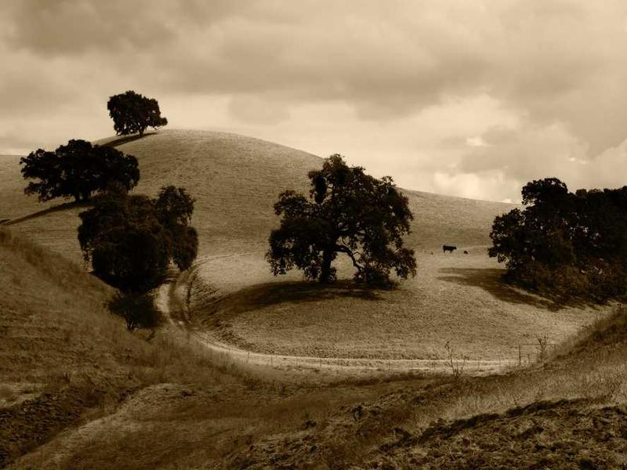
Conclusion and Future of AI
Recap of key points discussed
The future of AI: Opportunities and challenges
Encouraging further learning and exploration in AI

