Slide 1
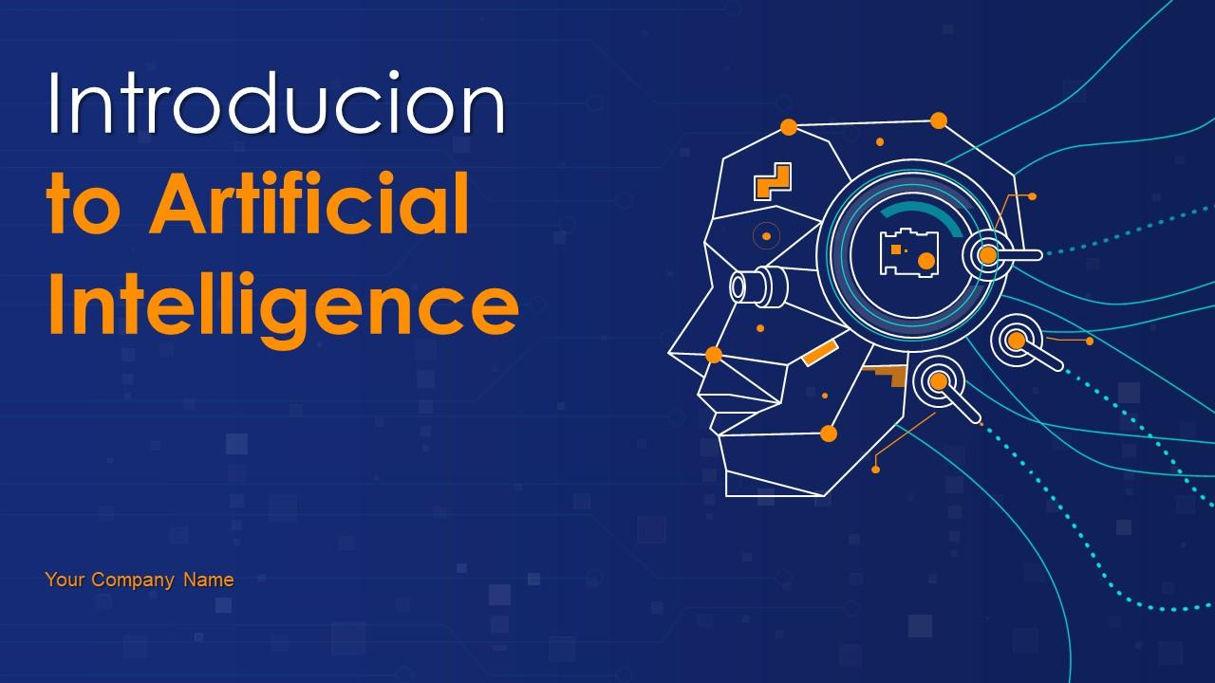
Introduction to Artificial Intelligence
This presentation provides a comprehensive overview of Artificial Intelligence, covering its definition, history, types, applications, and future trends. It is designed to be informative and engaging for a professional audience.

Slide 2

Introduction to Artificial Intelligence
• A journey into the world of AI
• Understanding the fundamentals and implications
• Designed for professionals and enthusiasts

Slide 3

What is Artificial Intelligence?
• Simulation of human intelligence in machines
• Capabilities: learning, reasoning, problem-solving, perception
• Subfields: Machine Learning, Natural Language Processing, Robotics, Computer Vision

Slide 4

A Brief History of AI
• 1950s: Birth of AI as a field (Turing, McCullouch-Pitts)
• 1980s: Expert Systems and commercial AI applications
• 2010s: Deep Learning and AI's resurgence

Slide 5
Applications of AI
• Healthcare: Disease diagnosis, drug discovery, personalized medicine
• Finance: Fraud detection, algorithmic trading, risk assessment
• Automotive: Autonomous vehicles, driver assistance systems

Slide 6

Conclusion and Future Trends
• AI is transforming industries and societies
• Future trends: Explainable AI, AI ethics, AI in edge computing
• Lifelong learning and staying updated in the AI field

