Slide 1
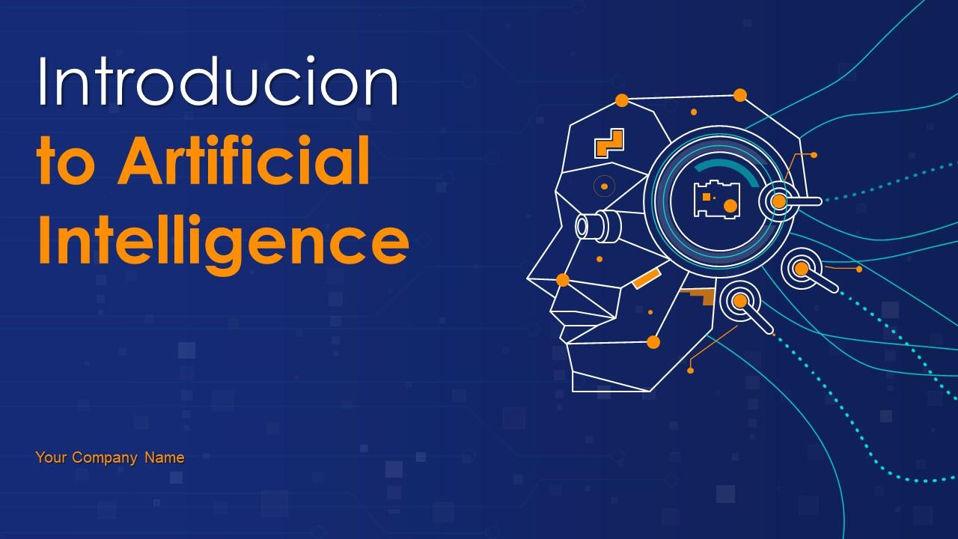
Introduction to Artificial Intelligence
This presentation provides a comprehensive overview of Artificial Intelligence, covering its definition, history, types, applications, and future trends. Designed for a professional audience, it offers an engaging and informative introduction to the fascinating world of AI.

Slide 2

Introduction to Artificial Intelligence
• Content for Introduction to Artificial Intelligence

Slide 3
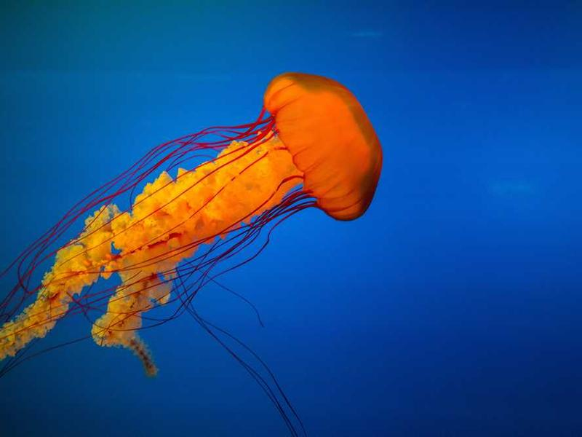
What is Artificial Intelligence?
• AI refers to the simulation of human intelligence in machines
• It enables machines to perform tasks that typically require human intelligence
• Key components include learning, reasoning, problem-solving, and perception
• AI can be classified into narrow AI and general AI

Slide 4

A Brief History of AI
• 1950s: Birth of AI as a field, with pioneers like Alan Turing and John McCarthy
• 1960s-1970s: Early AI programs and expert systems
• 1980s-1990s: Rise of machine learning and neural networks
• 2000s-Present: AI boom, with advancements in big data, deep learning, and AI applications

Slide 5
Applications of AI
• Healthcare: Disease diagnosis, drug discovery, and personalized medicine
• Finance: Fraud detection, algorithmic trading, and customer service
• Automotive: Autonomous vehicles, driver assistance, and predictive maintenance
• Entertainment: Recommendation systems, content creation, and gaming

Slide 6

Conclusion and Future Trends
• AI is a rapidly growing field with immense potential
• Future trends include explainable AI, AI ethics, and AI democratization
• Continuous learning and adaptation will be key to staying relevant in the AI landscape
• Embrace AI and explore its possibilities to drive innovation and growth

