Slide 1
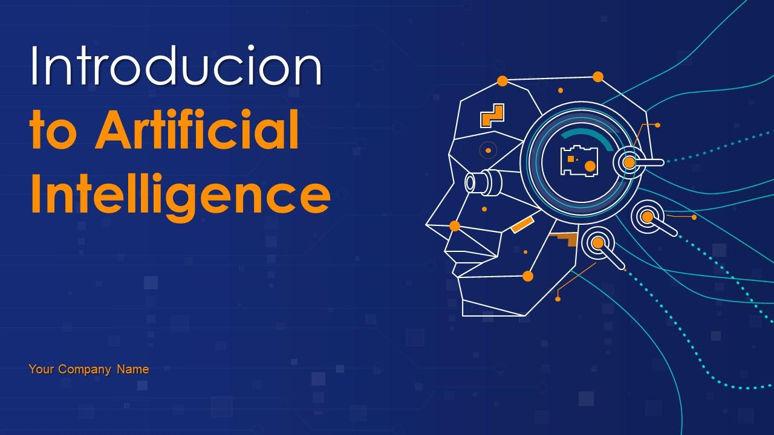
Introduction to Artificial Intelligence
This presentation provides a comprehensive overview of Artificial Intelligence, its history, applications, and future trends. It is designed to be informative and engaging for a professional audience.

Slide 2
Introduction to Artificial Intelligence
• Welcome to our presentation on AI
• We will cover the basics, applications, and future of AI
• Designed for a professional audience

Slide 3

What is Artificial Intelligence?
• AI refers to the simulation of human intelligence in machines
• It is a branch of computer science
• AI can be classified into narrow AI and general AI
• Narrow AI is designed for a specific task
• General AI has the ability to perform any intellectual task that a human can do

Slide 4

History of AI
• The concept of AI dates back to ancient times
• Modern AI began in the mid-20th century
• Key milestones include the Turing Test and the development of expert systems

Slide 5

Applications of AI
• AI is used in various fields such as healthcare, finance, and automotive
• It powers virtual assistants like Siri and Alexa
• AI is also used in predictive analytics and fraud detection
• The future of AI includes advancements in robotics and autonomous systems

Slide 6
Conclusion
• AI is a rapidly evolving field with vast potential
• It is transforming industries and improving efficiency
• Understanding AI is crucial for professionals in the 21st century
• Thank you for your attention. Any questions?

