Slide 1
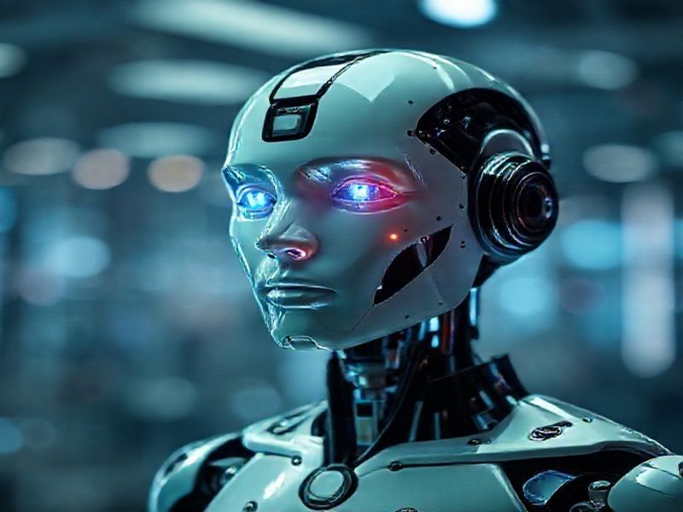
Introduction to Artificial Intelligence
This presentation provides a comprehensive overview of Artificial Intelligence (AI), covering its definition, history, applications, benefits, and future trends. It is designed to be informative and engaging for a professional audience.
by AI Research Team

Slide 2
Introduction to Artificial Intelligence
• Content for Introduction to Artificial Intelligence

Slide 3
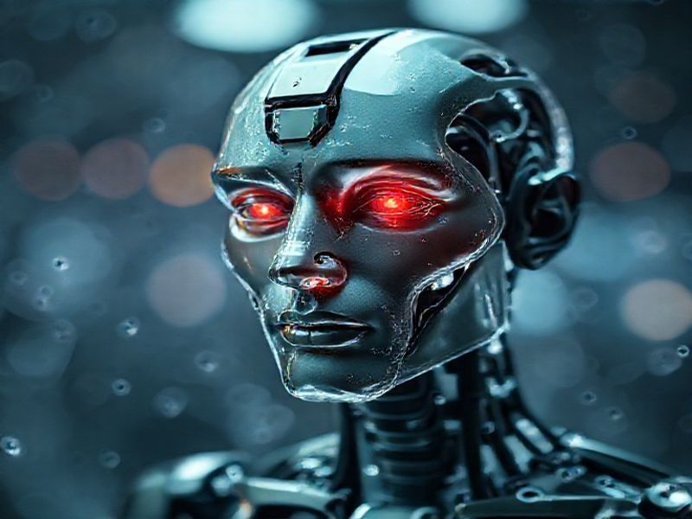
What is Artificial Intelligence?
AI refers to the simulation of human intelligence in machines
Involves learning, reasoning, problem-solving, and perception
Can be categorized into narrow AI and general AI

Slide 4
History and Evolution of AI
S
W
Origins trace back to ancient myths and philosophical debates
Modern AI began in the mid-20th century with Alan Turing's work
T
O
Key milestones include the development of expert systems, machine learning, and deep learning
Recent advancements driven by big data, powerful computing, and innovative algorithms

Slide 5

Applications and Benefits of AI
AI is transforming industries such as healthcare, finance, and transportation
Enhances efficiency, accuracy, and decision-making processes

Slide 6
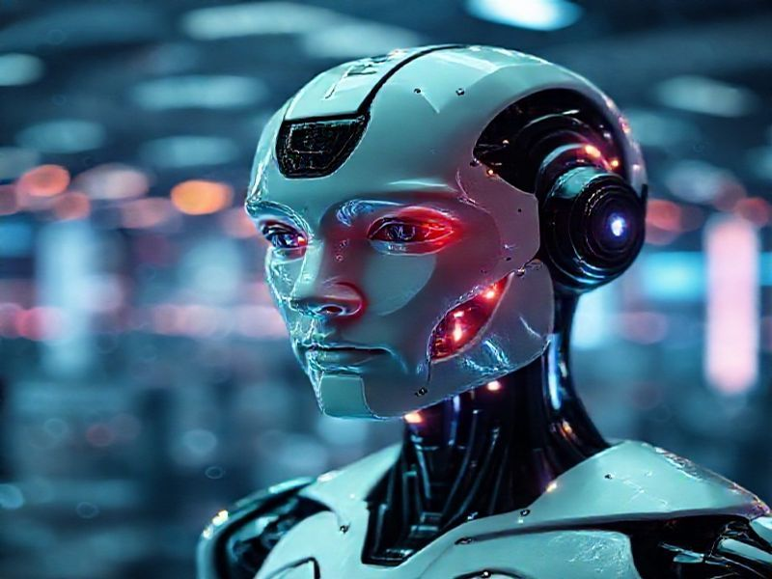
Conclusion
AI is a rapidly evolving field with immense potential
Understanding AI is crucial for leveraging its benefits and addressing challenges
Future trends include advancements in general AI, ethical considerations, and global collaboration

