Slide 1

Multi-Theme Test
Testing random themes and layouts.
by AI Research Team

Slide 2
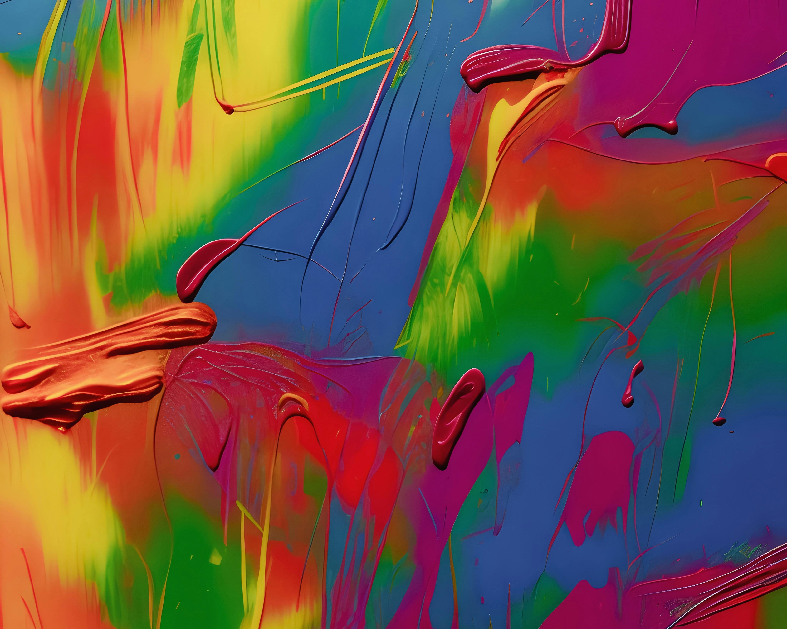
Introduction
This slide should have an image
Layout should be two-column

Slide 3
Text Only Slide
• This slide has NO image
• It should use full width
• Text should be readable

