Slide 1

Royal Enfield: A Legacy of Adventure and Innovation
This presentation explores the rich history, iconic models, global presence, and future innovations of Royal Enfield. Discover how this legendary brand continues to captivate motorcycle enthusiasts worldwide.
by AI Research Team

Slide 2
Royal Enfield: A Legacy of Adventure and Innovation
• Content for Royal Enfield: A Legacy of Adventure and Innovation

Slide 3
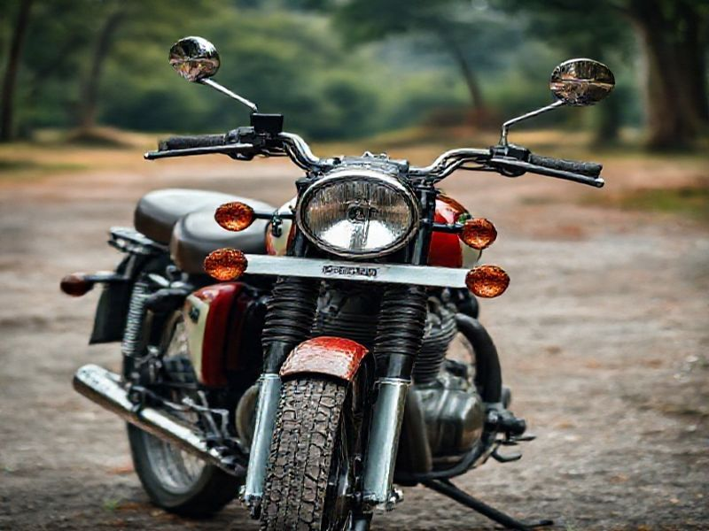
A Glimpse into History
Founded in 1898 in England, one of the oldest motorcycle brands in the world
Known for producing robust, affordable, and reliable motorcycles
Gained fame during World War II for its military motorcycles

Slide 4
Iconic Models
S
W
Bullets: The classic, timeless model that started it all
Classic Series: A blend of vintage design and modern technology
T
O
Himalayan: A purpose-built adventure motorcycle for rugged terrains
Continental GT: Inspired by 1960s caf racers, offering a sporty ride

Slide 5
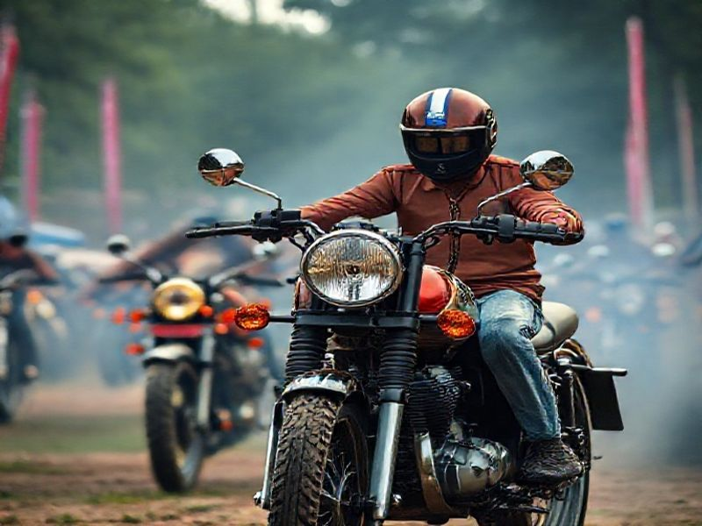
Global Presence and Community
Presence in over 50 countries with a strong dealer network
Thriving community of riders and enthusiasts worldwide

Slide 6
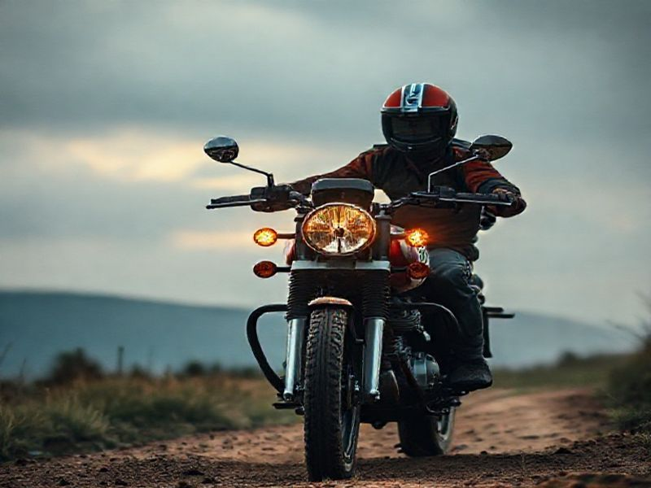
Conclusion: The Spirit of Royal Enfield
Royal Enfield's rich history and iconic models have cemented its place in motorcycle history
The brand's global presence and community continue to grow and inspire
With a focus on innovation and adventure, Royal Enfield's future looks promising

