Slide 1

Royal Enfield: A Legacy of Adventure and Innovation
This presentation explores the rich history, unique features, market presence, and future prospects of Royal Enfield, a iconic motorcycle brand. Discover what sets Royal Enfield apart in the world of motorcycling.
by AI Research Team

Slide 2
Royal Enfield: A Legacy of Adventure and Innovation
• Established in 1901, Royal Enfield is one of the oldest motorcycle brands in the world.
• Known for its classic design and robust engineering, Royal Enfield has a cult following.
• The brand is owned by Eicher Motors and is headquartered in Chennai, India.

Slide 3
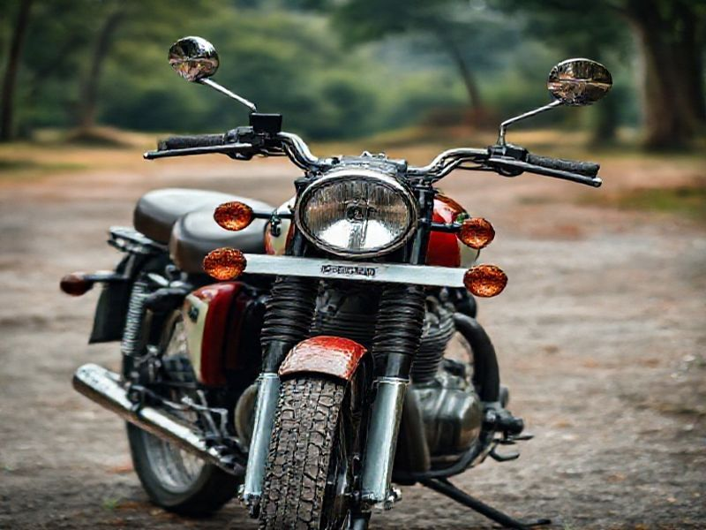
History and Evolution
Founded in England, Royal Enfield gained prominence during World War II for its reliable motorcycles.
Post-war, the brand expanded globally, with a significant presence in India since the 1950s.
In 1994, Eicher Motors acquired Royal Enfield, revitalizing the brand with modern technology and classic design.

Slide 4
Iconic Models and Features
S
W
Royal Enfield is renowned for models like the Bullet, Classic, and Himalayan.
These motorcycles are celebrated for their timeless design, durability, and off-road capabilities.
T
The brand offers a unique blend of retro styling and modern engineering, appealing to a wide range of riders.

Slide 5
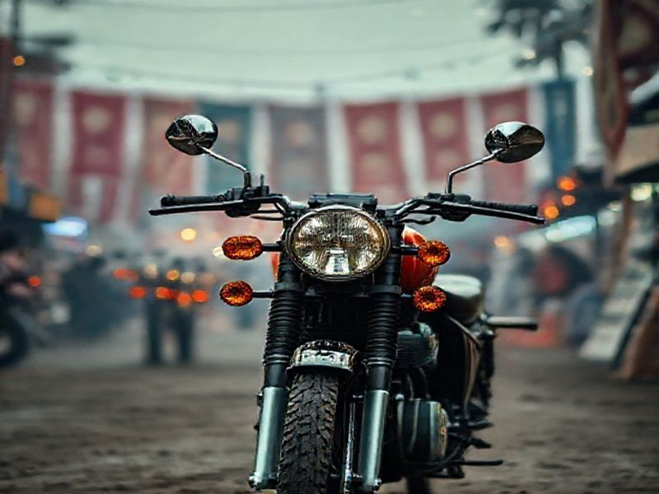
Global Market Presence and Community
Royal Enfield has a strong presence in over 50 countries, with a significant market share in India and Europe.
The brand fosters a vibrant community of riders through events, expeditions, and the 'Ride to Work' campaign.

Slide 6
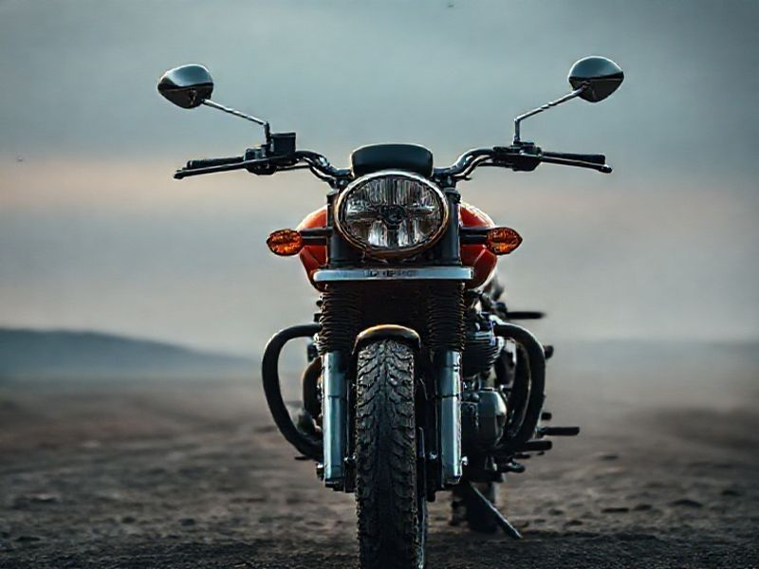
Conclusion: The Future of Royal Enfield
Royal Enfield continues to innovate while staying true to its heritage.
With a focus on sustainability, electric vehicles, and expanding its global footprint, the brand is poised for a dynamic future.
As Royal Enfield embarks on its next century, it remains a beacon of adventure, innovation, and timeless design in the world of motorcycling.

