Slide 1

Royal Enfield: A Legacy of Adventure and Innovation
This presentation explores the rich history, iconic models, global presence, and future innovations of Royal Enfield. Discover what makes this brand a legend in the motorcycle world.
by AI Research Team

Slide 2
Royal Enfield: A Legacy of Adventure and Innovation
• Content for Royal Enfield: A Legacy of Adventure and Innovation

Slide 3
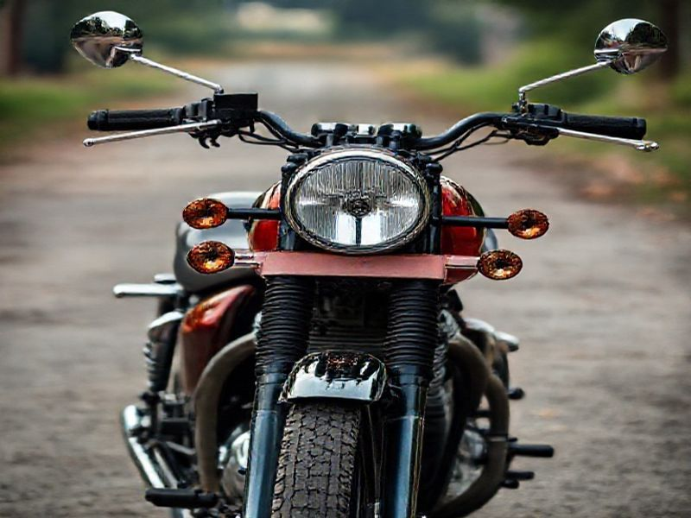
A Glimpse into History
Founded in 1898, one of the oldest motorcycle brands
Iconic Bullet model introduced in 1932
Rebranded and revived in 1990s under Enfield India

Slide 4
Iconic Models and Innovations
S
W
Classic 350 and 500: Timeless design with modern tech
Himalayan: Adventure bike for rugged terrains
T
O
Continental GT: Retro-modern caf racer
Electronic fuel injection and ABS for safety

Slide 5
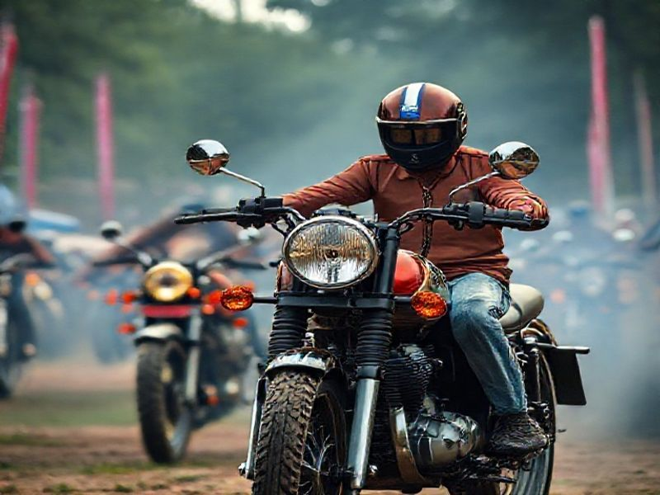
Global Presence and Community
Strong presence in India, Europe, and North America
Popular among adventure and retro motorcycle enthusiasts

Slide 6
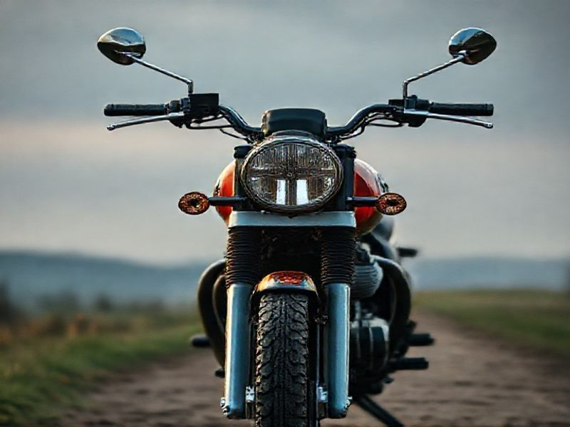
Conclusion: The Future of Royal Enfield
Continuing legacy with modern innovations
Expanding electric vehicle lineup
Growing global market presence

