Slide 1

Royal Enfield: Legacy, Innovation, and Future
This presentation explores the rich history, current market position, and future prospects of Royal Enfield, a iconic motorcycle brand. It highlights the brand's unique features and its impact on the global motorcycle industry.
by AI Research Team

Slide 2
Royal Enfield: A Legacy of Excellence
• Founded in 1901, Royal Enfield is one of the oldest motorcycle brands in the world.
• Known for its classic design and robust engines, the brand has a cult following.
• Headquartered in Chennai, India, Royal Enfield has a significant global presence.
• The brand is renowned for its Bullet model, which has been in production since 1932.

Slide 3
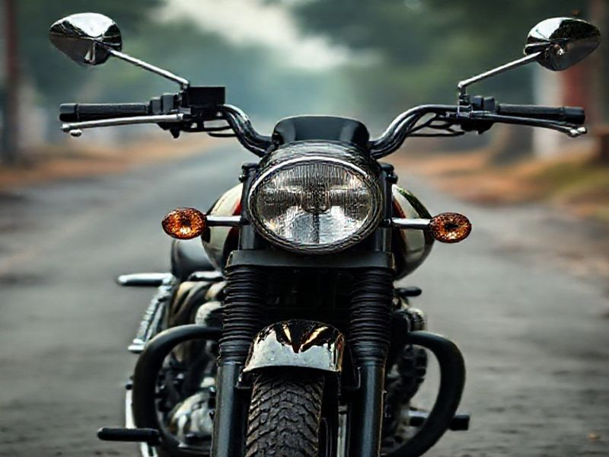
Market Position and Unique Features
Royal Enfield is the largest manufacturer of middleweight motorcycles in the world.
The brand's motorcycles are known for their timeless design and reliable performance.
Royal Enfield offers a range of models, including the Classic, Himalayan, and Interceptor.

Slide 4
Current Trends and Innovations
S
W
Royal Enfield is embracing digital technology with features like Bluetooth connectivity and trip computers.
The brand is expanding its electric vehicle lineup to meet global sustainability goals.
T
O
Royal Enfield has been investing in new manufacturing facilities to increase production capacity.
The brand's customization options and accessories have seen significant growth.

Slide 5
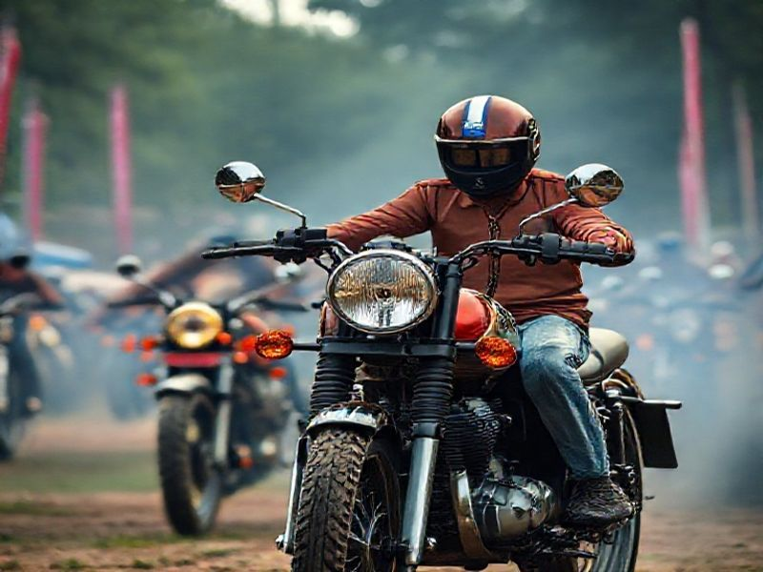
Global Impact and Community
Royal Enfield has a strong community of enthusiasts and riders worldwide.
The brand sponsors and participates in various motorcycle rallies and events.

Slide 6
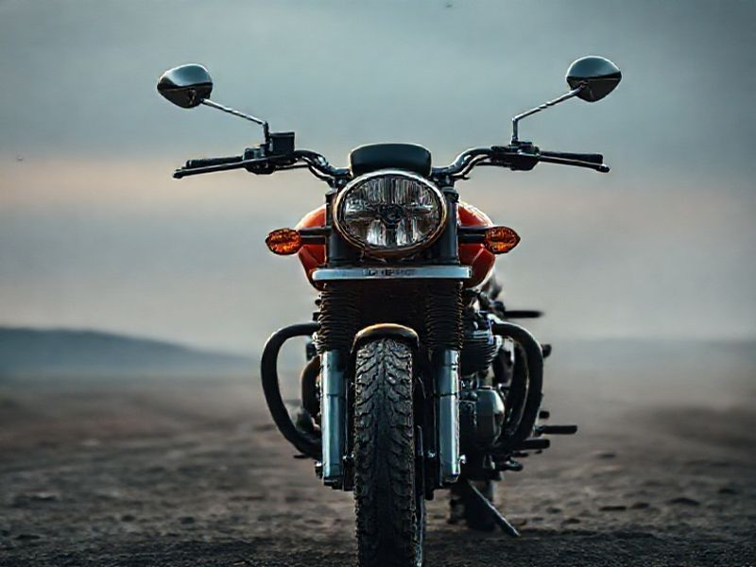
Conclusion: The Future of Royal Enfield
Royal Enfield continues to innovate while staying true to its heritage.
The brand's focus on sustainability and digital integration positions it for future growth.
With a strong community and global presence, Royal Enfield is set to remain a leader in the motorcycle industry.

