Slide 1
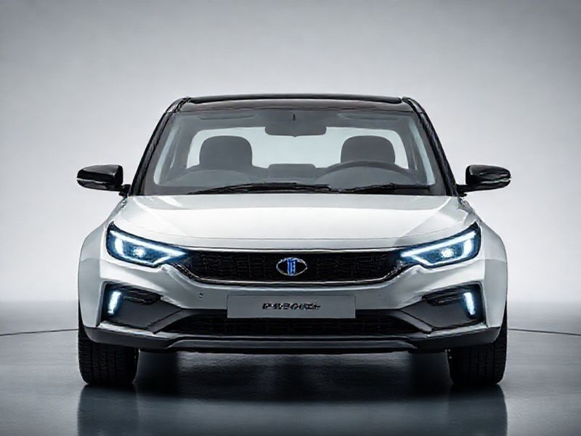
TATA Motars: Revolutionizing the Automotive Industry
This presentation provides an overview of TATA Motars, its innovations, market presence, and future prospects. It highlights the company's impact on the automotive industry and its commitment to sustainable mobility.
by AI Research Team

Slide 2
TATA Motars: Pioneering Innovation in Automotive Technology
• Introduction to TATA Motars
• Overview of the company's history and mission
• Key milestones and achievements

Slide 3
Innovative Product Line
Diverse range of vehicles including passenger cars, commercial vehicles, and electric vehicles
Cutting-edge technology and design
Commitment to sustainability and eco-friendly solutions

Slide 4
Market Presence and Global Reach
S
W
Strong presence in domestic and international markets
Strategic partnerships and collaborations
T
Expansion into emerging markets

Slide 5
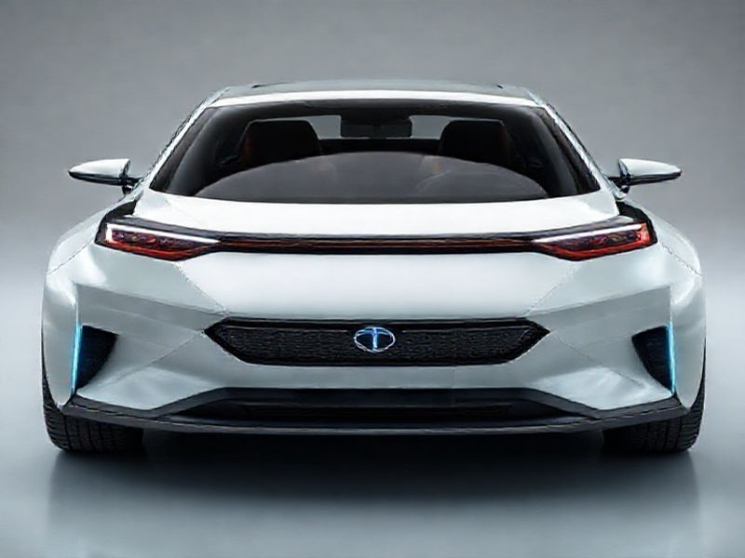
Future Prospects and Sustainability Initiatives
Focus on electric and autonomous vehicles
Investment in research and development

Slide 6
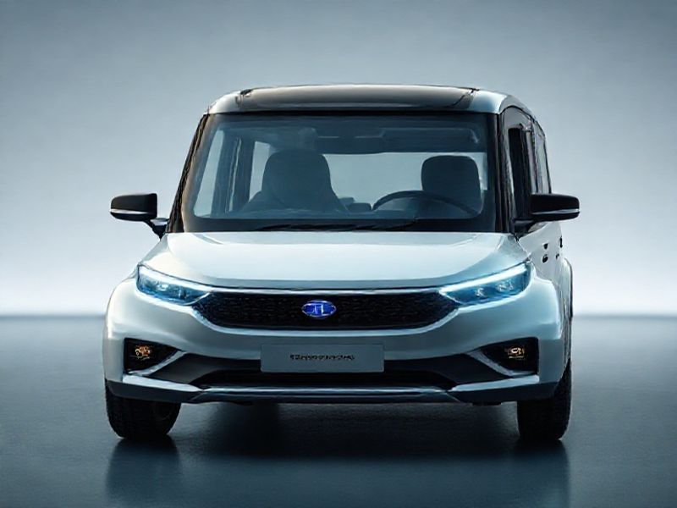
Conclusion
Recap of TATA Motars' achievements and innovations
Emphasis on the company's commitment to sustainable mobility
Final thoughts on the future of TATA Motars in the automotive industry

