Slide 1
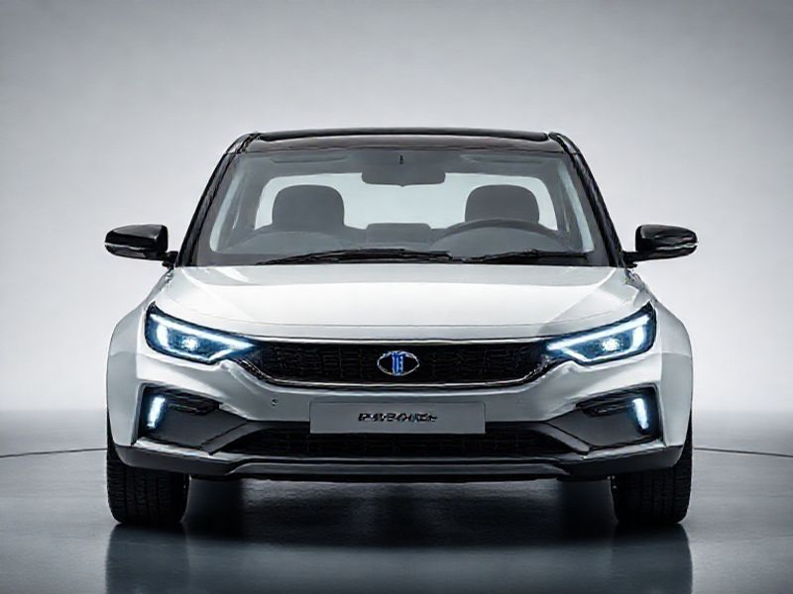
TATA Motars: Revolutionizing the Automotive Industry
This presentation provides an in-depth look at TATA Motars, covering its history, innovations, market presence, and future prospects. Discover how TATA Motars is shaping the future of transportation.
by AI Research Team

Slide 2
TATA Motars: Pioneering Automotive Excellence
• Overview of TATA Motars and its significance in the automotive industry
• Brief history and milestones
• Commitment to innovation and sustainability

Slide 3
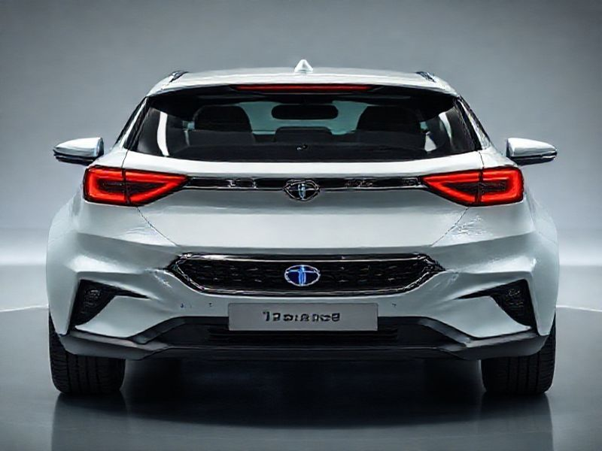
Innovations and Technological Advancements
Cutting-edge technologies integrated into TATA Motars vehicles
Focus on electric and hybrid vehicles
Smart connectivity features and autonomous driving capabilities

Slide 4
Market Presence and Global Impact
S
W
TATA Motars' market share and global reach
Key markets and strategic partnerships
T
Impact on local economies and job creation

Slide 5

Sustainability and Environmental Initiatives
TATA Motars' commitment to reducing carbon footprint
Eco-friendly manufacturing processes

Slide 6
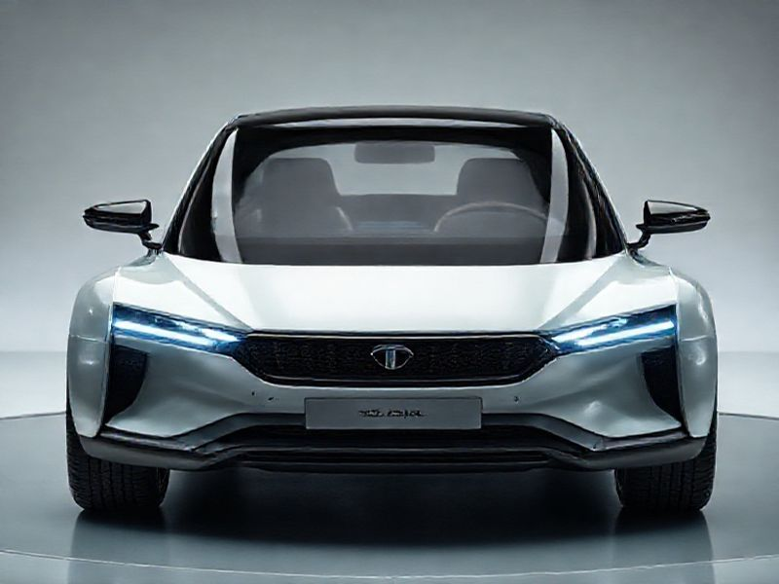
Conclusion: The Future of TATA Motars
Summary of key points discussed
Future prospects and upcoming projects
TATA Motars' vision for a sustainable and connected future

