Slide 1
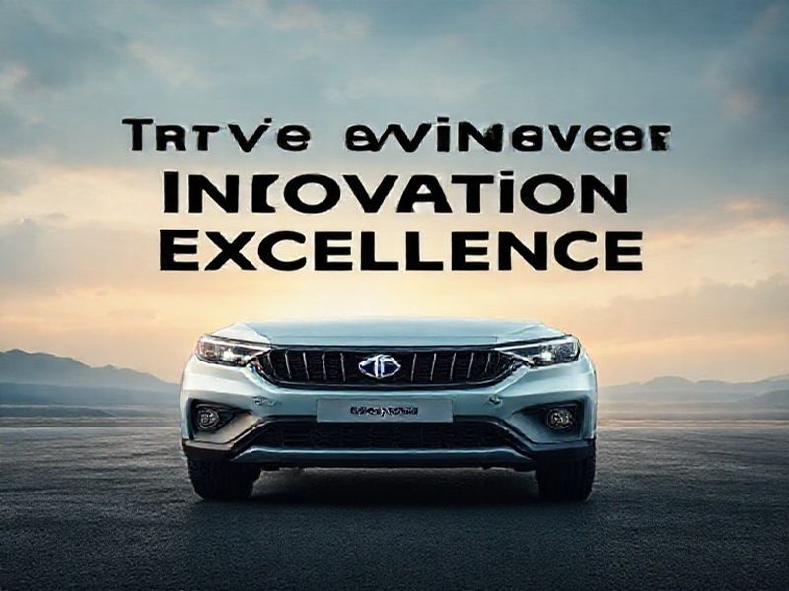
TATA Motors: Driving Innovation and Excellence
This presentation provides an overview of TATA Motors, its history, current trends, future innovations, and its impact on the automotive industry. It highlights the company's commitment to excellence and sustainability.
by AI Research Team

Slide 2
TATA Motors: Driving Innovation and Excellence
• A leading global automotive manufacturer
• Headquartered in India, with a strong international presence
• Committed to innovation, sustainability, and excellence

Slide 3
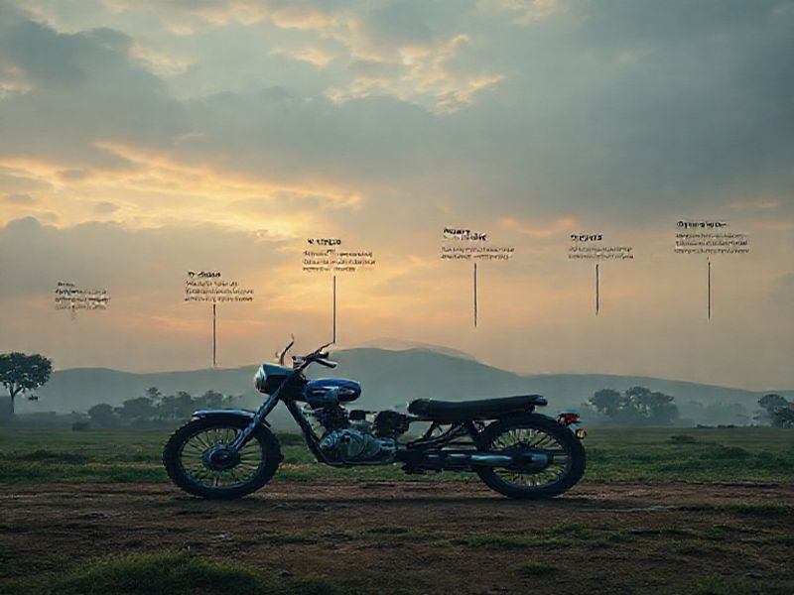
History and Growth
Founded in 1945 as TATA Engineering and Locomotive Company (TELCO)
Launched India's first indigenous truck, the TELCO 750, in 1954
Expanded globally with acquisitions and partnerships

Slide 4
Current Trends and Innovations
S
W
Focus on electric and hybrid vehicles
Investment in autonomous driving technology
T
O
Expansion of connected car features
Sustainable manufacturing practices

Slide 5
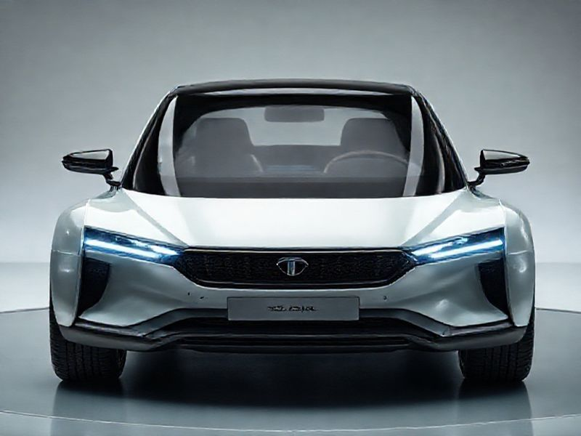
Future Predictions and Goals
Plans to launch 10 new electric vehicles by 2025
Expansion into new markets, including Europe and the USA

Slide 6

Conclusion
TATA Motors is a global leader in automotive innovation
Committed to sustainability, safety, and quality
Continues to drive the future of mobility with cutting-edge technology and strategic investments

