Slide 1
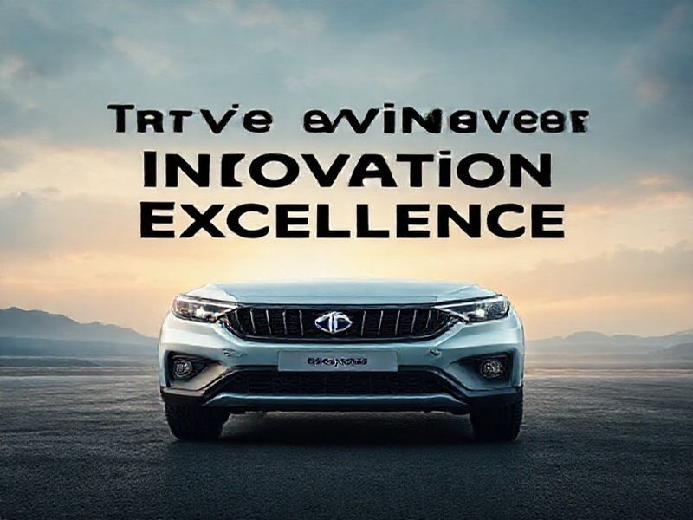
TATA Motors: Driving Innovation and Excellence
This presentation provides an overview of TATA Motors, its history, current trends, future predictions, and the benefits of its innovations. Join us as we explore the journey and impact of this leading automotive manufacturer.
by AI Research Team

Slide 2
TATA Motors: Driving Innovation and Excellence
• A global automotive manufacturer headquartered in India
• Part of the Tata Group, one of India's largest conglomerates
• Known for innovation, quality, and sustainability

Slide 3
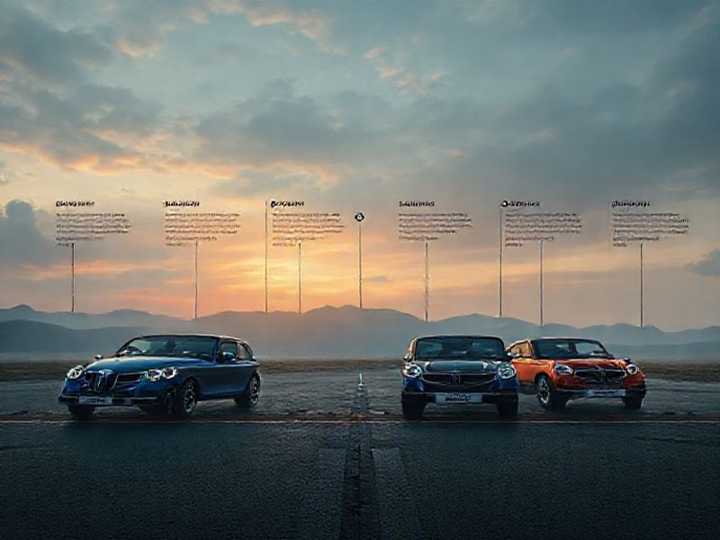
History and Milestones
Founded in 1945 as Tata Locomotive & Engineering Company
Launched India's first indigenously developed passenger car, the Tata Indica, in 1998
Acquired Jaguar Land Rover in 2008, expanding its global footprint

Slide 4
Current Trends and Innovations
S
W
Focus on electric and hybrid vehicles to reduce carbon footprint
Investment in autonomous driving technology
T
O
Expansion of connected car features and IoT integration
Development of advanced safety features and smart manufacturing processes

Slide 5
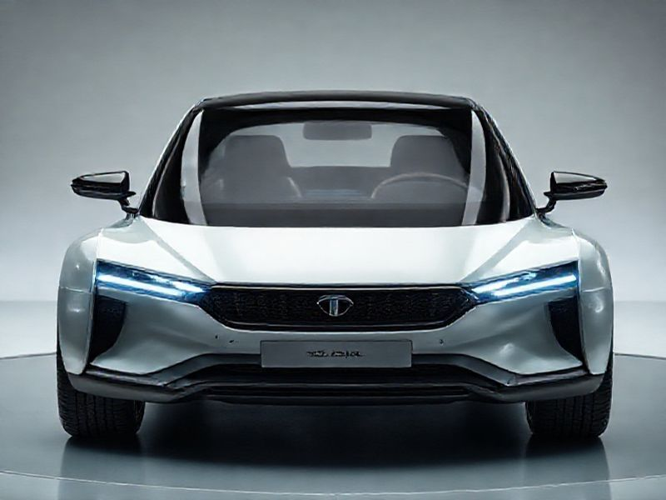
Future Predictions and Vision
Aim to become a global leader in electric and sustainable mobility
Plans to launch multiple electric vehicle models by 2025

Slide 6
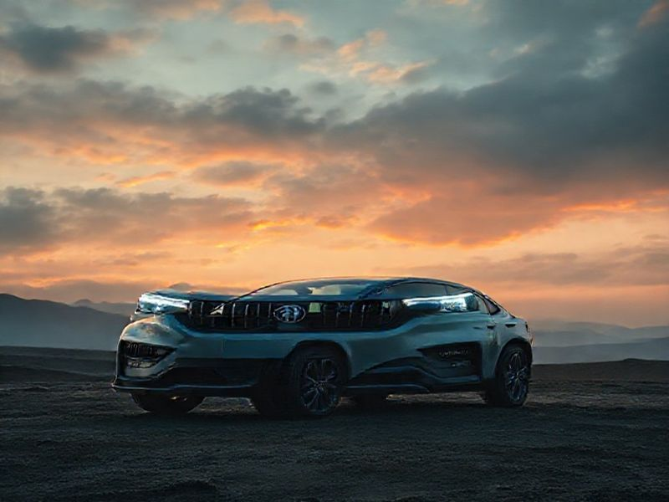
Conclusion
TATA Motors continues to drive innovation and excellence in the automotive industry
With a strong focus on sustainability and technology, it is well-positioned for future growth
Thank you for joining us on this journey through the world of TATA Motors

