Slide 1
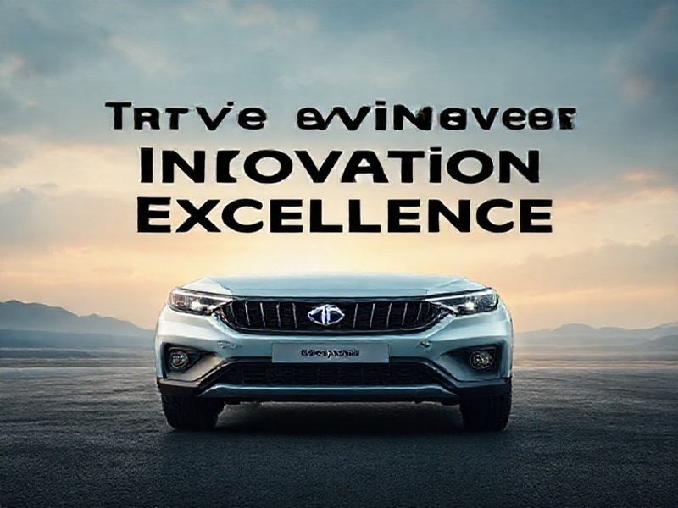
TATA Motors: Driving Innovation and Excellence
This presentation provides an overview of TATA Motors, its history, current trends, future predictions, and benefits. It highlights the company's commitment to innovation and excellence in the automotive industry.
by AI Research Team

Slide 2
TATA Motors: Driving Innovation and Excellence
• A leading global automobile manufacturer
• Headquartered in Mumbai, India
• Part of the Tata Group, one of India's largest business conglomerates
• Commitment to excellence, innovation, and sustainability

Slide 3

History and Growth
Founded in 1945 as a locomotive manufacturer
Entered the commercial vehicle sector in 1954
Launched the first indigenously developed passenger car, the Tata Indica, in 1998

Slide 4
Current Trends and Innovations
S
W
Focus on electric and hybrid vehicles
Investment in autonomous driving technology
T
O
Expansion of connected car features
Commitment to sustainable manufacturing practices

Slide 5
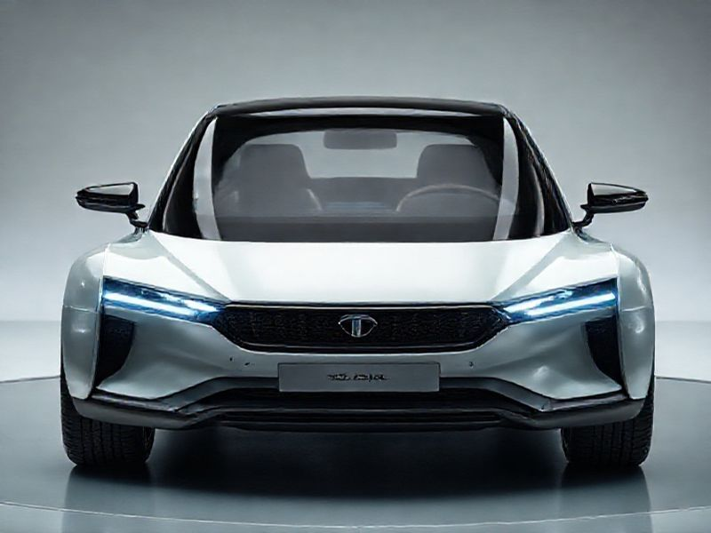
Future Predictions and Vision
Vision to become a global leader in automotive technology
Plans to launch advanced electric vehicles

Slide 6
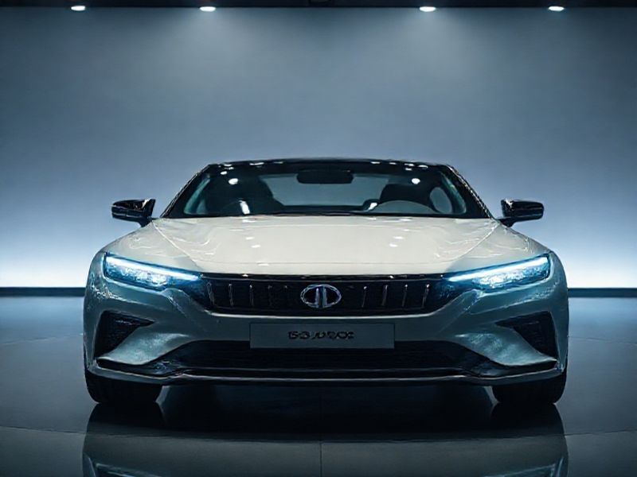
Conclusion
TATA Motors' journey of innovation and excellence
Commitment to sustainable and smart mobility
Leading the way in the automotive industry

