Slide 1
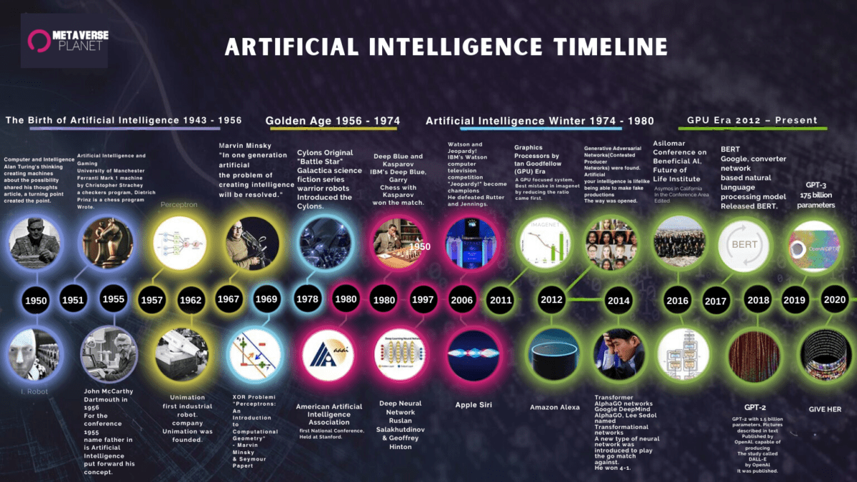
The Comprehensive History of Artificial Intelligence: From Theoretical Concepts to Modern Generative Models and Future Implications
A detailed exploration of AI's evolution.
by AI Research Team

Slide 2
Title Slide
• Introduction point

Slide 3

Grid Layout Test
This is a very long point that should test if the text overlaps with the letter S in the top left corner of the box.
Another long point to test the W box layout and ensure proper spacing from the top.
Testing the O box with substantial content to verify the font size reduction and line spacing adjustments.

