Slide 1
The Future of AI
This presentation explores the advancements, impacts, and future trends of Artificial Intelligence. It covers technological progress, ethical considerations, and the potential of AI in shaping our world.

Slide 2
The Future of AI
An exploration of AI's advancements and potential
Understanding the impacts and trends
Preparing for an AI-driven future

Slide 3
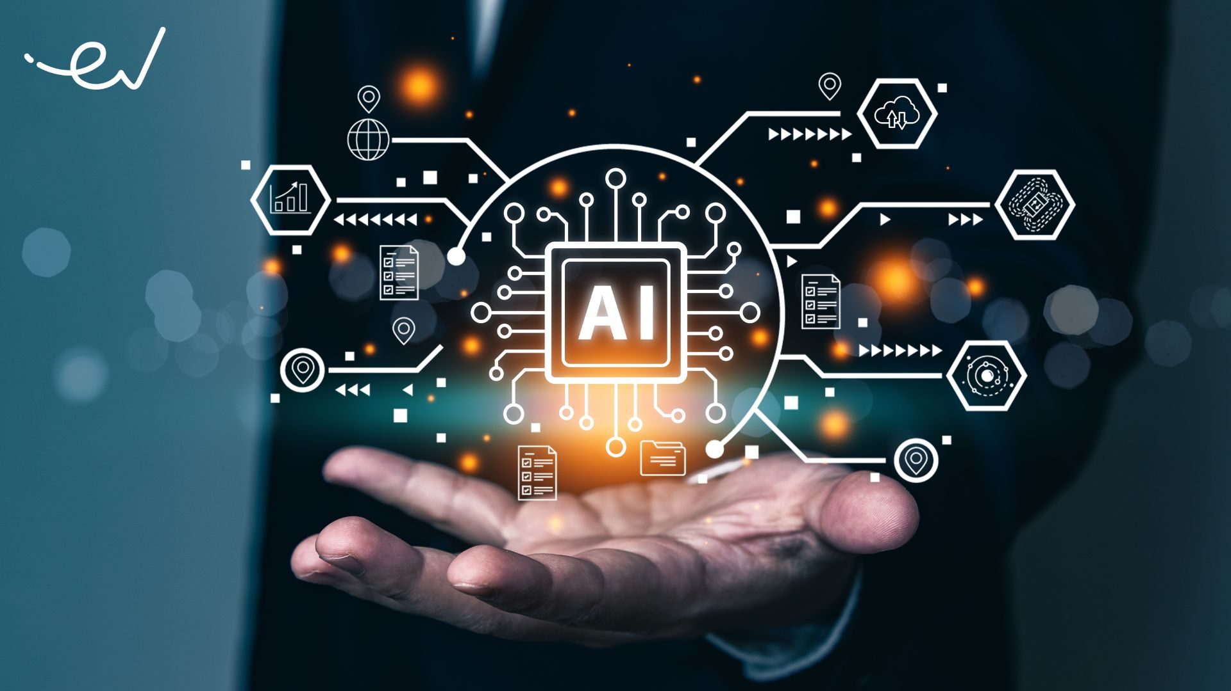
Current Advancements in AI
Breakthroughs in machine learning and deep learning
Improvements in natural language processing and computer vision
Integration of AI in various industries and applications

Slide 4

Ethical Considerations and Challenges
Bias and fairness in AI algorithms
Privacy concerns and data security
Job displacement and the future of work

Slide 5

Future Trends and Potential
General AI and artificial superintelligence
AI in healthcare, education, and environmental conservation
The role of AI in space exploration and scientific discovery

Slide 6

Conclusion
AI is rapidly evolving and transforming industries
Addressing ethical challenges is crucial for responsible AI development
Embracing AI's potential while preparing for its impacts is key to shaping a better future

