Slide 1
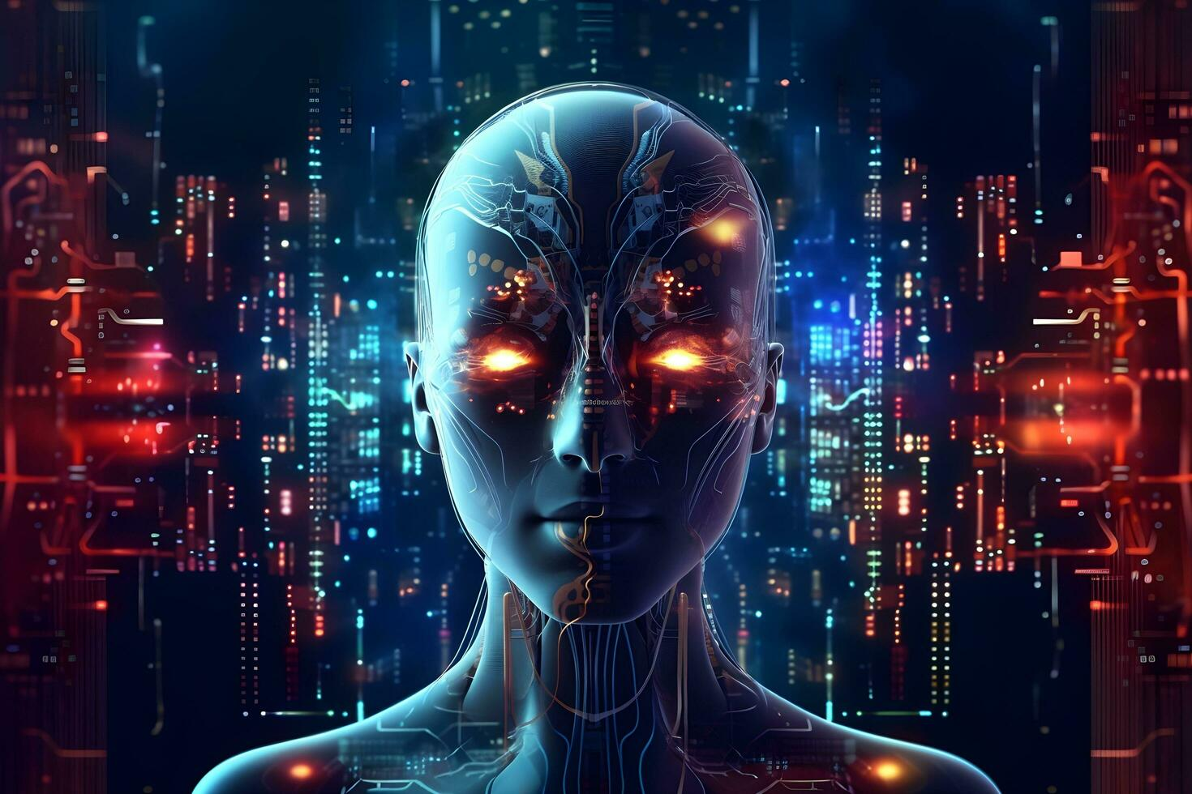
The Future of AI
This presentation explores the current trends, potential advancements, and ethical considerations in the field of artificial intelligence. It provides insights into how AI might shape our future.

Slide 2
The Future of AI
• Presented by [Your Name]
• Date: [Presentation Date]
• Exploring the next decade of artificial intelligence

Slide 3

Current Trends in AI
• Rapid advancements in machine learning and deep learning
• Increased adoption of AI in various industries
• Growth of AI ethics and governance frameworks
• Rise of AI-powered automation and robotics

Slide 4

Potential Advancements
• General AI: Moving towards artificial general intelligence (AGI)
• Explainable AI: Improving transparency and interpretability
• AI in healthcare: Revolutionizing diagnostics and treatment

Slide 5
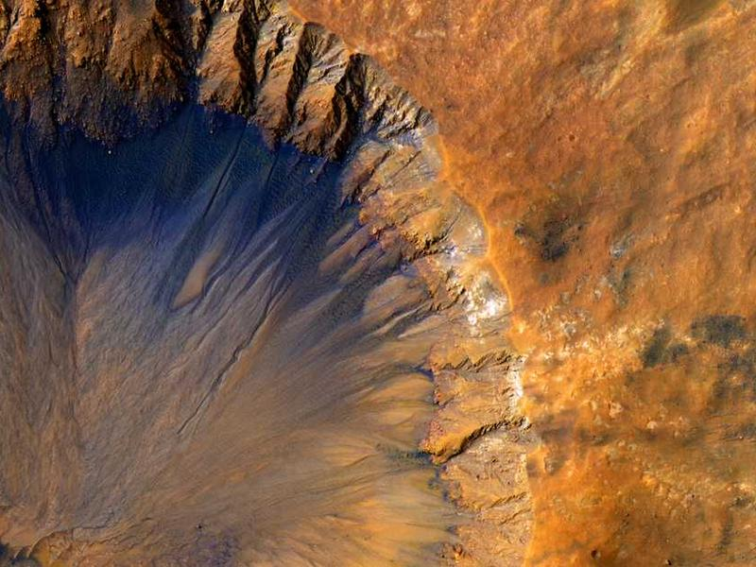
Ethical Considerations
• Bias and fairness in AI algorithms
• Privacy and security concerns
• Job displacement and the future of work
• Accountability and regulation of AI systems

Slide 6

Conclusion
• The future of AI holds immense potential and significant challenges
• Collaboration between technologists, policymakers, and society is crucial
• Stay informed and engaged as AI continues to evolve

