Slide 1
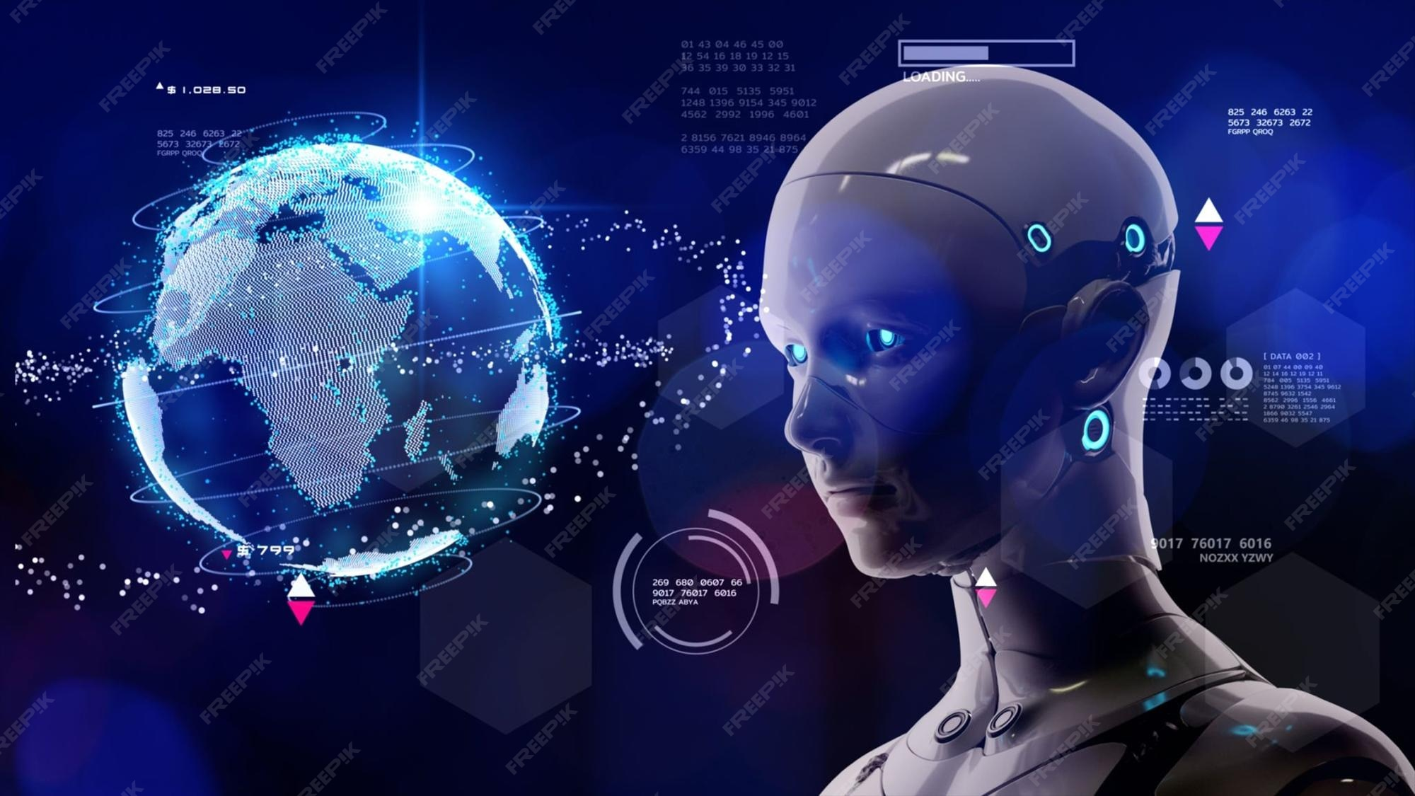
The Future of Artificial Intelligence
This presentation explores the current trends, future predictions, benefits, challenges, and ethical considerations of artificial intelligence. It provides a comprehensive overview of the evolving landscape of AI.
by AI Research Team

Slide 2
The Future of Artificial Intelligence
• Content for The Future of Artificial Intelligence

Slide 3
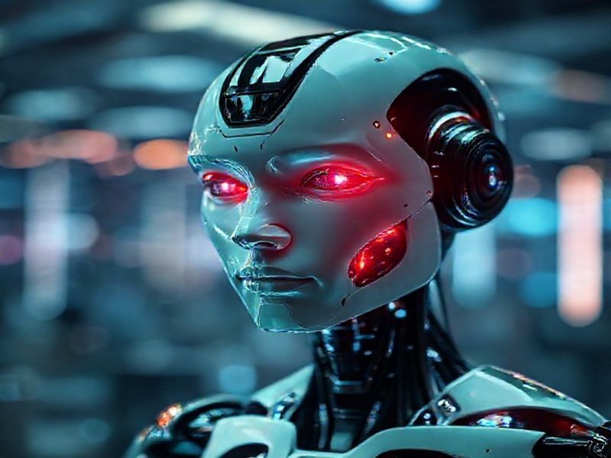
Current Trends in AI
Rapid advancements in machine learning and deep learning
Increased adoption of AI in various industries
Growth of AI-powered automation and robotics

Slide 4
Future Predictions for AI
AI will become more autonomous and self-improving
AI will be integrated into everyday devices and appliances
S
W
AI will play a crucial role in solving global challenges
AI will create new job opportunities and industries
T
O

Slide 5
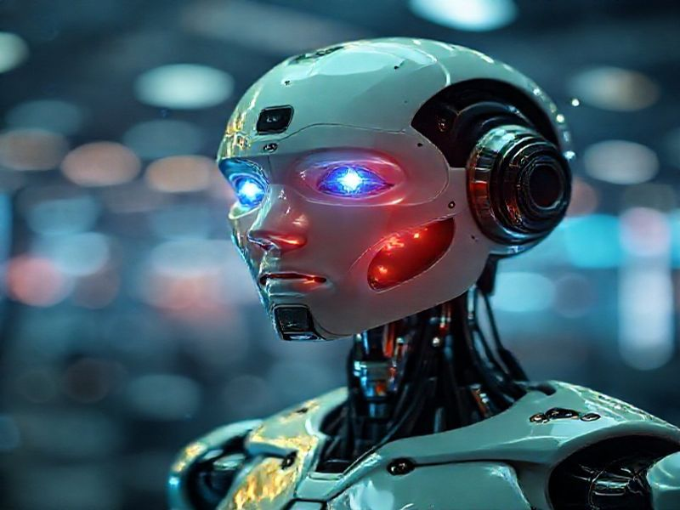
Benefits and Challenges of AI
Benefits: Increased efficiency, improved decision-making, and enhanced personalization
Challenges: Job displacement, data privacy concerns, and algorithmic bias

Slide 6
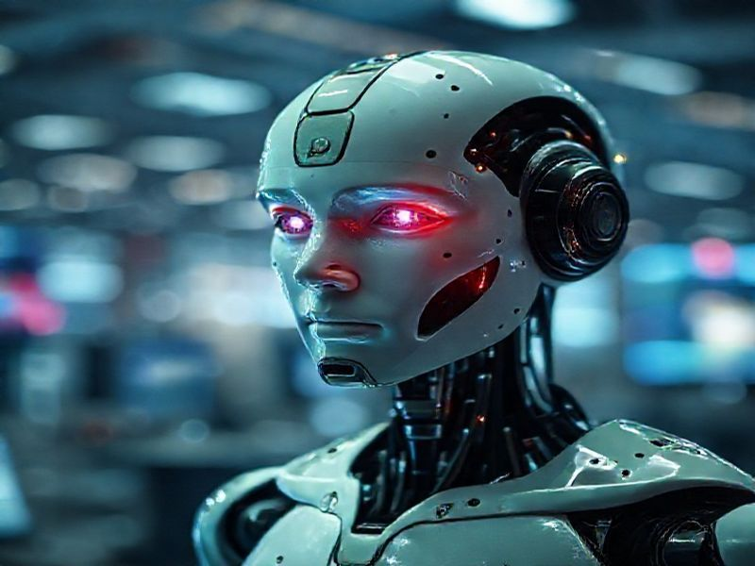
Conclusion
The future of AI is both exciting and uncertain
AI has the potential to transform industries and societies
It is crucial to address the ethical and societal implications of AI

