Slide 1
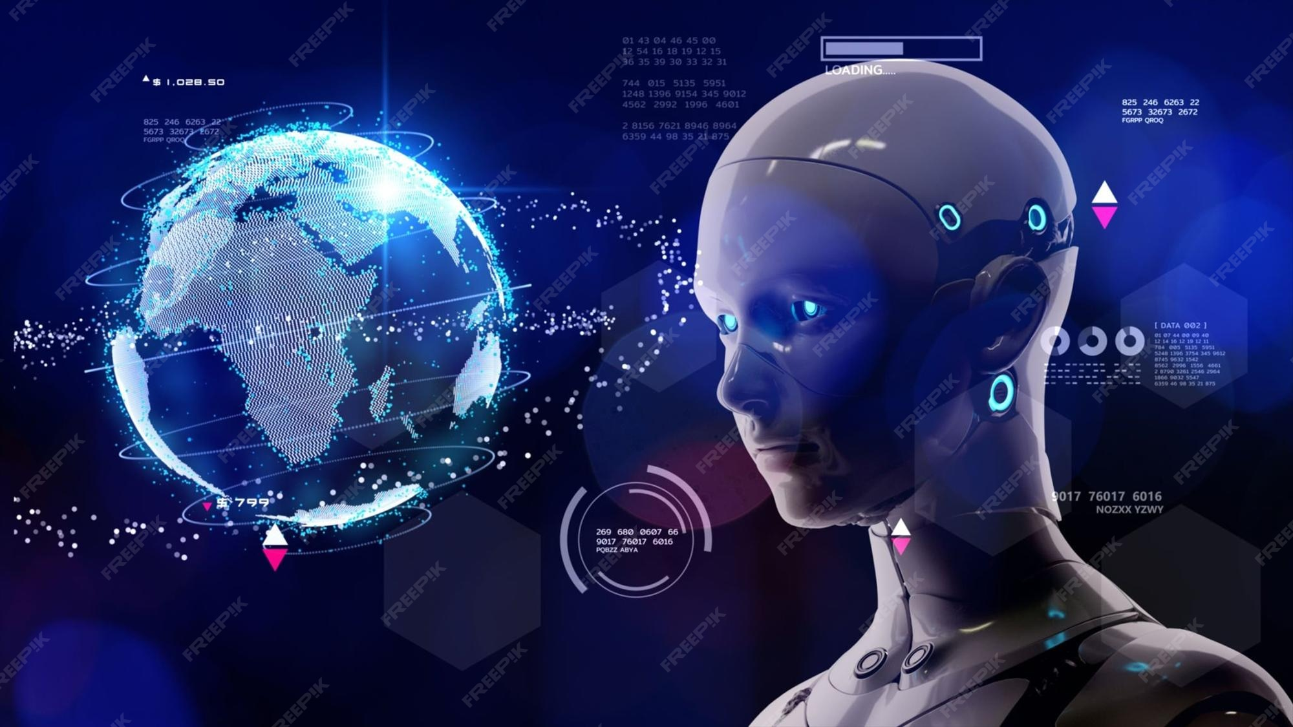
The Future of Artificial Intelligence
This presentation explores the current trends, future predictions, benefits, challenges, and ethical considerations of artificial intelligence. It provides a comprehensive overview of what the future holds for AI.
by AI Research Team

Slide 2
The Future of Artificial Intelligence
• Content for The Future of Artificial Intelligence

Slide 3
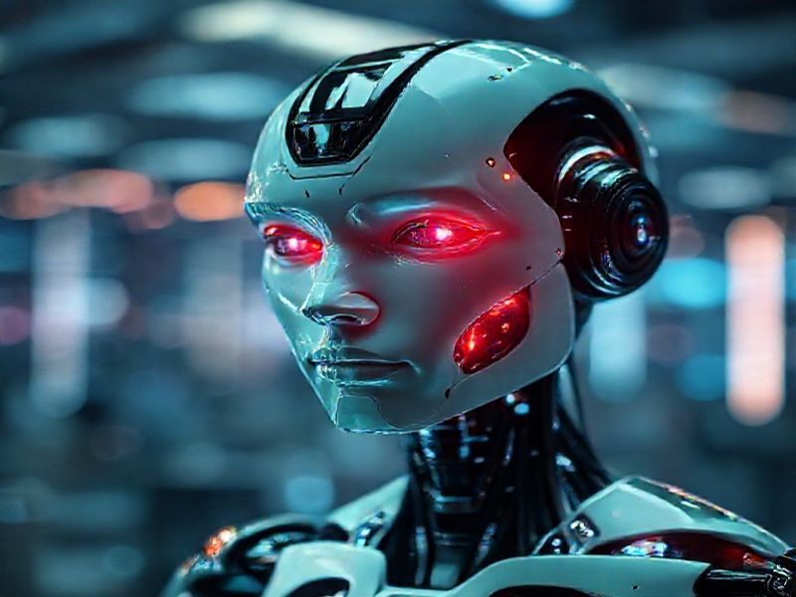
Current Trends in AI
Rapid advancements in machine learning and deep learning
Increased adoption of AI in various industries
Growth of AI-powered automation and robotics

Slide 4
Future Predictions for AI
S
W
AI will become more autonomous and self-improving
AI will revolutionize healthcare with personalized medicine
T
O
AI will enhance cybersecurity with advanced threat detection
AI will enable more sophisticated virtual and augmented reality experiences

Slide 5
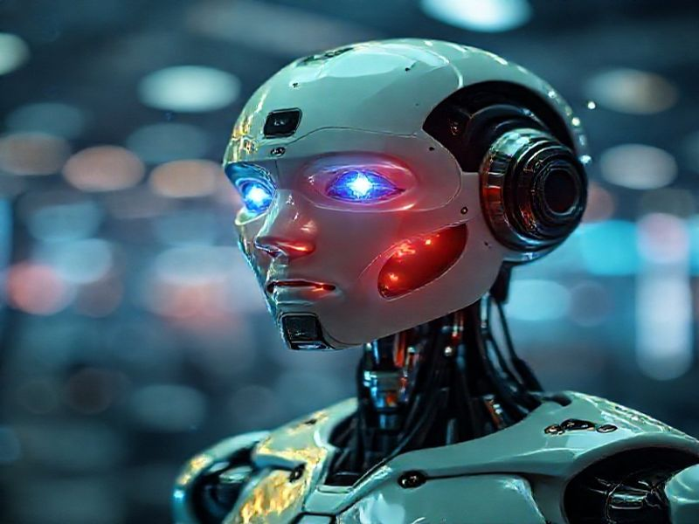
Benefits and Challenges of AI
Benefits: Increased efficiency, improved decision-making, and new business opportunities
Challenges: Job displacement, data privacy concerns, and ethical dilemmas

Slide 6
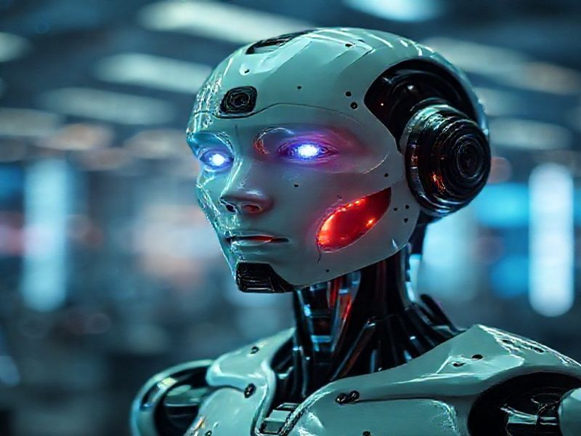
Conclusion: Embracing the Future of AI
AI holds immense potential to transform our world
Collaboration between technologists, policymakers, and society is crucial
Ethical considerations and responsible AI development are paramount

